Slide 1
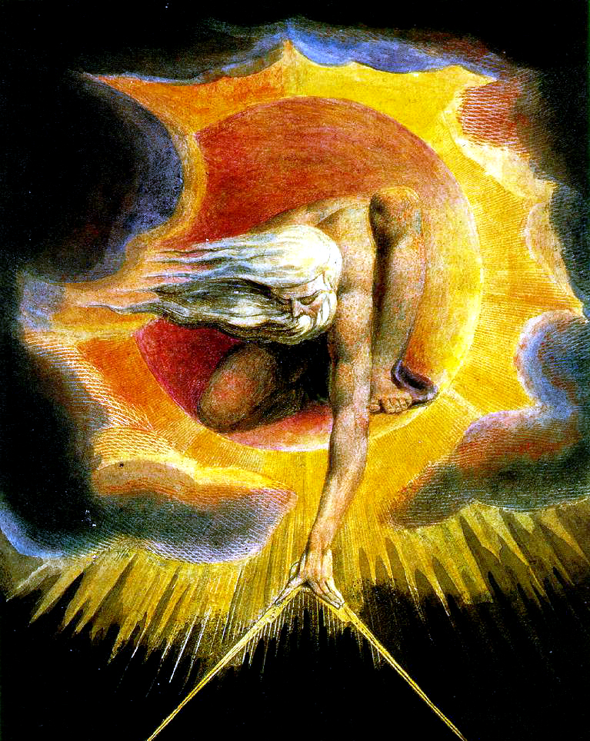
Declare the Glory of God
A Study of the Heavens
Kentucky 2018

Slide 2
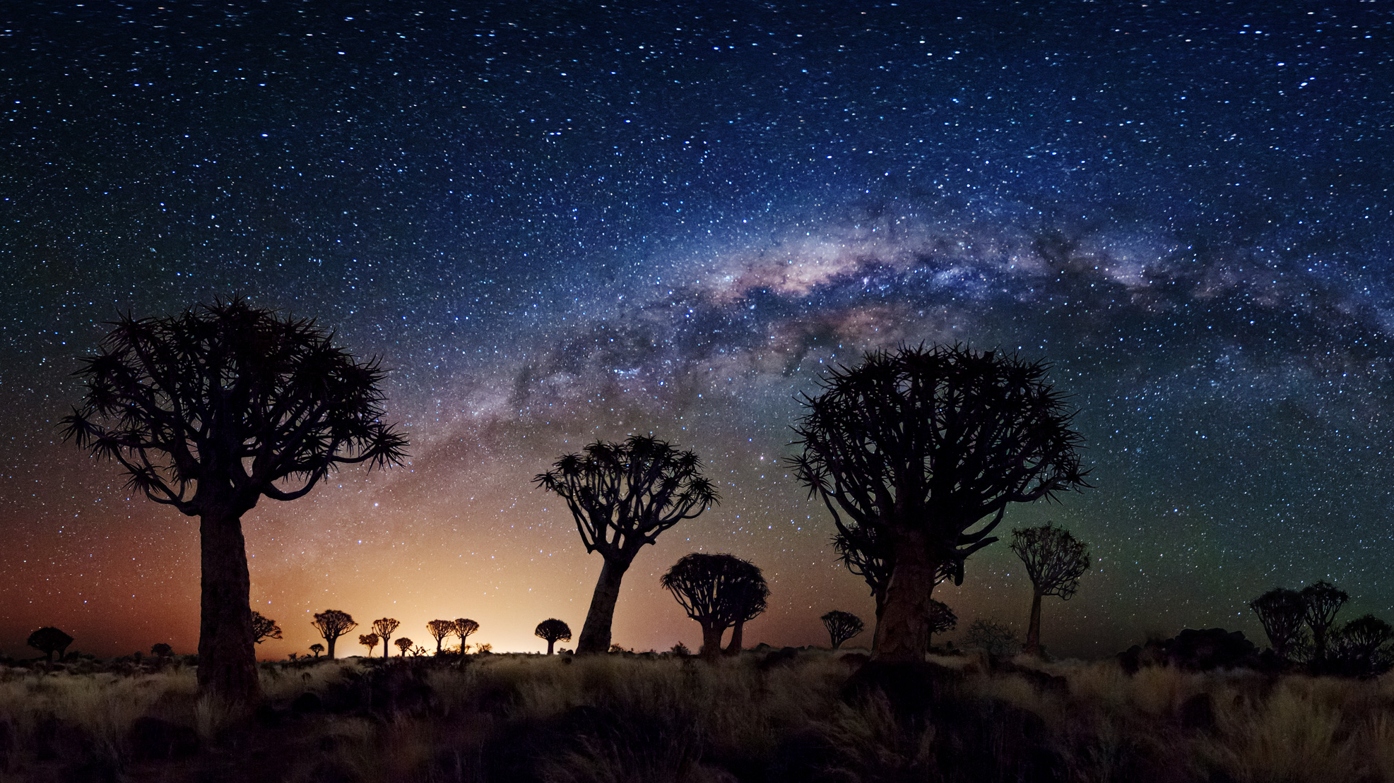
Between Two Rivers
From the Sixth Seal to the First Trumpet
311 – 411 AD

Slide 3
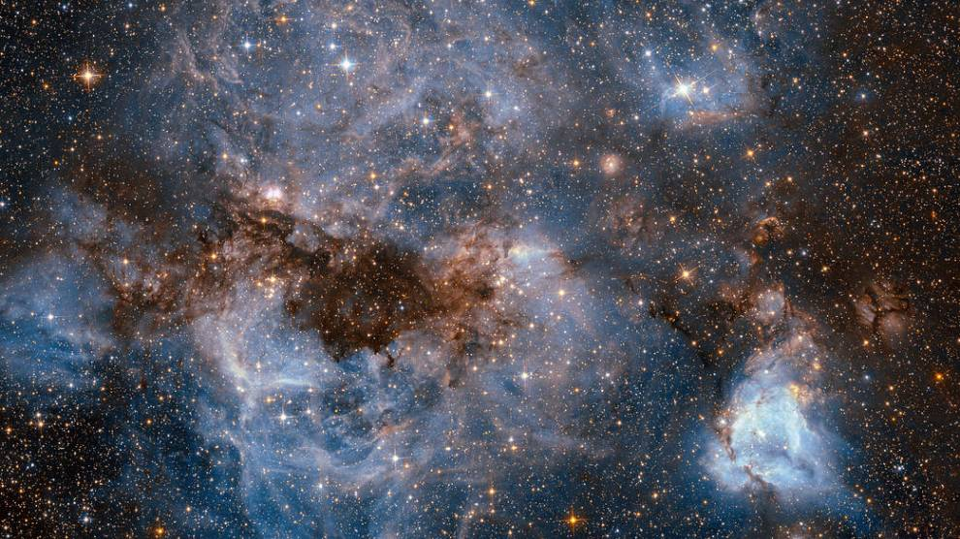

Slide 4
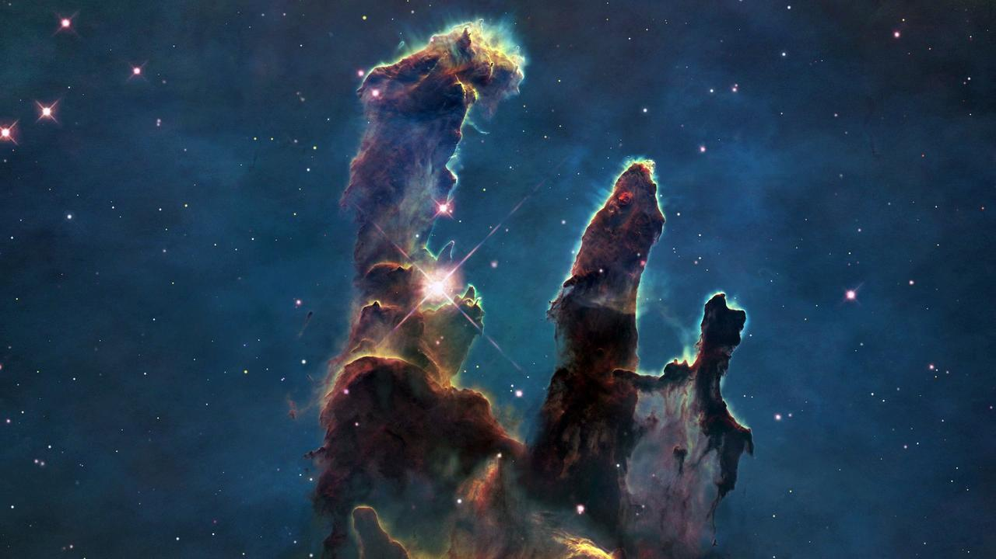

Slide 5
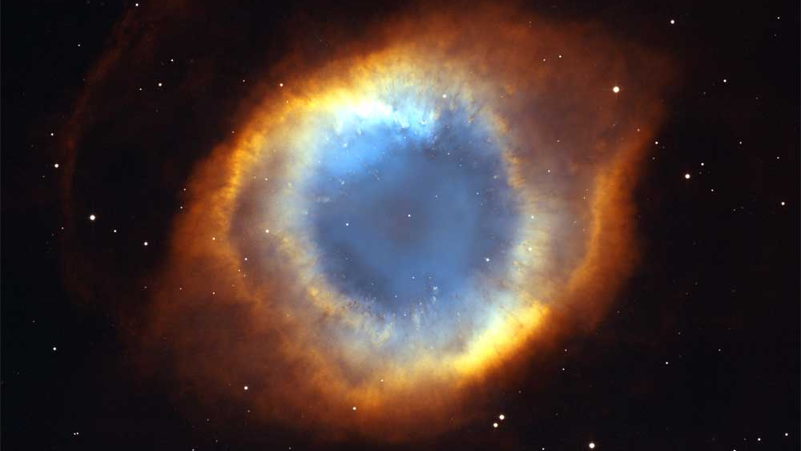

Slide 6
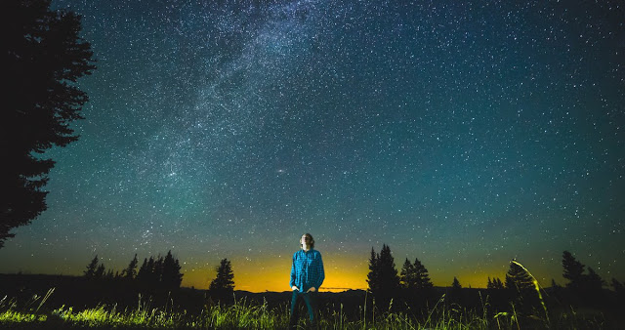
4,500
9,096
300 billion
2 trillion
70 billion trillion

Slide 7
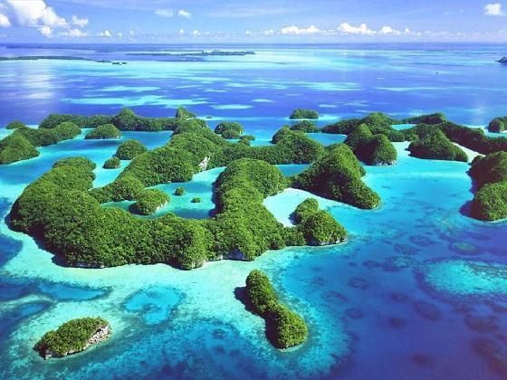
In the beginning God created the heaven and the earth

Slide 8
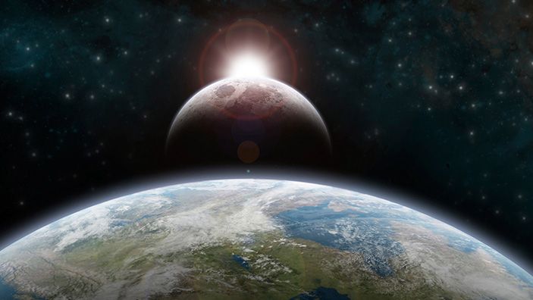
Let there be lights in the firmament of the heaven to divide the day from the night; and let them be for signs, and for seasons, and for days, and for years:

Slide 9
Pure chance?
Purposeful design?

Slide 10
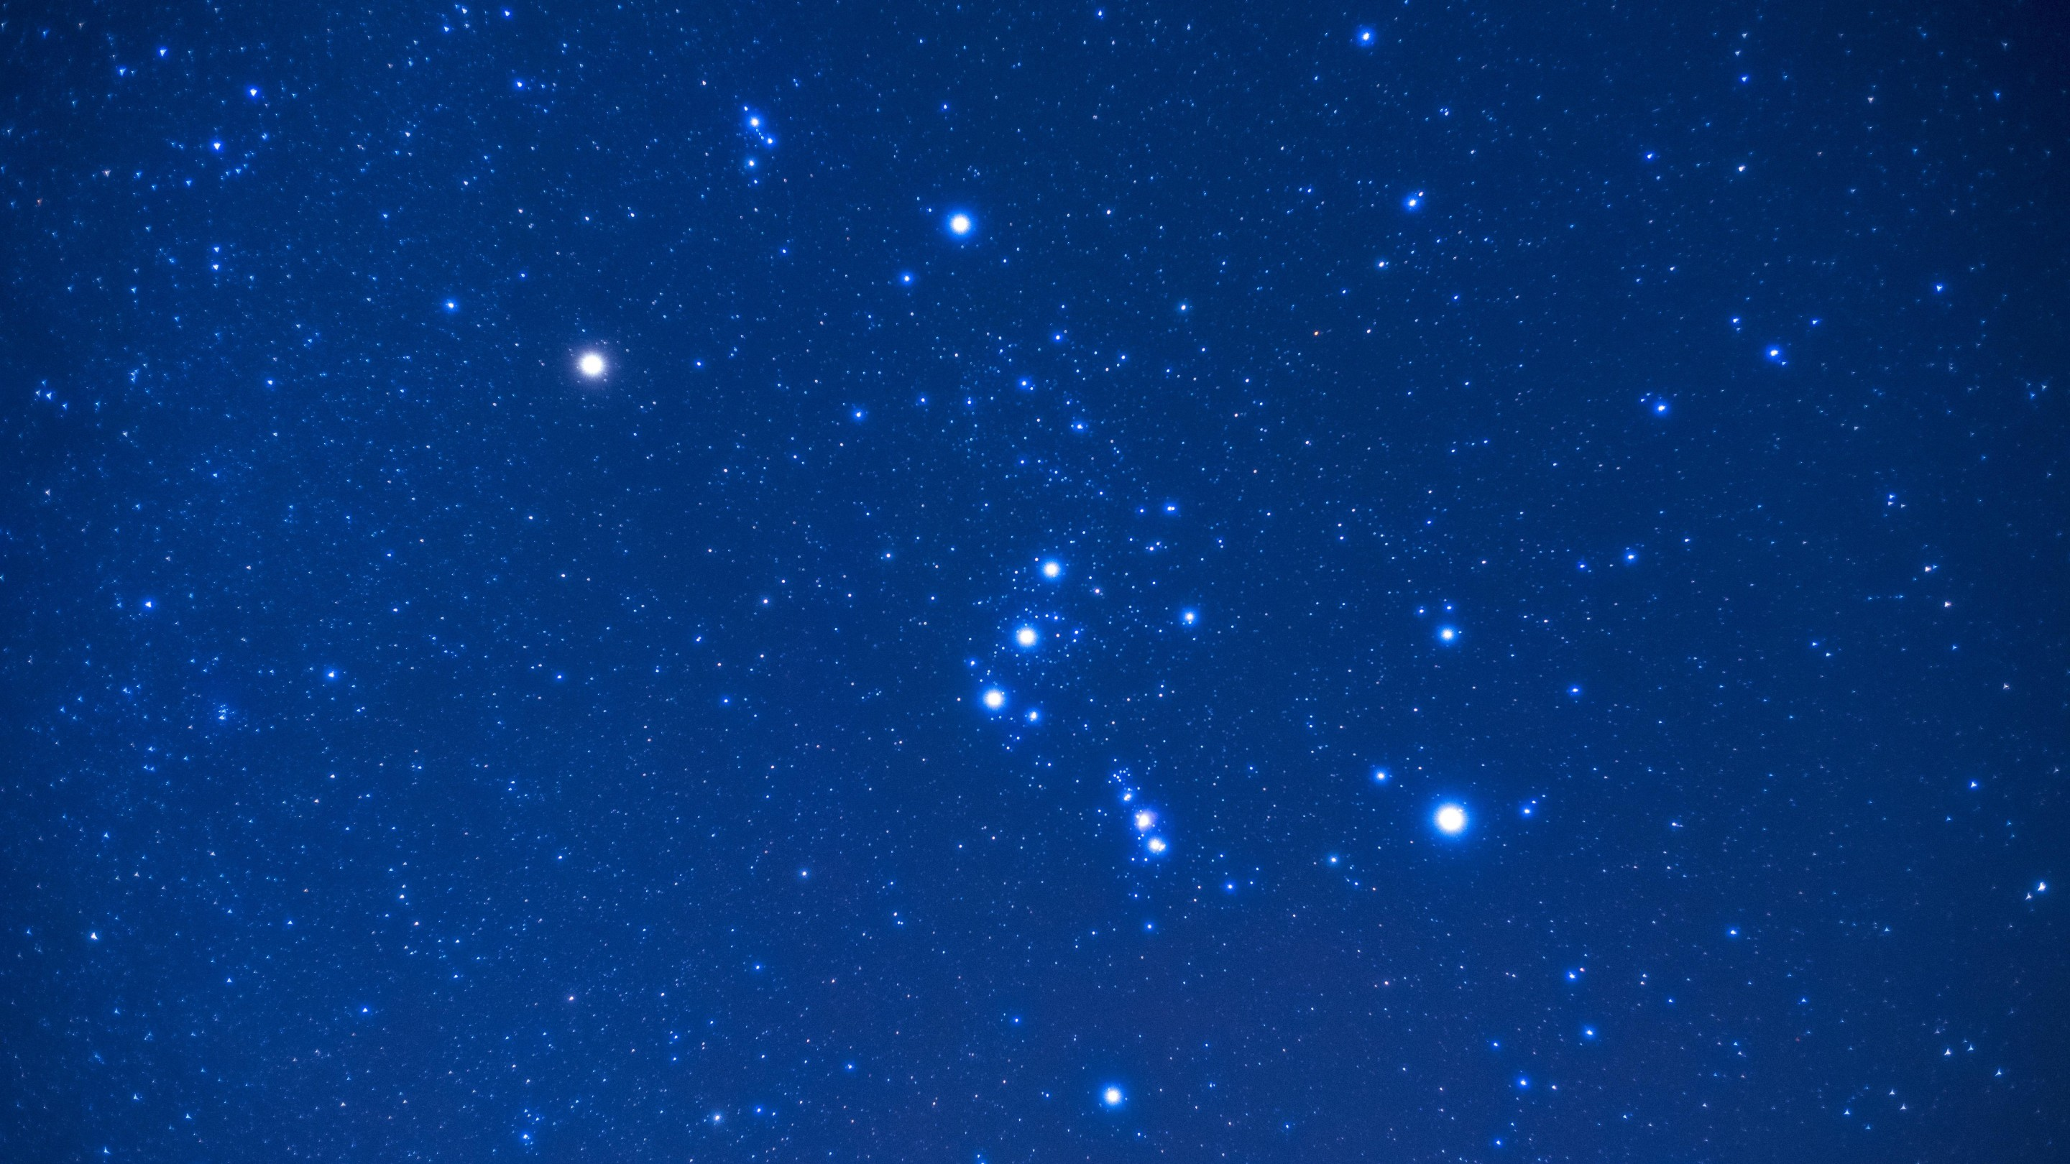
Psalm 19
The heavens declare the glory of God; and the firmament sheweth his handywork.
Day unto day uttereth speech, and night unto night sheweth knowledge.
There is no speech nor language, where their voice is not heard.
Their line is gone out through all the earth, and their words to the end of the world. In them hath he set a tabernacle for the sun.

Slide 11
Psalm 19 (w/Lexicon)
The heavens tell with praise and celebrate the glory of God; and the firmament proclaim and celebrate with praise the work of God
Day unto day they publish poems or hymns, and night unto night breathe out and declare discernment, understanding – the knowledge of good and evil.

Slide 12
Job 9:9
Which maketh Arcturus, Orion, and Pleiades, and the chambers of the south. KJV
He is the Maker of the Bear and Orion, the Pleiades and the constellations of the south. NIV

Slide 13
Job 38:31
Canst thou bind the sweet influences of Pleiades, or loose the bands of Orion? KJV
"Can you bind the chains of the Pleiades? Can you loosen Orion's belt? NIV

Slide 14
Job 38:32
Canst thou bring forth Mazzaroth in his season? or canst thou guide Arcturus with his sons? KJV
Can you bring forth the constellations in their seasons or lead out the Bear with its cubs? NIV

Slide 15
Amos 5:8
Seek him that maketh the seven stars and Orion, and turneth the shadow of death into the morning, and maketh the day dark with night: that calleth for the waters of the sea, and poureth them out upon the face of the earth: The LORD is his name: KJV
He who made the Pleiades and Orion, who turns midnight into dawn and darkens day into night, who calls for the waters of the sea and pours them out over the face of the land-- the LORD is his name. NIV

Slide 16
Between Two Rivers
From the Sixth Seal to the First Trumpet
311 – 411 AD

Slide 17
Not only is the history of the nation and God’s dealings with it thus appealed to, but the works of God in the starry universe:
Abraham had lifted up his eyes on high, and believed the promise, “So shall thy seed be.”
David had lifted up his eyes on high, and marveled that the Creator of these worlds should take any account of man at all. But the bulk of Israel was not of that way of thinking, and the appeal was in their case vain.
From Robert Roberts/C.C. Walker, regarding Isaiah 40:6

Slide 18
And that is only too truly illustrative of the way in which many lift up their eyes on high nowadays. It is a passing scene. It will not always be so. The withering grass that is gone almost as soon as it is sprouted, is not the final type of human life on earth. The ministry of John the Baptist and of Jesus, of which Isaiah here speaks, is proof of that, and of the reliability of the beautiful promise with which the chapter concludes: “They that wait upon the Lord shall renew their strength; they shall mount up with wings as eagles; they shall run and not be weary; they shall walk and not faint.”
From Robert Roberts/C.C. Walker, regarding Isaiah 40:6

Slide 19
Declare the Glory of God
A Study of the Heavens
Day 2

Slide 20
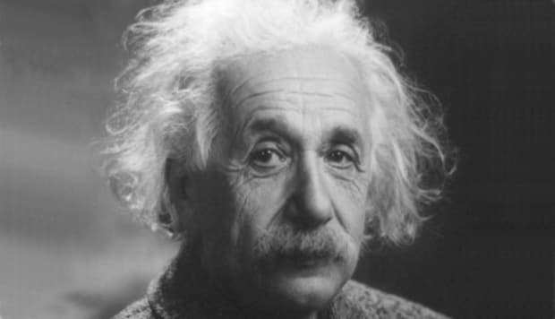

Slide 21
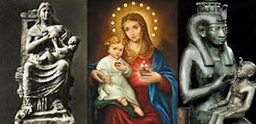

Slide 22
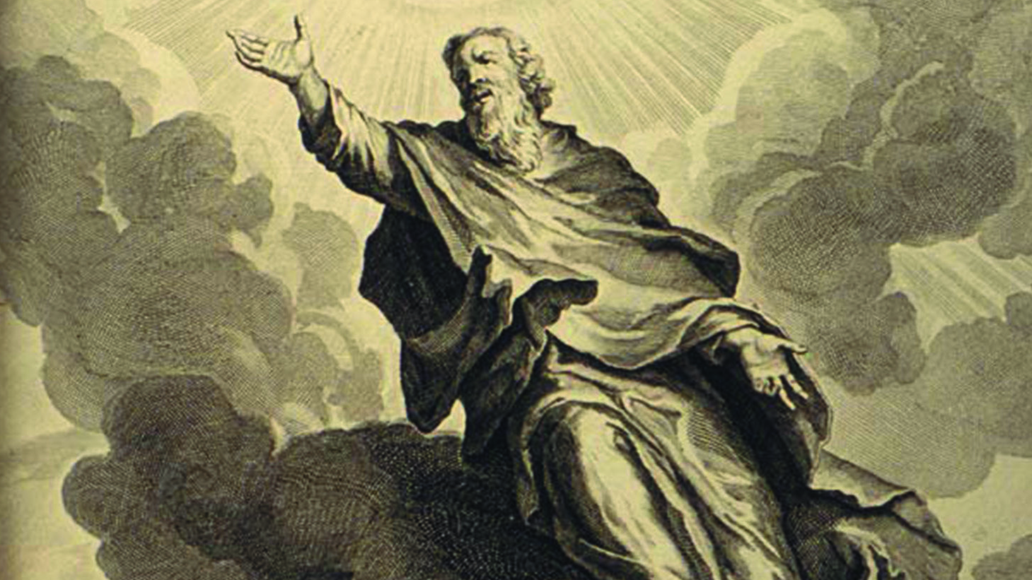

Slide 23
From Adam to Noah (line of Seth)
Adam
Seth
Enosh
Cainan
Mahalaleel
Jared
Enoch
Methuselah
Lamech
Noah
Genesis 5:24
And Enoch walked with God: and he was not; for God took him.

Slide 24
Genesis 6
When human beings began to increase in number on the earth and daughters were born to them, ² the sons of God saw that the daughters of humans were beautiful, and they married any of them they chose.³ Then the Lord said, “My Spirit will not contend with^{[a]} humans forever, for they are mortal^{[b]}; their days will be a hundred and twenty years.”
⁴ The Nephilim were on the earth in those days—and also afterward—when the sons of God went to the daughters of humans and had children by them. They were the heroes of old, men of renown.

Slide 25
Genesis 6
5 The Lord saw how great the wickedness of the human race had become on the earth, and that every inclination of the thoughts of the human heart was only evil all the time. 6 The Lord regretted that he had made human beings on the earth, and his heart was deeply troubled. 7 So the Lord said, “I will wipe from the face of the earth the human race I have created—and with them the animals, the birds and the creatures that move along the ground—for I regret that I have made them.” 8 But Noah found favor in the eyes of the Lord.

Slide 27
Mighty Men “Nephilim”
Gesenius’ Hebrew-Chaldee Lexicon
Giants. Chaldean “the giant of the sky, i.e. the constellation Orion, or the greater constellations (plural)”
Excellent, noble, skillful; falling on, attacking

Slide 28
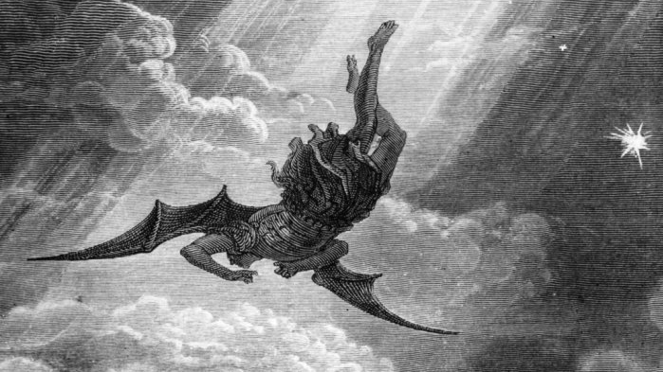
Book of Enoch

Slide 29
Jude
³ Dear friends, although I was very eager to write to you about the salvation we share, I felt compelled to write and urge you to contend for the faith that was once for all entrusted to God’s holy people. ⁴ For certain individuals whose condemnation was written about^{[b]} long ago have secretly slipped in among you. They are ungodly people, who pervert the grace of our God into a license for immorality and deny Jesus Christ our only Sovereign and Lord …

Slide 30
¹⁴ Enoch, the seventh from Adam, prophesied about them: “See, the Lord is coming with thousands upon thousands of his holy ones ¹⁵ to judge everyone, and to convict all of them of all the ungodly acts they have committed in their ungodliness, and of all the defiant words ungodly sinners have spoken against him.”^{[e]}
¹⁶ These people are grumblers and faultfinders; they follow their own evil desires; they boast about themselves and flatter others for their own advantage.

Slide 31
Book of Enoch, Chapter 7
1It happened after the sons of men had multiplied in those days, that daughters were born to them, elegant and beautiful.
2And when the angels, (3) the sons of heaven, beheld them, they became enamoured of them, saying to each other, Come, let us select for ourselves wives from the progeny of men, and let us beget children.

Slide 32
Book of Enoch, Chapter 7
9These are the names of their chiefs: Samyaza, who was their leader, Urakabarameel, Akibeel, Tamiel, Ramuel, Danel, Azkeel, Saraknyal, Asael, Armers, Batraal, Anane, Zavebe, Samsaveel, Ertael, Turel, Yomyael, Arazyal. These were the prefects of the two hundred angels, and the remainder were all with them.
10Then they took wives, each choosing for himself; whom they began to approach, and with whom they cohabited; teaching them sorcery, incantations, and the dividing of roots and trees.
11And the women conceiving brought forth giants (Nephilim),

Slide 33
Book of Enoch, Chapter 8
1 Moreover Azazyel taught men to make swords, knives, shields, breastplates, the fabrication of mirrors, and the workmanship of bracelets and ornaments, the use of paint, the beautifying of the eyebrows, the use of stones of every valuable and select kind, and all sorts of dyes, so that the world became altered.
Impiety increased; fornication multiplied; and they transgressed and corrupted all their ways.

Slide 34
Book of Enoch, Chapter 8
3 Amazarak taught all the sorcerers, and dividers of roots:
4 Armers taught the solution of sorcery;
5 Barkayal taught the observers of the stars, (9)
6 Akibeel taught signs;
7 Tamiel taught astronomy;
And Asaradel taught the motion of the moon,

Slide 35
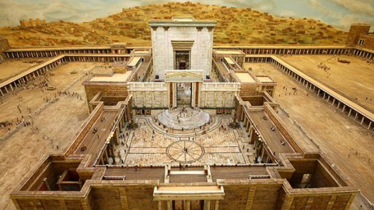
Exodus 31
Then the Lord said to Moses, ² “See, I have chosen Bezalel son of Uri, the son of Hur, of the tribe of Judah, ³ and I have filled him with the Spirit of God, with wisdom, with understanding, with knowledge and with all kinds of skills— ⁴ to make artistic designs for work in gold, silver and bronze, ⁵ to cut and set stones, to work in wood, and to engage in all kinds of crafts.

Slide 36
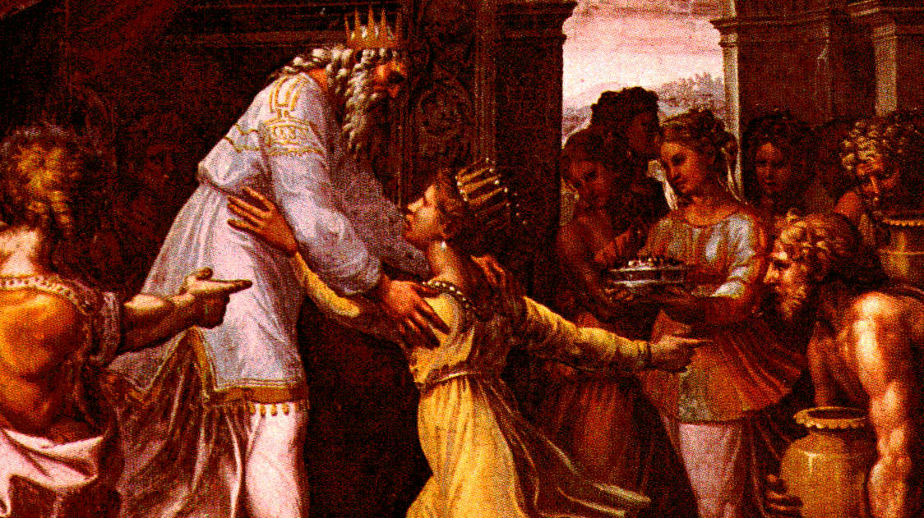
I Kings 4
³³ And he spake of trees, from the cedar tree that is in Lebanon even unto the hyssop that springeth out of the wall: he spake also of beasts, and of fowl, and of creeping things, and of fishes.
³⁴ And there came of all people to hear the wisdom of Solomon, from all kings of the earth, which had heard of his wisdom.

Slide 37
Mighty Men “Nephilim”
Gesenius’ Hebrew-Chaldee Lexicon
Giants. Chaldean “the giant of the sky, i.e. the constellation Orion, or the greater constellations (plural)”
Excellent, noble, skillful; falling on, attacking

Slide 38
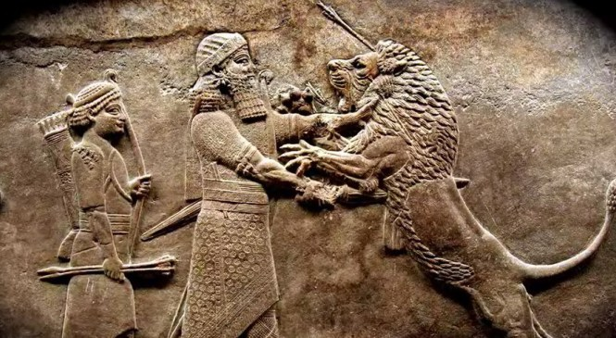
Genesis 10
⁸ Cush was the father^{[c]} of Nimrod, who became a mighty warrior on the earth. ⁹ He was a mighty hunter before the Lord; that is why it is said, “Like Nimrod, a mighty hunter before the Lord.” ¹⁰ The first centers of his kingdom were Babylon, Uruk, Akkad and Kalneh, in^{[d]} Shinar.^{[e]} ¹¹ From that land he went to Assyria, where he built Nineveh, Rehoboth Ir,^{[f]}Calah ¹² and Resen, which is between Nineveh and Calah—which is the great city.

Slide 39
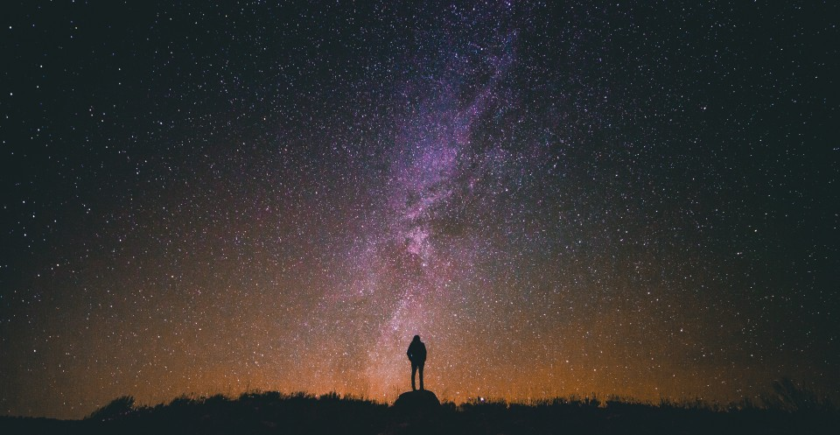

Slide 40
Job 38:32
Canst thou bring forth Mazzaroth in his season? or canst thou guide Arcturus with his sons? KJV
Can you lead out the constellations of the zodiac in their season, or guide the Great Bear and its cubs? Complete Jewish Bible

Slide 41
Mazzaroth
4216 in Strong’s
“the 12 signs of the Zodiac and their 36 associated constellations”

Slide 42
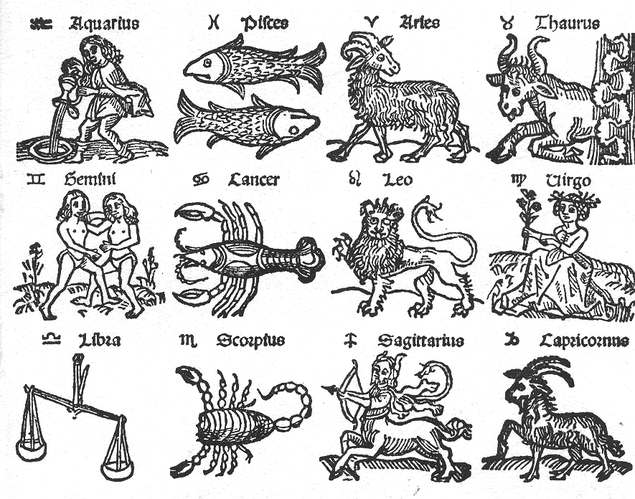

Slide 44
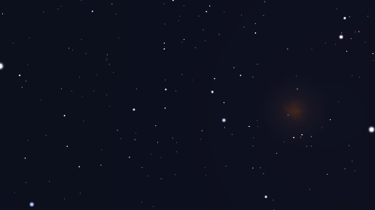

Slide 46
Declare the Glory of God
A Study of the Heavens
Day 3

Slide 47
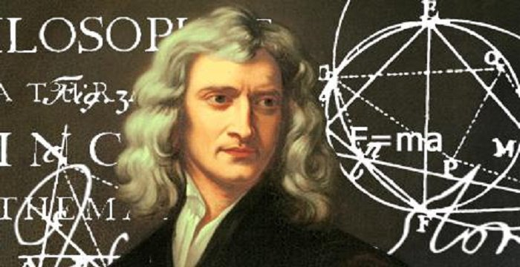

Slide 48
Psalm 19
The heavens declare the glory of God; and the firmament sheweth his handywork.
Day unto day uttereth speech, and night unto night sheweth knowledge.

Slide 49
Psalm 19 (w/Lexicon)
The heavens tell with praise and celebrate the glory of God; and the firmament proclaim and celebrate with praise the work of God
Day unto day they publish poems or hymns, and night unto night breathe out and declare discernment, understanding – the knowledge of good and evil.

Slide 50
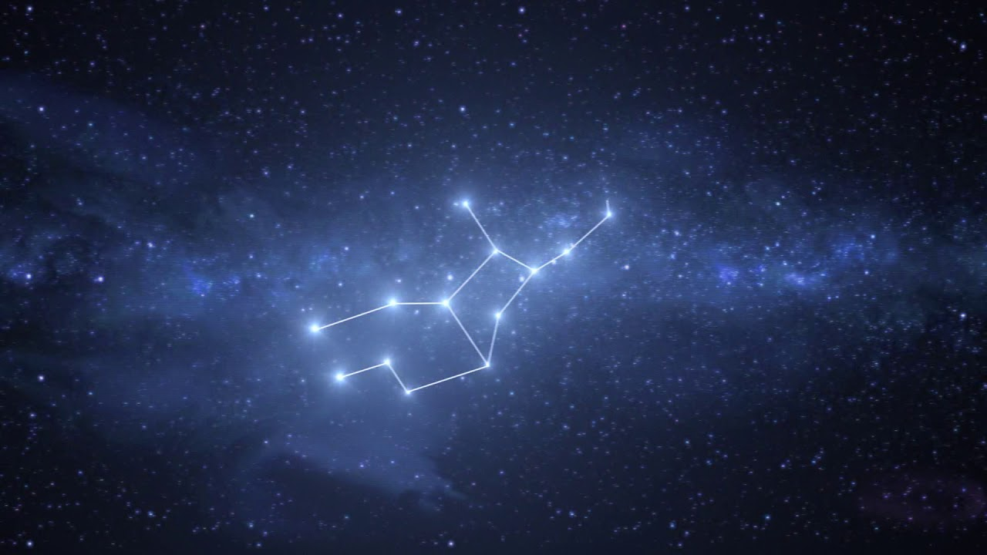

Slide 51
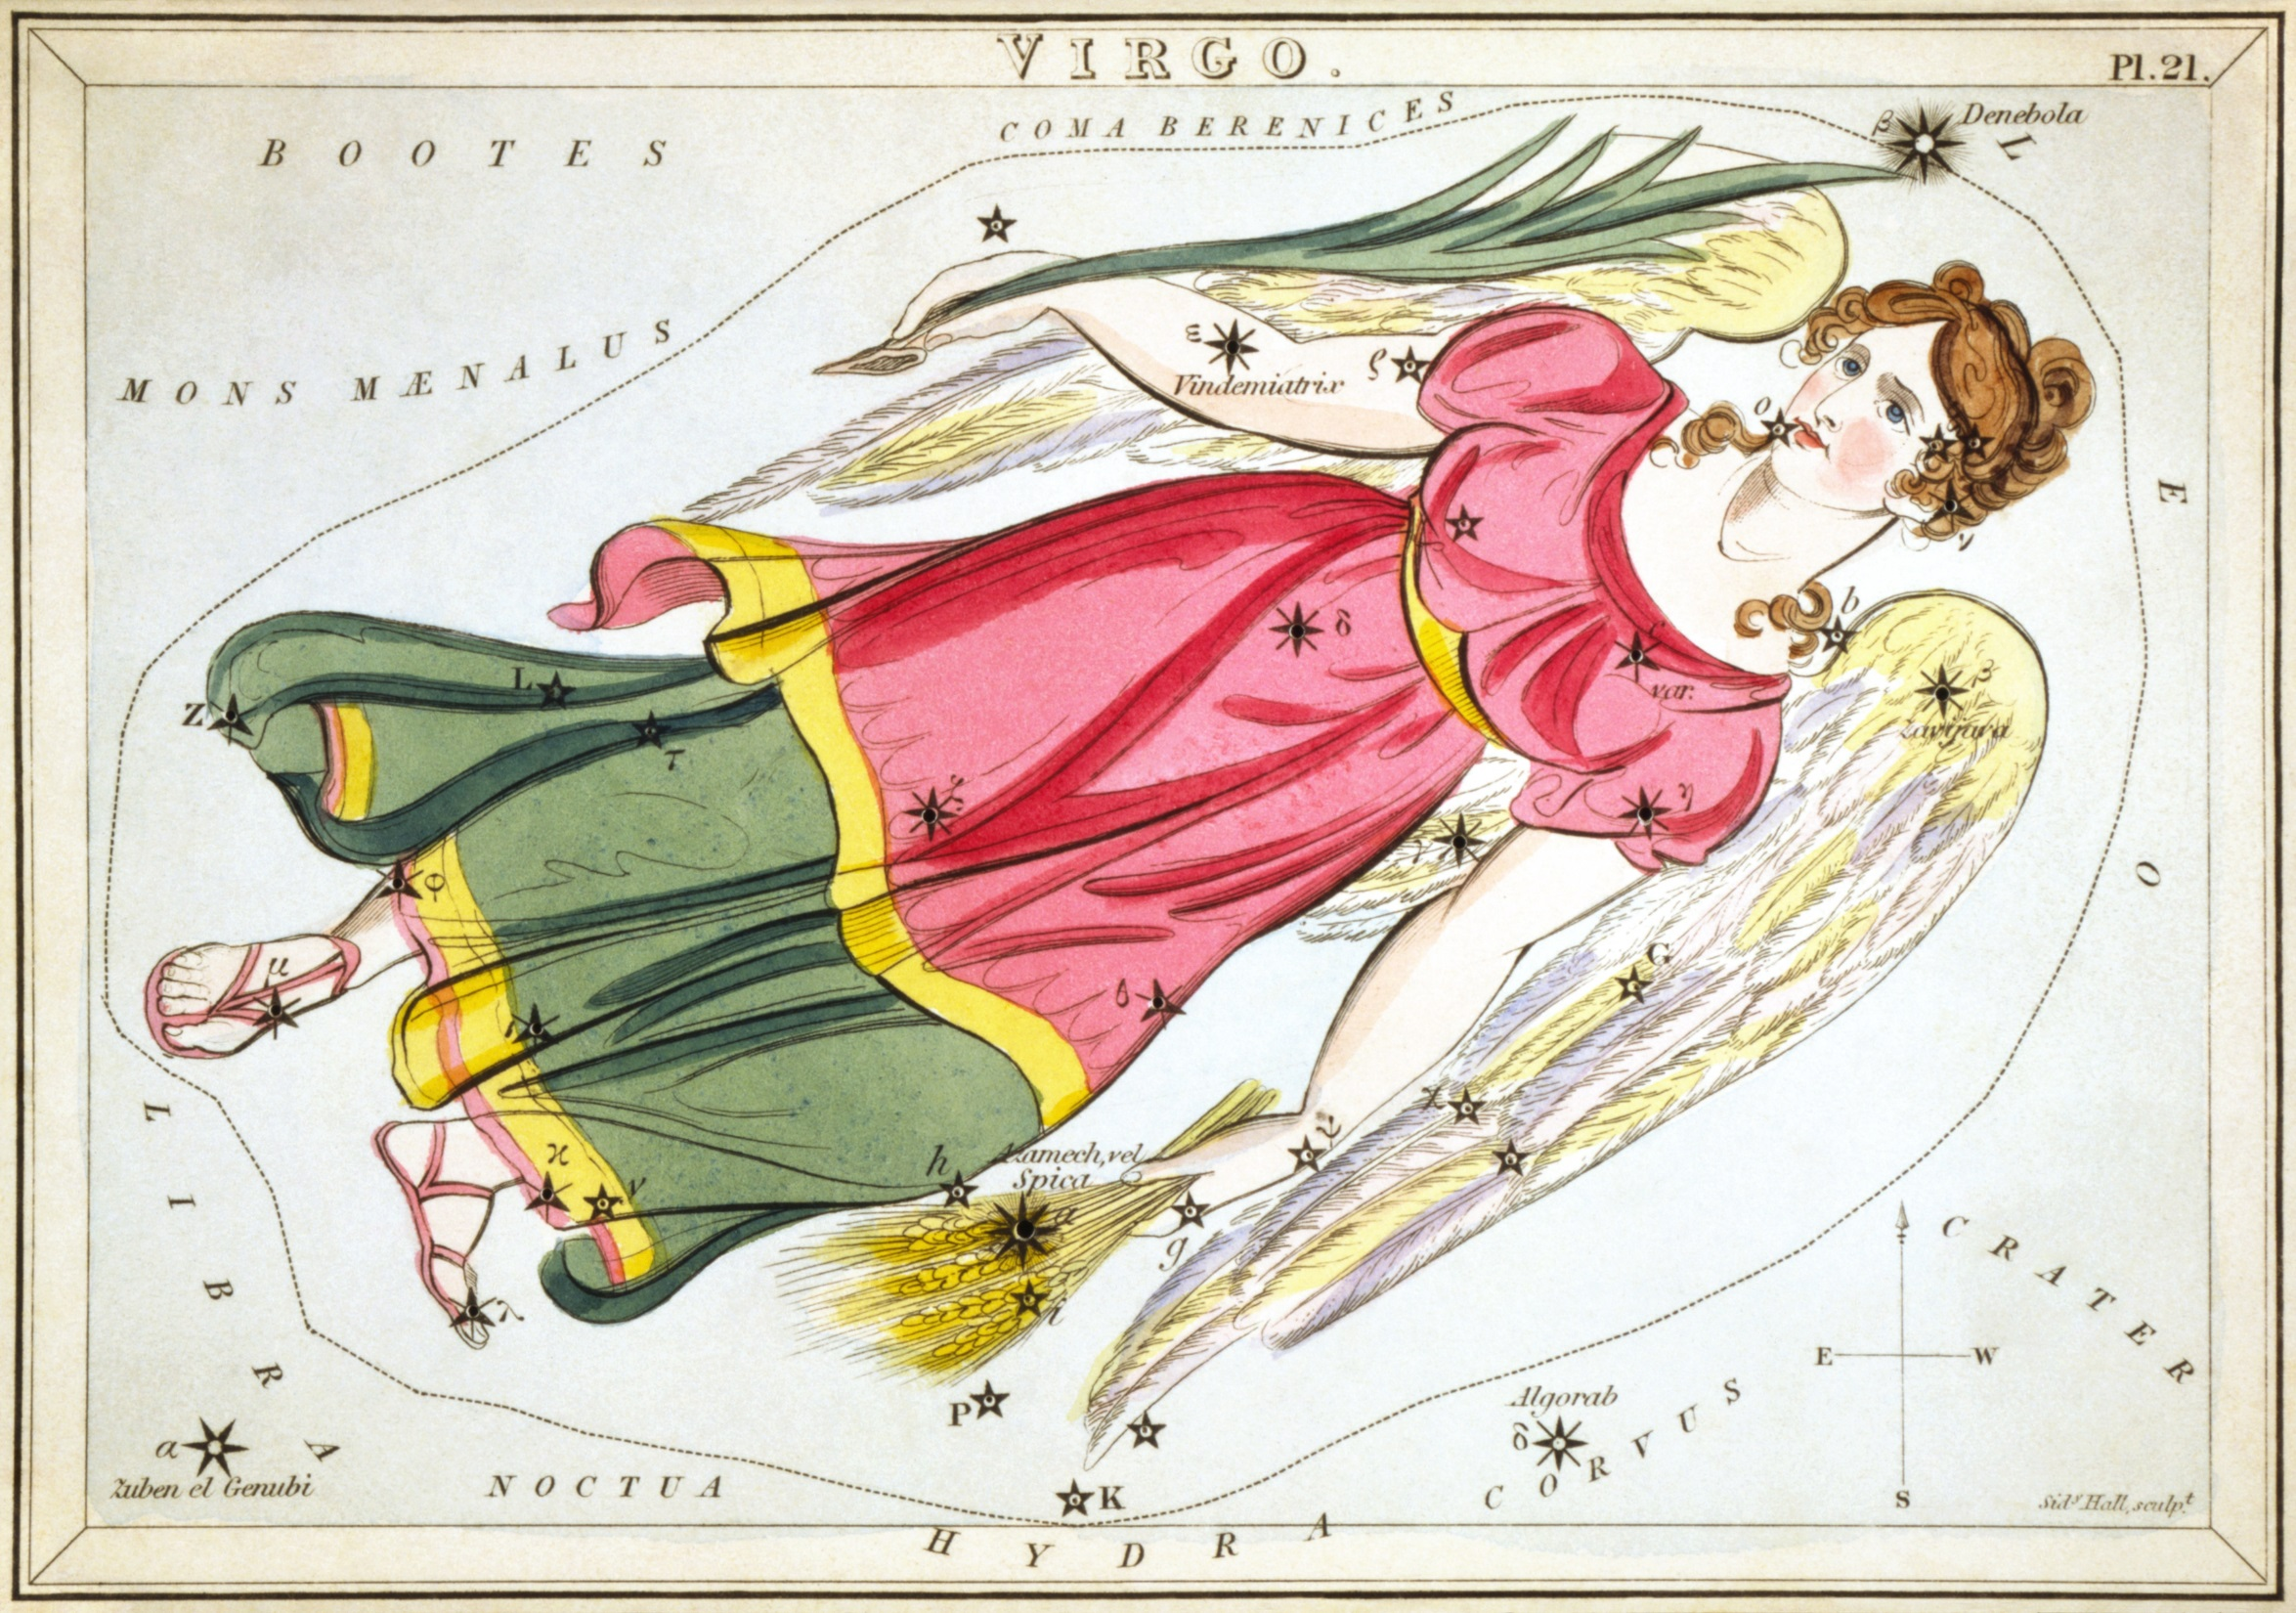

Slide 52
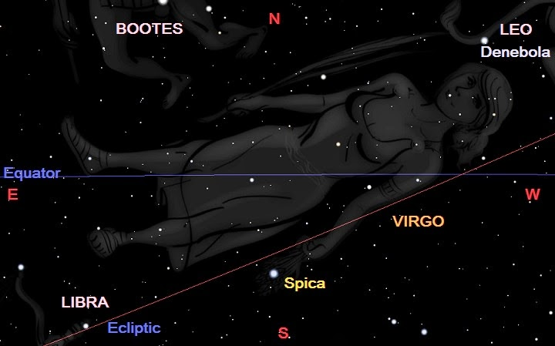

Slide 53
Job 9:9
Which maketh Arcturus, Orion, and Pleiades, and the chambers of the south. KJV
He made the Great Bear, Orion, the Pleiades and the hidden constellations of the south. CJB
He is the Maker of the Bear and Orion, the Pleiades and the constellations of the south. NIV

Slide 54
Job 38:32
Canst thou bring forth Mazzaroth in his season? or canst thou guide Arcturus with his sons? KJV
Can you lead out the constellations of the zodiac in their season, or guide the Great Bear and its cubs? CJB

Slide 55
Arcturus
5906 – Ayish
“A constellation; Great Bear, Ursa Major; Arcturus”
Root Word 5789 – uwsh
“To lend aid, come to help, hasten”, “to accelerate work” Joel 3:11

Slide 56
Arcturus
God made and named Arcturus
Arcturus is associated with a constellation
God’s dominion is affirmed in his ability to “guide”, or possibly “gather”, Arcturus and its “cubs”

Slide 57
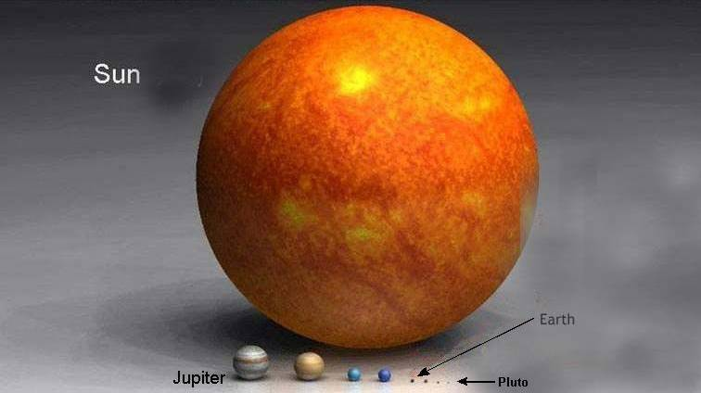

Slide 58
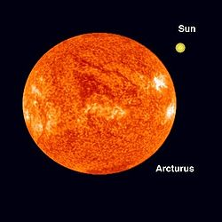

Slide 59
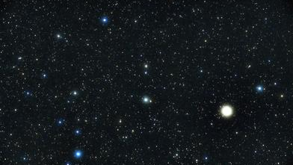

Slide 60
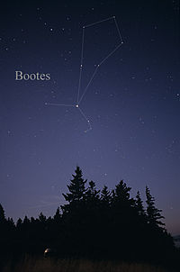
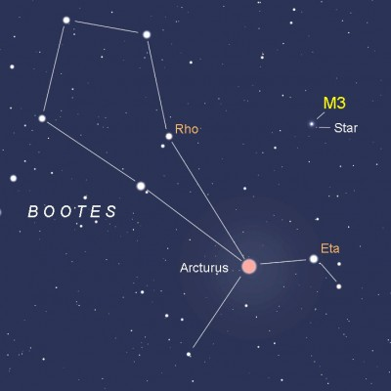

Slide 61
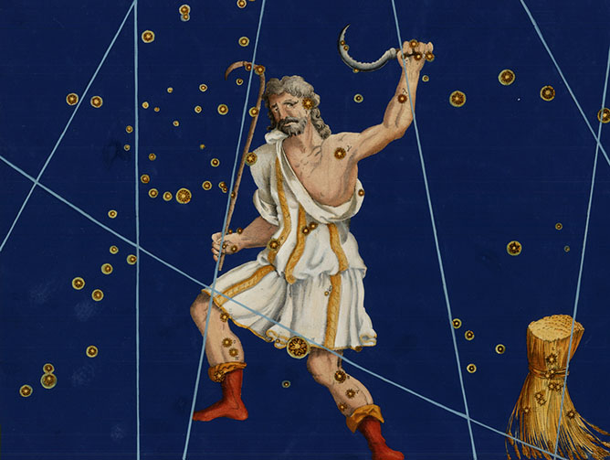

Slide 62
Bootes “herdsman”
Arcturus: “The Coming One”
“The Branch” (spearhead)
“The Preserver” (waist)
“Who Separates” (knee)
“Pierced” (head)

Slide 63
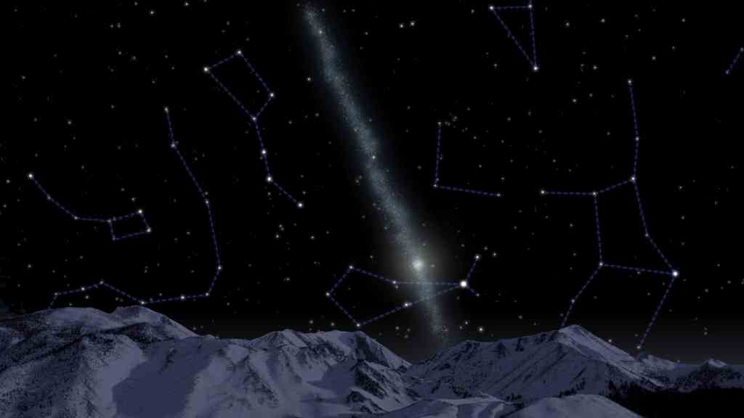
Canst thou guide?

Slide 64
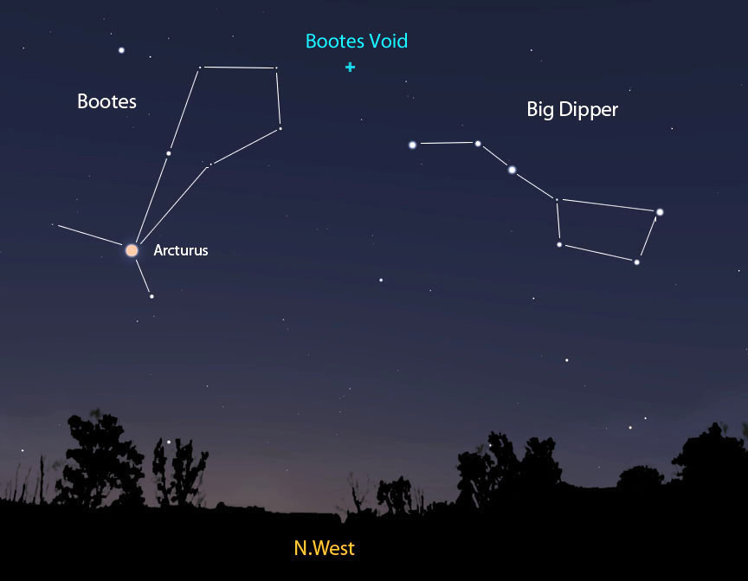
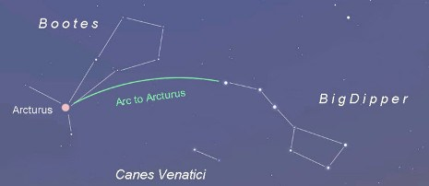

Slide 65
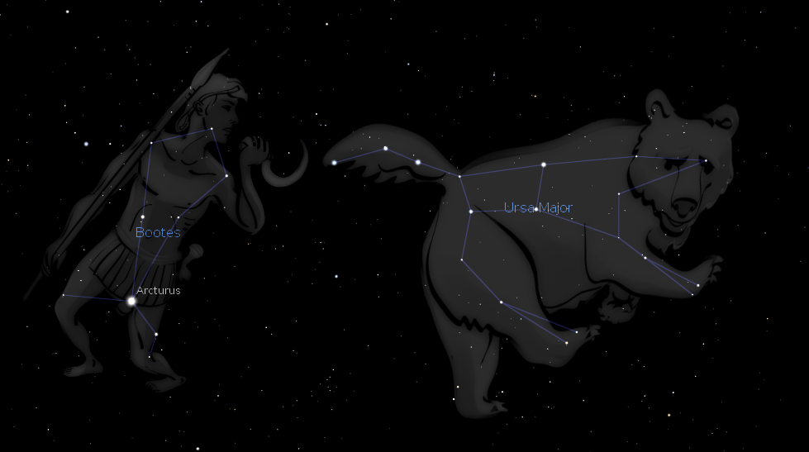

Slide 66
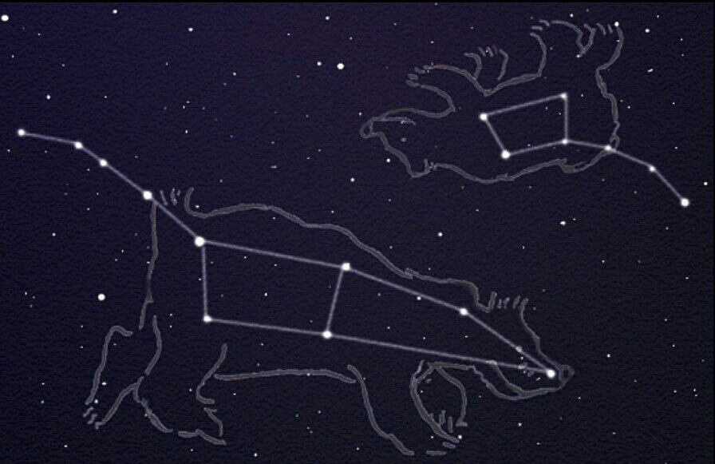

Slide 67
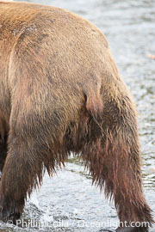
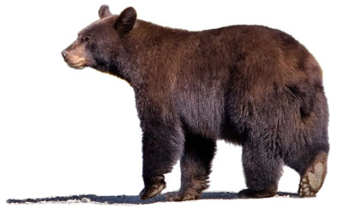
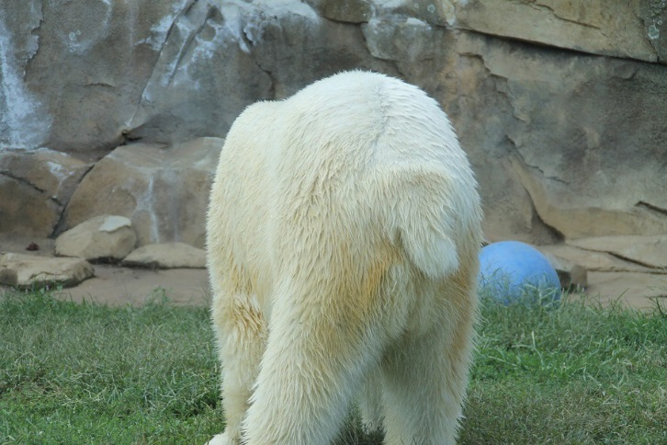

Slide 68
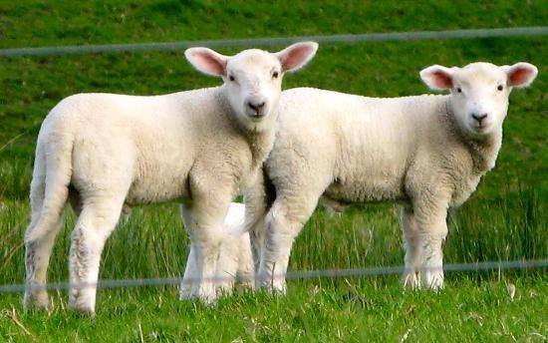

Slide 69
Ursa Major/Ursa Minor “the greater/lesser sheepfold”
Polaris “The Heavenly Position”
“Waiting on Him who cometh”
“The young”
“The redeemed assembly”
“Stronghold of the saved”
“Flock/purchased”
“Guarded/numbered/named”
“Multitude”
“Protected/covered”

Slide 70
Canst thou guide?

Slide 71
Declare the Glory of God
A Study of the Heavens
Day 4

Slide 72
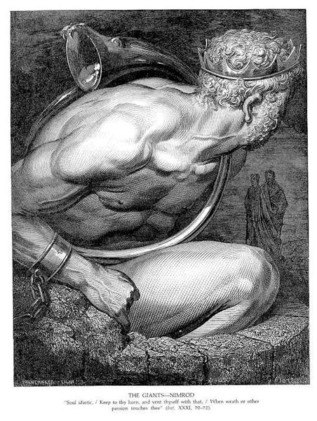
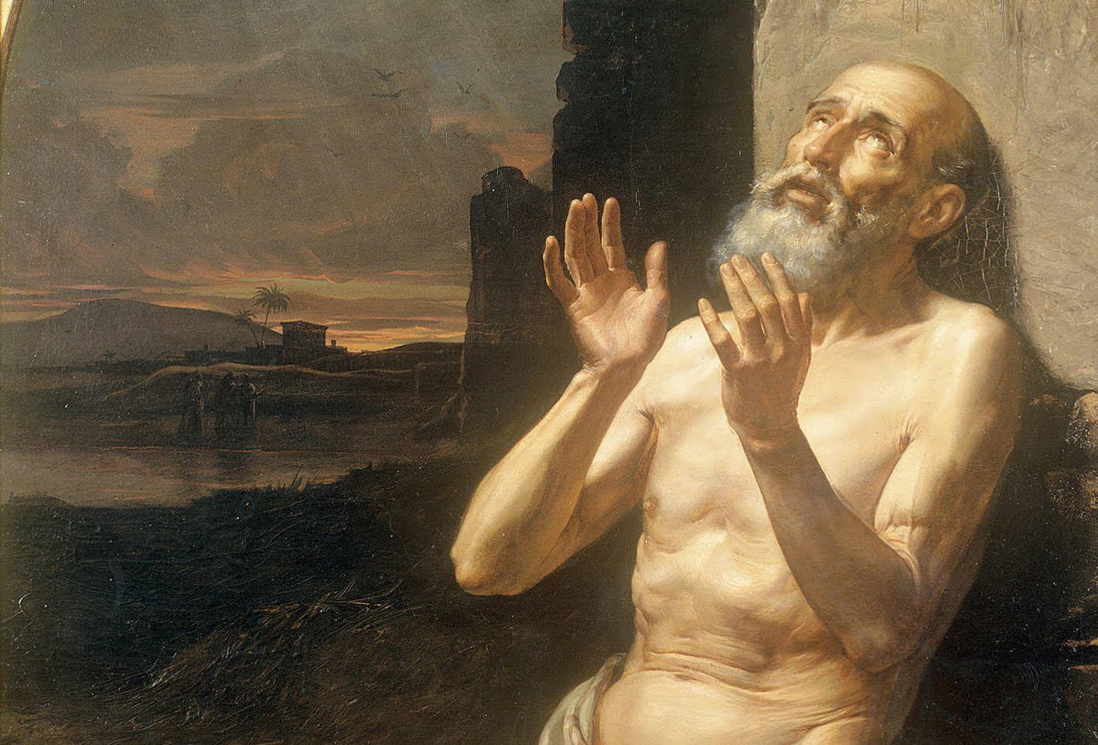

Slide 73
Job 9:9
Which maketh Arcturus, Orion, and Pleiades, and the chambers of the south. KJV
He made the Great Bear, Orion, the Pleiades and the hidden constellations of the south. CJB
He is the Maker of the Bear and Orion, the Pleiades and the constellations of the south. NIV

Slide 74
Job 38:31
Canst thou bind the sweet influences of Pleiades, or loose the bands of Orion? KJV
"Can you tie up the cords of the Pleiades or loosen the belt of Orion? CJB
"Can you bind the chains of the Pleiades? Can you loosen Orion's belt? NIV

Slide 75
Amos 5:8
Seek him that maketh the seven stars and Orion, and turneth the shadow of death into the morning, and maketh the day dark with night: that calleth for the waters of the sea, and poureth them out upon the face of the earth: The LORD is his name: KJV
He who made the Pleiades and Orion, who turns midnight into dawn and darkens day into night, who calls for the waters of the sea and pours them out over the face of the land-- the LORD is his name. NIV

Slide 76
Pleiades
3598 – kiymah
“A constellation of seven stars”
Root Word 3558 – kuwmaz
“Ornaments, golden, to store away, a jewel” Ex. 35:22; Num. 31:50

Slide 77
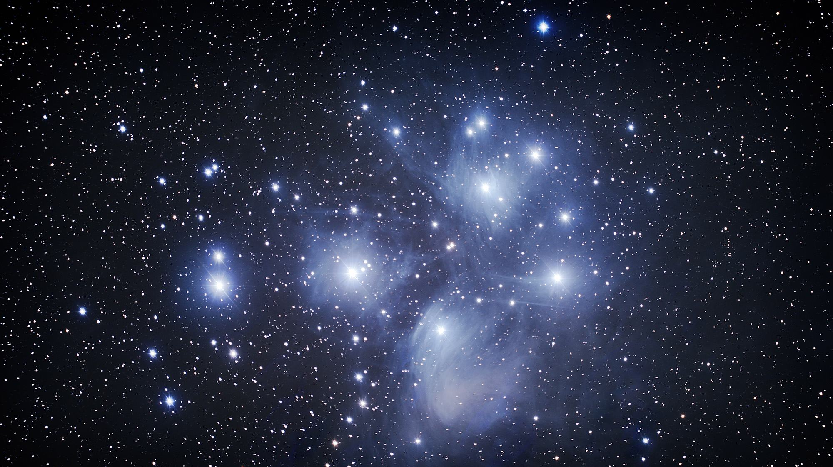

Slide 79
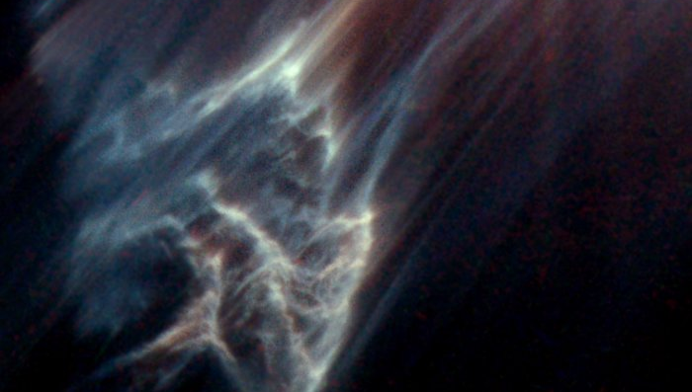

Slide 80
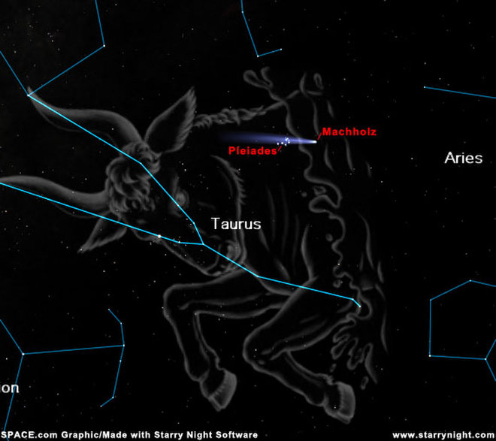

Slide 81
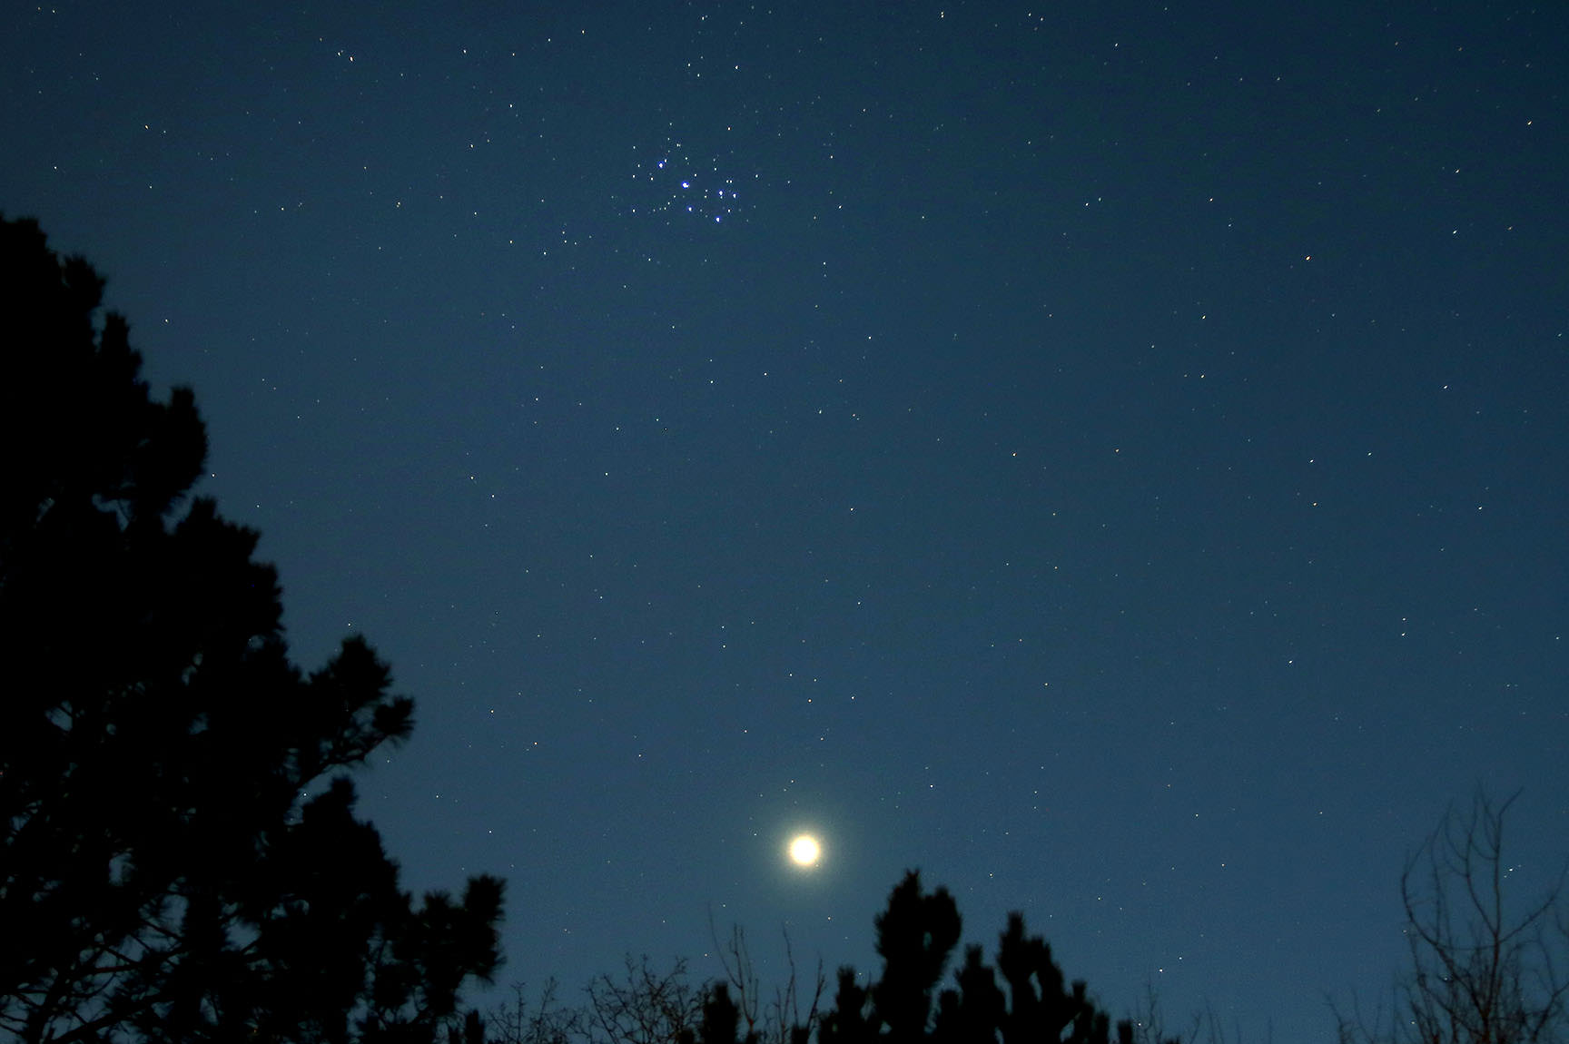

Slide 82
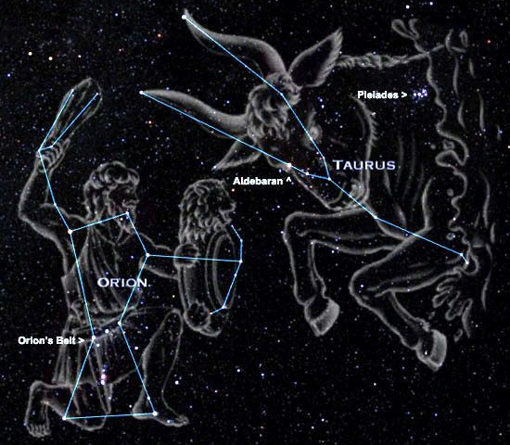

Slide 83
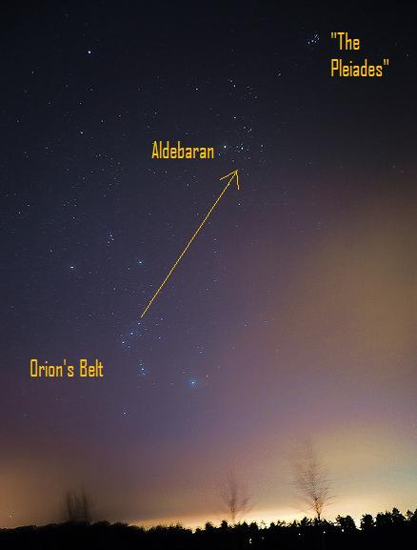

Slide 85
Orion
3685 – Keciyl
“Constellation Orion”

Slide 86
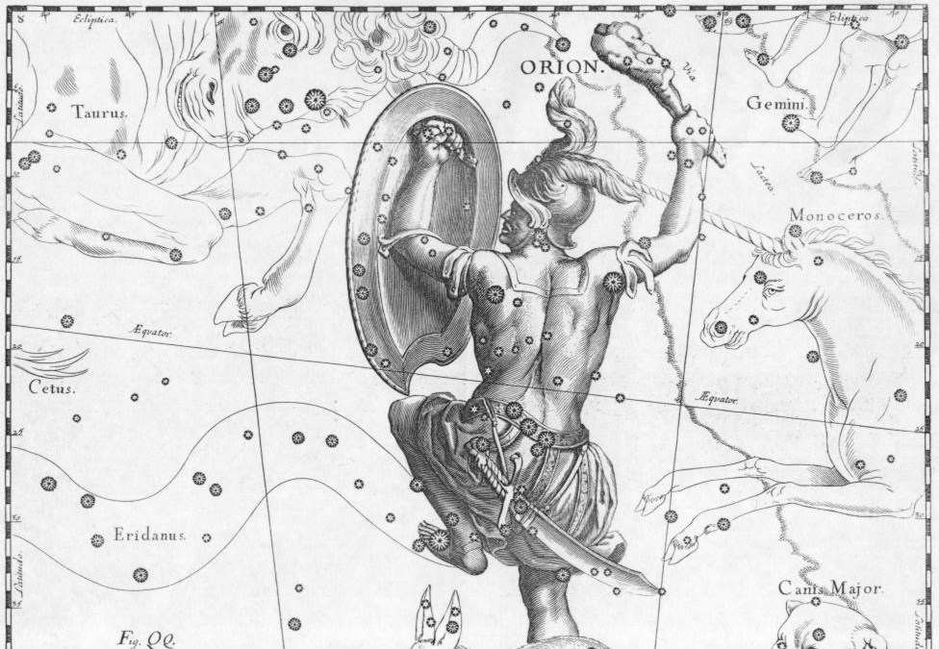
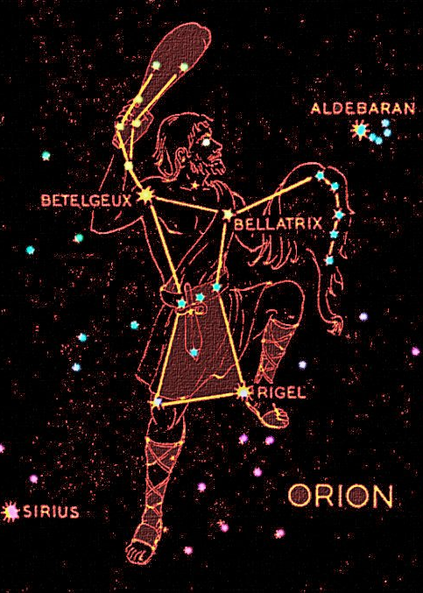

Slide 87
Job 38:31
Canst thou bind the sweet influences of Pleiades, or loose the bands of Orion? KJV
"Can you tie up the cords of the Pleiades or loosen the belt of Orion? CJB
"Can you bind the chains of the Pleiades? Can you loosen Orion's belt? NIV

Slide 88
The Pleiades is an open cluster of stars that many people initially mistake for the Little Dipper. It’s little, and it’s in about the same shape as the dippers. There’s six prominent stars visible, and many more dimmer stars visible in binoculars or a telescope. They are not a coincidental alignment of unrelated stars, but are in fact a gravitationally bound cluster with associated nebulosity that can be photographed with a good telescope.
Science Blogs

Slide 89
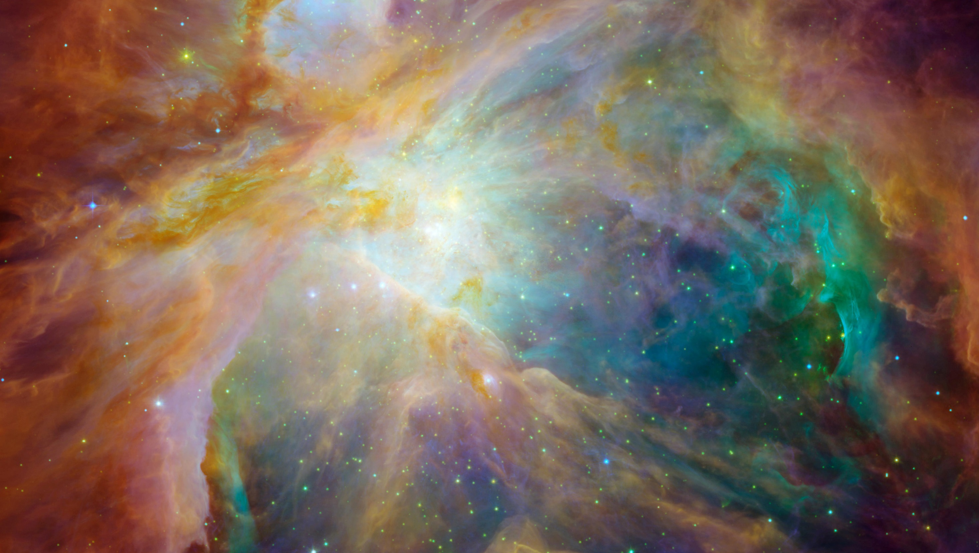

Slide 90
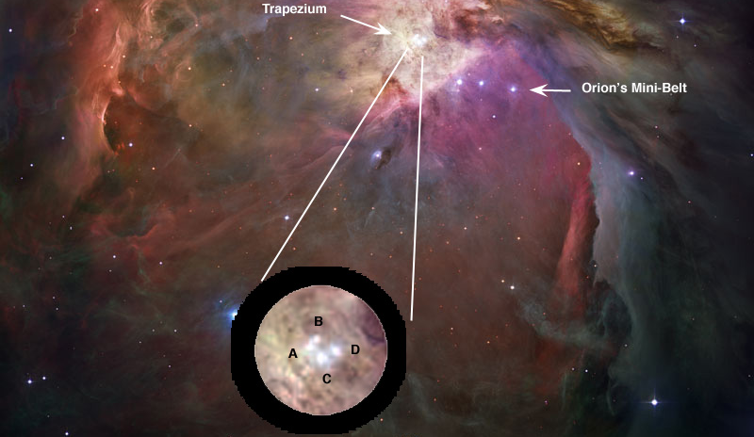

Slide 91
If you have binoculars handy, turn them to Orion’s Belt to see many fine arrangements of bright blue-white stars, including a winding S-shaped group between Mintaka and Alnilam. Arab astronomers once called Orion’s Belt the “String of Pearls”, but in binoculars it looks more like a web of diamonds. Many of these stars here, along with the three Belt stars, are part of the Orion OB1b association, a loose aggregation of stars unbound by gravity but still moving together through space. These stars formed together in the gas and dust of the great Orion star factory some 4 million years ago.

Slide 93
Orion “Coming forth as light”
Betelgeux “the coming of the branch”
Rigel “the foot that crusheth”
Bellatrix “quickly coming”
Al Nitak “the wounded One”
Saiph “bruised”

Slide 94
Canst thou guide?

Slide 95
Declare the Glory of God
A Study of the Heavens
Day 5

Slide 98
Maybe the signal for their star was to be a sign in the constellation of Leo, the Lion.
To the early Israelites, Leo was a constellation of great astrological significance and considered a sacred part of the sky. A very close conjunction of Venus and Jupiter would have been visible in the eastern dawn sky of the Middle East on Aug. 12, 3BC
When they first emerged above the eastern horizon, the two planets were separated by only about two-fifths of the moon's apparent diameter.
Planets this close can be very striking, if they don't differ too much in brightness. Incidentally, this sign would have been both seen "in the east" by Persian men "in the East," explaining the ambiguous phrase in St. Matthew.

Slide 99
Then, during June of 2 B.C., as Jupiter and the stars of Leo began to sink into the western evening twilight, Venus again returned to this same region of the sky for an even more spectacular encore. The Magi certainly would have especially taken note that on the evening of June 17, Jupiter and Venus appeared even closer together than they did in the dawn skies of the previous August.
As the planets slowly descended toward the horizon they got closer and closer together. Finally, at 8:30 p.m. local time they drew to within a mere 0.6 of an arc minute of each other while appearing in the western twilight sky.
To the Magi the two brightest planets must have appeared to coalesce into one and glowed before them like a dazzling beacon over Judea.

Slide 101
Revelation 2:26, 28
And he that overcometh, and keepeth my works unto the end, to him will I give power over the nations …
And I will give him the morning star.

Slide 102
Genesis 49:27
Benjamin shall ravin as a wolf: in the morning he shall devour the prey, and at night he shall divide the spoil.

Slide 103
Deuteronomy 32:36
For the LORD shall judge his people, and repent himself for his servants, when he seeth that their power is gone, and there is none shut up, or left.

Slide 104
Joel 3:15
The sun and the moon shall be darkened, and the stars shall withdraw their shining.

Slide 106
Exodus 16:7
And in the morning, then ye shall see the glory of the LORD; for that he heareth your murmurings against the LORD: and what are we, that ye murmur against us?

Slide 107
He will then give them bread to the full, and his dew will lay round about the host. The life and power of Israel is not in their own prowess; but in the Eternal Spirit, Yahweh, manifested in Messiah and his brethren – the one Yahweh Elohim of Israel. It is he that makes “their latter end” glorious; and turns the weeping of their long and dreary night into the joy that cometh in the morning.
Eureka vol. 1

Slide 108
2 Samuel 23:4
And he shall be as the light of the morning, when the sun riseth, even a morning without clouds; as the tender grass springing out of the earth by clear shining after rain.

Slide 109
Numbers 24:7
I shall see him, but not now: I shall behold him, but not nigh: there shall come a Star out of Jacob, and a Sceptre shall rise out of Israel, and shall smite the corners of Moab, and destroy all the children of Sheth.

Slide 110
This One Ruling Body, the mystical Christ, is the Shiloh, to whom shall be the gathering of the peoples, as the Sceptre of Judah.
Eureka vol. 1

Slide 112
Revelation 22:16
"I, Jesus, have sent my angel to give you this testimony for the churches. I am the Root and the Offspring of David, and the bright Morning Star.“

Slide 113
The Spirit, apart from Jesus, could not say this. The Spirit is the Root of David, because David and all mankind sprung from the Spirit who created them; but apart from flesh and blood, He was not “the Offspring” of David. It was necessary for the Spirit to become flesh of Judah and David’s line … to become “the offspring of David.” When he raised up the dead body named Jesus, he transformed it into spirit-body.
This became the Bright Star – the bright particular star – of that galaxy of stars pertaining to that morning when “Israel shall do valiantly;” …
Eureka vol. 1

Slide 114
The Bright and the Morning Star, then, the Eternal Spirit glorified in Jesus, promises to give the morning star to him that overcomes …
… He (that overcomes) will, then, be a star pertaining to the Millennial Dawn – a morning star …
Eureka vol. 1

Slide 115
Between Two Rivers
From the Sixth Seal to the First Trumpet
311 – 411 AD

Slide 116
Psalm 19 (w/Lexicon)
The heavens tell with praise and celebrate the glory of God; and the firmament proclaim and celebrate with praise the work of God
Day unto day they publish poems or hymns, and night unto night breathe out and declare discernment, understanding – the knowledge of good and evil.

Slide 117
Bootes “herdsman”
Arcturus: “The Coming One”
“The Branch” (spearhead)
“The Preserver” (waist)
“Who Separates” (knee)
“Pierced” (head)

Slide 118
Ursa Major/Ursa Minor “the greater/lesser sheepfold”
Polaris “The Heavenly Position”
“Waiting on Him who cometh”
“The young”
“The redeemed assembly”
“Stronghold of the saved”
“Flock/purchased”
“Guarded/numbered/named”
“Multitude”
“Protected/covered”

Slide 119
Orion “Coming forth as light”
Betelgeux “the coming of the branch”
Rigel “the foot that crusheth”
Bellatrix “quickly coming”
Al Nitak “the wounded One”
Saiph “bruised”

Slide 121
Of all the Stars in the New Heavens, Jesus will be the brightest; for in all things it is the Father’s will and pleasure, not only that all the fullness shall dwell in him, but that he also shall have the preeminence …
He that overcomes, to him it shall be given to be one of these – a splendid one sparkling in the glory of the great and fearful Name of Yahweh Elohim.
Eureka vol. 1

