Slide 1
Exercise #1
Notes:
How to revive stale bread

Slide 2
Exercise #2
Notes:
Apollo 13

Slide 3
Exercise #2
Notes:
Apollo 13

Slide 4
Takeaway
Difficult to summarize something in a very few words
Difficult to capture more than the essence in a few words

Slide 5
Inspiration
All scripture is given by inspiration of God (II Tim 3:16)
theopneustos
God-breathed; breathed-out-by-God

Slide 6
Examples of inspiration
II Peter 1:21 – For the prophecy came not in old time by the will of man: but holy men of God spake as they were moved by the Holy Spirit.

Slide 7
Examples of inspiration
John 14:26 – But when the Comforter comes, even the Holy Spirit, which the Father will send in My name, that one shall teach you all things, and shall bring to your remembrance everything that I have told you.
Notes:
No masculine gender noun is used anywhere in the NT (KJV – “whom” s/b “which”; “he” s/b “that one”)

Slide 8
Examples of inspiration
II Chronicles 36:22 – Now in the first year of Cyrus king of Persia, that the word of the LORD spoken by the mouth of Jeremiah might be accomplished …

Slide 9
Examples of inspiration
Numbers 23:5 – And the LORD put a word in Balaam’s mouth …

Slide 10
Another indication of inspiration
Short, compact phrases that compress a lot of information
Something that only a divine mind could express perfectly
Notes:
Implicit, rather than explicit

Slide 11
Purpose of the class
Identify some of these short, compact phrases in the Bible
unpack them
increase our faith that the Bible is inspired
appreciate the divine mind that inspired them
practical: look for these as you read the Bible

Slide 12
“Spiritual DNA”
Kentucky Bible School 2018

Slide 13
DNA videos
What is DNA and how does it work?
What you didn’t know about your DNA?
Wonder of DNA – 2:28 – 4:05; 44:35 - 46:14
Notes:
If the right proteins are built at the right time in the right place ….
DNA creates RNA, RNA creates proteins, and proteins go on to form life.
The haploid human genome contains approximately 3 billion base pairs of DNA packaged into 23 chromosomes. Of course, most cells in the body (except for female ova and male sperm) are diploid, with 23 pairs of chromosomes. That makes a total of 6 billion base pairs of DNA per cell. Because each base pair is around 0.34 nanometers long (a nanometer is one-billionth of a meter), each diploid cell therefore contains about 2 meters of DNA [(0.34 × 10⁻⁹) × (6 × 10⁹)]. Moreover, it is estimated that the human body contains about 50 trillion cells—which works out to 100 trillion meters of DNA per human. Now, consider the fact that the Sun is 150 billion meters from Earth. This means that each of us has enough DNA to go from here to the Sun and back more than 300 times, or around Earth's equator 2.5 million times! How is this possible?
6 feet of DNA in every nucleus of every cell; can fit 10,000 nuclei on the head of a pin – major packaging

Slide 14
DNA
“major packaging”
vast quantities of compressed information in something so miniature (a cell’s nucleus) that 10,000 nuclei will fit on the head of a pin
6 feet of DNA in every nucleus of every cell
Notes:
60,000 feet = 11.4 miles / 18.3 km

Slide 15
“Spiritual DNA”
Information in the Bible is also compressed or packaged

Slide 16
Spiritual DNA Example #1
Psalm 4:4
Stand in awe, and sin not

Slide 17
Stand in awe, and sin not (Psalm 4:4)

Slide 18
Stand in awe, and sin not (Psalm 4:4)

Slide 19
Spiritual DNA Example #2
Colossians 2:7
Abounding with thanksgiving
Notes:
Overflowing with thankfulness (NIV)
Abounding therein with thanksgiving (KJV)

Slide 21
Gratitude to God
There is a relationship between gratitude and sin
Romans 1:21 – When they knew God, they glorified him not as God, neither were thankful; but became vain in their imaginations, and their foolish heart was darkened…
Romans 1:26-31 – list of sinful behaviors

Slide 22
How does someone overcome sin?
Stand in awe and sin not
Abound in thanksgiving
Very positive motives
Easy to remember
Notes:
Resist the devil, and he will flee from you (James 4:17)
Flee also youthful lusts (II Tim 2:22)
Enter not into the path of the wicked, and go not in the way of evil men. Avoid it, do not travel on it; turn away from it and pass on (Prov 4:14-15).
Thy word have I hid in my heart that I might not sin against thee (Psalm 119:11)

Slide 23
Spiritual DNA Example #3
John 8:11
Go, and sin no more

Slide 24
Background
v.4 – a ‘setup’? (adultery is something done privately)
no man – only the woman

Slide 25
Background
v. 6 – a trap
If Jesus says ‘yes’, he would break Roman law, as only a judge could sentence someone to death
If Jesus says ‘no’, he would break the Jewish law (Leviticus 20:10; Deut 22:22). He would also contradict his teachings about mercy (see Matt 9:13 & 12:7)

Slide 26
The plot thickens
Jesus has to deal with the adulterous man, otherwise he is not being fair to the adulterous woman
As well, the law of Moses said that the adulterer and adulteress should be put to death (Lev. 20:10; Deut. 22:22)
The scribes & Pharisees were being hypocritical, since they were ignoring the entire commandment by seeking retribution for the woman only

Slide 27
What does Jesus do?
v. 6 - he wrote on the ground
cp. Jeremiah 17:13
the scribes & Pharisees had forsaken God by being hypocritical
What did Jesus write?
perhaps the name of the adulterous man

Slide 28
What does Jesus do?
v. 7 – He that is without sin among you, let him first cast a stone at her
v. 8 - what did Jesus write?
Perhaps the names of the scribes & Pharisees
v. 9-10 – the men slunk away, leaving Jesus with the woman

Slide 29
Proverbs 26
Proverbs 18
²⁴ He who hates, disguises it with his lips, And lays up deceit within himself; ²⁵ When he speaks kindly, do not believe him, For there are seven abominations in his heart; ²⁶ Though his hatred is covered by deceit, His wickedness will be revealed before the assembly.
²⁷ Whoever digs a pit will fall into it, And he who rolls a stone will have it roll back on him.
¹³ He who answereth a matter before he heareth it, it is folly and shame to him.

Slide 30
v.11 – Neither do I condemn thee: go, and sin no more.

Slide 31
Go, and sin no more
Go
move on with your life
don’t wallow in self-pity
accept the consequences
you cannot change what just happened
implied forgiveness
mercy
cp. Philippians 3:13-14
cp. II Cor. 2:7
Sin
Jesus explicitly acknowledges that her conduct was a sin
No more
She must never repeat her sinful behaviour
cp. Proverbs 28:13

Slide 32
Go, and sin no more
What does Jesus do?
What does Jesus not do?
he does something!
cp. Galatians 6:1-2
attempts to recover her
relieves her of her burden (guilt)
he takes the emotion out of the situation
downplay her sin
endorse her sin
tell her to feel guilty or ashamed
belittle or degrade her
tell others what she did
the words of a talebearer are as wounds, and they go down into the innermost parts of the belly (Prov. 26:22)

Slide 33
Go, and sin no more
Jesus’ response shows that he is not a respecter of persons
Proverbs 24:23 – It is not good to have respect of persons in judgment
respecting of persons is a sin (James 2:9)
we know nothing about the woman
irrelevant!
Notes:
Nothing about the woman … intellect, physical appearance, personality type, etc.

Slide 34
Go, and sin no more
Jesus confronted an issue
His focus was on the issue, not the person

Slide 35
Go, and sin no more
we are not told how the woman responded
irrelevant!
Notes:
how someone reacts is out of our control
Jesus followed the ‘golden rule’
What if we knew how the woman responded?

Slide 36
Go, and sin no more
lessons for us?
parenting
ecclesial life
dealing with ourselves
Notes:
how someone reacts is out of our control
Jesus followed the ‘golden rule’
What if we knew how the woman responded?

Slide 37
Spiritual DNA Example #4
Matt. 12:34 / Luke 6:45
For out of the abundance of the heart the mouth speaketh
Jesus’ response to the adulterous woman is a good example of his own teaching

Slide 38
Spiritual DNA Example #5
Jesus / Romans 13:9 / Gal. 5:19 / James 2:8
Thou shalt love thy neighbour as thyself

Slide 39
Thou shalt love thy neighbour
… is not what Jesus said

Slide 40
Thou shalt love thy neighbour as thyself
… is what Jesus said

Slide 41
What does it mean to love yourself?
Notes:
Does not mean to think more highly of yourself than you should, or to become puffed up with pride

Slide 42
We all have reasons not to love ourselves
we have
sinned
made mistakes
made decisions that did not ‘work out’
second-guessed ourselves
realized in hindsight that we should have done something differently
etc.

Slide 43
Trivial example

Slide 44
What does it mean to love yourself?
the standard by which we are to treat our neighbours is how we treat ourselves

Slide 45
If we love ourselves, it should be natural to love someone else
E.g., if we practice patience with ourselves, it should become easier to be patient with someone else
If we do not love ourselves, it should be unnatural to love someone else
E.g., if we are impatient with ourselves, it will be difficult to be patient with someone else

Slide 46
Who loved himself? (III John)
Diotrophes (evil)
Demetrius (good)
loved the pre-eminence
malicious words
refused to receive the brethren; and those who did, he cast out of the ecclesia
Good report of all men and the truth
cp. Eph 4:21 – the truth as it is in Jesus

Slide 47
What does it mean to love yourself?
Perhaps Jesus was saying that someone can only love someone else if they have first practiced showing love to themselves
patient with ourselves?
kind to ourselves?
at peace with ourselves?
forgive ourselves?
etc.

Slide 48
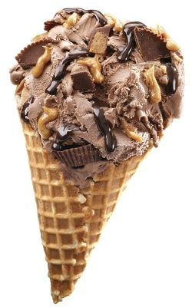
Can you think of practical ways to be nice to yourself?

Slide 49
Marriage
Would you want to be married to someone who didn’t love him/herself?
They wouldn’t be able to love you!
Eph. 5:28 – He that loveth his wife loveth himself

Slide 50
What about Jesus?
Did Christ practice his own teaching (to love others as himself?)
Yes
Example: the woman caught in adultery (John 8).
He was firm, gentle and kind to her; therefore, he must have been firm, gentle and kind with/to himself.

Slide 51
It may be harder to love yourself than someone else
We may be harder on ourselves than on others
We have to live with our decisions
We know our shortcomings far more intimately than anyone else

Slide 52
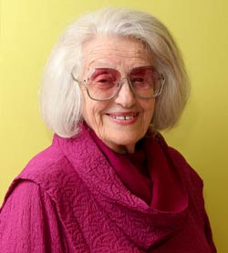
The opposite of loving yourself
Someone who is hostile, spiteful, unkind, etc., toward someone else is not loving themselves
Their poor treatment of others reflects the fact that they do not love themselves
Dr. Truda Rosenberg

Slide 53
Forgiveness
Easier to do when we realize that someone who mistreated us is unhappy with him/herself
they showed “love” to us according as they love him/herself (i.e., they don’t love him/herself, therefore they can’t love us!)
did not show love to us the way that Jesus intended

Slide 54
Memorial service
“let a man examine himself” (I Cor. 11:38)
How?
Do we ever examine how much we love ourselves?

Slide 55
Thou shalt love thy neighbour as thyself
Profound!

Slide 56
Spiritual DNA Example #6
Galatians 3:8
In thee shall all nations be blessed

Slide 57
In thee shall all nations be blessed
Def’n of “the gospel”
proeuaggelizomai – to announce good news in advance

Slide 58
In thee shall all nations be blessed
quotes Genesis 12:3 – “in thee shall all families of the earth be blessed”
“all nations” = heathen (ethnos - Gentiles), per Gal. 3:8

Slide 59
In thee shall all nations be blessed
Abraham
future
Jews & Gentiles
eternal inheritance
The gospel / good news

Slide 60
In thee shall all nations be blessed
Abraham
future
Jews & Gentiles
eternal inheritance
Genesis 17:7-8 – And I will establish my covenant between me and thee and thy seed after thee in their generations for an everlasting covenant, to be a God unto thee, and to thy seed after thee. And I will give unto thee, and to thy seed, the land wherein thou art a stranger, all the land of Canaan, for an everlasting possession; and I will be their God.

Slide 61
Where in the OT does it indicate that the Gentiles can be accepted with God?

Slide 62
Romans 15:8-12
⁸ Now I say that Jesus Christ was a minister of the circumcision for the truth of God, to confirm the promises made unto the fathers:
⁹ And that the Gentiles might glorify God for his mercy; as it is written, For this cause I will confess to thee among the Gentiles, and sing unto thy name.
¹⁰ And again he saith, Rejoice, ye Gentiles, with his people.
¹¹ And again, Praise the Lord, all ye Gentiles; and laud him, all ye people.
¹² And again, Esaias saith, There shall be a root of Jesse, and he that shall rise to reign over the Gentiles; in him shall the Gentiles trust.

Slide 63
^{Romans 15:9} For this cause I will confess to thee among the Gentiles, and sing unto thy name.
^{Psalm 18:49} Therefore will I give thanks unto thee, O Lord, among the heathen, and sing praises unto thy name.
^{Romans 15:10} Rejoice, ye Gentiles, with his people.
^{Deut. 32:43} Rejoice, O ye nations, with his people:
^{Romans 15:11} Praise the Lord, all ye Gentiles; and laud him, all ye people.
^{Psalm 117:1} O praise the Lord, all ye nations: praise him, all ye people.
^{Romans 15:12} There shall be a root of Jesse, and he that shall rise to reign over the Gentiles; in him shall the Gentiles trust.
^{Isaiah 11:10} And in that day there shall be a root of Jesse, and he that shall arise to rule over the Gentiles; in him shall the Gentiles trust, and his rest shall be glorious.

Slide 64
The root of Jesse… who will rule over the Gentiles
Luke 1:31-33
II Samuel 7:12-13, 16
Psalm 89:35-36
Psalm 132:11

Slide 65
Gospel of the kingdom (Matt. 4:23)
kingdom
king
domain / territory
Christ / Messiah
Land of Canaan / Israel
promised to David
promised to Abraham

Slide 66
Isaiah 42
¹ Behold my servant, whom I uphold; mine elect, in whom my soul delighteth; I have put my spirit in him: he shall bring forth judgment to the Gentiles.
⁶ I the LORD have called thee in righteousness, and will hold thine hand, and will keep thee, and give thee for a covenant of the people, for a light of the Gentiles;
⁷ To open the blind eyes, to bring out the prisoners from the prison, and them that sit in darkness out of the prison house.

Slide 67
Isaiah 49
⁶ …I will also give thee for a light to the Gentiles, that thou mayest be my salvation unto the end of the earth.
⁸ … I will preserve thee and give thee for a covenant of the people, to establish the earth, to cause to inherit the desolate heritages;
⁹ That thou mayest say to the prisoners, Go forth; to them that are in darkness, Shew yourselves.
²⁰ The children which thou shalt have, after thou hast lost the other, shall say again in thine ears, The place is too strait for me: give place to me that I may dwell.
²² Thus saith the Lord GOD, Behold, I will lift up mine hand to the Gentiles, and set up my standard to the people…

Slide 68
Isaiah 54
¹ Sing, O barren, thou that didst not bear; break forth into singing, and cry aloud, thou that didst not travail with child: for more are the children of the desolate [Gentiles] than the children of the married wife [Jews], saith the LORD.
² Enlarge the place of thy tent…
³ …thy seed shall inherit the Gentiles, and make the desolate cities to be inhabited.
¹³ And all thy children shall be taught of the LORD; and great shall be the peace of thy children.
Notes:
The married wife = Jews – see v. 5 – thy Maker is thy husband
Enlarge the place of thy tent – see Genesis 9:27 – God shall enlarge Japheth, and he shall dwell in the tents of Shem (Septuagint – enlarge is “make room for”)
v. 13 – compare John 6:45

Slide 69
Isaiah 55
¹ Ho, every one that thirsteth, come ye to the waters, and he that hath no money; come ye, buy, and eat; yea, come, buy wine and milk without money and without price.
² Wherefore do ye spend money for that which is not bread? and your labour for that which satisfieth not? hearken diligently unto me, and eat ye that which is good, and let your soul delight itself in fatness.
³ Incline your ear, and come unto me: hear, and your soul shall live; and I will make an everlasting covenant with you, even the sure mercies of David.
Notes:
Who is thirsty?
Cp John 6:35 – he that believeth on me …. V. 37 – him that cometh to me … v 45- every man that hath heard and learned, cometh to me …
Revelation 22:17

Slide 70
Isaiah 56
⁵ Even unto them will I give in mine house and within my walls a place and a name better than of sons and of daughters: I will give them an everlasting name, that shall not be cut off.
⁶ Also the sons of the stranger, that join themselves to the Lord, to serve him, and to love the name of the Lord, to be his servants, every one that keepeth the sabbath from polluting it, and taketh hold of my covenant;
⁷ Even them will I bring to my holy mountain, and make them joyful in my house of prayer: their burnt offerings and their sacrifices shall be accepted upon mine altar; for mine house shall be called an house of prayer for all people.

Slide 71
Isaiah 60
¹ Arise, shine; for thy light is come, and the glory of the Lord is risen upon thee.
² For, behold, the darkness shall cover the earth, and gross darkness the people: but the Lord shall arise upon thee, and his glory shall be seen upon thee.
³ And the Gentiles shall come to thy light, and kings to the brightness of thy rising.

Slide 72
Isaiah 61
¹ The Spirit of the Lord God is upon me; because the Lord hath anointed me to preach good tidings unto the meek; he hath sent me to bind up the brokenhearted, to proclaim liberty to the captives, and the opening of the prison to them that are bound;
² To proclaim the acceptable year of the Lord, and the day of vengeance of our God; to comfort all that mourn;
³ To appoint unto them that mourn in Zion, to give unto them beauty for ashes, the oil of joy for mourning, the garment of praise for the spirit of heaviness; that they might be called trees of righteousness, the planting of the Lord, that he might be glorified.
⁴ And they shall build the old wastes, they shall raise up the former desolations, and they shall repair the waste cities, the desolations of many generations.
⁵ And strangers shall stand and feed your flocks, and the sons of the alien shall be your plowmen and your vinedressers.

Slide 73
Isaiah 66
¹² For thus saith the Lord, Behold, I will extend peace to her like a river, and the glory of the Gentiles like a flowing stream: then shall ye suck, ye shall be borne upon her sides, and be dandled upon her knees.

Slide 74
The law of Moses provided for Gentiles
Exodus 20:10
But the seventh day is the sabbath of the Lord thy God: in it thou shalt not do any work, thou, nor thy son, nor thy daughter, thy manservant, nor thy maidservant, nor thy cattle, nor thy stranger that is within thy gates

Slide 75
The law of Moses provided for Gentiles
Deuteronomy 31:12
Gather the people together, men and women, and children, and thy stranger that is within thy gates, that they may hear, and that they may learn, and fear the Lord your God, and observe to do all the words of this law

Slide 76
Where in the NT does it indicate that the Gentiles can be accepted with God?

Slide 77
John 10:16
And other sheep I have, which are not of this fold: them also I must bring, and they shall hear my voice; and there shall be one fold, and one shepherd.

Slide 78
Acts 13:46-48
⁴⁶ Then Paul and Barnabas waxed bold, and said, It was necessary that the word of God should first have been spoken to you: but seeing ye put it from you, and judge yourselves unworthy of everlasting life, lo, we turn to the Gentiles.
⁴⁷ For so hath the Lord commanded us, saying, I have set thee to be a light of the Gentiles, that thou shouldest be for salvation unto the ends of the earth.
⁴⁸ And when the Gentiles heard this, they were glad, and glorified the word of the Lord: and as many as were ordained to eternal life believed.

Slide 79
Acts 15:13-17
¹³ And after they had held their peace, James answered, saying, Men and brethren, hearken unto me:
¹⁴ Simeon hath declared how God at the first did visit the Gentiles, to take out of them a people for his name.
¹⁵ And to this agree the words of the prophets; as it is written,
¹⁶ After this I will return, and will build again the tabernacle of David, which is fallen down; and I will build again the ruins thereof, and I will set it up:
¹⁷ That the residue of men might seek after the Lord, and all the Gentiles, upon whom my name is called, saith the Lord, who doeth all these things.
Notes:
Quotes Amos 9:11

Slide 80
Acts 10:34-35
³⁴ Then Peter opened his mouth, and said, Of a truth I perceive that God is no respecter of persons:
³⁵ But in every nation (ethnos) he that feareth him, and worketh righteousness, is accepted with him.

Slide 81
In thee shall all nations be blessed
Abraham
future
Jews & Gentiles
eternal inheritance
The gospel / good news

Slide 82
Be blessed – how?
Ephesians 3
¹ For this cause I Paul, the prisoner of Jesus Christ for you Gentiles,
² If ye have heard of the dispensation of the grace of God which is given me to you-ward:
³ How that by revelation he made known unto me the mystery; (as I wrote afore in few words,
⁴ Whereby, when ye read, ye may understand my knowledge in the mystery of Christ)
⁵ Which in other ages was not made known unto the sons of men, as it is now revealed unto his holy apostles and prophets by the Spirit;
⁶ That the Gentiles should be fellowheirs, and of the same body, and partakers of his promise in Christ by the gospel:

Slide 83
Be blessed – how?
Gal. 3:14 (Phillips) - God’s purpose is therefore plain: that the blessing promised to Abraham might reach the Gentiles through Jesus Christ…
Through baptism into Christ, we are Abraham’s seed, and heirs according to the promise (3:29)

Slide 84
blessed / blessing
Promise – covenant made with Abraham (Gal. 3:15, 17)
includes an inheritance (3:18)
can give life (3:21)
implies that this covenant must offer the forgiveness of sins, since the wages of sin is death (Rom. 6:23)

Slide 85
The covenant made with Abraham
Eternal land grant
Forgiveness of sins
Gen 12:7 – unto thy seed will I give this land
Gen 13:15 – for all the land which thou seest, to thee will I give it, and to thy seed for ever
Gen 15:18 – the LORD made a covenant with Abraham, saying, Unto thy seed have I given this land
Gen 17:8 – And I will give unto thee, and to thy seed after thee, the land wherein thou art a stranger, all the land of Canaan, for an everlasting possession
Jeremiah 31:31-34 … I will make a new covenant with the house of Israel, and with the house of Judah … I will forgive their iniquity, and remember their sin no more.
Quoted in Heb. 8:8-12 & 10:15-18
Acts 3:25-26 – … and in thy seed shall all the kindreds of the earth be blessed. Unto you first God, having raised up his Son Jesus, sent him to bless you, in turning away every one of you from his iniquities

Slide 86
The covenant made with Abraham
Eternal land grant & forgiveness of sins
3 NT passages mention these two things
Acts 26:18
Ephesians 1:7-11
Colossians 1:12-14

Slide 87
In thee shall all nations be blessed
Abraham
future
Jews & Gentiles
inheritance
Both Jews & Gentiles have the opportunity to inherit the land of Israel forever & have their sins forgiven

Slide 88
In thee shall all nations be blessed
Abraham
future
Jews & Gentiles
eternal inheritance
The gospel / good news

Slide 89
Spiritual DNA Example #7
Isaiah 1:16-17
Cease to do evil; Learn to do well

Slide 90
5 applications
Romans 12:21
Matt. 12
Matt. 25 – parable of the talents
Matt. 25 – sheep & goats
Paul’s epistles (e.g., Colossians)

Slide 91
Romans 12
²⁰ Therefore if thine enemy hunger, feed him; if he thirst, give him drink: for in so doing thou shalt heap coals of fire on his head.
²¹ Be not overcome of evil, but overcome evil with good.

Slide 92
2) Matthew 12
⁴³ “When the unclean spirit has gone out of a person, it passes through waterless places seeking rest, but finds none.
⁴⁴ Then it says, ‘I will return to my house from which I came.’ And when it comes, it finds the house empty, swept, and put in order.
⁴⁵ Then it goes and brings with it seven other spirits more evil than itself, and they enter and dwell there, and the last state of that person is worse than the first. So also will it be with this evil generation.”

Slide 93
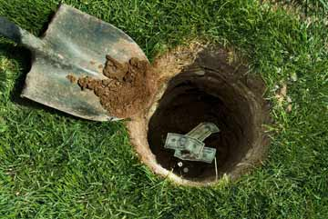
3) Matt. 25 - talents
the person with one talent
did no evil; but s/he did not learn to do well
the people with the talents learned to do well

Slide 94
4) Matt. 25 – sheep & goats
Did not learn to do well
Learned to do well
⁴¹ Then shall he say also unto them on the left hand, Depart from me, ye cursed, into everlasting fire, prepared for the devil and his angels:
⁴² For I was an hungred, and ye gave me no meat: I was thirsty, and ye gave me no drink:
⁴³ I was a stranger, and ye took me not in: naked, and ye clothed me not: sick, and in prison, and ye visited me not.
⁴⁴ Then shall they also answer him, saying, Lord, when saw we thee an hungred, or athirst, or a stranger, or naked, or sick, or in prison, and did not minister unto thee?
⁴⁵ Then shall he answer them, saying, Verily I say unto you, Inasmuch as ye did it not to one of the least of these, ye did it not to me.
³⁷ Then shall the righteous answer him, saying, Lord, when saw we thee an hungred, and fed thee? or thirsty, and gave thee drink?
³⁸ When saw we thee a stranger, and took thee in? or naked, and clothed thee?
³⁹ Or when saw we thee sick, or in prison, and came unto thee?
⁴⁰ And the King shall answer and say unto them, Verily I say unto you, Inasmuch as ye have done it unto one of the least of these my brethren, ye have done it unto me.

Slide 95
5) Paul’s epistles (e.g., Colossians)
Is the emphasis in the Bible on negative behaviour? Or positive behaviour?

Slide 96
Spiritual DNA Example #8
Psalm 17:15
I shall be satisfied, when I awake, with thy likeness

Slide 97
God’s likeness
Spirit nature (John 4:24)
1 Cor. 15
flesh and blood cannot inherit the kingdom of God
corruptible must put on incorruption
mortal must put on immortality

Slide 98
Spiritual DNA Example #9
Isaiah 25:8
Death shall be swallowed up in victory

Slide 99
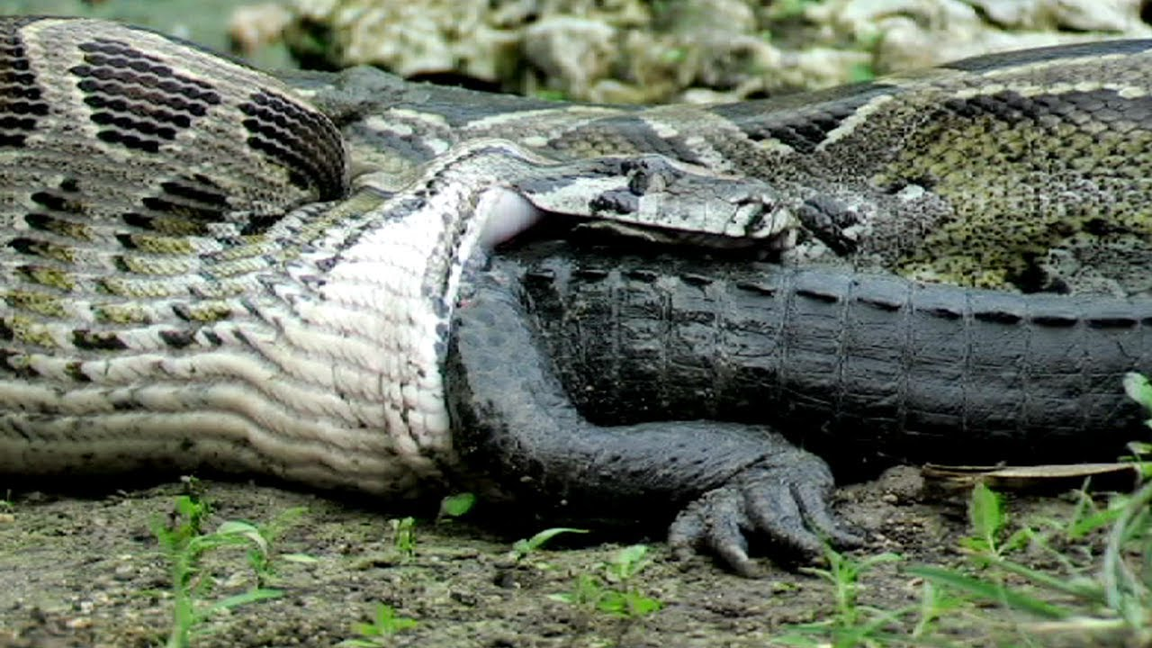
Swallowed up

Slide 100
1 Corinthians 15
⁵⁰ Now this I say, brethren, that flesh and blood cannot inherit the kingdom of God; neither doth corruption inherit incorruption.
⁵¹ Behold, I shew you a mystery; We shall not all sleep, but we shall all be changed,
⁵² In a moment, in the twinkling of an eye, at the last trump: for the trumpet shall sound, and the dead shall be raised incorruptible, and we shall be changed.
⁵³ For this corruptible must put on incorruption, and this mortal must put on immortality.
⁵⁴ So when this corruptible shall have put on incorruption, and this mortal shall have put on immortality, then shall be brought to pass the saying that is written, Death is swallowed up in victory.

Slide 101
Swallowed up
Numbers 16:32 – And the earth opened her mouth, and swallowed them up…
Numbers 26:10 – And the earth opened her mouth, an swallowed them up together with Korah…
Deut. 11:6 - … how the earth opened her mouth, and swallowed them up
Psalm 106:17 – the earth opened and swallowed up Dathan, and covered the company of Abiram.

Slide 102
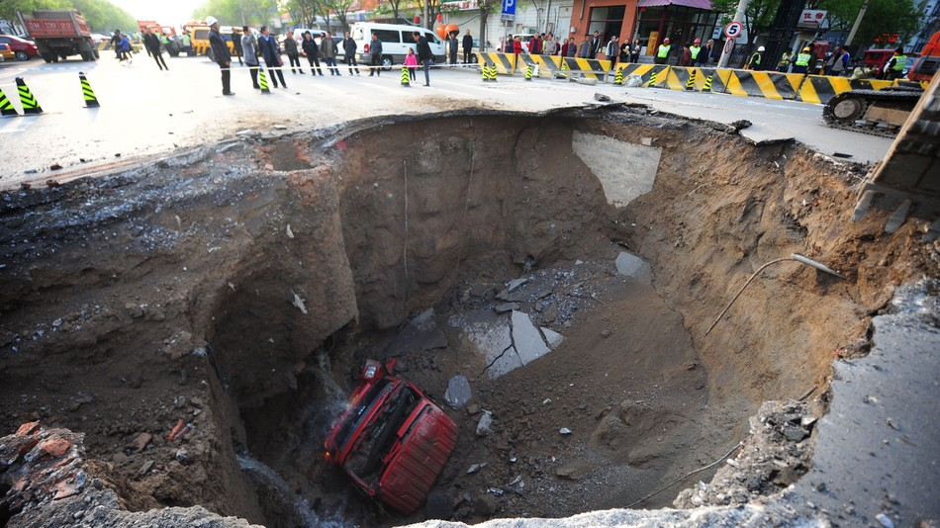

Slide 103
Death, life & swallowing
When people die, they return to the dust in the ground (Psalm 104:29; Eccl. 12:7)
the earth swallows them
At the resurrection, the earth will “cast out the dead” (Isaiah 26:19)
The earth opens its mouth
Notes:
Psalm 104:29 – they die, and return to their dust
Ecclesiastes 12:7 – then shall the dust return to the earth

Slide 104
Death, life & swallowing
Death is swallowed up in victory
The power of the grave (Psalm 49:15; Hosea 13:14) to contain someone is gone forever
That which swallows up is swallowed up
Notes:
Psalm 104:29 – they die, and return to their dust
Ecclesiastes 12:7 – then shall the dust return to the earth

Slide 105
Spiritual DNA Example #10
John 11:25
I am the resurrection and the life

Slide 106
I am the resurrection and the life
Jesus said this prior to his resurrection
Demonstrates faith in his own resurrection
Perhaps based on Psalm 16:10-11; Psalm 31:5

Slide 107
Hendiadys
A figure of speech
means ‘one by means of two’
Sometimes called ‘two for one’
The use of two words linked by a conjunction to express a single, more complex idea
Used commonly in Hebrew and Greek
Notes:
Eg. ‘nice and warm’

Slide 108
Hendiadys
From Bullinger:

Slide 109
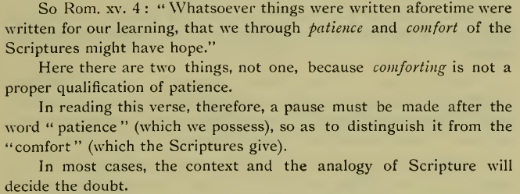

Slide 110
Must be determined from the context
Genesis 19:24
Then the LORD rained upon Sodom and upon Gomorrah brimstone and fire from the LORD out of heaven
Hendiadys – burning sulfur

Slide 111
John 11:25 - hendiadys
I am the resurrection and the life (zoe)
‘eternal life’ qualifies resurrection
I am the resurrected eternal life
Notes:
v. 26 – eternal life is taught there too – whosoever liveth and believeth in me shall never die.

Slide 112
John 11:25 - hendiadys
zoe (eternal life)
bios (life of the physical body)
psuche (mind or emotion or will)
Wouldn’t make sense for Jesus to say, I am the resurrected bios / psuche
Jesus was given eternal life after his resurrection
Lazarus, who was resurrected shortly after, was given a resurrection to bios
Did Martha understand Jesus’ statement? (see v.26)

Slide 113
I am the resurrection and the life
Jesus was indicating what he would be after his death, and what those who live and believe in him would be after their death: a resurrected, immortal body
Jesus’ statement dovetails very well with Romans 6:4-5

Slide 114
Spiritual DNA Example #11
1 Corinthians 6:12
All things are possible, but not all things are profitable

Slide 115
Context
⁹ Or do you not know that the unrighteous will not inherit the kingdom of God? Do not be deceived: neither the sexually immoral, nor idolaters, nor adulterers, nor men who practice homosexuality,
¹⁰ Nor thieves, nor the greedy, nor drunkards, nor revilers, nor swindlers will inherit the kingdom of God.
¹¹ And such were some of you. But you were washed, you were sanctified, you were justified in the name of the Lord Jesus Christ and by the Spirit of our God.
¹² “All things are lawful for me,” but not all things are helpful. “All things are lawful for me,” but I will not be dominated by anything.

Slide 116
What if a behaviour is not mentioned in 1 Corinthians 6:9-10?
_______
_______
_______
_______
_______

Slide 117
All things are possible, but not all things are profitable (1 Cor. 6:12)
_______
_______
_______
_______
_______
What? Know ye not that your body is the temple of the Holy Spirit which is in you, which ye have of God, and ye are not your own? For ye are bought with a price: therefore glory God in your body, and in your spirit (mind), which are God’s. (1 Cor. 6:19-21)

Slide 118
All things are possible, but not all things are profitable (because they do not glory God with our body and with our mind)

Slide 119
Spiritual DNA Example #12
Proverbs 22:1 / Ecclesiastes 7:1
A good name

Slide 122
A good name
Better than
great riches (Prov. 22:1)
precious ointment (Eccl. 7:1)
Why?

Slide 123
“A good name” (reputation)
Who in the Bible had a reputation?
how does someone get a reputation?
why is having a (good) reputation important?

Slide 126
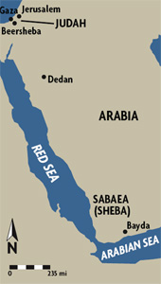
Solomon
I Kings 10:1 – And when the queen of Sheba heard of the fame of Solomon concerning the name of the LORD, she came to prove him with hard questions.
v. 7 – fame was about his wisdom and prosperity
Notes:
1,400 mile journey one-way
Must have been something powerfully compelling about his reputation – if he had been a very poor, very foolish man, she would not have travelled to see him.
Solomon’s good reputation attracted people. They wanted to be around him.

Slide 127
Mordecai
Esther 9
³ All the officials of the provinces and the satraps and the governors and the royal agents also helped the Jews, for the fear of Mordecai had fallen on them.
⁴ For Mordecai was great in the king's house, and his fame spread throughout all the provinces, for the man Mordecai grew more and more powerful.
raised Esther as his daughter
blew the whistle on an assassination attempt; later honoured
would not reverence Haman
prompted Esther to act courageously
received the king’s ring; dictated the decree to counteract Haman’s decree
Notes:
His respect & fame grew over time
consistency

Slide 128
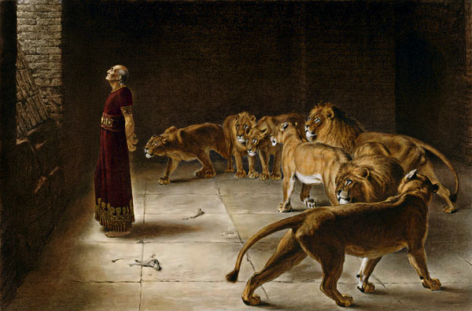
Daniel
Daniel 6
³ Then this Daniel became distinguished above all the other high officials and satraps, because an excellent spirit was in him. And the king planned to set him over the whole kingdom.
⁴ Then the high officials and the satraps sought to find a ground for complaint against Daniel with regard to the kingdom, but they could find no ground for complaint or any fault, because he was faithful, and no error or fault was found in him.
Notes:
Sterling reputation
His reputation was further enhanced by his refusal to make a petition to any God other than Neb

Slide 129
David
I Sam. 18:7
Acts 13:22
And the women answered one another as they played, and said, Saul hath slain his thousands, and David his ten thousands.
A man after mine own heart
Notes:
This context is when David returned from the slaughter of Goliath. It was his first major conquest – no past history.

Slide 130
Jesus
Miracles
Wisdom
Matt 4:24 – And his fame went throughout all Syria: and they brought unto him all sick people…
Matt 9:26 – And the fame hereof went abroad into all that land.
Matt 9:31 – But they, when they departed, spread abroad his fame in all that country.
Matt 14:1 – Herod the tetrarch heard of the fame of Jesus
Matt 22:46 – And no man was able to answer him a word, neither durst any man from that day forth ask him any more questions.

Slide 131
Stephen, Philip, Prochorus, Nicanor, Timon, Parmenas & Nicolas
Acts 6:3
Wherefore, brethren, look ye out among you seven men of honest report (good repute – ESV), full of the Holy Spirit and wisdom, whom we may appoint over this business.
martureo - to be a witness
Notes:
Good reputation – trustworthy; knew that the issue would be taken care of properly
A witness of a holy lifestyle

Slide 132
Elders
1 Timothy 3
² Therefore an overseer must be above reproach … ⁷ Moreover, he must be well thought of by outsiders, so that he may not fall into disgrace, into a snare of the devil.
Notes:
Bishop … AB member

Slide 133
Widows
1 Timothy 5:9-10 (Phillips)
Widows for your church list should be at least sixty years of age, should have had only one husband and have a well-founded reputation for having lived a good life. Some such questions as these should be asked:—has she brought up her children well, has she been hospitable to strangers, has she been willing to serve fellow-Christians in menial ways, has she relieved those in distress, has she, in a word, conscientiously done all the good she can?

Slide 134
Dorcas
Acts 9:36
This woman was full of good works and almsdeeds which she did (KJV)
She was full of good works and acts of charity (ESV)
Notes:
Her good works and acts of charity would have garnered her a good reputation

Slide 135
Timothy
Acts 16
¹ Paul came also to Derbe and to Lystra. A disciple was there, named Timothy, the son of a Jewish woman who was a believer, but his father was a Greek.
² He was well spoken of by the brothers at Lystra and Iconium.
Notes:
Good reputation – from many people

Slide 136
Demetrius
III John
Demetrius hath good report of all men, and of the truth itself: yea, and we also bear record; and ye know that our record is true.

Slide 137
Israel – in the past
Joshua 2:9-10 – And she said unto the men, I know that the Lord hath given you the land, and that your terror is fallen upon us, and that all the inhabitants of the land faint because of you.
For we have heard how the Lord dried up the water of the Red sea for you, when ye came out of Egypt; and what ye did unto the two kings of the Amorites, that were on the other side Jordan, Sihon and Og, whom ye utterly destroyed.
Notes:
Also the Gibeonites

Slide 138
Israel – in the future
Zech 8:23 - Thus saith the Lord of hosts; In those days it shall come to pass, that ten men shall take hold out of all languages of the nations, even shall take hold of the skirt of him that is a Jew, saying, We will go with you: for we have heard that God is with you.

Slide 139
Nabal
1 Sam 25:3 … but the man was churlish and evil in his doings
David asked for leftovers for him and his men, since it was a feast day (and Nabal was very rich)
Nabal: ¹⁰“Who is David? Who is the son of Jesse? There are many servants these days who are breaking away from their masters. ¹¹ Shall I take my bread and my water and my meat that I have killed for my shearers and give it to men who come from I do not know where?

Slide 140
Moses
Exodus 2:14
¹⁴ Then he said, “Who made you a prince and a judge over us? Do you intend to kill me as you killed the Egyptian?”
So Moses feared and said, “Surely this thing is known!”
Notes:
A one-time action can create a reputation

Slide 141
Slander
malicious and/or lying words that can destroy a good reputation
thou shalt not bear false witness (Exodus 20:16)
whoever spreads slander is a fool (Prov. 10:18)

Slide 142
“A good name” (reputation)
Who in the Bible had a reputation?
how does someone get a reputation?
Consistent pattern of behaviour
why is having a (good) reputation important?
we are ambassadors for Christ (II Cor. 5:20)
God esteems someone’s character much more than their wealth
more satisfying relationships
Notes:
A godly character can be preserved forever; wealth is lost at death
What about having a bad reputation – people lose trust or will not trust you.

Slide 143
Can a reputation be reversed?
good→bad or bad→good?
good→bad
Rehoboam
forsook the wise counsel of the elders
bad→good?
Saul / Paul
pre- and post-conversion

Slide 144
Do you know what your reputation is?
probably not
why not find out something that can be improved?
Notes:
How can you grow as a disciple of Christ? Is your ecclesia helping you to grow?
This might be a good activity for an ecclesia to do.

Slide 146
Spiritual DNA
Stand in awe and sin not
Abounding in thanksgiving
Go and sin no more
For out of the abundance of the heart the mouth speaketh
Thou shalt love thy neighbour as thyself
In thee shall all nations be blessed
Cease to do evil; learn to do well
I shall be satisfied, when I awake, with thy likeness
Death shall be swallowed up in victory
I am the resurrection and the life
All things are possible, but not all things are profitable
A good name

Slide 147
Summary
The Bible is inspired by God
Many important concepts are condensed in just a few simple words
Look for more examples of these when you read the Bible

Slide 148
The greatest commandment
Mark 12:30
And thou shalt love the Lord thy God with all thy heart, and with all thy soul, and with all thy min, and with all thy strength: this is the first commandment.

