Slide 1
Jeremiah – the Prophet and Man of God
Kentucky Christadelphian Bible School
June 25 - July 1, 2016

Slide 2
Old Testament Prophetic Books
Isaiah Jonah
Jeremiah Micah
Ezekiel Nahum
Daniel Habakkuk
Hosea Zephaniah
Joel Haggai
Amos Zechariah
Obadiah Malachi

Slide 3
Jeremiah’s Background
Time of Birth - ~650 BC
Dark Days of reign of Mannasseh
Place of Birth – Anathoth
2.5 miles NE of Jerusalem
A town of the Levites
Father – Hilkiah
Was he the high priest at the time?
Abiathar was also from Anathoth

Slide 4
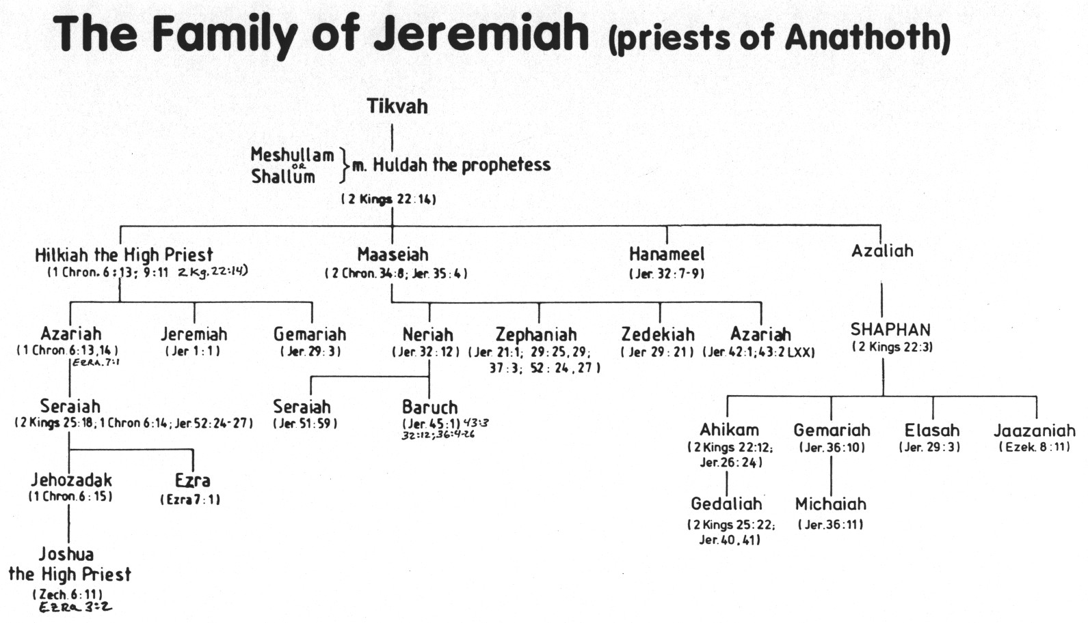
Jeremiah’s Family Tree

Slide 5
The Beginning of His Ministry
Before I formed thee in the belly I knew thee…and I ordained thee a prophet unto the nations. [Jer. 1:5]
His name in Hebrew – “appointed of Yahweh”; literally – “Yah establishes”
Ah, Lord GOD! Behold, I cannot speak: for I am a child. [Jer. 1:6]
Word translated “child” is the Hebrew naar, translated elsewhere as “lad” or “young man”.
Josiah was 21 years old when Jeremiah began to prophesy
It is therefore reasonable to assume that he was of a similar age to Josiah when he began his prophetic ministry.

Slide 6
His Commission - I ordained thee a prophet unto the nations. [Jer. 1:5]
Be not afraid of (or dismayed at) their faces for I am with thee to deliver thee. [Jer. 1:8]
Like unto Moses - Who am I, that I should go unto Pharaoh, and that I should bring forth the children of Israel out of Egypt? [Ex. 3:11]
Like unto Paul - My grace is sufficient for thee: for my strength is made perfect in weakness. [2 Cor. 12:9]
The Principle of Divine Election

Slide 7
His Commission (cont’d)
Thou therefore gird up thy loins, and arise, and speak unto them all that I command thee: be not dismayed at their faces, lest I confound thee before them. [Jer. 1:17]
For, behold, I have made thee this day a defenced city, and an iron pillar, and brasen walls against the whole land, against the kings of Judah, against the princes thereof, against the priests thereof, and against the people of the land. [Jer. 1:18]
Jeremiah was one of those “holy men of God” who “spake as they were moved by the Holy Spirit”. [2 Pet. 1:21]

Slide 8
Summary Points from His Call and Commission
There was a master plan for Jeremiah before the prophet was conceived in his mother’ womb. [Yahweh’s foreknowledge and the process of election]
Jeremiah’s call to his prophetic office was effectual as he responded fully. [Yahweh’s sovereignty and the prophet’s obedience]
God gave Jeremiah all he needed to fulfill his ministry. [inspiration and providential care]
Then the Lord put forth his hand, and touched my mouth. And the Lord said unto me, Behold, I have put my words in thy mouth.

Slide 9
Doing ‘Hard Things’ in Their Youth
Joseph, Moses and Miriam
Joshua, Samuel, David and Daniel
King Josiah, Queen Esther and
Mary and Our Lord and Master, himself
Timothy
Let no man despise thy youth; but be thou an example of the believers, in word, in conversation, in charity, in spirit, in faith, in purity.

Slide 10


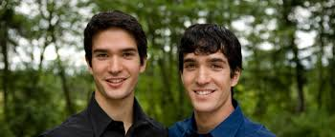

Slide 11
Three Questions re: Jeremiah and his relationship to Josiah
Did Josiah and Jeremiah just happen to be contemporaries or was there something more to their relationship that would have tied these two men closer together even going back to their childhood?
Was Hilkiah, the father of Jeremiah, the same man as the Hilkiah that was high priest at this time [2 Chron. 34:9]?
Why did Josiah turn to God in his youth and become one of the most righteous kings, despite having such a wicked father?

Slide 12
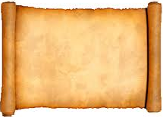
Josiah’s Reformation… Only Skin Deep!
Jeremiah 3:10-11
10 "And yet for all this her treacherous sister Judah has not turned to Me with her whole heart, but in pretense," says the LORD.
11 Then the LORD said to me, "Backsliding Israel has shown herself more righteous than treacherous Judah.
Repentance in Pretense only!

Slide 13
Jeremiah’s Preaching Mission
An uphill battle all the way
Coming judgment was the predominant theme
Sincere repentance could delay the inevitable
Started during Josiah’s reformation movement
To whom the word of the Lord came in the days of Josiah the son of Amon king of Judah, in the thirteenth year of his reign. Jer. 1:2
Laments over the reaction to his message and the fate of his fellows in Judah
Oh that my head were waters, and mine eyes a fountain of tears, that I might weep day and night for the slain of the daughter of my people!. Jer. 9:1

Slide 14
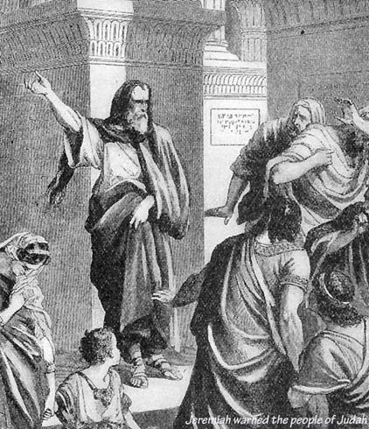
Preaching in the Temple courtyard

Slide 15
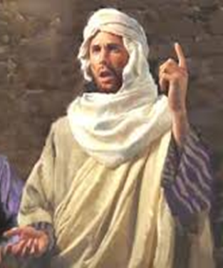
His Preaching in Jerusalem
Jeremiah chapter 7, verses 1-7:
¹The word that came to Jeremiah from the Lord, saying,
² Stand in the gate of the Lord's house, and proclaim there this word, and say, Hear the word of the Lord, all ye of Judah, that enter in at these gates to worship the Lord.
³ Thus saith the Lord of hosts, the God of Israel, Amend your ways and your doings, and I will cause you to dwell in this place.
⁴ Trust ye not in lying words, saying, The temple of the Lord, The temple of the Lord, The temple of the Lord, are these.
⁵ For if ye throughly amend your ways and your doings; if ye throughly execute judgment between a man and his neighbour;
⁶ If ye oppress not the stranger, the fatherless, and the widow, and shed not innocent blood in this place, neither walk after other gods to your hurt:
⁷ Then will I cause you to dwell in this place, in the land that I gave to your fathers, for ever and ever.

Slide 16
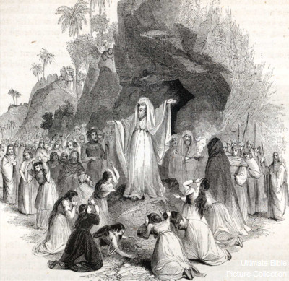
Lamenting over King Josiah’s death

Slide 17
The Length of Jeremiah’s Ministry - see chapter 1:2-3
King
Josiah
Jehoahaz
Jehoiakim
Jehoiachin
Zedekiah
TOTAL
Duration BC
18 years (31-13) 640-610
3 months 609
11 years 609-598
3 months 598
11 years 597-586
40 years & 6 months

Slide 18
The Faithful Remnant
And I will gather the remnant of my flock out of all countries whither I have driven them, and will bring them again to their folds; and they shall be fruitful and increase.
And I will set up shepherds over them which shall feed them: and they shall fear no more, nor be dismayed, neither shall they be lacking, saith the Lord. [Jer. 23:3-4]
For thus saith the Lord; Sing with gladness for Jacob, and shout among the chief of the nations: publish ye, praise ye, and say, O Lord, save thy people, the remnant of Israel.
Behold, I will bring them from the north country, and gather them from the coasts of the earth, and with them the blind and the lame, the woman with child and her that travaileth with child together: a great company shall return thither. [Jer. 31:7-8]

Slide 19
Jeremiah – the Prophet and Man of God
His Friends and Enemies

Slide 20
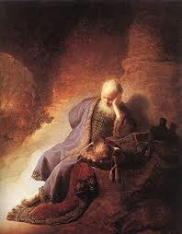
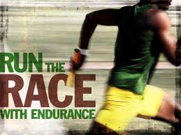
Jeremiah’s Personal Life (Chapter 16)
v.2 No wife or kids: not worth having a family now
v.5 No grieving at funerals: God won’t grieve when the nation goes captive
v.8 No feasts: too many terrible events coming on the nation
He lived God’s message!

Slide 21
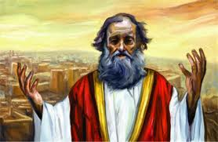

Jeremiah’s Message
Northern army is coming! Change before the judgment begins! Then it will be too late!
Jeremiah began this message during Josiah’s reformation years!
Once the Babylonians arrived in 4th year of Jehoiakim, Jeremiah was vindicated & his message changed to: “surrender & go to Babylon”
His message still applies to us today! Now is the time! When Jesus returns it will be too late!

Slide 22
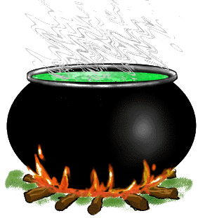
Jeremiah had no credibility - Chapter 1:13-17
13 And the word of the LORD came to me the second time, saying, "What do you see?" And I said, said "I see a boiling pot, and it is facing away from the north.“ [KJV error: “toward the north”]
14 Then the LORD said to me: "Out of the north calamity shall break forth on all the inhabitants of the land.
15 For behold, I am calling all the families of the kingdoms of the north," says the LORD; "They shall come and each one set his throne at the entrance of the gates of Jerusalem, against all its walls all around, and against all the cities of Judah.
16 I will utter My judgments against them concerning all their wickedness, because they have forsaken Me, burned incense to other gods, and worshiped the works of their own hands.
Egypt was the power of the day! The people couldn’t see how a northern power would capture them.

Slide 23
Losing the will to keep going - Jeremiah Chapter 20
O Lord, thou hast deceived me, and I was deceived; thou art stronger than I, and hast prevailed: I am in derision daily, every one mocketh me. For since I spake, I cried out, I cried violence and spoil; because the word of the Lord was made a reproach unto me, and a derision, daily. (vv. 7-8)
Jeremiah did not want to deliver his message any longer (20:9)
Became so discouraged he wished he was not born (20:14-18)

Slide 24
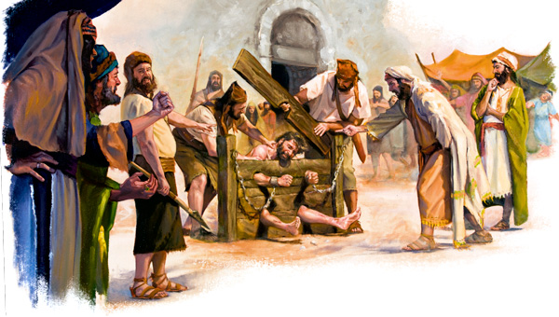
Jeremiah 19:14-15; 20:1-2

Slide 25
The Persecutions of Jeremiah
At the hand of:
His hometown ‘friends’ in Anathoth who plotted to kill him (11:18-23),
The priests and prophets (26:8-9),
The princes and civil leaders (36:19, 26; 38:4),
And even his family (12:6)

Slide 26
The Family Tree of Jeremiah
Many of Jeremiah’s contemporary family members rejected his prophecies

Slide 27
Sufferings of Jeremiah and Jesus
Jeremiah
Jesus
Hated by the religious world 26:7-8
Plotted against by citizens of their own 11:21 hometowns
Castigated by his own brethren 12:6
Denounced by synagogue leaders 20:1-2
Wept over the city of Jerusalem 9:1
Falsely accused and beaten 37:12-15
Jn. 11:47-53
Lk. 4:28-30
Jn. 7:3-5
Jn. 18:13,24
Lk. 19:41
Matt. 26:61; Matt. 27:26

Slide 28
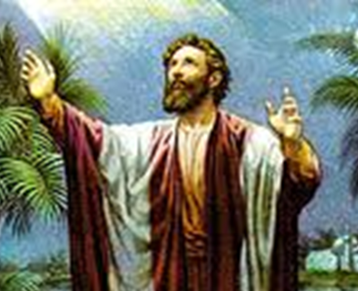
Motivation to Keep Going
For I reckon that the sufferings of this present time are not worthy to be compared with the glory which shall be revealed in us.” Rom. 8:18
Then I said, I will not make mention of him, nor speak any more in his name. But his word was in mine heart as a burning fire shut up in my bones, and I was weary with forbearing, and I could not stay. Jer. 20:9

Slide 29
Reactions to Jeremiah’s Message
Typical of human nature
Self-preservation through retaliation;
Blind vindictiveness and;
Humiliation of their opponent
Matthew 10:17-20
A prophet is not without honor, save in his own country and in his own house [Matt. 13:57].

Slide 30
Beware of your “friends”; do not trust your brothers
Beware of your friends; do not trust your brothers…You live in the midst of deception…; because in their deceit they refuse to acknowledge Me, declares the LORD [Jer. 9:4-6, NIV].
Then said they, Come and let us devise devices against Jeremiah; for the law shall not perish from the priest, nor counsel from the wise, nor the word from the prophet. Come, and let us smite him with the tongue, and let us not give heed to any of his words. [Jer. 18:18]

Slide 31
The Process of Ruining Someone’s Reputation
Mud-slinging For I heard the defaming of many, fear on every side [20:10]
Whispering phase and peer-group pressure
Your brothers, your own family – even they have betrayed you; they have raised a loud cry against you. [12:6 NIV]
More serious threats - verbal and even physical abuse [18:18]
4. Most extreme situations incarceration or even extermination [32:1-5; 11:21]

Slide 32
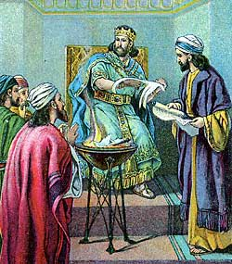
Josiah and His Prodigal Son
Neither before nor after Josiah was there a king like him who turned to the LORD as he did – with all his heart…soul and… strength. 2 Kg. 23:25 NIV
…did what was right and just and defended the cause of the poor and needy Jer. 22:15,16, NIV
Jehoiakim – a Prodigal Son [Jer. 22:13-19]
Rebelled against powerful King Nebuchadnezzar
Cut up and burnt Jeremiah’s scroll
Tried to have the prophet and his scribe imprisoned

Slide 33
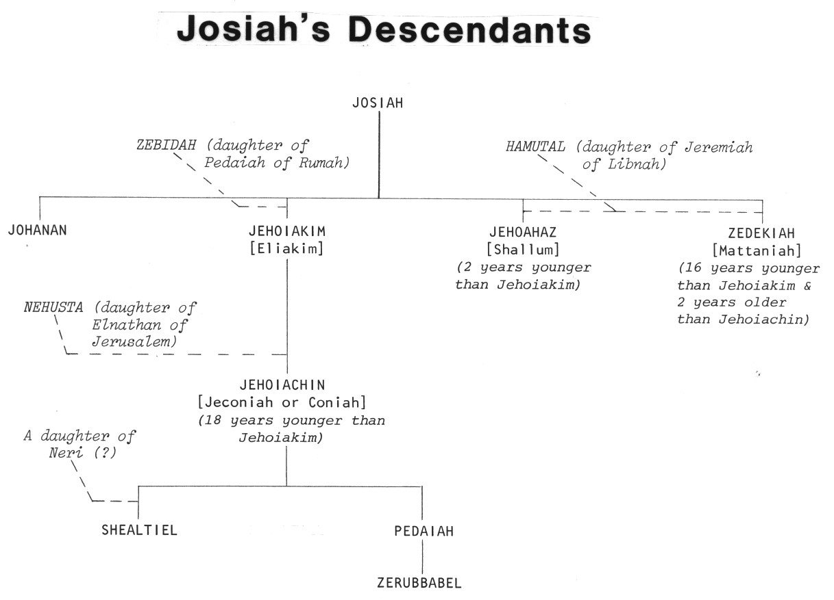
King Josiah’s Descendants
Josiah
Good King Josiah had no children who were like him!

Slide 34
Zedekiah
His request to the prophet: Pray now unto the LORD our God for us. [Jer. 37:3]
Answer received: Deceive not yourselves…the Chaldeans shall fight against this city, and take it and burn it with fire. [Jer. 37:8-9]
Zedekiah asks the prophet: Is there any word from Yahweh?
The answer comes again: Thou shalt be delivered into the hand of the king of Babylon [Jer. 37:17]

Slide 35
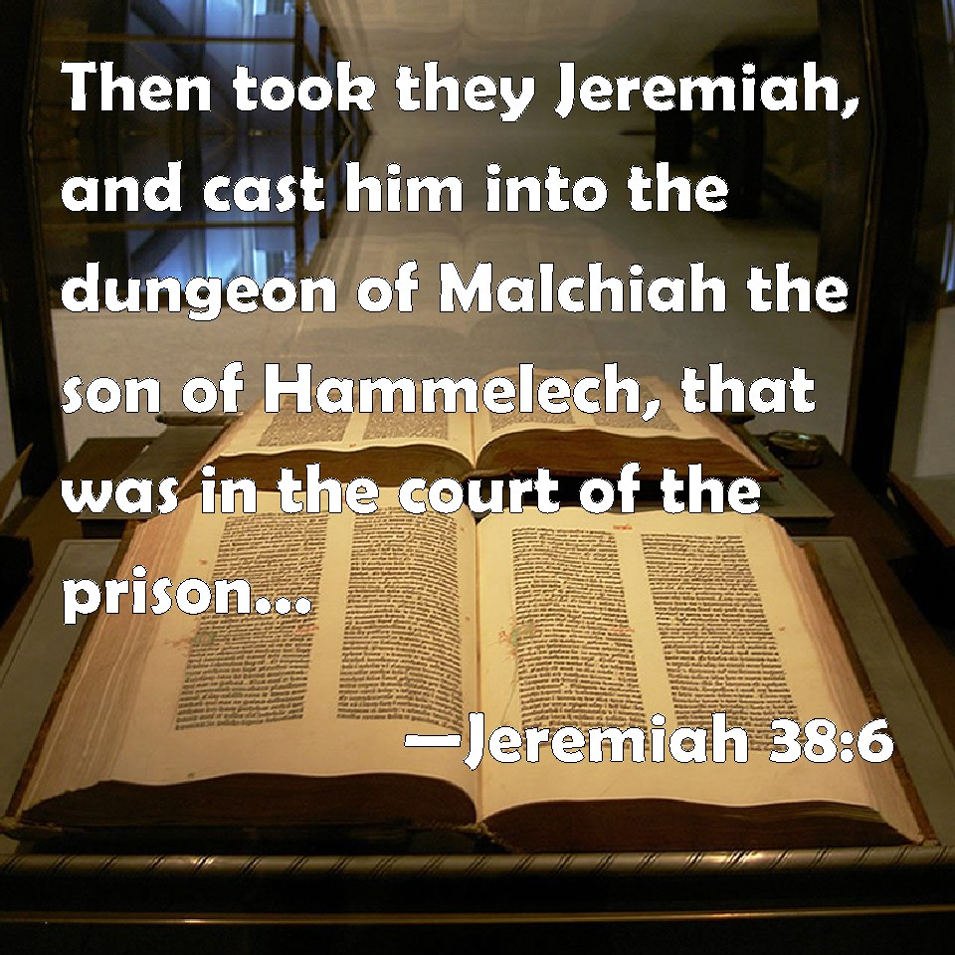
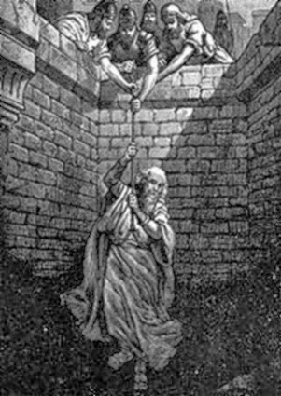

Slide 36
Zedekiah – tossed about by every wind of…
On the one hand, he would…
And then…
Seek a private audience with Jeremiah
Be incarcerating the prophet
He would bow to one pressure group
And, finally he would make an oath to Nebuchadnezzar before Yahweh
Refuse to humble himself to the words of God he heard from the prophet
Release and feed him
Relent to someone’s personal plea
Turn around and break it in rebellion.
A “profane wicked prince” [Ezek. 21:25]

Slide 37

Choosing Friends
Close friendships are invaluable when they are based on the sound principles of the Truth – as with Jeremiah and Josiah. Such friendships can last a lifetime and help us remain steadfast in the Faith.
We must be very careful who we select to be our friends, especially in the world.
Young people must listen carefully to their parents and receive their advice and counsel with all humility in the Lord when it comes to whom they select for friends and with whom they associate with in general.

Slide 38
Providential friends
A small and close group of real friends rather than a large company of shallow, sociable acquaintances
Sympathy for those who were in similar situations
How well do we support the lonely, the fatherless and the widows in our community?
Pure religion and undefiled before God and the Father is this, To visit the fatherless and widows in their affliction, and to keep himself unspotted from the world. [James 1:27]

Slide 39
Jeremiah – the Prophet and Man of God
His Few Valued Friends

Slide 40
Jeremiah’s Family Tree

Slide 41
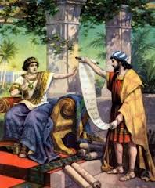
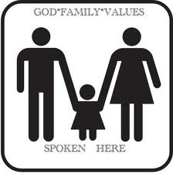
Shaphan’s Family Values
But as for me and my house, we will serve the LORD. Josh. 24:15

Slide 42
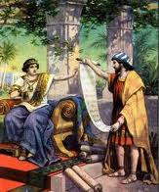
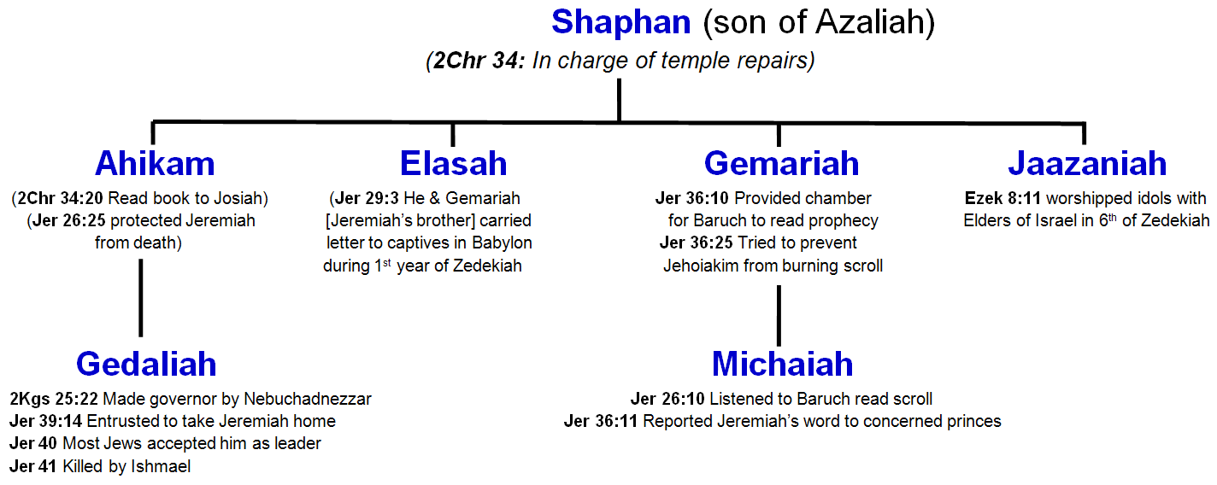
Shaphan’s Sons & Grandsons
1
2
4
3
5
6
3
Chronilogical Sequence
Shaphan – Josiah’s day Ahikam – Josiah & Jehoiakim
Gemariah & Michaiah – 5th yr of Jehoiakim
Elasah – 1st yr of Zedekiah Jaazaniah – 6th yr of Zedekiah
Gedaliah – 11th yr of Zedekiah

Slide 43
Shaphan’s Family
1
2
4
3
5
6
3
Shaphan raised Godly children & grandchildren during a tough spiritual time

Slide 44
2 Chronicles 34:8-13
8 Now in the eighteenth year of his (Josiah’s) reign, when he had purged the land and the temple, he sent Shaphan the son of Azaliah, Maaseiah the governor of the city, and Joah the son of Joahaz the recorder, to repair the house of the LORD his God.
9 When they came to Hilkiah the high priest, they delivered the money that was brought into the house of God,…
10 Then they put it (the money) in the hand of the foremen who had the oversight of the house of the LORD; and they gave it to the workmen who worked in the house of the LORD, to repair and restore the house.
11 They gave it to the craftsmen and builders to buy hewn stone and timber for beams, and to floor the houses which the kings of Judah had destroyed.
12 And the men did the work faithfully…Others of the Levites, all of whom were skillful with instruments of music,
13 were over the burden bearers and were overseers of all who did work in any kind of service. And some of the Levites were scribes, officers, and gatekeepers.
Worked with responsible people

Slide 45
2 Chronicles 34:15-21
15 Then Hilkiah answered and said to Shaphan the scribe, "I have found the Book of the Law in the house of the LORD." And Hilkiah gave the book to Shaphan.
16 So Shaphan carried the book to the king, bringing the king word, saying, "All that was committed to your servants they are doing.
17 "And they have gathered the money that was found in the house of the LORD, and have delivered it into the hand of the overseers and the workmen."
18 Then Shaphan the scribe told the king, saying, "Hilkiah the priest has given me a book." And Shaphan read it before the king.
19 Thus it happened, when the king heard the words of the Law, that he tore his clothes.
20 Then the king commanded Hilkiah, Ahikam the son of Shaphan, Abdon the son of Micah, Shaphan the scribe, and Asaiah a servant of the king, saying,
21 "Go, inquire of the LORD for me, and for those who are left in Israel and Judah, concerning the words of the book that is found; for great is the wrath of the LORD that is poured out on us, because our fathers have not kept the word of the LORD, to do according to all that is written in this book.”
Josiah trusted Shaphan

Slide 46
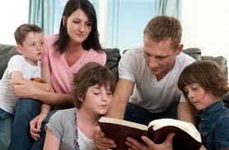
Shaphan’s Mutual Respect
Shaphan was a Godly man who was trusted by the King
He developed trust with the temple workers
He highly respected the Word of God
He had Godly children
Now let’s look at the impact he had on his sons!

Slide 47
Shaphan’s Family
1
2
4
3
5
6
3

Slide 48
2 Chronicles 34:18-22
18 Then Shaphan the scribe told the king, saying, "Hilkiah the priest has given me a book." And Shaphan read it before the king.
19 Thus it happened, when the king heard the words of the Law, that he tore his clothes.
20 Then the king commanded Hilkiah, Ahikam the son of Shaphan, Abdon the son of Micah, Shaphan the scribe, and Asaiah a servant of the king, saying,
21 "Go, inquire of the LORD for me, and for those who are left in Israel and Judah, concerning the words of the book that is found; for great is the wrath of the LORD that is poured out on us, because our fathers have not kept the word of the LORD, to do according to all that is written in this book."
22 So Hilkiah and those the king had appointed went to Huldah the prophetess, the wife of Shallum the son of Tokhath, the son of Hasrah, keeper of the wardrobe. (She dwelt in Jerusalem in the Second Quarter.) And they spoke to her to that effect.
Josiah entrusted Ahikam to inquire of God for him!

Slide 49
Jeremiah 26
20 Now there was also a man who prophesied in the name of the LORD, Urijah the son of Shemaiah of Kirjath Jearim, who prophesied against this city and against this land according to all the words of Jeremiah.
21 And when Jehoiakim the king, with all his mighty men and all the princes, heard his words, the king sought to put him to death; but when Urijah heard it, he was afraid and fled, and went to Egypt.
22 Then Jehoiakim the king sent men to Egypt: Elnathan the son of Achbor, and other men who went with him to Egypt.
23 And they brought Urijah from Egypt and brought him to Jehoiakim the king, who killed him with the sword and cast his dead body into the graves of the common people.
24 Nevertheless the hand of Ahikam the son of Shaphan was with Jeremiah, so that they should not give him into the hand of the people to put him to death.
Ahikam saved Jeremiah’s life!
He must have had a lot of influence!

Slide 50
Shaphan’s Family
1
2
4
3
5
6
3

Slide 51
Jeremiah 36:10-13, 25
10 Then Baruch read from the book the words of Jeremiah in the house of the LORD, in the chamber of Gemariah the son of Shaphan the scribe, in the upper court at the entry of the New Gate of the LORD'S house, in the hearing of all the people.
11 When Michaiah the son of Gemariah, the son of Shaphan, heard all the words of the LORD from the book,
12 he then went down to the king's house, into the scribe's chamber; and there all the princes were sitting-- Elishama the scribe, Delaiah the son of Shemaiah, Elnathan the son of Achbor, Gemariah the son of Shaphan, Zedekiah the son of Hananiah, and all the princes.
13 Then Michaiah declared to them all the words that he had heard when Baruch read the book in the hearing of the people.
25 Nevertheless Elnathan, Delaiah, and Gemariah implored the king not to burn the scroll; but he would not listen to them.
3 Generations of faithful service!

Slide 52
Shaphan’s Family
1
2
4
3
5
6
3
Jeremiah Chapter 29:1-3

Slide 53
Jeremiah 29
1 Now these are the words of the letter that Jeremiah the prophet sent from Jerusalem to the remainder of the elders who were carried away captive-- to the priests, the prophets, and all the people whom Nebuchadnezzar had carried away captive from Jerusalem to Babylon.
2 (This happened after Jeconiah the king, the queen mother, the eunuchs, the princes of Judah and Jerusalem, the craftsmen, and the smiths had departed from Jerusalem.)
3 The letter was sent by the hand of Elasah the son of Shaphan, and Gemariah (Jeremiah’s brother!) the son of Hilkiah, whom Zedekiah king of Judah sent to Babylon, to Nebuchadnezzar king of Babylon, saying,
4 Thus says the LORD of hosts, the God of Israel, to all who were carried away captive, whom I have caused to be carried away from Jerusalem to Babylon:
5 Build houses and dwell in them; plant gardens and eat their fruit.
An important letter entrusted with the son of Shaphan!

Slide 54
Shaphan’s Family
1
2
4
3
5
6
3

Slide 55
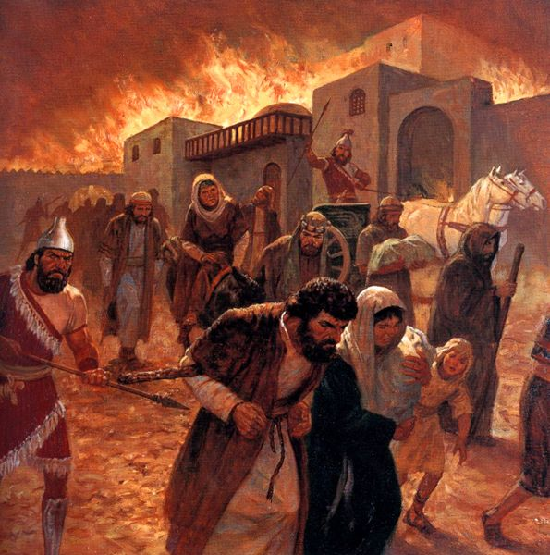

Slide 56
Shaphan’s Family
1
2
4
3
5
6
3

Slide 57
Jeremiah 39:13-14
13 So Nebuzaradan the captain of the guard sent Nebushasban, Rabsaris, Nergal-Sharezer, Rabmag, and all the king of Babylon's chief officers;
14 then they sent someone to take Jeremiah from the court of the prison, and committed him to Gedaliah the son of Ahikam, the son of Shaphan, that he should take him home. So he dwelt among the people.
Jeremiah was entrusted to the care of Gedaliah upon his release.

Slide 58
Jeremiah 40
5 Now while Jeremiah had not yet gone back, Nebuzaradan said, "Go back to Gedaliah the son of Ahikam, the son of Shaphan, whom the king of Babylon has made governor over the cities of Judah, and dwell with him among the people. Or go wherever it seems convenient for you to go." So the captain of the guard gave him rations and a gift and let him go.
6 Then Jeremiah went to Gedaliah the son of Ahikam, to Mizpah, and dwelt with him among the people who were left in the land.
7 And when all the captains of the armies who were in the fields, they and their men, heard that the king of Babylon had made Gedaliah the son of Ahikam governor in the land, and had committed to him men, women, children, and the poorest of the land who had not been carried away captive to Babylon,
Jeremiah dwelt with Gedaliah and all the people left in Judah were committed to him as a faithful leader.

Slide 59
Jeremiah 41
1 Now it came to pass in the seventh month that Ishmael the son of Nethaniah, the son of Elishama, of the royal family and of the officers of the king, came with ten men to Gedaliah the son of Ahikam, at Mizpah. And there they ate bread together in Mizpah.
2 Then Ishmael the son of Nethaniah, and the ten men who were with him, arose and struck Gedaliah the son of Ahikam, the son of Shaphan, with the sword, and killed him whom the king of Babylon had made governor over the land.
3 Ishmael also struck down all the Jews who were with him, that is, with Gedaliah at Mizpah, and the Chaldeans who were found there, the men of war.
Gedaliah suffers an untimely death!

Slide 60
Lessons from the Family of Shaphan
Faithful family – father, sons, grandsons
Equal or greater role of mothers in nurturing these faithful children
Discipleship - an even greater joy to behold the same motivation in your children.
I rejoiced greatly that I found of thy children walking in truth, as we have received a commandment from the Father. 2 John 4

Slide 61
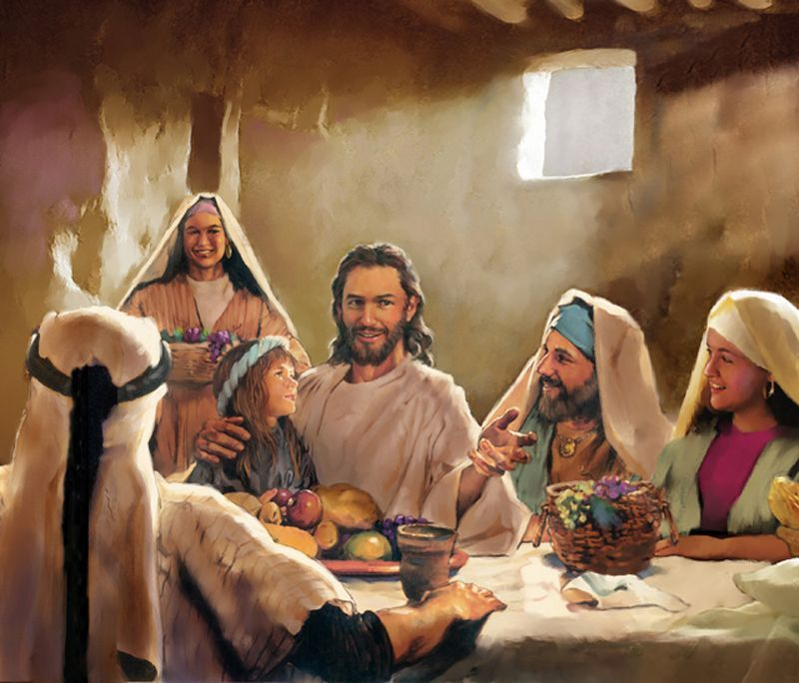

Families – Building Blocks of the Nation & Ecclesia
Turn, O backsliding children, saith the Lord; for I am married unto you: and I will take you one of a city, and two of a family, and I will bring you to Zion. Jeremiah 3:14

Slide 62
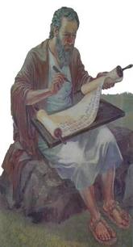
Baruch – scribe & friend of Jeremiah
Son of Neriah,
Grandson of Maaseiah
- see Jer. 32:12

Slide 63
The Family of Jeremiah
Baruch, the scribe, recorded many of Jeremiah’s prophecies.

Slide 64
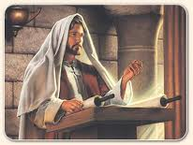
Baruch records and reads the scroll (Jeremiah 36)
v. 4 Baruch writes all the words of the
Lord spoken unto Jeremiah upon a scroll
v. 6 Jeremiah instructs Baruch to read the scroll in the LORD’s
house on a fast day
v.10 Baruch does as he was instructed, reading the scroll in the
temple “in the ears of all the people”
v.11 Micaiah (grandson of Shaphan) hears the words & knows
concerned princes will want to know the message
v. 15-16 Baruch reads to the princes and they respond with fear!
v.19 They tell Baruch that he and Jeremiah should hide themselves

Slide 65
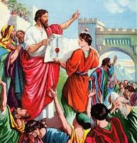
Baruch, the scribe
Faithfully helped Jeremiah get God’s word out!
But then the unimaginable happens
The King of Judah burns the scroll after hearing Jeremiah’s prophecies (Jer. 36:23)

Slide 66
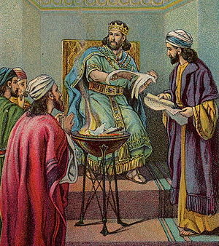
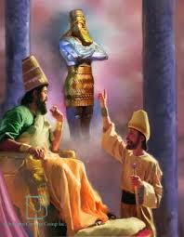
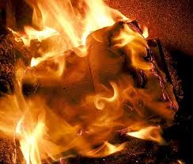
The unbelievable irony!
A gentile king was responding to God’s word in Babylon!
While the king of Judah was burning the Bible in Jerusalem
This would have been devastating to Jeremiah

Slide 67
Jeremiah 45
1 The word that Jeremiah the prophet spoke to Baruch the son of Neriah, when he had written these words in a book at the instruction of Jeremiah, in the fourth year of Jehoiakim the son of Josiah, king of Judah, saying,
2 "Thus says the LORD, the God of Israel, to you, O Baruch:
3 'You said, "Woe is me now! For the LORD has added grief to my sorrow. I fainted in my sighing, and I find no rest."'
4 "Thus you shall say to him, 'Thus says the LORD: "Behold, what I have built I will break down, and what I have planted I will pluck up, that is, this whole land.
5 "And do you seek great things for yourself? Do not seek them; for behold, I will bring adversity on all flesh," says the LORD. "But I will give your life to you as a prize in all places, wherever you go."‘”
Yahweh gives Baruch encouragement after he is brought low by words the scribe had recorded and recited.

Slide 68
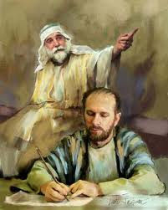

It’s all God’s gifts to us!
Jeremiah’s dictation is all about the complete destruction of Jerusalem.
Baruch realizes he will loose his lands, possessions, government position
God has to remind Baruch that God owns it all: He built & He planted (45:4)

Slide 69
Jeremiah 36:26-32
26 And the king commanded Jerahmeel the king's son, Seraiah the son of Azriel, and Shelemiah the son of Abdeel, to seize Baruch the scribe and Jeremiah the prophet, but the LORD hid them.
27 Now after the king had burned the scroll with the words which Baruch had written at the instruction of Jeremiah, the word of the LORD came to Jeremiah, saying:
28 "Take yet another scroll, and write on it all the former words that were in the first scroll which Jehoiakim the king of Judah has burned.
32 Then Jeremiah took another scroll and gave it to Baruch the scribe, the son of Neriah, who wrote on it at the instruction of Jeremiah all the words of the book which Jehoiakim king of Judah had burned in the fire. And besides, there were added to them many similar words.

Slide 70
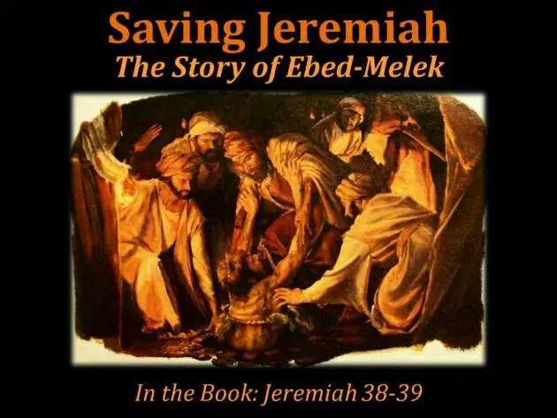

Slide 71
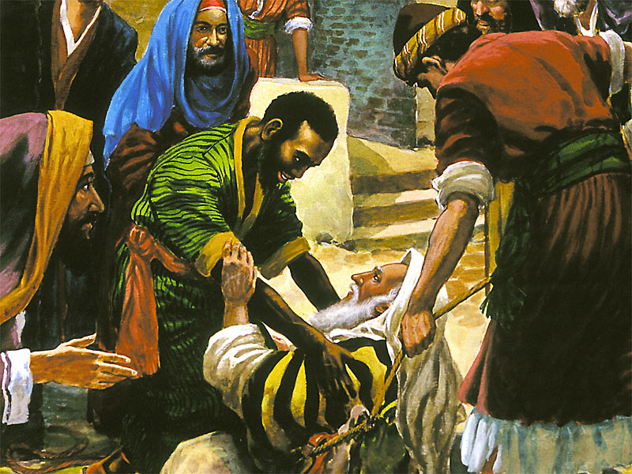

Slide 72
Jeremiah 39:15-18
15 Now the word of the Lord came unto Jeremiah, while he was shut up in the court of the prison, saying,
16 Go and speak to Ebedmelech the Ethiopian, saying, Thus saith the Lord of hosts, the God of Israel; Behold, I will bring my words upon this city for evil, and not for good; and they shall be accomplished in that day before thee.
17 But I will deliver thee in that day, saith the Lord: and thou shalt not be given into the hand of the men of whom thou art afraid.
18 For I will surely deliver thee, and thou shalt not fall by the sword,..: because thou hast put thy trust in me, saith the Lord.

Slide 73
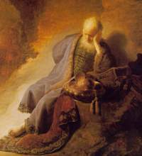
The Lonely Prophet –
who had a few friends to lean on

Slide 74
Jeremiah – the Prophet and Man of God
Signs, Symbols & Allegories

Slide 75
Jeremiah’s Signs, Symbols and Allegories
Break up your fallow ground – chap. 4, verse 3
Circumcision of the heart – chap. 4, verse 4
The Old Paths – chap. 6, verse 16
Shiloh – chap. 7, verses 12-15
The Stork in the Heaven – chap. 8, verse 7
Bows and Arrows – chap. 9, verses 3-9
The Swelling of Jordan – chap. 12, verse 6
The Unwashed Girdle and Wineskins - chapter 13
The Potter and the Clay – chapter 18, chap. 19:1
The Good and Bad Figs – chapter 24
Yokes and Bonds – chapters 27 & 28
The Rechabites – chapter 35

Slide 76
Find any that seeketh the Truth?
Run ye to and fro through the streets of Jerusalem, and see now, and know, and seek in the broad places thereof, if ye can find a man, if there be any that executeth judgment, that seeketh the truth; and I will pardon it.
² And though they say, The Lord liveth; surely they swear falsely.
³ O Lord, are not thine eyes upon the truth? thou hast stricken them, but they have not grieved; thou hast consumed them, but they have refused to receive correction: they have made their faces harder than a rock; they have refused to return.
⁴ Therefore I said, Surely these are poor; they are foolish: for they know not the way of the Lord, nor the judgment of their God. Jeremiah 5:1-4

Slide 77
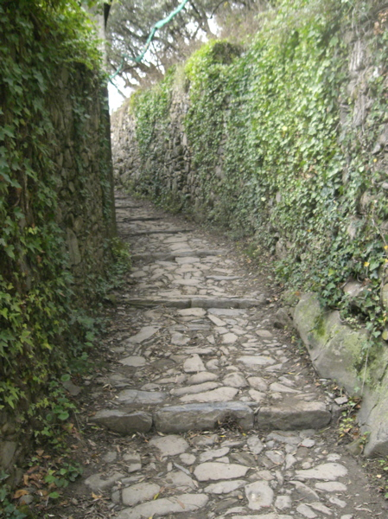
The Old Paths
Thus saith the Lord, Stand ye in the ways, and see, and ask for the old paths, where is the good way, and walk therein, and ye shall find rest for your souls. But they said, We will not walk therein. Jeremiah 6:16

Slide 78
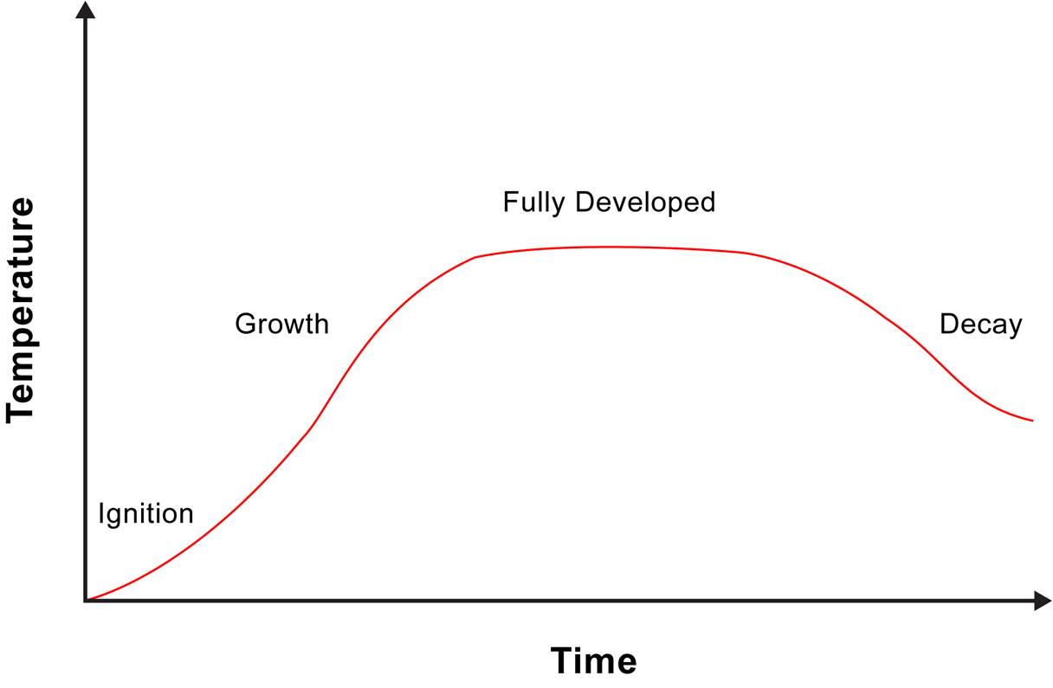
Stages in the history of organizations - analogous to chemical, thermal (fire) and biological reactions

Slide 79
Stage 1 – Building-up & Growth

Slide 80
Stage 2 – Consolidation & Stabilization

Slide 81
Stage 3 – Decline

Slide 82
Flee from Babylon and bring Jerusalem to mind
Flee out of the midst of Babylon, and deliver every man his soul: be not cut off in her iniquity; for this is the time of the Lord's vengeance; he will render unto her a recompence…
Ye that have escaped the sword, go away, stand not still: remember the Lord afar off, and let Jerusalem come into your mind. [Jer. 51:6,50]

Slide 83

The Old Paths =
Enter ye in at the strait gate: for wide is the gate, and broad is the way, that leadeth to destruction, and many there be which go in thereat:
Because strait is the gate, and narrow is the way, which leadeth unto life, and few there be that find it. Matt. 7:13-14
And unto this people thou shalt say, Thus saith the Lord; Behold, I set before you the way of life, and the way of death. Jer. 21:8

Slide 84
The Potter and the Clay - Jeremiah 18
Arise, and go down to the potter's house, and there I will cause thee to hear my words. v. 2
Then I went down to the potter's house, and, behold, he wrought a work on the wheels. v. 3
O house of Israel, cannot I do with you as this potter? saith the Lord. Behold, as the clay is in the potter's hand, so are ye in mine hand, O house of Israel. v. 6

Slide 85
The Potter and the Nation - Jeremiah 18:7-10
⁷ At what instant I shall speak concerning a nation, and concerning a kingdom, to pluck up, and to pull down, and to destroy it;
⁸ If that nation, against whom I have pronounced, turn from their evil, I will repent of the evil that I thought to do unto them.
⁹ And at what instant I shall speak concerning a nation, and concerning a kingdom, to build and to plant it;
¹⁰ If it do evil in my sight, that it obey not my voice, then I will repent of the good, wherewith I said I would benefit them.

Slide 86
Jeremiah 19
Thus saith the Lord, Go and get a potter's earthen bottle, and take of the ancients of the people, and of the ancients of the priests;
² And go forth unto the valley of the son of Hinnom…;
⁶ Therefore, behold, the days come, saith the Lord, that this place shall no more be called Tophet, nor The valley of the son of Hinnom, but The valley of slaughter.
¹⁰ Then shalt thou break the bottle in the sight of the men that go with thee,
¹¹ And shalt say unto them, Thus saith the Lord of hosts; Even so will I break this people and this city, as one breaketh a potter's vessel, that cannot be made whole again: and they shall bury them in Tophet, till there be no place to bury.

Slide 89
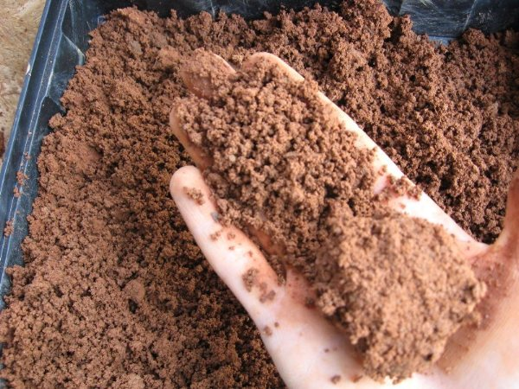
Step 1: The Potter collects his material

Slide 90
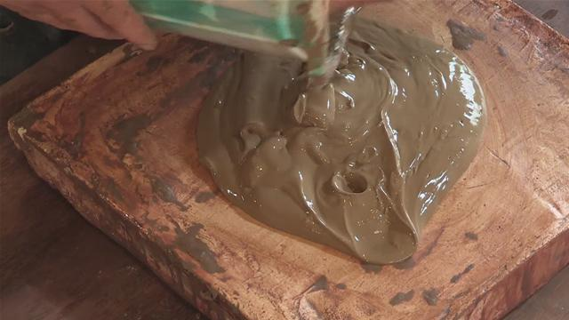
Step 2: Softening of the Clay

Slide 91

Step 3: Applying the Clay Mixture to the Potter’s Wheel

Slide 92
Step 4: Working the Clay on the Wheels

Slide 93
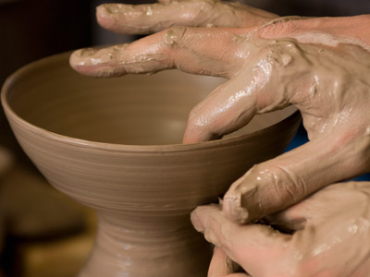
Step 5: Shaping the Clay

Slide 94
Step 6: Reshaping into the Final Form

Slide 95
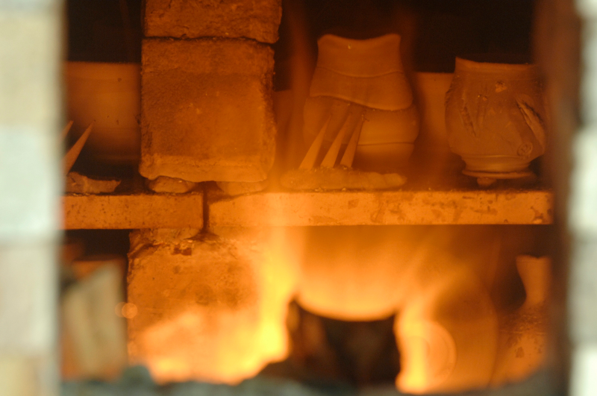
Step 7: The Firing of the Clay Vessels 1 Pet 4:12-13

Slide 96
The Divine Potter
But now, O Lord, thou art our father; we are the clay, and thou our potter; and we all are the work of thy hand. Isaiah 64:8
Nay but, O man, who art thou that repliest against God? Shall the thing formed say to him that formed it, Why hast thou made me thus?
Hath not the potter power over the clay, of the same lump to make one vessel unto honour, and another unto dishonour?
What if God, willing to shew his wrath, and to make his power known, endured with much longsuffering the vessels of wrath fitted to destruction. Romans 9:20-22

Slide 97
Step 8: Sealing and Curing into the Vessel’s Final Beauty

Slide 98
Jeremiah – the Prophet and Man of God
The Rechabites – Chapter 35

Slide 99
Jeremiah 35:1-2
1 The word which came to Jeremiah from the LORD in the days of Jehoiakim the son of Josiah, king of Judah, saying,
2 "Go to the house of the Rechabites, speak to them, and bring them into the house of the LORD, into one of the chambers, and give them wine to drink."
The test of Rechab’s family

Slide 100
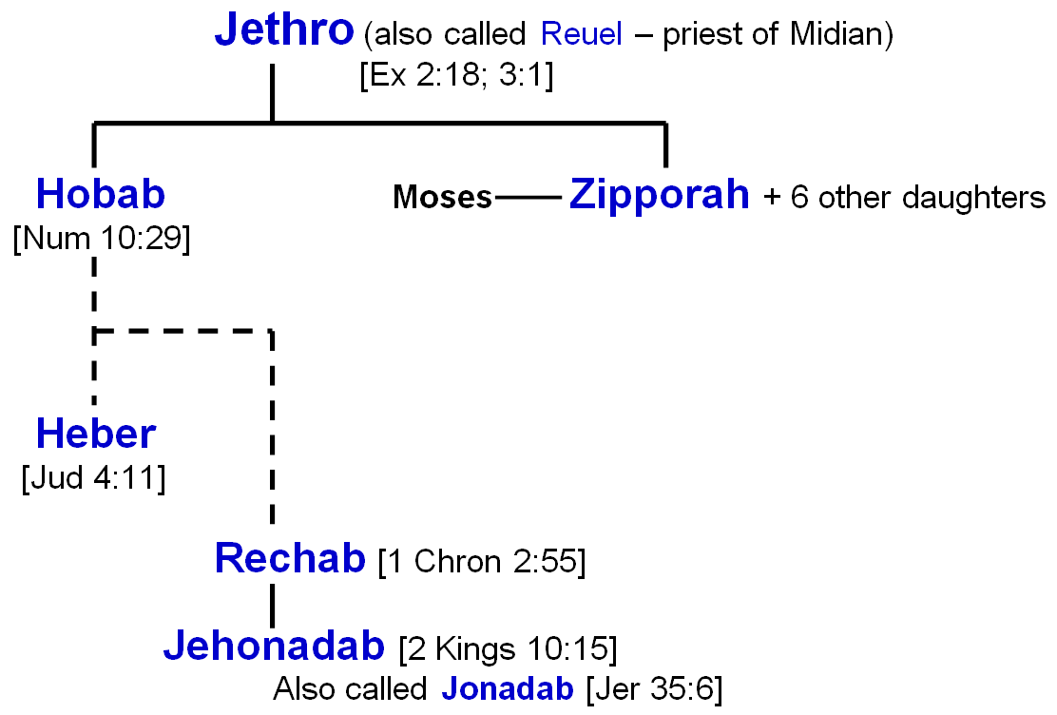
The Family of the Rechabites
S
G

Slide 101
Jethro’s Wise Counsel to Moses
Exodus 18:17-24
Delegate your responsibilities
Let them judge the smaller matters

Slide 102
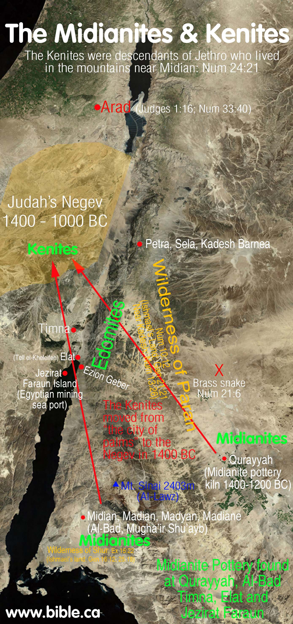
Judges 1:16
And the children of the Kenite, Moses’ father-in-law, went up out of the city of palm trees with the children of Judah into the wilderness of Judah, which lieth in the south of Arad; and they went and dwelt among the people.

Slide 103
Baalam’s Parable (Numbers 24:21-22)
And he looked on the Kenites, and took up his parable, and said, Strong is thy dwelling-place, and thou puttest thy nest in a (the) rock.

Slide 104
The Family of the Rechabites
S
G

Slide 105
Heber, the Kenite – Judges Chapter 4
v. 11 – Heber separates himself from rest of the people – moves north to plain of Zaaniam near Laish, a city of Dan.
Lived in a tent, typical of Kenites as strangers and sojourners.
v. 17 – Howbeit Sisera fled away on his feet to the tent of Jael the wife of Heber the Kenite: for there was peace between Jabin the king of Hazor and the house of Heber the Kenite.

Slide 106
The Kenites & The Amalekites
And Saul came to a city of Amalek, and laid wait in the valley. And Saul said unto the Kenites, Go, depart, get you down from among the Amalekites, lest I destroy you with them: for ye shewed kindness to all the children of Israel, when they came up out of Egypt. So the Kenites departed from among the Amalekites.
1 Samuel 15:5-6
Cities of Kenites – among those to whom spoils of Amalekites were delivered by David. 1 Samuel 30:29

Slide 107
Jehonadab – Leader of the Kenites 2 Kings 10
And when he [Jehu] was departed thence, he lighted on Jehonadab the son of Rechab coming to meet him: and he saluted him, and said to him, Is thine heart right, as my heart is with thy heart?...If it be, give me thine hand. And he gave him his hand and he took him up to him in the chariot. v. 15

Slide 108
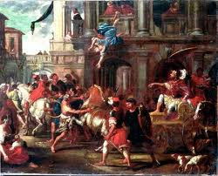
Destruction of Baal Worshippers
Contrasting Jehu & Jonadab
Jehu liked to fight for God, but not live for Him. He never internalized the war and slaughter of Baal worshippers to fight against his own evil desires.
Jonadab saw evils of Ahab & Jezebel, & downfall of Jehu. He established principles in his life to prevent him & his family from being lost!
Jonadab planned for the future of his family!

Slide 109
The Family of the Rechabites
S
G

Slide 110
The Rechabites
- A pastoral people but not backward or ignorant, for they were:
the families of the scribes… (1 Chron. 2:55)
- Scribes – learned people associated with study & teaching of God’s Word

Slide 111
Jeremiah 35 – House of the Rechabites
Written 250 years after time of Jonadab
Group of Kenites of family of Rechab taken temporary refuge from Babylonians in Jerusalem
Faithful and obedient to instructions of Jonadab and the Nazarite vow
Living a simple tent life; separate from settled inhabitants of the land.

Slide 112
Response to Jeremiah’s Test of Loyalty

Slide 113
Jeremiah 35:7-11
7 'You shall not build a house, sow seed, plant a vineyard, nor have any of these; but all your days you shall dwell in tents, that you may live many days in the land where you are sojourners.'
8 "Thus we have obeyed the voice of Jonadab the son of Rechab, our father, in all that he charged us, to drink no wine all our days, we, our wives, our sons, or our daughters,
9 "nor to build ourselves houses to dwell in; nor do we have vineyard, field, or seed.
10 "But we have dwelt in tents, and have obeyed and done according to all that Jonadab our father commanded us.
11 …So we dwell at Jerusalem.”
Rechabites faithful obedience to their father Jonadab’s commands!

Slide 114
Jeremiah 35:14-16
¹⁴ The words of Jonadab the son of Rechab, that he commanded his sons not to drink wine, are performed; for unto this day they drink none, but obey their father's commandment: notwithstanding I have spoken unto you, rising early and speaking; but ye hearkened not unto me.
¹⁵ I have sent also unto you all my servants the prophets, rising up early and sending them, saying, Return ye now every man from his evil way, and amend your doings, and go not after other gods to serve them, and ye shall dwell in the land which I have given to you and to your fathers: but ye have not inclined your ear, nor hearkened unto me.
¹⁶ Because the sons of Jonadab the son of Rechab have performed the commandment of their father, which he commanded them; but this people hath not hearkened unto me:
Rechabites obeyed; but God’s people did not hearken to their Father’s commands!

Slide 115
Jeremiah 35:17-19
¹⁷ Therefore thus saith the Lord God of hosts, the God of Israel; Behold, I will bring upon Judah and upon all the inhabitants of Jerusalem all the evil that I have pronounced against them: because I have spoken unto them, but they have not heard; and I have called unto them, but they have not answered.
¹⁸ And Jeremiah said unto the house of the Rechabites, Thus saith the Lord of hosts, the God of Israel; Because ye have obeyed the commandment of Jonadab your father, and kept all his precepts, and done according unto all that he hath commanded you:
¹⁹ Therefore thus saith the Lord of hosts, the God of Israel; Jonadab the son of Rechab shall not want a man to stand before me for ever.
Jonadab & Rechabites receive Yahweh’s blessing; but evil will be brought upon Judah!

Slide 117
Psalm 71 – parallels with Numbers 24

Slide 118
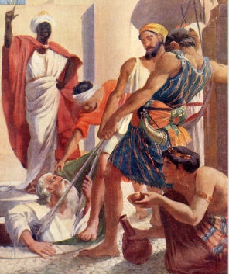
Jeremiah
The prophet and man of God
His Message: Change before it is too late & the end begins

Slide 119
Jeremiah – the Prophet and Man of God
Concluding Thoughts

