Slide 1
“Who May Abide The Day of His Coming?...”
Malachi 3:2
Class 1

Slide 2
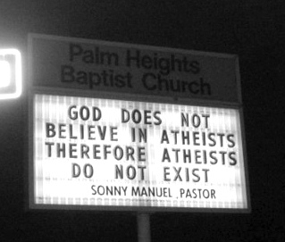

Slide 3
In what way do you view
“Day of the Lord”?
  Terrified
  Afraid
  Fearful
  Concerned
  Relieved
  Strong anticipation
  Joyful
  Excited (etc…)

Slide 4
Purpose of the Class:
Simple but lofty –
  For all who hear this class, may you focus on personal preparation for Christ’s return to the point where the result, for you, is life everlasting through the grace of Christ at his return.
The only thing that we can truly control is our own action, belief and faith. (And even this is helped by God).
There are so many factors that we cannot control. What we do want to focus on is what God has called us to focus on, ourselves!

Slide 5
2 Tim 4:7-8
I have fought a good fight, I have finished my course, I have kept the faith: Henceforth there is laid up for me a crown of righteousness, which the Lord, the righteous judge, shall give me at that day: and not to me only, but unto all them also that love his appearing.

Slide 6
How to get the most from this class:
This class is mostly designed to be one of self-examination based on the example left to us from the book of Malachi.
This class is not aimed at anyone or any controversial topic.
If this class ever seems uncomfortable, that may be the Word of God at work on your heart – please listen to it.
Don’t think: “O, it would be great for brother or sister so & so to hear that.” These words need to work on each of us individually for any hope of true benefit.

Slide 7
Guiding Principle
But the wisdom that is from above is first pure, then peaceable, gentle, and easy to be intreated, full of mercy and good fruits, without partiality, and without hypocrisy. (Jas 3:17)

Slide 8
Why should we study Malachi?
Malachi’s Day
Our Day
Written to the Jews that had returned from Babylonian captivity.
This was a witness to fulfilled prophecy of Jeremiah.
This was later confirmed to Daniel.
We have seen natural Israel return to their land in witness of fulfilled prophecy. This should be a engine of faith to each of us.

Slide 9
Fulfillment of Prophecy
Jeremiah 25:11-12
Jeremiah 29:10
And this whole land shall be a desolation, and an astonishment; and these nations shall serve the king of Babylon seventy years. And it shall come to pass, when seventy years are accomplished, that I will punish the king of Babylon, and that nation, saith the LORD, for their iniquity, and the land of the Chaldeans, and will make it perpetual desolations.
For thus saith the LORD, That after seventy years be accomplished at Babylon I will visit you, and perform my good word toward you, in causing you to return to this place.

Slide 10
Fulfillment of Prophecy
Daniel 9:2
2 Chronicles 36:21-23
In the first year of his reign I Daniel understood by books the number of the years, whereof the word of the LORD came to Jeremiah the prophet, that he would accomplish seventy years in the desolations of Jerusalem.
To fulfil the word of the LORD by the mouth of Jeremiah, until the land had enjoyed her sabbaths: for as long as she lay desolate she kept sabbath, to fulfil threescore and ten years. Now in the first year of Cyrus king of Persia, that the word of the LORD spoken by the mouth of Jeremiah might be accomplished, the LORD stirred up the spirit of Cyrus king of Persia, that he made a proclamation throughout all his kingdom, and put it also in writing, saying, Thus saith Cyrus king of Persia, All the kingdoms of the earth hath the LORD God of heaven given me; and he hath charged me to build him an house in Jerusalem, which is in Judah. Who is there among you of all his people? The LORD his God be with him, and let him go up.

Slide 11
Fulfillment of Prophecy
Ezekiel 37:12:14
Therefore prophesy and say unto them, Thus saith the Lord GOD; Behold, O my people, I will open your graves, and cause you to come up out of your graves, and bring you into the land of Israel. And ye shall know that I am the LORD, when I have opened your graves, O my people, and brought you up out of your graves, And shall put my spirit in you, and ye shall live, and I shall place you in your own land: then shall ye know that I the LORD have spoken it, and performed it, saith the LORD.

Slide 12
Why should we study Malachi?
Malachi’s Day
Our Day
Despite the fulfilled promises near to their time, they had fallen into spiritual apathy.
The Israelites had not departed into gross neglect of God’s laws such as idol worship and gross immorality. Consequently, their worship lacked heart and saving faith.
Is there an application to us? (either or both)

Slide 13
Why should we study Malachi?
Malachi’s Day
Our Day
They failed to appreciate the privileges they had been given.
  Have we not all one father? hath not one God created us? why do we deal treacherously every man against his brother, by profaning the covenant of our fathers? (Mal 2:10)
This is one example of several, as we will see.
Do we fail to appreciate the “…the exceeding, great and precious promises…” (2 Peter 1:4)?
He that saith he is in the light, and hateth his brother, is in darkness even until now. (1Jn 2:9)

Slide 14
Why should we study Malachi?
Malachi’s Day
Our Day
They were waiting for the Messiah, the promised seed.
The people and priests were ignorant to their true state in God’s eyes?
We are waiting for the second coming of the Messiah.
Can there an application to us in this regard?

Slide 15
Why should we study Malachi?
Malachi’s Day
Our Day
The great question that God poses to Israel through His messenger:
But who may abide the day of his coming? and who shall stand when he appeareth? … (Mal 3:2)
We have each pondered this question.
It is this question that we want to work toward answering scripturally this week.

Slide 16
 | To Israel | To Judah | To Foreign Nation
Assyrian Age | Amos: 763-750 B.C. Hosea: 755-715 B.C. | Joel: 835-797 B.C. Isaiah: 740-700 B.C. Micah 737-690 B.C. | Jonah:770-750 B.C. (& to Northern Kingdom)
Babylonian Age |  | Habakkuk: 630-605 B.C. Zephaniah: 640-609 B.C. Jeremiah: 627-580 B.C. Daniel: 605-530 B.C. Ezekiel: 593-570 B.C. | Nahum 663-615 B.C. (& to Judah)
Persian Age |  | Haggai: 520 B.C. Zechariah: 520-518 B.C. Malachi: 433 B.C. | Obadiah: 586-553 B.C. (& to Judah)

Slide 17
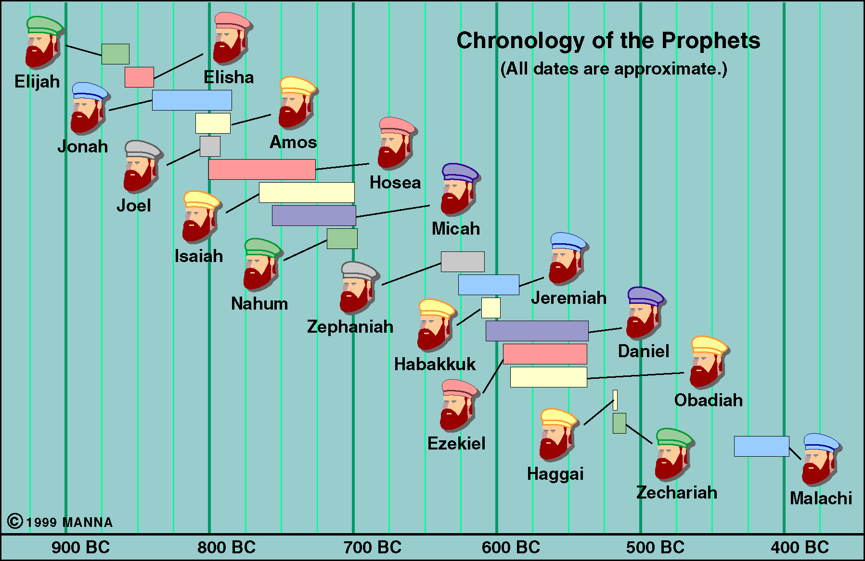

Slide 18
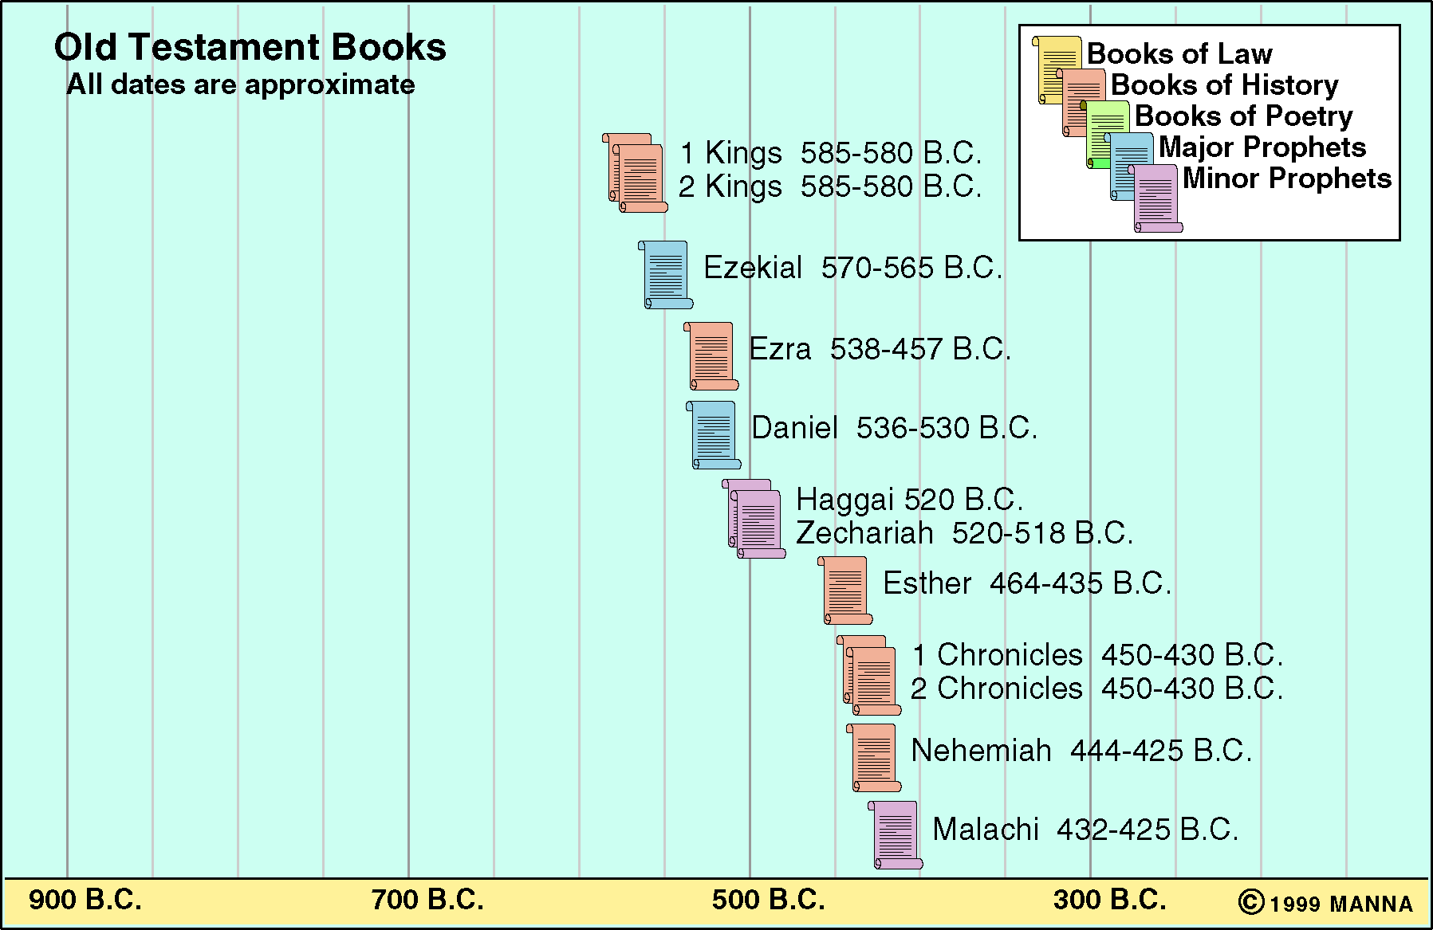

Slide 19
Comparable conditions present:
Neh 13:23
Mal 2:11
In those days also saw I Jews that had married wives of Ashdod, of Ammon, and of Moab:
Judah hath dealt treacherously, and an abomination is committed in Israel and in Jerusalem; for Judah hath profaned the holiness of the LORD which he loved, and hath married the daughter of a strange god.
Condemnation given to marriage of gentile wives.

Slide 20
Comparable conditions present:
Neh 13:4-5, 8
Mal 1:12-13
And before this, Eliashib the priest, having the oversight of the chamber of the house of our God, was allied unto Tobiah: And he had prepared for him a great chamber, where aforetime they laid the meat offerings, the frankincense, and the vessels, and the tithes of the corn, the new wine, and the oil, which was commanded to be given to the Levites, and the singers, and the porters; and the offerings of the priests…And it grieved me sore: therefore I cast forth all the household stuff of Tobiah out of the chamber.
But ye have profaned it, in that ye say, The table of the LORD is polluted; and the fruit thereof, even his meat, is contemptible. Ye said also, Behold, what a weariness is it! and ye have snuffed at it, saith the LORD of hosts; and ye brought that which was torn, and the lame, and the sick; thus ye brought an offering: should I accept this of your hand? saith the LORD.
2. Profaning the offerings of God.

Slide 21
Comparable conditions present:
Neh 13:10
Mal 3:8
And I perceived that the portions of the Levites had not been given them: for the Levites and the singers, that did the work, were fled every one to his field.
Will a man rob God? Yet ye have robbed me. But ye say, Wherein have we robbed thee? In tithes and offerings.
3. Failure to tithe.

Slide 22
Comparable conditions present:
Neh 13:23 & 26-27
Mal 2:15-16
In those days also saw I Jews that had married wives of Ashdod, of Ammon, and of Moab:
Did not Solomon king of Israel sin by these things? yet among many nations was there no king like him, who was beloved of his God, and God made him king over all Israel: nevertheless even him did outlandish women cause to sin.
Shall we then hearken unto you to do all this great evil, to transgress against our God in marrying strange wives?
And did not he make one? Yet had he the residue of the spirit. And wherefore one? That he might seek a godly seed. Therefore take heed to your spirit, and let none deal treacherously against the wife of his youth. For the LORD, the God of Israel, saith that he hateth putting away: for one covereth violence with his garment, saith the LORD of hosts: therefore take heed to your spirit, that ye deal not treacherously.
4. Jewish men casting away their lawful wives.

Slide 23
Comparable conditions present:
Neh 1:11
Mal 3:16
O Lord, I beseech thee, let now thine ear be attentive to the prayer of thy servant, and to the prayer of thy servants, who desire to fear thy name: and prosper, I pray thee, thy servant this day, and grant him mercy in the sight of this man. For I was the king's cupbearer.
Then they that feared the LORD spake often one to another: and the LORD hearkened, and heard it, and a book of remembrance was written before him for them that feared the LORD, and that thought upon his name.
5. Need to fear Yahweh’s name.

Slide 24
5 similar situations in Nehemiah’s day
Condemnation given to marriage of gentile wives.
Profaning the offerings of God.
Failure to tithe.
Jewish men casting away their lawful wives.
Need to fear Yahweh’s name.

Slide 25
John Ulman writes:
“In Malachi’s day the exile and restoration appears to have become almost forgotten. There was little evidence of zeal and dedication…The people of the restoration had become worldly, and grown careless in spiritual matters… When Malachi challenged the poor spiritual standards of the people, they had become so lacking in spiritual perception that they strongly defended their apostate attitudes and practices.”

Slide 26
What were the main problems these people faced, according to God?
Ignorance (lack of recognition) – 1:6
Indifference – 1:13
Self-seeking – 3:8
4. Failure to see God’s perspective – “ye say” 8x.

Slide 27
8 Questions of Malachi
Mal 1:2
Mal 1:6
Mal 1:7
Mal 2:14
Mal 2:17
Mal 3: 7
Mal 3:8
Mal 3:13-14
Where is your love for Yahweh?
Why do you despise Yahweh’s name?
Why do you offer polluted bread?
Why do fail to uphold covenant of marriage?
Why do you weary Yahweh with your actions?
Why do you question the appeal to return?
Why do you rob God of His rightful demands?
Why do you speak against Yahweh’s character and purpose?

Slide 28
Outline of the Book of Malachi
God’s Love and Covenant with Israel (1:1-5)
Israel’s Unfaithfulness Rebuked (1:6-2:16)
  The Unfaithfulness of the Priests (1:6-2:9)
  The Unfaithfulness of the People (2:10-16)
The Lord is Coming (2:17-4:6)
  His coming Will bring Purification & Judgment (2:17-3:5)
  Repentance is Appropriate Preparation for Lord’s Return (3:6-18)
  The Day of the Lord is Certain to Come (Ch 4)

Slide 29
Outline of the Book of Malachi
The Denunciation of Israel’s Sins (1:1-2:16)
  Reminder of God’s Love for Israel (1:1-5)
  Rebuke of the Priests (1:6-2:9)
    Contempt for God’s Alter (1:6-14)
    Contempt for God’s glory (2:1-3)
    Contempt for God’s law (2:4-9)
The Declaration of Israel’s Judgment & Blessing (2:17-4:6)
  Coming of a Messenger (2:17-3:5)
  Challenge to Repent (3:6-12)
  Criticism by Israel Against the Lord (3:13-15)
  Consolation to the Faithful Remnant (3:16-4:6)

Slide 30
Themes of Malachi
  Israel’s Unfaithfulness:
    The priests had shown contempt for God’s name by:
      Offering diseased or imperfect animals (1:6-14)
      By violating the covenant (2:1-9)
    The men of Israel had shown contempt for God’s name by:
      Marring idolatrous Gentile women by breaking the marriage covenants by divorcing their Israelite wives (2:10-16)
      Failing to honor God by failing to tithe (3:8-12) and giving God their best (1:7-8). This is true in service and lifestyle.
  Judgment:
    God will judge those who practice evil (2:17-3:5; 4:1)
    God will save those who honor Him (3:16-18; 4:2-3)

Slide 31
Overview of the Book of Malachi
Worship God Correctly, return His love to Him.
Live faithfully as they waited for the fulfillment of His promises.
Substandard animals as sacrifices
Neglect of duty among priests
Intermarriage with pagans/idol-worshippers
General immorality
Failure to tithe
Widespread cynicism about the individuals duty toward God.

Slide 32
Overview of the Book of Malachi
Encouraged the people to maintain hope in the coming Kingdom of God (3:1-4)
Asked for them to turn from their sins (3:5) and return to Him (3:6-7)
There are natural blessing associated with following God’s commandments (3:10)

Slide 33
LXX (Septuagint)
The burden of the word of the Lord to Israel by the hand of his messenger. Take this to heart, I pray.
Mal 1:1

Slide 34
Why is Malachi considered a Prophet?

