Slide 1
“Who May Abide The Day of His Coming?...”
Malachi 3:2
Class 2

Slide 2
8 Questions of Malachi
Mal 1:2
Mal 1:6
Mal 1:7
Mal 2:14
Mal 2:17
Mal 3: 7
Mal 3:8
Mal 3:13-14
Where is your love for Yahweh?
Why do you despise Yahweh’s name?
Why do you offer polluted bread?
Why do fail to uphold covenant of marriage?
Why do you weary Yahweh with your actions?
Why do you question the appeal to return?
Why do you rob God of His rightful demands?
Why do you speak against Yahweh’s character and purpose?

Slide 3
Why is Malachi considered a Prophet?
Behold, I will send my messenger, and he shall prepare the way before me: and the Lord, whom ye seek, shall suddenly come to his temple, even the messenger of the covenant, whom ye delight in: behold, he shall come, saith the LORD of hosts. (Mal 3:1)

Slide 4
Fulfillment: John the Baptist
And as they departed, Jesus began to say unto the multitudes concerning John, What went ye out into the wilderness to see? A reed shaken with the wind? But what went ye out for to see? A man clothed in soft raiment? behold, they that wear soft clothing are in kings' houses. But what went ye out for to see? A prophet? yea, I say unto you, and more than a prophet. For this is he, of whom it is written, Behold, I send my messenger before thy face, which shall prepare thy way before thee. Verily I say unto you, Among them that are born of women there hath not risen a greater than John the Baptist: notwithstanding he that is least in the kingdom of heaven is greater than he. (Mat 11:7-11)

Slide 5
“Covenant of Life and Peace”
A Study of the Life of Phinehas
Mal 2:5

Slide 6



Slide 7
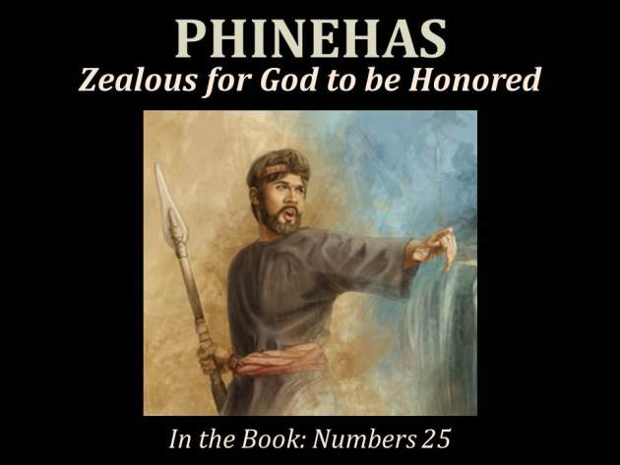

Slide 8
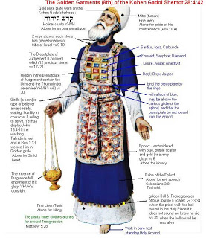

Slide 9
Purpose of this Exhortation
To learn the joy of discovery in the word of God.
To apply and encourage our hearts and minds to the zeal of God.
To learn some principles of true worship and fellowship that are eternal.
Learn from a special individual that is a fitting type of Christ in principle and practice as well as his priesthood.
Learn the wisdom of God centered decisions in times of trouble.

Slide 10
Timeline
Probably born in the land of Egypt, counted as part of the tribe of Levi.
Probably about 10 at the time of the Exodus
That would mean he was about 11-12 at the time of Nadab and Abihu.
He would have been 13 at the time of of the rebellion of Kora, Dathan and Abirum
He would have been 50 at the time of “the javelin” – Numbers 25
Controversy of the alter, he was about 60 - Joshua 22
Story of the destruction of Benjamin, he was about 90 - Judges 20.

Slide 11
Exodus 6
Why does the genealogy stop after only 3 tribes?
It is only the genealogy of Moses and Levi, “the delivers of Israel”.
Why was Phinehas’s greatgrandmother and grandmother mentioned but not his mother?
Father-in-law was Putiel – “the aflicted of God”
Eleazar “I will succor”
Why does the record skip over Nadab and Abihu? Numbers 3:1-4

Slide 12
Reuben
Hanoch
Carmi
Simeon
Levi
Pallu
Hezron
Jemuel
Jamin
Ohad
Jachin
Zohar
Shaul
Gershon
Merari
Kohath

Slide 13
Sons of Levi
Gershon
Libni
Shimi
Kohath
Merari
Amram
Izhar
Uzziel
Hebron
Mahali
Mushi

Slide 14
Sons of Kohath
Aaron
Moses
Amram
Izhar
Zichri
Korah
Nepheg
Hebron
Uzziel
???
Zithri
Mishael
Elzaphan
Notes:
Mishael and Elzaphan were the bothers that carried out the dead bodies of Nadab and Abihu, their nephews. The 1st cousins of Aaron and mentioned in Lev 10 as. Aaron’s Uncle Uzziel.

Slide 15
Nadab
Abihu
Aaron
Eleazar
Ithamar
Korah
Abiasaph
Assir
Elkanah
Phinehas
Notes:
Phinehas was the only person of his generation that was mentioned. It seems as though there is a special purpose and intention by mentioning him here.

Slide 16
Phinehas Hero of Israel
At the beginning of the wilderness wanderings there is a story of rebellion and corruption.
Ex 32 – in the first 6 months of wilderness wanderings (corrupted the principles of Divine worship, which leads to corrupted practice)
Numbers 25 – in the last 6 months of the wilderness wanderings (corrupted the principles of Divine worship, which leads to corrupted practice)

Slide 17
What was the Outstanding Characteristic of Phinehas?
Compare:
  Abraham: Faith
  David: Mercy
  Hezekiah: Trust
Phinehas – Zeal
“for zeal for your house consumes me, and the insults of those who insult you fall on me.”
Psalms 69:9 (Quoted in John 2:17)

Slide 18
The Portrait of Phinehas
Remarkable account in the book of Ex 6:13-26
An event that shaped his life – Lev 10:1-7
The most remarkable event in his life and a special blessing with “an oath”– Num 25
A remarkable conquest – Num 31:1-8 & 48-49
Application of the “Eternal Priesthood” Psa 110:4-6
His most important mediation – Joshua 22
The destruction of the tribe of Benjamin– Judges 20
His great accomplishments are sung about in – Psa. 106:27-31
His final eulogy is found – Malachi 2:5-7

Slide 19
Discernment of Phinehas in Israel
Baal-Peor and the matter of Zimri and Cozbi
The Controversy of the Alter
False worship and immorality was clearly being practiced
God specifically commanded death to offenders
Done in the sight of all, specifically Moses (no shame and prideful).
Salvation was the purpose, with fellowship restored with God
False worship was alleged
No command to kill
Acting on what they heard
Intention was to go to war
Significant accusations
Those accused appealed to God as their witness in humility
Trespass was prevented by the “soft answer”
Fellowship restored between brethren

Slide 20
Romans 10:2-3
For I can testify about them that they are zealous for God, but their zeal is not based on knowledge. Since they did not know the righteousness that comes from God and sought to establish their own, they did not submit to God's righteousness.

Slide 21
Commentary Elsewhere in Scripture
And Phinehas the son of Eleazar was the ruler over them in time past, and the LORD was with him.
1 Chronicles 9:20
And of Levi he said, Let thy Thummim and thy Urim be with thy holy one, whom thou didst prove at Massah, and with whom thou didst strive at the waters of Meribah; Who said unto his father and to his mother, I have not seen him; neither did he acknowledge his brethren, nor knew his own children: for they have observed thy word, and kept thy covenant. They shall teach Jacob thy judgments, and Israel thy law: they shall put incense before thee, and whole burnt sacrifice upon thine altar. Bless, LORD, his substance, and accept the work of his hands: smite through the loins of them that rise against him, and of them that hate him, that they rise not again.
Deuteronomy 33:8-11

Slide 22
Commentary Elsewhere in Scripture
And Eleazar the son of Aaron died; and they buried him in a hill that pertained to Phinehas his son, which was given him in mount Ephraim.
Joshua 24:33
For they gave them Shechem with her suburbs in mount Ephraim, to be a city of refuge for the slayer; and Gezer with her suburbs,
Joshua 21:21

Slide 23
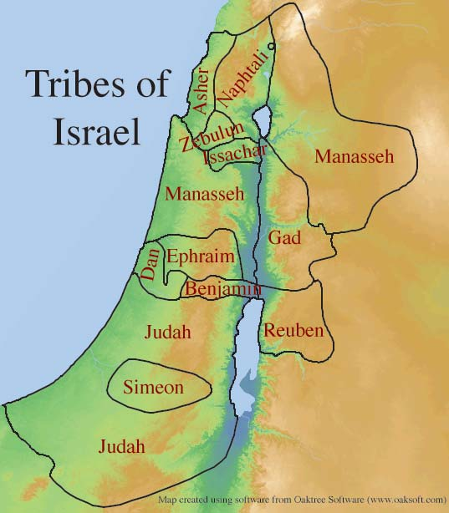

Slide 24
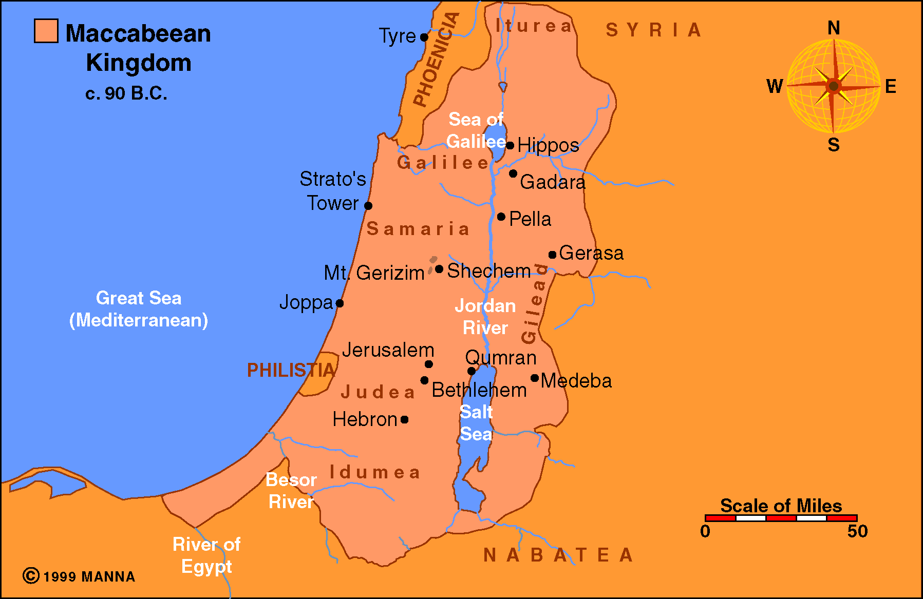

Slide 25
Mechisedec
For this Melchisedec, king of Salem, priest of the most high God, who met Abraham returning from the slaughter of the kings, and blessed him; To whom also Abraham gave a tenth part of all; first being by interpretation King of righteousness, and after that also King of Salem, which is, King of peace;
Hebrews 7:1-2
And inasmuch as not without an oath he was made priest:
Hebrews 7:20

Slide 26
“Counted for Righteousness”
And he believed in the LORD; and he counted it to him for righteousness.
Genesis 15:6
For what saith the scripture? Abraham believed God, and it was counted unto him for righteousness. Now to him that worketh is the reward not reckoned of grace, but of debt. But to him that worketh not, but believeth on him that justifieth the ungodly, his faith is counted for righteousness.
Romans 4:3-5
Then stood up Phinehas, and executed judgment: and so the plague was stayed. And that was counted unto him for righteousness unto all generations for evermore.
Psalms 106:30-31
Notes:
The 3 times that the phrase and idea of “counting for righteousness” is applied to 2 men in the scriptures – Abraham and Phinehas, very interesting.

Slide 27
Summary of the Life of Phinehas
Exodus introduces Phinehas as one called out of Eygpt with special attention placed on him. He was a unique individual. He was the only one of his generation that is mentioned in that geneology. It was through his line that the Aaronic priesthood would flow.
Phinehas would have experienced the reality of God and His power. He was a part of the plagues of Eygpt and the deliverance from the Egyptian army at the crossing of the Red Sea. He would have seen the cloud of glory and joy of deliverance of God. He witnessed the quick slide of unbelief of the newly delivered Israelites. Phinehas was probably even more impacted by the death of his uncles, Nadab and Abihu. That even focused him on the need for a holy approach unto God, the way prescribed, rather the way man may want to do, it must be done with all humility.

Slide 28
Summary of the Life of Phinehas
Phinehas kept this high exaltation of God focus throughout his life and he had the appropriate zeal toward God for it. He was given a special blessing, an oath from God, that promised an everlasting priesthood. The everlasting priesthood was one of life and peace. He was focused on God and His glory primarily but also on the salvation of the nation. He was not zealous to only carry the spear but it was to execute God’s will with the purpose of salvation.
After the plague was stopped and a special covenant was given, he lead 12,000 men of Israel against the Kings of Midianites and won an amazing victory - he did not loose one man! After this great deliverance he continued in faithful and zealous service to the Lord. He was then brought to a controversy with his brethren that would test the intention and focus of his zeal. Reports of false worship about the 3 tribes on the east of Jordon contained truth, however at best there was misinformation about their intension and at worse a false report to stir up the wrath of Israel and Phinehas’ zeal against their brethren.

Slide 29
Summary of the Life of Phinehas
He learned to listen to his brethren and hear what they were saying. He understood that they were appealing to God as their witness and what their true intention was. He realized that he was dangerously close to falsely condemning and going to war against his brethren. He then celebrated the alter of Ed (Witness). He was also ministering as the high priest when the controversy of the tribe of Benjamin. He carefully and faithfully sought the instruction of the Lord during this controversy and acted faithfully, in spite of what appeared to be failure. He and Israel were ultimately successful but not before great losses.
The actions of faith of Phinehas were commemorated by Moses in his final recorded prayer of blessings on the children of Israel before his death (Deut 33:8-11), recorded as a major event in the nation of Israel (Psa 106:30-31) and his priesthood was applied to the order of Melchizeck by David in Psa 110. He was referenced about 600 years after his death to stir to proper leadership from the priests (Mal 2:5-7). There is one more explicit application to the works of Phinehas and it is applied to the work, which Christ has yet do accomplish - Isa 9.

Slide 30
Isaiah 9:1-7
Nevertheless, there will be no more gloom for those who were in distress. In the past he humbled the land of Zebulun and the land of Naphtali, but in the future he will honor Galilee of the Gentiles, by the way of the sea, along the Jordan--The people walking in darkness have seen a great light; on those living in the land of the shadow of death a light has dawned. You have enlarged the nation and increased their joy; they rejoice before you as people rejoice at the harvest, as men rejoice when dividing the plunder. For as in the day of Midian's defeat, you have shattered the yoke that burdens them, the bar across their shoulders, the rod of their oppressor. Every warrior's boot used in battle and every garment rolled in blood will be destined for burning, will be fuel for the fire. For to us a child is born, to us a son is given, and the government will be on his shoulders. And he will be called Wonderful Counselor, Mighty God, Everlasting Father, Prince of Peace. Of the increase of his government and peace there will be no end. He will reign on David's throne and over his kingdom, establishing and upholding it with justice and righteousness from that time on and forever. The zeal of the LORD Almighty will accomplish this.

Slide 31
Supplement notes to class 2
Below this slide:

Slide 32
God’s Love
The LORD did not set his love upon you, nor choose you, because ye were more in number than any people; for ye were the fewest of all people: But because the LORD loved you, and because he would keep the oath which he had sworn unto your fathers, hath the LORD brought you out with a mighty hand, and redeemed you out of the house of bondmen, from the hand of Pharaoh king of Egypt. (Deu 7:7-8)

Slide 33
God’s Love
Behold, the heaven and the heaven of heavens is the LORD'S thy God, the earth also, with all that therein is. Only the LORD had a delight in thy fathers to love them, and he chose their seed after them, even you above all people, as it is this day. Circumcise therefore the foreskin of your heart, and be no more stiffnecked. (Deu 10:14-16)
Thou shalt fear the LORD thy God; him shalt thou serve, and to him shalt thou cleave, and swear by his name. He is thy praise, and he is thy God, that hath done for thee these great and terrible things, which thine eyes have seen. Thy fathers went down into Egypt with threescore and ten persons; and now the LORD thy God hath made thee as the stars of heaven for multitude. (Deu 10:20-22)

Slide 34
God’s Love
Now will I sing to my wellbeloved a song of my beloved touching his vineyard. My wellbeloved hath a vineyard in a very fruitful hill: And he fenced it, and gathered out the stones thereof, and planted it with the choicest vine, and built a tower in the midst of it, and also made a winepress therein: and he looked that it should bring forth grapes, and it brought forth wild grapes. And now, O inhabitants of Jerusalem, and men of Judah, judge, I pray you, betwixt me and my vineyard. What could have been done more to my vineyard, that I have not done in it? wherefore, when I looked that it should bring forth grapes, brought it forth wild grapes? (Isa 5:1-4)

Slide 35
God’s Love
For I would not, brethren, that ye should be ignorant of this mystery, lest ye should be wise in your own conceits; that blindness in part is happened to Israel, until the fulness of the Gentiles be come in. And so all Israel shall be saved: as it is written, There shall come out of Sion the Deliverer, and shall turn away ungodliness from Jacob: For this is my covenant unto them, when I shall take away their sins. As concerning the gospel, they are enemies for your sakes: but as touching the election, they are beloved for the fathers' sakes. For the gifts and calling of God are without repentance. (Rom 11:25-29)

Slide 36
God’s Love
Why didn’t they “see” Yahweh’s love?
He that loveth not knoweth not God; for God is love. (1Jn 4:8)
But God commendeth his love toward us, in that, while we were yet sinners, Christ died for us. (Rom 5:8)

Slide 37
God’s love & their position
After confirming the unconditional love of Yahweh (v 2-5) there is a clear statement that this did not absolve their guilt.
This was first against the spiritual leaders. The priest were showing contempt:
  For His sacrifices (v6-14)
  For His glory (2:1-3)
  For His law (2:4-9)

Slide 38
God’s love & their position
And ye have forgotten the exhortation which speaketh unto you as unto children, My son, despise not thou the chastening of the Lord, nor faint when thou art rebuked of him: For whom the Lord loveth he chasteneth, and scourgeth every son whom he receiveth. If ye endure chastening, God dealeth with you as with sons; for what son is he whom the father chasteneth not? (Heb 12:5-7)

Slide 39
Hating Esau?
Why was Esau not chosen?
Lest there be any fornicator, or profane person, as Esau, who for one morsel of meat sold his birthright. (Heb 12:16)
For the day of the LORD is near upon all the heathen: as thou hast done, it shall be done unto thee: thy reward shall return upon thine own head. (Oba 1:15)
And the house of Jacob shall be a fire, and the house of Joseph a flame, and the house of Esau for stubble, and they shall kindle in them, and devour them; and there shall not be any remaining of the house of Esau; for the LORD hath spoken it. (Oba 1:18)
And saviours shall come up on mount Zion to judge the mount of Esau; and the kingdom shall be the LORD'S. (Oba 1:21)

Slide 40
Hating Esau?
Isa 34:6-15
Rom 9:10-17
Prov 16:6

Slide 41
God’s Judgment on Edom
Psa 83:5-18
Psa 137:7
Jer 49:7-22
La 4:21-22
Ez 25:12-14; 35:1-15
Joel 3:19
Am 1:11-12; 9:11-12
Mal 1:2-5

Slide 42
God’s Judgment on Edom
The Edomites opposed Saul (1043-1011) and were subdued under David (1011-971) and Solomon (971-931). They fought against Jehoshophat (873-848) and successfully rebelled against Jehoram (853-841). They were again conquered by Judah under Amaziah (796-767) but they regained their freedom durn the reign of Ahaz (735-715). Edom was later controlled by Assyria and Babylon; and in the 5th century the Edomites were forced by the Nabateans to leave their territory. They moved to the area of southern Palestine and became known as Idumeans. Herod the Great, an Idumean, became king of Judah under Rome in 37 BC. In a sense, the enmity between Esau and Jacob was continued in Herod’s attempt to murder Jesus. The Idumeans participated in the rebellion of Jerusalem against Rome and were defeated along with the Jews by Titus in 70 AD. Ironically, the Edomites applauded the destruction of Jerusalem in 586 BC but they died trying to defend it in 70 AD. After that time they were never heard of again. As Obadiah predicted, they would be “cut off forever” v. 10 and there would be “no survivor of the house of Esau” v. 18.

Slide 43
Malachi 1:9
KJV
LXX
NASB
And now, I pray you, beseech God that he will be gracious unto us: this hath been by your means: will he regard your persons? saith the LORD of hosts.
“And now entreat the face of your God, and make supplication to Him. These things have been done by your hands; shall I accept you?” says the Lord Almighty.
But now will you entreat God’s favor, that He may be gracious to us? With such an offering on your part, will He receive any of you kindly? Says the Lord of hosts.

Slide 44
“Lord of Hosts”
Found 273 times in the OT.
This phrase occurs 24 times in the book of Malachi.
H6635
צבאה צבא
tsâbâ' tsebâ'âh
tsaw-baw', tseb-aw-aw'
From H6633; a mass of persons (or figurative things), especially regularly organized for war (an army); by implication a campaign, literally or figuratively (specifically hardship, worship): - appointed time, (+) army, (+) battle, company, host, service, soldiers, waiting upon, war (-fare).

Slide 45
“Lord of Hosts”
Why is this important?
Because God placed this emphasis on His name in the book of Malachi!
  Mal 1:6 (2x); 1:11 (3x); 1:14; 2:2; 2:5; 3:16; 4:2.

Slide 46
“Lord of Hosts”
10 times God refers the hears back to His name. He points out how:
His name was despised in Israel at the time.
His name shall be great among the Gentiles.
His name is dreadful among the heathen.
His name calls for repentance & due glory.
His name was revered by Levi.
His name will be thought on and revered by the faithful resulting in ”a book of remembrance”.
His name being revered will result eternal healing!

Slide 47
Scriptural Definition of “Lord of Hosts”
So the people sent to Shiloh, that they might bring from thence the ark of the covenant of the LORD of hosts, which dwelleth between the cherubims: and the two sons of Eli, Hophni and Phinehas, were there with the ark of the covenant of God. (1 Sam 4:4)
And David arose, and went with all the people that were with him from Baale of Judah, to bring up from thence the ark of God, whose name is called by the name of the LORD of hosts that dwelleth between the cherubims. (2 Sam 6:2)
In the year that king Uzziah died I saw also the Lord sitting upon a throne, high and lifted up, and his train filled the temple. Above it stood the seraphims: each one had six wings; with twain he covered his face, and with twain he covered his feet, and with twain he did fly. And one cried unto another, and said, Holy, holy, holy, is the LORD of hosts: the whole earth is full of his glory. (Isa 6:1-3)
And Hezekiah prayed unto the LORD, saying, O LORD of hosts, God of Israel, that dwellest between the cherubims, thou art the God, even thou alone, of all the kingdoms of the earth: thou hast made heaven and earth. (Isa 37:15-16)
Give ear, O Shepherd of Israel, thou that leadest Joseph like a flock; thou that dwellest between the cherubims, shine forth… O LORD God of hosts, how long wilt thou be angry against the prayer of thy people? (Psa 80:1-4)
Notes:
See also: Psa 24:10; Hag 2:7;Zech 14:16

Slide 48
Scriptural Definition of “Lord of Hosts”
It seems that the name of God specifically associated with the Cherubim of glory is “The Lord of Hosts”.
The title “Lord of Hosts” is Yahweh Sabaoth in the Hebrew. This phrase is “The Lord Almighty” in other translations.

Slide 49
Scriptural Definition of “Lord of Hosts”
The Preface to the NIV explains:
Because for most readers today the phrases “the Lord of hosts” and “God of hosts” have little meaning, this version renders them “the Lord Almighty” and “God Almighty.” These renderings convey the sense of the Hebrew, namely, “he who is sovereign over all the ‘hosts’ (powers) in heaven and on earth, especially over the ‘hosts’ (armies) of Israel.” For readers unacquainted with Hebrew this does not make clear the distinction between Sabaoth (“hosts” or “Almighty”) and Shaddai (which can also be translated “Almighty”), but the latter occurs infrequently and is always footnoted.
Similarly, Eichrodt concludes that Sabaoth “does not refer to any particular ‘hosts,’ but to all bodies, multitudes, masses in general, the content of all that exists in heaven and in earth … [a] name expressive of the divine sovereignty.”¹⁰ As “the Lord Almighty,” Yahweh is the controller of history who musters all the powers of heaven and earth to accomplish his will.¹¹

Slide 50
“Lord of Hosts”
James 5:4-11
Rom 9:29
Isa 1:9-18
Luke 2:13-14
G4756
στρατία
stratia
strat-ee'-ah
Feminine of a derivative of στρατός stratos (an army; from the base of G4766, as encamped); camp likeness, that is, an army, that is, (figuratively) the angels, the celestial luminaries: - host.

