Slide 1
“Who May Abide The Day of His Coming?...”
Malachi 3:2
Class 3

Slide 2
“Lord of Hosts”
Found 273 times in the OT.
This phrase occurs 24 times in the book of Malachi.
H6635
צבאה צבא
tsâbâ' tsebâ'âh
tsaw-baw', tseb-aw-aw'
From H6633; a mass of persons (or figurative things), especially regularly organized for war (an army); by implication a campaign, literally or figuratively (specifically hardship, worship): - appointed time, (+) army, (+) battle, company, host, service, soldiers, waiting upon, war (-fare).

Slide 3
“Lord of Hosts”
10 times God refers the hears back to His name. He points out how:
His name was despised in Israel at the time.
His name shall be great among the Gentiles.
His name is dreadful among the heathen.
His name calls for repentance & due glory.
His name was revered by Levi.
His name will be thought on and revered by the faithful resulting in ”a book of remembrance”.
His name being revered will result eternal healing!

Slide 4
“Lord of Hosts”
Why is this important?
Because God placed this emphasis on His name in the book of Malachi!
  Mal 1:6 (2x); 1:11 (3x); 1:14; 2:2; 2:5; 3:16; 4:2.

Slide 5
Scriptural Definition of “Lord of Hosts”
So the people sent to Shiloh, that they might bring from thence the ark of the covenant of the LORD of hosts, which dwelleth between the cherubims: and the two sons of Eli, Hophni and Phinehas, were there with the ark of the covenant of God. (1 Sam 4:4)
And David arose, and went with all the people that were with him from Baale of Judah, to bring up from thence the ark of God, whose name is called by the name of the LORD of hosts that dwelleth between the cherubims. (2 Sam 6:2)
In the year that king Uzziah died I saw also the Lord sitting upon a throne, high and lifted up, and his train filled the temple. Above it stood the seraphims: each one had six wings; with twain he covered his face, and with twain he covered his feet, and with twain he did fly. And one cried unto another, and said, Holy, holy, holy, is the LORD of hosts: the whole earth is full of his glory. (Isa 6:1-3)
And Hezekiah prayed unto the LORD, saying, O LORD of hosts, God of Israel, that dwellest between the cherubims, thou art the God, even thou alone, of all the kingdoms of the earth: thou hast made heaven and earth. (Isa 37:15-16)
Give ear, O Shepherd of Israel, thou that leadest Joseph like a flock; thou that dwellest between the cherubims, shine forth… O LORD God of hosts, how long wilt thou be angry against the prayer of thy people? (Psa 80:1-4)
Notes:
See also: Psa 24:10; Hag 2:7;Zech 14:16

Slide 6
Scriptural Definition of “Lord of Hosts”
It seems that the name of God specifically associated with the Cherubim of glory is “The Lord of Hosts”.
The title “Lord of Hosts” is Yahweh Sabaoth in the Hebrew. This phrase is “The Lord Almighty” in other translations.

Slide 7
“Lord of Hosts”
James 5:4-11
Rom 9:29
Isa 1:9-18
Luke 2:13-14
G4756
στρατία
stratia
strat-ee'-ah
Feminine of a derivative of στρατός stratos (an army; from the base of G4766, as encamped); camp likeness, that is, an army, that is, (figuratively) the angels, the celestial luminaries: - host.

Slide 8
“Footprints of the Cherubim”
~ Gen 3:24 ~

Slide 9
The first place we find Cherubim:
So he drove out the man; and he placed at the east of the garden of Eden Cherubims, and a flaming sword which turned every way, to keep the way of the tree of life.
Gen 3:24 (KJV)
After he drove the man out, he placed on the east side of the Garden of Eden cherubim and a flaming sword flashing back and forth to guard the way to the tree of life. (NIV)
Notes:
Placed could be ‘caused to dwell’.

Slide 10
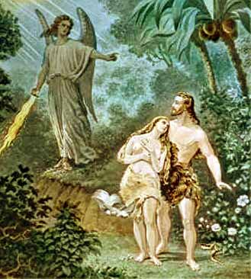
Notes:
This picture is most likely not correct. This is for several reasons that we will try to show throughout this class.

Slide 11
Should we study the Cherubim?
You might say…
  Too academic.
  There is not that much to know about them.
  Most references to the Cherubim are in the OT.
  The only specific reference to them in the NT is to say that the writer could not speak about them particularly right then.

Slide 12
Should we study the Cherubim?
The word ‘Cherubims’ occurs 65 times in 57 verses. Only one time is the word used in the NT (Heb 9:5). It does not occur in singular form, always plural.

Slide 13
What we hope to cover:
What are the Cherubim?
What is the role and importance of the Cherubim in God’s plan?
What are some of the lessons I should see in Cherubim?
How does the Cherubim relate to Christ?
How does the Cherubim relate to you?

Slide 14
Before we start...
What ideas do you have about the Cherubim?
What would you say to someone else about this subject/idea?

Slide 15
Generally accepted places where the Cherubim occur in the scriptures:
  Gen. 3:24 - Cherubim and a flaming sword
  Isa 6 – Referred to as ‘seraphim’ there.
  Ezek 1 & 10 – summary in a moment…
  Rev 4 – 4 beasts

Slide 16
The Cherubim – Ezekiel 1 Summary
Whirlwind
Appearance of a flash of lightning.
Clouds that are bright and flashing with fire
Great noise, voice (& thundering?)
4 fold chariot
Oxen in form
4 faces – Man, lion, eagle, ox

Slide 17
The Cherubim – Ezekiel 1 Summary
Six wings to each Cherubim
Hands were under the wings
Wheels were full of eyes
Above the firmament was the Almighty Himself seated on a glorious throne
Above the throne was a great bow radiant with glory

Slide 18
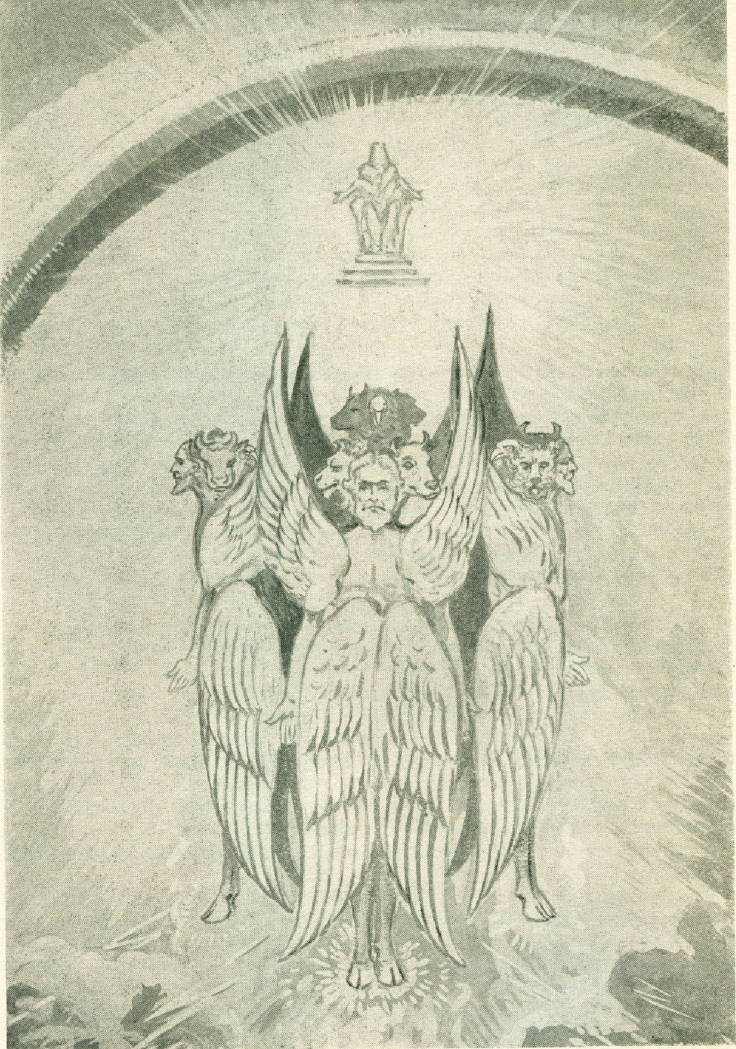
Notes:
In Ezekiel’s vision language is wanting for him to describe what it is that he has seen, ‘the likeness of…”

Slide 19
The Cherubim
“As the Serpent in the scriptures is the synonym for sin and everything that is opposed to God and therefore doomed to ultimate complete destruction, so the Cherubim stand for all that is pleasing and acceptable to God, and that which is destined to be eternally perpetuated on this planet.”

Slide 20
The Cherubim
“At the outset of God’s operations upon the earth we are introduced to these two opposing forces – the Serpent, the embodiment of that which leads men away from God to utter extinction: the Cherubim, the embodiment of those things which direct the sinner back to God’s favor, forgiveness and ultimate salvation”.

Slide 21
The Cherubim
“The Cherubim represent principles upon compliance with which man may return to God;”
– H. Madeley, The Cherubim

Slide 22
The Cherubim is a symbol of God’s power, presence, might and ultimately his work in Christ. They are angelic activity particularly with the chariot of the Lord.

Slide 23
The Cherubim should be understood then as keeping way of life open rather than the way closed.
The Cherubim keep the way of life open to the obedient and bars the disobedient. God has left open a way to return to fellowship with him without compromising His Holiness and righteousness.

Slide 24
Let’s start by pulling out some of the more explicit things that the scriptures tell us about the cherubim and the importance attached to it.

Slide 25
Exodus 25:18-20
18And thou shalt make two cherubims of gold, of beaten work shalt thou make them, in the two ends of the mercy seat. 19And make one cherub on the one end, and the other cherub on the other end: even of the mercy seat shall ye make the cherubims on the two ends thereof. 20And the cherubims shall stretch forth their wings on high, covering the mercy seat with their wings, and their faces shall look one to another; toward the mercy seat shall the faces of the cherubims be.

Slide 26
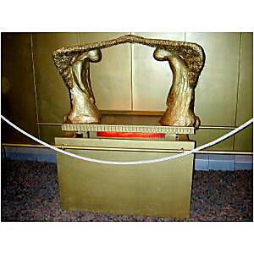

Slide 27
Exodus 25:21-22
21And thou shalt put the mercy seat above upon the ark; and in the ark thou shalt put the testimony that I shall give thee. 22 And there I will meet with thee, and I will commune with thee from above the mercy seat, from between the two cherubims which are upon the ark of the testimony, of all things which I will give thee in commandment unto the children of Israel.

Slide 28
Cherubim representations were on:
The curtains of the tabernacle –
Exodus 26:1
1Moreover thou shalt make the tabernacle with ten curtains of fine twined linen, and blue, and purple, and scarlet: with cherubims of cunning work shalt thou make them.

Slide 29
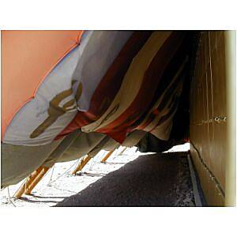

Slide 30
Cherubim representations were on:
The doors of the temple –
1 Kings 6:32-33
32The two doors also were of olive tree; and he carved upon them carvings of cherubims and palm trees and open flowers, and overlaid them with gold, and spread gold upon the cherubims, and upon the palm trees. 33So also made he for the door of the temple posts of olive tree, a fourth part of the wall.

Slide 31
Cherubim representations were on:
1 Kings 6:34-35
34And the two doors were of fir tree: the two leaves of the one door were folding, and the two leaves of the other door were folding. 35And he carved thereon cherubims and palm trees and open flowers: and covered them with gold fitted upon the carved work.

Slide 32
Cherubim representations were on:
The walls of the temple –
2 Chronicles 3:7
7He overlaid also the house, the beams, the posts, and the walls thereof, and the doors thereof, with gold; and graved cherubims on the walls.

Slide 33
Cherubim representations were on:
The brazen Laver –
1 Kings 7:29
29And on the borders that were between the ledges were lions, oxen, and cherubims: and upon the ledges there was a base above: and beneath the lions and oxen were certain additions made of thin work.

Slide 34
Cherubim representations were on:
The Veil of the tabernacle –
Exodus 26:31
31And thou shalt make a veil of blue, and purple, and scarlet, and fine twined linen of cunning work: with cherubims shall it be made:

Slide 35
What else do we know about the veil?
By a new and living way, which he hath consecrated for us, through the veil, that is to say, his flesh;
Heb 10:20
And the sun was darkened, and the veil of the temple was rent in the midst.
Luke 23:45

Slide 36
How did Hezekiah address God when he was terribly afraid of the potential destruction of Sennacherib’s army?
And Hezekiah prayed before the LORD, and said, O LORD God of Israel, which dwellest between the cherubims, thou art the God, even thou alone, of all the kingdoms of the earth; thou hast made heaven and earth.
2Ki 19:15

Slide 37
Is that all we know about Cherubim?
Do we see the evidence of the Cherubim in other places in the scripture?
If we do, what does it matter?

Slide 38
We see the evidence of the Cherubim throughout the major points in redemptive history.
We find the Cherubim in the garden of Eden –
Genesis 3:24
24So he drove out the man; and he placed at the east of the garden of Eden Cherubims, and a flaming sword which turned every way, to keep the way of the tree of life.
As we will see, the Cherubim are a symbol of the Divine presence, power to fulfill his will in the earth.

Slide 39
We see the evidence of the Cherubim in the Covenant with Noah
Gen 9:8-10
And God spake unto Noah, and to his sons with him, saying, And I, behold, I establish my covenant with you, and with your seed after you; And with every living creature that is with you, of the fowl, of the cattle, and of every beast of the earth with you; from all that go out of the ark, to every beast of the earth.

Slide 40
We see the evidence of the Cherubim in the Covenant with Noah
God mentions each aspect of creation that is specifically present in the Cherubim.
  With you (Noah) = Man
  The fowl = Eagle
  The cattle = Ox
  Beast of the earth = Lion

Slide 41
We see the evidence of the Cherubim in the covenant with Abraham
Genesis 15:17
17And it came to pass, that, when the sun went down, and it was dark, behold a smoking furnace, and a burning lamp that passed between those pieces.

Slide 42
We see the evidence of the Cherubim in the deliverance from Egypt
Exodus 14:19-20
19And the angel of God, which went before the camp of Israel, removed and went behind them; and the pillar of the cloud went from before their face, and stood behind them: 20And it came between the camp of the Egyptians and the camp of Israel; and it was a cloud and darkness to them, but it gave light by night to these: so that the one came not near the other all the night.
Notes:
Stand still and see the salvation of the Lord.

Slide 43
We see the evidence of the Cherubim in the deliverance from Egypt
1 Corinthians 10:1-2
1Moreover, brethren, I would not that ye should be ignorant, how that all our fathers were under the cloud, and all passed through the sea; 2And were all baptized unto Moses in the cloud and in the sea;

Slide 44
We see the evidence of the Cherubim at Sinai, the first covenant
Exodus 19:16
16And it came to pass on the third day in the morning, that there were thunders and lightnings, and a thick cloud upon the mount, and the voice of the trumpet exceeding loud; so that all the people that was in the camp trembled.

Slide 45
We see the evidence of the Cherubim in the taking of Elijah
2 Kings 2:11-12
11And it came to pass, as they still went on, and talked, that, behold, there appeared a chariot of fire, and horses of fire, and parted them both asunder; and Elijah went up by a whirlwind into heaven. 12And Elisha saw it, and he cried, My father, my father, the chariot of Israel, and the horsemen thereof. And he saw him no more: and he took hold of his own clothes, and rent them in two pieces.

Slide 46
Isaiah 29:6
6Thou shalt be visited of the LORD of hosts with thunder, and with earthquake, and great noise, with storm and tempest, and the flame of devouring fire.

Slide 47
Those are some OT references…
What about the NT?
If this had any real importance, surely it would relate to Christ, right?

Slide 48
Luke 2:13-14
And suddenly there was with the angel a multitude of the heavenly host praising God, and saying, Glory to God in the highest, and on earth peace, good will toward men.

Slide 49
How does this relate to Christ?
Matthew 27:45
45Now from the sixth hour there was darkness over all the land unto the ninth hour.

Slide 50
Psalm 18:6-14
In my distress I called upon the LORD, and cried unto my God: he heard my voice out of his temple, and my cry came before him, even into his ears. Then the earth shook and trembled; the foundations also of the hills moved and were shaken, because he was wroth. There went up a smoke out of his nostrils, and fire out of his mouth devoured: coals were kindled by it.
(Psa 18:6-8)

Slide 51
He bowed the heavens also, and came down: and darkness was under his feet. And he rode upon a cherub, and did fly: yea, he did fly upon the wings of the wind. He made darkness his secret place; his pavilion round about him were dark waters and thick clouds of the skies.
(Psa 18:9-11)

Slide 52
At the brightness that was before him his thick clouds passed, hail stones and coals of fire. The LORD also thundered in the heavens, and the Highest gave his voice; hail stones and coals of fire. Yea, he sent out his arrows, and scattered them; and he shot out lightnings, and discomfited them.
(Psa 18:12-14)

Slide 53
Amo 8:8-10
Shall not the land tremble for this, and every one mourn that dwelleth therein? and it shall rise up wholly as a flood; and it shall be cast out and drowned, as by the flood of Egypt. And it shall come to pass in that day, saith the Lord GOD, that I will cause the sun to go down at noon, and I will darken the earth in the clear day: And I will turn your feasts into mourning, and all your songs into lamentation; and I will bring up sackcloth upon all loins, and baldness upon every head; and I will make it as the mourning of an only son, and the end thereof as a bitter day.

Slide 54
Isaiah 59:9-10
9Therefore is judgment far from us, neither doth justice overtake us: we wait for light, but behold obscurity; for brightness, but we walk in darkness. 10We grope for the wall like the blind, and we grope as if we had no eyes: we stumble at noonday as in the night; we are in desolate places as dead men.

Slide 55
And it was about the sixth hour, and there was a darkness over all the earth until the ninth hour. And the sun was darkened, and the veil of the temple was rent in the midst. And when Jesus had cried with a loud voice, he said, Father, into thy hands I commend my spirit: and having said thus, he gave up the ghost. Now when the centurion saw what was done, he glorified God, saying, Certainly this was a righteous man. And all the people that came together to that sight, beholding the things which were done, smote their breasts, and returned.
(Luk 23:44-48)

Slide 56
Matthew 27:54
54Now when the centurion, and they that were with him, watching Jesus, saw the earthquake, and those things that were done, they feared greatly, saying, Truly this was the Son of God.

Slide 57
John 8:28
28Then said Jesus unto them, When ye have lifted up the Son of man, then shall ye know that I am he, and that I do nothing of myself; but as my Father hath taught me, I speak these things.

Slide 58
Acts 6:7
7And the word of God increased; and the number of the disciples multiplied in Jerusalem greatly; and a great company of the priests were obedient to the faith.

Slide 59
Exodus 25:22
22And there I will meet with thee, and I will commune with thee from above the mercy seat, from between the two cherubims which are upon the ark of the testimony, of all things which I will give thee in commandment unto the children of Israel.

Slide 60
Here we have the one eternal sacrifice that is to take away the sins of the world having the blood shed outside of the city. The high priest was supposed to take blood into the most holy place once a year for an offering for sins.
The two things that the high priest took into the most holy were an alter of incense and blood from the slain sacrifice.

Slide 61
Hebrews 13:11-12
11For the bodies of those beasts, whose blood is brought into the sanctuary by the high priest for sin, are burned without the camp. 12Wherefore Jesus also, that he might sanctify the people with his own blood, suffered without the gate.

Slide 62
His body was taken outside the camp, just as the burnt offering was commanded to be done.
But what about the blood? Christ’s blood was not being sprinkled in the sanctuary like the sin offering was supposed to be. (right?)

Slide 63
What happened to Christ’s blood? His blood was falling down on Golgotha the place of the skull (Mark 15:22)
But it was not taken to the physical ark of the covenant to be sprinkled. Christ as the high priest being hung on the cross was unable to take his own blood into the most holy.
God came to him to accept his sacrifice.
Notes:
The Latin is calvaria meaning skull, therefore the two different terms for the same thing, one Aramaic and the other Latin.

Slide 64
Psalm 18:6
6 In my distress I called upon the LORD, and cried unto my God: he heard my voice
out of his temple, and my cry came before him, even into his ears.

Slide 65
Psalms 18:9-11
He bowed the heavens also, and came down:
and darkness was under his feet.
And he rode upon a cherub, and did fly: yea, he
did fly upon the wings of the wind.
He made darkness his secret place; his pavilion
round about him were dark waters and thick
clouds of the skies.

Slide 66
We see quite literally the fulfillment of the types foreshadowed in the Law.
God came to Christ and accepted the sacrifice!

Slide 67
God drew near to Christ and accepted the sacrificial blood that Christ was unable to take to an earthly alter. This demonstrates how it was God working in the whole process. His holiness and righteousness were never compromised and His grace bountifully extended to all that will avail themselves of this eternally sufficient sacrifice.

Slide 68
We too are called to draw near and worship the Father, just as Jesus did, in spirit and in truth. We worship on the basis of that great and eternal sacrifice that was provided for us, if we will but do so.

Slide 69
John 20:9-12
For as yet they knew not the scripture, that he must rise again from the dead. Then the disciples went away again unto their own home. But Mary stood without at the sepulchre weeping: and as she wept, she stooped down, and looked into the sepulchre, And seeth two angels in white sitting, the one at the head, and the other at the feet, where the body of Jesus had lain.

Slide 70
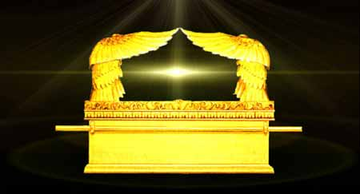
Notes:
The Cherubim are always associated with the throne of God.
Luke 7:40-43,47
Darkness to Egyptians fill out.
John 8 – seeking to the Jewish leaders.

Slide 71
Exodus 25:22
22And there I will meet with thee, and I will commune with thee from above the mercy seat, from between the two cherubims which are upon the ark of the testimony, of all things which I will give thee in commandment unto the children of Israel.

Slide 72
Hebrews 9:5-7
5And over it the cherubims of glory shadowing the mercyseat; of which we cannot now speak particularly. 6Now when these things were thus ordained, the priests went always into the first tabernacle, accomplishing the service of God. 7But into the second went the high priest alone once every year, not without blood, which he offered for himself, and for the errors of the people:

Slide 73
Hebrews 9:8-9
8The Holy Ghost this signifying, that the way into the holiest of all was not yet made manifest, while as the first tabernacle was yet standing: 9Which was a figure for the time then present, in which were offered both gifts and sacrifices, that could not make him that did the service perfect, as pertaining to the conscience;

Slide 74
Hebrews 9:24-25
24For Christ is not entered into the holy places made with hands, which are the figures of the true; but into heaven itself, now to appear in the presence of God for us: 25Nor yet that he should offer himself often, as the high priest entereth into the holy place every year with blood of others;

Slide 75
Psalm 80:1-3
1 Give ear, O Shepherd of Israel, thou that leadest Joseph like a flock; thou that dwellest between the cherubims, shine forth.
2 Before Ephraim and Benjamin and Manasseh stir up thy strength, and come and save us.
3 Turn us again, O God, and cause thy face to shine; and we shall be saved.

Slide 76
Numbers 6:22-27
22And the LORD spake unto Moses, saying, 23Speak unto Aaron and unto his sons, saying, On this wise ye shall bless the children of Israel, saying unto them, 24The LORD bless thee, and keep thee: 25The LORD make his face shine upon thee, and be gracious unto thee: 26The LORD lift up his countenance upon thee, and give thee peace. 27And they shall put my name upon the children of Israel; and I will bless them.

Slide 77
John 20:19-21
19Then the same day at evening, being the first day of the week, when the doors were shut where the disciples were assembled for fear of the Jews, came Jesus and stood in the midst, and saith unto them, Peace be unto you. 20And when he had so said, he showed unto them his hands and his side. Then were the disciples glad, when they saw the Lord. 21Then said Jesus to them again, Peace be unto you: as my Father hath sent me, even so send I you.

Slide 78
Daniel 12:2-3
And many of them that sleep in the dust of the earth shall awake, some to everlasting life, and some to shame and everlasting contempt. And they that be wise shall shine as the brightness of the firmament; and they that turn many to righteousness as the stars for ever and ever.

Slide 79
Revelation 21:22-23
22And I saw no temple therein: for the Lord God Almighty and the Lamb are the temple of it. 23And the city had no need of the sun, neither of the moon, to shine in it: for the glory of God did lighten it, and the Lamb is the light thereof.

Slide 80
That’s not the end of the story:
Acts 1:9
9And when he had spoken these things, while they beheld, he was taken up; and a cloud received him out of their sight.

Slide 81
Which also said, Ye men of Galilee, why stand ye gazing up into heaven? this same Jesus, which is taken up from you into heaven, shall so come in like manner as ye have seen him go into heaven.
Act 1:11

Slide 82
Hebrews 1:3
3Who (Christ) being the brightness of his glory, and the express image of his person, and upholding all things by the word of his power, when he had by himself purged our sins, sat down on the right hand of the Majesty on high;

Slide 83
Romans 3:23-26
23For all have sinned, and come short of the glory of God; 24Being justified freely by his grace through the redemption that is in Christ Jesus: 25Whom God hath set forth to be a propitiation (mercy seat) through faith in his blood, to declare his righteousness for the remission of sins that are past, through the forbearance of God; 26To declare, I say, at this time his righteousness: that he might be just, and the justifier of him which believeth in Jesus.
Notes:
Heb 9:5 is the same word hear as propitiation.

Slide 84
Matthew 24:30
30And then shall appear the sign of the Son of man in heaven: and then shall all the tribes of the earth mourn, and they shall see the Son of man coming in the clouds of heaven with power and great glory. (16:27 “shall come in the glory of his Father with his angels”)

Slide 85
Cherubim activity in relation to Christ:
At his birth
At his death
At his resurrection
At his ascension
At his return

Slide 86
Implications for our Faith:
God, through His great love and mercy, has preserved access to the tree of life. He has caused a perpetual watch to be over ‘the way’ throughout redemptive history. It has been kept open to the obedient and closed to the disobedient. He has done this in a manner that does not compromise His holiness but allows for repentance, mercy and redemption.

Slide 87
Implications for our Faith:
God is our refuge and strength, a very present help in trouble -Psa 46:1. He is constantly on watch for His plan and people to come to the end that He has purposed.
This is illustrated in no better place than in Christ’s sacrifice…

Slide 88
Implications for our Faith:
Christ was unable to complete the atoning work himself. It was God riding upon the Cherubim that came and accepted Christ’s eternal sacrifice. Without God’s action there would not have been reconciliation.
I would suggest to you that this was significant comfort to Christ during his great time of trial and need.

Slide 89
Implications for our Faith:
The hand of God is not reveled to the world but to His chosen people.
“…it was a cloud and darkness to them, but it gave light by night to these…” Ex 14:20
  Did Christ ‘see’ God upon the Cherubim in the darkness upon the world?
  Do we ‘see’ God upon the Cherubim in the darkness that is coming upon our world?

Slide 90
Implications for our Faith:
5. The crucifixion of Christ was the supreme illustration that we cannot approach God on our own terms. God has given us a very gracious offer. He has keep the way to life open but closed it to those who ignore the straight and narrow way that the Cherubim have been keeping since the garden of Eden. Our culture is one that cheapens God’s grace and distorts God’s holiness to the point where the need for Christ’s blood can be missed.

Slide 91
Implications for our Faith:
God has not finished His work with the Cherubim.
And then shall appear the sign of the Son of man in heaven: and then shall all the tribes of the earth mourn, and they shall see the Son of man coming in the clouds of heaven with power and great glory. And he shall send his angels with a great sound of a trumpet, and they shall gather together his elect from the four winds, from one end of heaven to the other.
Mat 24:30-31

Slide 92
Implications for our Faith:
God has not finished His work with the Cherubim.
For the Lord himself shall descend from heaven with a shout, with the voice of the archangel, and with the trump of God: and the dead in Christ shall rise first: Then we which are alive and remain shall be caught up together with them in the clouds, to meet the Lord in the air: and so shall we ever be with the Lord.
1Th 4:16-17

Slide 93
Implications for our Faith:
7. God’s power and sovereignty is unmatched by the powers of nature or this world. His purpose will not be frustrated. In His hand is eternal comfort and joy if we but respond obediently to the call to repentance. An active spirit-filled life of thankfulness is a natural out-flowing based on such “exceeding great and precious promises”.

Slide 94
Implications for our Faith:
8. The cherubim are ultimately a call to repentance!
And I will give them one heart, and I will put a new spirit within you; and I will take the stony heart out of their flesh, and will give them an heart of flesh: That they may walk in my statutes, and keep mine ordinances, and do them: and they shall be my people, and I will be their God. But as for them whose heart walketh after the heart of their detestable things and their abominations, I will recompense their way upon their own heads, saith the Lord GOD. Then did the cherubims lift up their wings, and the wheels beside them; and the glory of the God of Israel was over them above.
Eze 11:19-22

Slide 95
There is plenty more:
Gideon – Judges 7:20
Solomon’s temple – 1 Kings 8-10-12
Psa 29 and the peace promised in conclusion
Malachi 4:2
Christ’s transfiguration – Matt 17:5
Rev 14:1-2
Psa 97

Slide 96
The Cherubim
Represent the glory of God in the earth
Represent the glory of God in Israel
Represent the glory of God in Christ
Represent the glory of God in redemption, namely you and me!
Represent the very throne of God and the action He is taking.

Slide 97
The Cherubim are a symbol of His power, presence and ultimately His work in Christ.
The Cherubim are the guard of God’s holiness. It is associated with destruction for those who ignore God’s will. However, it is great comfort and joy to those that do His will.

Slide 98
Closing Reading:
Psa. 34:6-7
Heb 1:13-14

