Slide 1
“Who May Abide The Day of His Coming?...”
Malachi 3:2
Class 4

Slide 2
Isaiah 9:1-7
Nevertheless, there will be no more gloom for those who were in distress. In the past he humbled the land of Zebulun and the land of Naphtali, but in the future he will honor Galilee of the Gentiles, by the way of the sea, along the Jordan--The people walking in darkness have seen a great light; on those living in the land of the shadow of death a light has dawned. You have enlarged the nation and increased their joy; they rejoice before you as people rejoice at the harvest, as men rejoice when dividing the plunder. For as in the day of Midian's defeat, you have shattered the yoke that burdens them, the bar across their shoulders, the rod of their oppressor. Every warrior's boot used in battle and every garment rolled in blood will be destined for burning, will be fuel for the fire. For to us a child is born, to us a son is given, and the government will be on his shoulders. And he will be called Wonderful Counselor, Mighty God, Everlasting Father, Prince of Peace. Of the increase of his government and peace there will be no end. He will reign on David's throne and over his kingdom, establishing and upholding it with justice and righteousness from that time on and forever. The zeal of the LORD Almighty will accomplish this.

Slide 3
Implications for our Faith:
God, through His great love and mercy, has preserved access to the tree of life. He has caused a perpetual watch to be over “the way” throughout redemptive history. It has been kept open to the obedient and closed to the disobedient. He has done this in a manner that does not compromise His holiness but allows for repentance, mercy and redemption.

Slide 4
Implications for our Faith:
God is our refuge and strength, a very present help in trouble -Psa 46:1. He is constantly on watch for His plan and people to come to the end that He has purposed.
This is illustrated in no better place than in Christ’s sacrifice…

Slide 5
Implications for our Faith:
Christ was unable to complete the atoning work himself. It was God riding upon the Cherubim that came and accepted Christ’s eternal sacrifice – the blood of the everlasting covenant. It was God’s action and mercy that effected the reconciliation.
I would suggest to you that this was significant comfort to Christ during this greatest trial and time of need.

Slide 6
Implications for our Faith:
The hand of God is not reveled to the world but to His chosen people.
“…it was a cloud and darkness to them, but it gave light by night to these…” Ex 14:20
Did Christ ‘see’ God upon the Cherubim in the darkness upon the world?
Do we ‘see’ God upon the Cherubim in the darkness that is coming upon our world?

Slide 7
Implications for our Faith:
5. The crucifixion of Christ was the supreme illustration that we cannot approach God on our own terms. God has given us a very gracious offer. He has keep the way to life open but closed it to those who ignore the straight and narrow way that the Cherubim have been keeping since the garden of Eden. Our culture is one that cheapens God’s grace and distorts God’s holiness to the point where the need for Christ’s blood can be missed.

Slide 8
Implications for our Faith:
God has not finished His work with the Cherubim.
And then shall appear the sign of the Son of man in heaven: and then shall all the tribes of the earth mourn, and they shall see the Son of man coming in the clouds of heaven with power and great glory. And he shall send his angels with a great sound of a trumpet, and they shall gather together his elect from the four winds, from one end of heaven to the other. Mat 24:30-31

Slide 9
Implications for our Faith:
God has not finished His work with the Cherubim.
For the Lord himself shall descend from heaven with a shout, with the voice of the archangel, and with the trump of God: and the dead in Christ shall rise first: Then we which are alive and remain shall be caught up together with them in the clouds, to meet the Lord in the air: and so shall we ever be with the Lord.
1Th 4:16-17

Slide 10
Implications for our Faith:
7. God’s power and sovereignty is unmatched by the powers of nature or this world. His purpose will not be frustrated. In His hand is eternal comfort and joy if we but respond obediently to the call to repentance. An active spirit-filled life of thankfulness is a natural out-flowing based on such “exceeding great and precious promises”.

Slide 11
Implications for our Faith:
8. The cherubim are ultimately a call to repentance!
And I will give them one heart, and I will put a new spirit within you; and I will take the stony heart out of their flesh, and will give them an heart of flesh: That they may walk in my statutes, and keep mine ordinances, and do them: and they shall be my people, and I will be their God. But as for them whose heart walketh after the heart of their detestable things and their abominations, I will recompense their way upon their own heads, saith the Lord GOD. Then did the cherubims lift up their wings, and the wheels beside them; and the glory of the God of Israel was over them above.
Eze 11:19-22

Slide 12
The Cherubim
Represent the glory of God in the earth
Represent the glory of God in Israel
Represent the glory of God in Christ
Represent the glory of God in redemption, namely you and me!
Represent the very throne of God and the action He is taking.

Slide 13
Yahweh Sabaoth
The emphasis on the name of Yahweh Sabaoth should ensure that all who are approaching God have the right God.
The covenant name of God with all the promises associated with it help to draw us to the only true and living God. Not only this but the collective work that the host of Yahweh is using to “to take out of them a people for his name” – Acts 15:14.

Slide 14
The Cherubim
The Cherubim are a symbol of His power, presence and ultimately His work in Christ.
The Cherubim are the guard of God’s holiness. It is associated with destruction for those who ignore God’s will. However, it is great comfort and joy to those that do His will.
The Cherubim are associated with keeping “the way” to the tree of life open to the obedient and closed to the disobedient.

Slide 15
Group A | Group B | Group C | Group D | Group E
Apathy | Apathy | Unresolved Conflict | Lack of Unity - fellowship | Apathy
Focus | Communication technology | Stress in the Brotherhood | Apathy | Breakdown of Family/ecclesia
Relationships | Shepherding | Apathy | World’s influence | Breakdown of Biblical Authority
Group A | Group B | Group C | Group D | Group E
Apathy | Apathy | Unresolved Conflict | Lack of Unity - fellowship | Apathy
Focus | Communication technology | Stress in the Brotherhood | Apathy | Breakdown of Family/ecclesia
Relationships | Shepherding | Apathy | World’s influence | Breakdown of Biblical Authority

Slide 16
Top Three
Apathy
Relationships
World’s influence

Slide 17
Top Three
Apathy (Lust of the Eye)
Relationships (Pride of Life)
World’s influence (Lust of the Flesh)

Slide 18
“The Way” in Acts
And I persecuted this way unto the death, binding and delivering into prisons both men and women. (Act 22:4)
And desired of him letters to Damascus to the synagogues, that if he found any of this way, whether they were men or women, he might bring them bound unto Jerusalem. (Act 9:2)
This man was instructed in the way of the Lord; and being fervent in the spirit, he spake and taught diligently the things of the Lord, knowing only the baptism of John. And he began to speak boldly in the synagogue: whom when Aquila and Priscilla had heard, they took him unto them, and expounded unto him the way of God more perfectly. (Act 18:25-26)
But when divers were hardened, and believed not, but spake evil of that way before the multitude, he departed from them, and separated the disciples, disputing daily in the school of one Tyrannus. (Act 19:9)
And the same time there arose no small stir about that way. (Act 19:23)

Slide 19
“The Way” in the Gospels
“For John came unto you in the way of righteousness, …”(Mat 21:32)
As it is written in the book of the words of Esaias the prophet, saying, The voice of one crying in the wilderness, Prepare ye the way of the Lord, make his paths straight. (Luk 3:4)
And Jesus said unto him, Go thy way; thy faith hath made thee whole. And immediately he received his sight, and followed Jesus in the way. (Mar 10:52)
Jesus saith unto him, I am the way, the truth, and the life: no man cometh unto the Father, but by me. (Joh 14:6)
To give light to them that sit in darkness and in the shadow of death, to guide our feet into the way of peace. (Luk 1:79)

Slide 20
“The Way” in the NT
Destruction and misery are in their ways: And the way of peace have they not known: (Rom 3:16-17)
By a new and living way, which he hath consecrated for us, through the veil, that is to say, his flesh; (Heb 10:20)
The Holy Ghost this signifying, that the way into the holiest of all was not yet made manifest, while as the first tabernacle was yet standing: (Heb 9:8)
And many shall follow their pernicious ways; by reason of whom the way of truth shall be evil spoken of. (2Pe 2:2)
Which have forsaken the right way, and are gone astray, following the way of Balaam the son of Bosor, who loved the wages of unrighteousness; (2Pe 2:15)
For it had been better for them not to have known the way of righteousness, than, after they have known it, to turn from the holy commandment delivered unto them. (2Pe 2:21)
Woe unto them! for they have gone in the way of Cain, and ran greedily after the error of Balaam for reward, and perished in the gainsaying of Core. (Jud 1:11)

Slide 21
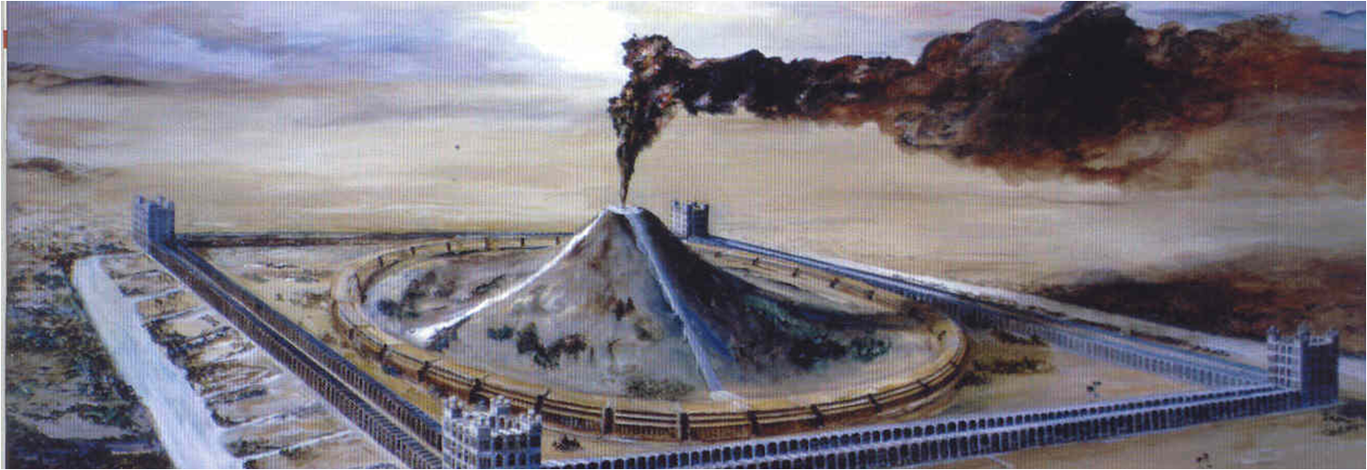
Keeping the
Unity of the Spirit in the Bond of Peace with Agape as the motivation.
Spirit
Truth
The “straight gait” & “narrow way” that leads unto life (Matt 7:14)
Grace
Law
Faith
Works
Zeal
Knowledge
Love of neighbor
Love of God

Slide 22
Are you loosing the focus?
I thought this was supposed to be a class on self-examination and preparation for the day of the Lord?
Why so much emphasis on the name?
The point is that to ever be able to examine yourself, you must first hear God’s perspective and have his presence in mind to make a quality decision.
We must recognize and respect His will on the issue.

Slide 23
Isaiah 6
V5 The vision of the divine glory takes all the spirit out of Him: “I am undone.”
V5 There is confession of utter unworthiness
V7 Confession leads to cleansing
V8 The glad response of a forgiven sinner: “Here am I; send me.”
V9 The commission: “Go, tell this people.”
Notes:
In symbol the live coal taken from the alter, where there has been sacrifice of complete self-consecration, now achieves what would otherwise be impossible.

Slide 24
True worshippers will come in the spirit of brokenness and contrition. He sees sin and confesses.
We should then live a life of thanksgiving because he has not dealt with us after our sin and what we deserve.

Slide 25
Interesting quote:
We are drifting toward a religion, conscious or unconsciously, which keeps its eye on humanity rather than deity.
1928, Evelyn Underhill

Slide 26
Interesting quote:
Faced with a choice between changing one’s mind and proving that there is no need to do so, almost everyone gets busy on the proof.
John Galbraith

Slide 27
The Key:
Repentance
Mal 2:2
Mal 2:15
Mal 3:1

Slide 28
Fulfillment: John the Baptist
For this is he that was spoken of by the prophet Esaias, saying, The voice of one crying in the wilderness, Prepare ye the way of the Lord, make his paths straight. (Mat 3:3)
For this is he, of whom it is written, Behold, I send my messenger before thy face, which shall prepare thy way before thee. (Mat 11:10)
And if ye will receive it, this is Elias, which was for to come. (Mat 11:14)
And his disciples asked him, saying, Why then say the scribes that Elias must first come? And Jesus answered and said unto them, Elias truly shall first come, and restore all things. But I say unto you, That Elias is come already, and they knew him not, but have done unto him whatsoever they listed. Likewise shall also the Son of man suffer of them. Then the disciples understood that he spake unto them of John the Baptist. (Mat 17:10-13)

Slide 29
Repentance
Repentance is not being sorry for the consequences of sin.
Repentance is a change of mind, purpose and specifically turning from sin.

Slide 30
Repentance
“…how ye turned to God from idols to serve the living and true God;”(1Th 1:9)
3 elements of repentance:
A turning toward God
A turning away from idols
An intent to serve (worship) God
You must have all these elements!

Slide 31
Repentance
Our message is repentance.
It unmasks hypocrisy and superficiality and confronts sin.
Rev 2-3 Christ commands repentance.
Act 11:18 God saves through repentance.
Him hath God exalted with his right hand to be a Prince and a Saviour, for to give repentance to Israel, and forgiveness of sins. (Act 5:31)

Slide 32
Assessing Ourselves
 | God ‘s Assessment: True Servant/Son | God’s Assessment: NOT a Servant/Son
Our Assessment: True servant/Son | True Positive: (Correct estimation) | False Positive : (self-deceived)
Our Assessment False Servant/Son | False Negative: (self-condemned) | True Negative: (apostate, worker of iniquity)

Slide 33
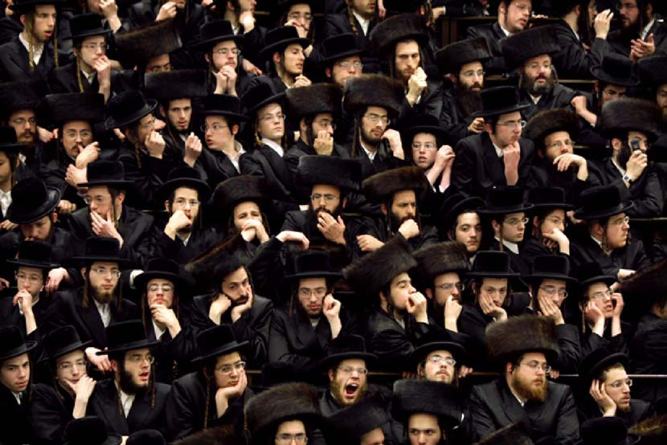

Slide 34
“True Worshippers” ~ John 4:23 ~
New Mexico Bible School 2011
Evening Lecture
Notes:
We are coving a good bit of information tonight. If you would rather listen than take notes, let me know an I will get you this information.
It will be but a taste of the riches found in this chapter and hopefully will stimulate your faith, action and further desire to truly worship the God of Israel.
This title can be considered bold and that I have the answers. I do not profess to have all the answers but there are clear scriptural markers for have guides on this subject.

Slide 35
Outline
The basic understanding
The historical context
The effect of this encounter on Samaritan Woman and on Jesus
Discerning – “Am I a true worshipper?”
Summary

Slide 36
A basic understanding
But the hour cometh, and now is, when the true worshippers shall worship the Father in spirit and in truth: for the Father seeketh such to worship him. 24God is a Spirit: and they that worship him must worship him in spirit and in truth.
John 4:23-24

Slide 37
A Basic Understanding
True worship is the ultimate priority. We are to have the worship of God as the primary focus in our lives.
God in multiple ways has consistently called us to worship Him, in spirit and in truth.
Notes:
We may not think on this term much because we might think it too churchy but it is the central theme of the bible – God manifestation or glorification.

Slide 38
The Importance of Worship
All of life is affected by worship, now and forever. Worship is not an addendum to life but at the core of life.
Worshippers in scriptures have only 2 options:
A true worshipper (acceptable)
A false worshipper (unacceptable)
Notes:
The study of worship is something that we can take for granted but the shear familiarity of it. It is assumed that you would agree with this basis premise rather than spending the time to prove it. A word you should look out for in studying this subject is service. Also consider sacrificial terms such as acceptable and offering, etc.

Slide 39
The Importance of Worship
If a person comes to God on their own terms (man made) they are not seeking God. In that case they are only seeking to pacify their own imagination and desires.
Acceptable worship is a key to understand the matter of salvation. The goal of salvation is to produce acceptable worshippers.

Slide 40
The Importance of Worship
The reason for salvation is not simply to save one from death or to make you happy but to worship God. God could have not created you and you would not need to be saved. He wants to be worshiped.
There are many who desire a Savior but few who want a Lord. God and Christ must be both to us.

Slide 41
The Importance of Worship
Therefore, believers are first and foremost worshippers. We are redeemed to worship. This is essential.
Worship or service to God has inherent in the concept the idea of giving.
Do we come to get or to give?
Notes:
Our culture does not fit with this concept and attitude, unless you are talking about worshipping self.
Relate this to your home ecclesia. Do you go to minister or to be ministered to?
If you do no get something from the classes/exhortation, is it the vessel you are bringing or are you trying to help to elevate the level of worship?

Slide 42
John 9:31
Now we know that God heareth not sinners: but if any man be a worshipper of God, and doeth his will, him he heareth.

Slide 43
The historical context
The history of the Samaritans
The importance of Shechem in scripture
Ideas related to Jacob

Slide 44
2 Kings 17:24-25 24 And the king of Assyria brought men from ¹Babylon, and from ²Cuthah, and from ³Ava, and from ⁴Hamath, and from ⁵Sepharvaim, and placed them in the cities of Samaria instead of the children of Israel: and they possessed Samaria, and dwelt in the cities thereof. 25And so it was at the beginning of their dwelling there, that they feared not the LORD: therefore the LORD sent lions among them, which slew some of them.

Slide 45
2 Kings 17:32-33 32So they feared the LORD, and made unto themselves of the lowest of them priests of the high places, which sacrificed for them in the houses of the high places. 33 They feared the LORD, and served their own gods, after the manner of the nations whom they carried away from thence.

Slide 46
2 Kings 17:34
34 Unto this day they do after the former manners: they fear not the LORD, neither do they after their statutes, or after their ordinances, or after the law and commandment which the LORD commanded the children of Jacob, whom he named Israel;

Slide 47
The Samaritans
Boasted of their decent from Jacob –
John 4:12 12 Art thou greater than our father Jacob, which gave us the well, and drank thereof himself, and his children, and his cattle?
Notes:
but they were not, 2 King 17 references

Slide 48
The Samaritans
But Jesus explicitly says they were not descendants of Jacob –
John 4:22 22Ye worship ye know not what: we know what we worship: for salvation is of the Jews.

Slide 49
The Samaritans
Professed to worship God –
Ezra 4:2 2Then they came to Zerubbabel, and to the chief of the fathers, and said unto them, Let us build with you: for we seek your God, as ye do; and we do sacrifice unto him since the days of Esarhaddon king of Assur, which brought us up hither.
The comment in the companion bible states that the Hebrew text says – “although we have not been sacrificing”
The LXX adds “unto Him”
Notes:
The comment in the companion bible states that the Hebrew text says – “although we have not been sacrificing”
The LXX adds “unto Him”

Slide 50
The Scriptures state that they were not seeking God.
Ezra 4:1 1Now when the adversaries of Judah and Benjamin heard that the children of the captivity builded the temple unto the LORD God of Israel;

Slide 51
The Samaritans
Worshipped on Mt. Gerizim
Opposed the Jews on return from exile – Neh. 2:10 & 4:1-8
Expected the Messiah – John 4:25, 29
Were superstitious – Acts 8:9-11
Were possibly more humane than the Jews – Luke 10:33-36; 17:16-18
Notes:
Sanballat was called the “governor of Samaria”. He was grieved of Israel’s prospering (Neh. 2:10) He was angry (4:1,7) and mocked the Jews.
He opposed the Jews in six ways: 1) Grief (2:01) 2)laughter (2:19) 3)wrath and indignation (4:1-3)
4)fighting (4:7-8) 5)subtily (6:1-2) 6)compromise (6:5-7)

Slide 52
The Samaritans
Were abhorred by the Jews – John 8:48
Had no dealings with the Jews –
Luke 9:52-53, John 4:9
Notes:
2 Kings 1 – Elijah and the king of Samaria.

Slide 53
Sanballat was called the “governor of Samaria”.
He was grieved of Israel’s prospering (Neh. 2:10)
He was angry (4:1,7) and mocked the Jews.
He opposed the Jews in six ways:
Grief (2:01)
Laughter (2:19)
Wrath and indignation (4:1-3)
4) Fighting (4:7-8)
5) Subtily (6:1-2)
6) Compromise (6:5-7)

Slide 54
Where is Shechem and Why Shechem?

Slide 55
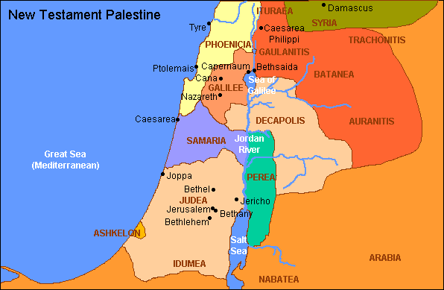

Slide 56
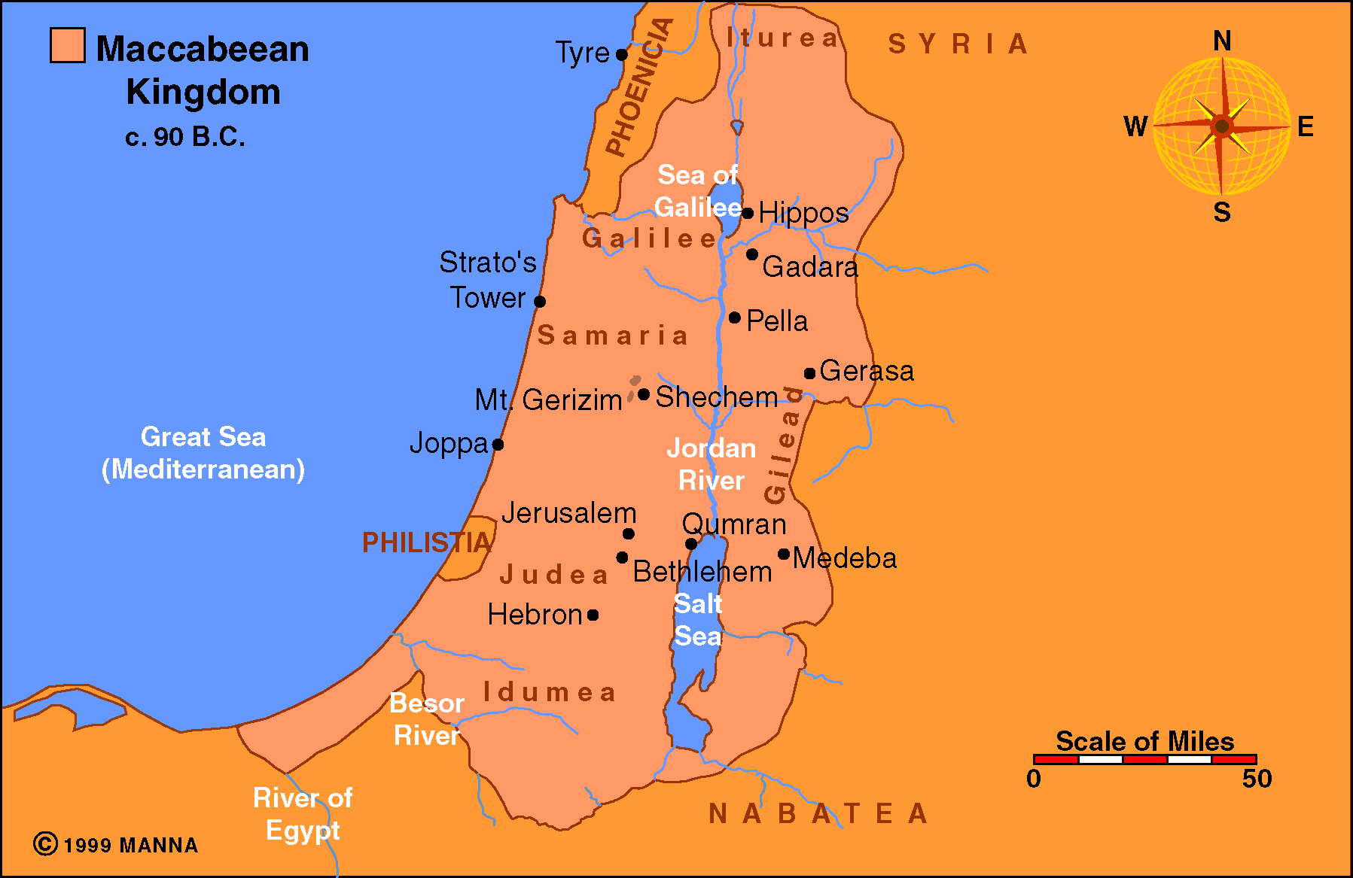

Slide 57
b)Why Shechem?
The place of Abraham’s first altar (Gen 12:6-7)
The Samaritans believe that it was Mt. Gerizim that Abraham ‘offered’ Isaac.
(Gen 22:2)

Slide 58
Why Shechem?
The place of Jacob’s altar (Gen 33:18-20)
Joseph was buried there
(Josh 24:32)

Slide 59
Why Mount Gerizim?
The Samaritans also understood it to be the place where God put his name – Deut. 12:5
It is the Mt of Blessing – Deut. 27:12
Notes:
It was also a city of refuge – 1 Chron.6:67

Slide 60
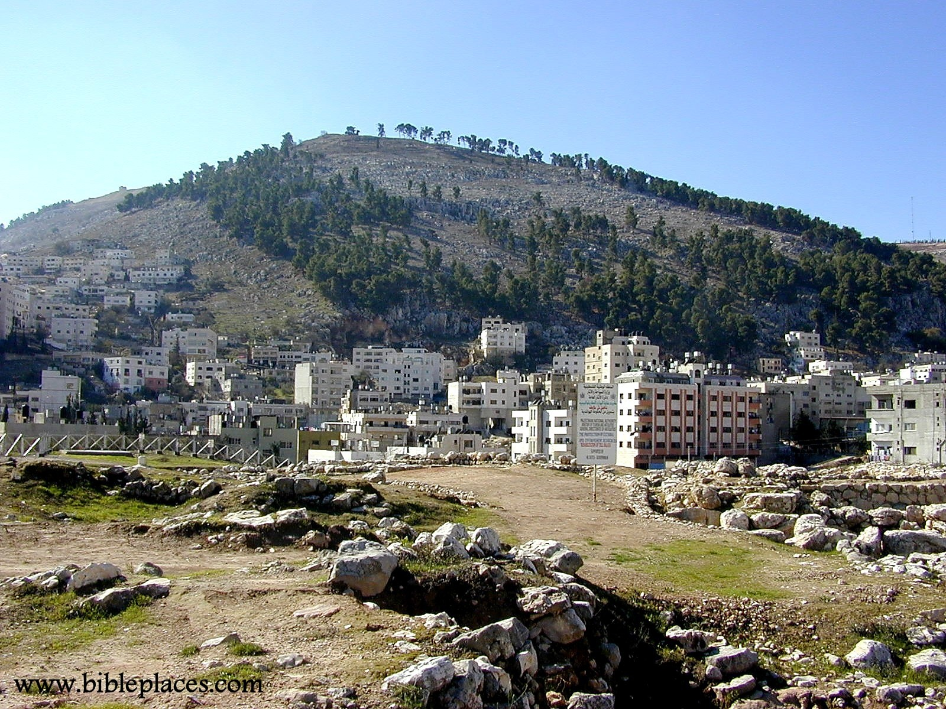
Notes:
Mount Gerizim
In between Mt. Gerizim an Ebal is the place known as Shecso known as Shechem - Shakim, Shekhem, Sichem, Sychar, Sychem, and today as Nablus,

Slide 61
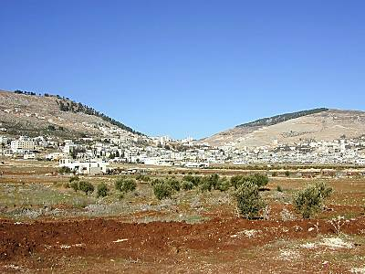
Mt. Gerizim
Mt. Ebal
Notes:
Mts. Gerizim and Ebal Located between Mt. Gerizim (left) and Mt. Ebal (right) Shechem is preeminent in the biblical record, beginning with God's promise of the land to Abraham. Later Jacob would return here with his family and settle shortly. During the Conquest, the twelve tribes gathered on these two hills to recite God's Law and the blessings and curses that accompanied obedience and disobedience.

Slide 62
Similarities between the Samaritan religion and Judaism
Both claimed to worship the God of Abraham, Isaac and Jacob
Both revered the first five books of the bible.
Both worshipped God using animal sacrifice.
Both looked forward to a Messiah.

Slide 63
It is tempting to look at only the similarities and not the differences.
The Samaritans did not accept the entire OT as the Jews did.
The Samaritans’ concept of God was corrupted by Paganism.
They missed the promises that are essential to salvation. Salvation is of the Jews.
They worshipped in spirit but not in truth.

Slide 64
Romans 10:2
For I bear them record that they have a zeal of God, but not according to knowledge.
The Samaritans are a witness of spiritual worship without understanding and void of saving truth.

Slide 65
Conversely, the Jews (Pharisees & Sadducees) were worshipping the right God with His truth in their grasp but with out the right heart.
The Jews had the promises but not the faith and action of their fathers.
They worshipped with the heritage of truth but not in spirit.

Slide 66
Mark 7:6
He answered and said unto them, Well hath Esaias prophesied of you hypocrites, as it is written, This people honoureth me with their lips, but their heart is far from me.

Slide 67
The two poles of worship:
Mt. Zion – lifeless orthodoxy
(truth but not spirit)
2. Mt. Gerizim – Enthusiastic heresy
(spirit but not truth)
Notes:
We must make sure that we do not fall into either side of the problem. We must take the exhortation to heart for each of us individually.

Slide 68
John 4 – Christ & the Woman
Now Jacob’s well was there. Jesus therefore, being wearied with his journey, sat thus on the well: and it was about the sixth hour.
John 4:6
Notes:
He was tired, hungry, thirsty and discouraged. Discouraged because of the opposition to his teaching and the imprisonment of his cousin and fellow-laborer John.

Slide 69
Christ before the well:
He was tired, hungry, thirsty and discouraged. Discouraged because of the opposition to his teaching and the imprisonment of his cousin and fellow-laborer John.

Slide 70
What effect did this encounter have on Christ?
He was no longer hungry, thirsty, tired or discouraged but rather uplifted and ministering unto others.
But he said unto them, I have meat to eat that ye know not of.
John 4:32

Slide 71
Neither have I gone back from the commandment of his lips; I have esteemed the words of his mouth more than my necessary food.
Job 23:12
Jesus saith unto them, My meat is to do the will of him that sent me, and to finish his work.
John 4:34

Slide 72
Christ at the well – John 4:6
Many centuries before this occurrence Jacob, traveling north, and similarly come to a well where he had met the woman who was to become his wife - Genesis 29: 10-11. Perhaps it was with this in mind that Jesus likewise sat on a well.
Notes:
The semi Gentile origins of the Samaritans were despised, their rejection of Psalms and prophets from the scriptures was resented, their choice of Mt. Gerizim as a holy site in place of Mount Zion was condemned, and there easy-going standards of religious practice were reprobated.

Slide 73
She had a knowledge of God and worshipped Him, evidenced by her reference to Abraham (12:6,7) and Jacob (33:18-20).
But in turn Jesus had to remind her the name of Jacob's altar was "God is the God of Israel" and that the promises given there was unto Abraham "unto thy Seed will I give this land.“
There was a difference in the status of the two religions.
The Samaritans had inadequate zealous adherence to Moses but it was in ignorance.
They were not related to the promises made to Abraham, Isaac and Jacob.
They claimed to have Abraham as their father but they did not.
Notes:
There was a difference in the status of the two religions.
The Samaritans had inadequate zealous adherence to Moses but it was in ignorance.
They were not related to the promises made to Abraham, Isaac and Jacob.
They claimed to have Abraham as their father but they did not.

Slide 74
Her first address of him was "thou, being a Jew" was promptly replaced by "Sir, Lord." She quickly recognized he was one with far higher spiritual powers that her own. Ultimately she progresses to address him as a prophet and finally – Messiah!
Christ explicitly says to her that he is the messiah (v25)

Slide 75
Are you greater than our father Jacob, which gave this this well?
She saw the well inherited by all later generations by Jacob as a symbol of divine promise. It was a promise of a center worship with an altar and a place of ready access.
Notes:
It appears that this woman grasps what Jesus was trying to teach.
If there was to be a true and acceptable approach to God it must be through a man of gods providing.
A seed promised to Abraham at Shechem, a prophet liken unto the Moses, a Joshua settling the people in God's land and leading them in worship which made the soul of the sincere believer to his covenant God.

Slide 76
Why is there so much emphasis on the place of worship?
The house of God is where He meets the unworthy in grace.
It is also a place to bring to remembrance to promises that were made in those places.

Slide 77
Malachi 1:11 11For from the rising of the sun even unto the going down of the same my name shall be great among the Gentiles; and in every place incense shall be offered unto my name, and a pure offering: for my name shall be great among the heathen, saith the LORD of hosts.

Slide 78
Acts 7:48-50
48Howbeit the most High dwelleth not in temples made with hands; as saith the prophet, 49Heaven is my throne, and earth is my footstool: what house will ye build me? saith the Lord: or what is the place of my rest? 50Hath not my hand made all these things?

Slide 79
Ephesians 2:20-22
20And are built upon the foundation of the apostles and prophets, Jesus Christ himself being the chief corner stone; 21In whom all the building fitly framed together groweth unto an holy temple in the Lord: 22In whom ye also are builded together for an habitation of God through the Spirit.

Slide 80
The place to go was not the issue.
The issue is to whom do you worship and how.

Slide 81
Jeremiah 23:23
Am I a God at hand, saith the LORD, and not a God afar off?

Slide 82
Is He a God of some place?
No, He is every place.
The issue is not here or there, because God is not here or there but everywhere.
We do not go somewhere to get holy.
We are to be holy every where.
God is to be an ever present God.
Notes:
We do not go somewhere to get holy.
We are to be holy every where.
God is to be an ever present God.

Slide 83
Why was he preaching to this Samaritan?
These twelve Jesus sent forth, and commanded them, saying, Go not into the way of the Gentiles, and into any city of the Samaritans enter ye not: 6But go rather to the lost sheep of the house of Israel.
Matthew 10:5-6

Slide 84
Genesis 29:8
And they said, We cannot, until all the flocks be gathered together, and till they roll the stone from the well’s mouth; then we water the sheep.

Slide 85
The 2 stipulations to watering the sheep:
The flocks had to be gathered
The stone must be rolled away

Slide 86
The Good Shepherd comes to water his flock, at Jacob’s well
It appears then that Christ has revealed himself to the woman at the well to begin the gathering process.

Slide 87
John 10:16
And other sheep I have, which are not of this fold: them also I must bring, and they shall hear my voice; and there shall be one fold, and one shepherd.
So even though he had commanded not to preach to the Samaritans, he was preparing them to gather them to be watered.

Slide 88
In Gen 29 the sheep being watered was impeded by a stone.
The impediment between the living water and the woman (and us) is sin.
The stone is remove literally and spiritually with the resurrection of Christ.

Slide 89
True worship?
We can readily see from this account that Jesus is gentle with her and drawing her to him.
There is also a firmness that is unmistakable. If she continues in a life of promiscuity she is not able to walk in his company and not an acceptable worshipper.

Slide 90
Is there any further record of the Samaritans?
Acts 1:8 8But ye shall receive power, after that the Holy Ghost is come upon you: and ye shall be witnesses unto me both in Jerusalem, and in all Judaea, and in Samaria, and unto the uttermost part of the earth.

Slide 91
Acts 8:5-6
Then Philip went down to the city of Samaria, and preached Christ unto them. 6 And the people with one accord gave heed unto those things which Philip spake, hearing and seeing the miracles which he did.

Slide 92
Acts 9:31
Then had the churches rest throughout all Judaea and Galilee and Samaria, and were edified; and walking in the fear of the Lord, and in the comfort of the Holy Ghost, were multiplied.

Slide 93
Character | Gender | Nationality | Social Position | Approach to Jesus
Nicodemus | Male (high status) | Jewish (high status) | Sanhedrin (high status) | At night John 3:2
Woman at the Well | Female (low status) | Samaritan (low status) | 5 husbands (low status) | At noon John 4:6

Slide 94
Discerning : “Am I a true Worshipper?”
Search me, O God, and know my heart: try me, and know my thoughts:
And see if there be any wicked way in me, and lead me in the way everlasting.
Psalm 139:24

Slide 95
Am I a true worshipper?
Hebrews 10:22
Let us draw near with a true heart in full assurance of faith, having our hearts sprinkled from an evil conscience, and our bodies washed with pure water.

Slide 96
4 Ways to Examine this Question:
“With a true heart” – Sincerely. Are you really sincere and worshipping with the whole heart, an undivided heart?
In full assurance of faith – Fidelity.
By full faith in the truth of Christ.
Having our hearts sprinkled from an evil conscience – humility, recognizing our unworthiness. No business being here based on my own goodness. We are to be recognizing God’s holiness.

Slide 97
4 Ways to Examine this Question:
Bodies washed with pure water – purity, daily cleansing of sin. Must deal with sin. This is not just baptism to enter into covenant but also a daily cleansing from sin.

Slide 98
So Heb 10 list would be:
Sincerity – drawing near with a true heart
Fidelity – full assurance of faith
Humility – hearts sprinkled from an evil conscience.
Purity – bodies washed with pure water (covenant making and continuing dealing with sin).

Slide 99
In question format:
Am I sincere?
Is my heart fixed on God?
Is my whole heart devoted to God?
Am I focusing on Him?
I am seeing Him in my life?
Is my desire to Him and His truth?
Do I know I have no right to be in God’s presence except for Christ’s sacrificial covering?
Have I dealt with any sin that might be present in my life?

Slide 100
Mt. Gerizim
Mt. Ebal
Notes:
Mts. Gerizim and Ebal Located between Mt. Gerizim (left) and Mt. Ebal (right) Shechem is preeminent in the biblical record, beginning with God's promise of the land to Abraham. Later Jacob would return here with his family and settle shortly. During the Conquest, the twelve tribes gathered on these two hills to recite God's Law and the blessings and curses that accompanied obedience and disobedience.

Slide 101
Joshua 24:14 14Now therefore fear the LORD, and serve him in sincerity and in truth: and put away the gods which your fathers served on the other side of the flood, and in Egypt; and serve ye the LORD.
Notes:
Just as Joshua exhorted the leaders of the 12 tribes that gathered together at Shechem.
Here is the greater Joshua repeating the same warning at the same place.

Slide 102
Joshua 24:14 14Now therefore fear the LORD, and serve him in sincerity (contrast Israel) and in truth (contrast the Samaritans): and put away the gods which your fathers served on the other side of the flood (Euphrates – from where the Samaritans came), and in Egypt (from where Israel came); and serve ye the LORD.
Notes:
Just as Joshua exhorted the leaders of the 12 tribes that gathered together at Shechem.
Here is the greater Joshua repeating the same warning at the same place.

Slide 103
Not limited to John 4
For the law was given by Moses, but grace and truth came by Jesus Christ. (Joh 1:17)
I beseech thee, O LORD, remember now how I have walked before thee in truth and with a perfect heart, and have done that which is good in thy sight. And Hezekiah wept sore. (2Ki 20:3 & Isa 38:3)
Therefore let us keep the feast, not with old leaven, neither with the leaven of malice and wickedness; but with the unleavened bread of sincerity and truth. (1Co 5:8)
For we are not as many, which corrupt the word of God: but as of sincerity, but as of God, in the sight of God speak we in Christ. (2Co 2:17)
For we are the circumcision, which worship God in the spirit, and rejoice in Christ Jesus, and have no confidence in the flesh.(Phil3:3)

Slide 104
Lessons from John 4
True worship is the ultimate priority.
It does matter in whom and in what you believe, as well as how you act.
The promises that God made to the fathers are essential.
We can not place our faith in natural lineage or the location of worship.
True worship is service properly given to God – in sincerity and in truth.

Slide 105
Lessons from John 4
God is actively seeking individuals, (you!), to worship Him in the appointed way.
The living water that Christ gave is not confined to a specific location (unlike Jacob’s well) but is available for all to drink if they approach him as instructed.
Those who are true worshippers of God have a source of strength that is not discernable to others. The weariness of our journey and controversy are removed when focus is on God while acting as agents to draw others to Him.

Slide 106
Lessons from John 4
There is no time to rest now. We are called to action. We are to use the gospel and help build the true temple of the Lord – a dwelling place for Him.
We can not let our social position in this world affect how we come to Christ.

Slide 107
Conclusion
Wherefore Jesus also, that he might sanctify the people with his own blood, suffered without the gate. Let us go forth therefore unto him without the camp, bearing his reproach. For here have we no continuing city, but we seek one to come. By him therefore let us offer the sacrifice of praise to God continually, that is, the fruit of our lips giving thanks to his name. But to do good and to communicate forget not: for with such sacrifices God is well pleased.
Heb 13:12-16

Slide 108
Conclusion
Now the God of peace, that brought again from the dead our Lord Jesus, that great shepherd of the sheep, through the blood of the everlasting covenant, Make you perfect in every good work to do his will, working in you that which is wellpleasing in his sight, through Jesus Christ; to whom be glory for ever and ever. Amen.
(Heb 13:20-21)

Slide 109
Treacherously
Found 18 times in the OT, 5 of which are in Malachi:
Jdg. 9:23; Isa. 21:2; 24:16; 33:1; 48:8; Jer. 3:20; 5:11; 12:1, 6; Lam. 1:2; Hos. 5:7; 6:7; Hab. 1:13; Mal. 2:10, 11, 14, 15, 16;
H898
בּגד
bâgad
baw-gad'
A primitive root; to cover (with a garment); figuratively to act covertly; by implication to pillage: - deal deceitfully (treacherously, unfaithfully), offend, transgress (-or), (depart), treacherous (dealer, -ly, man), unfaithful (-ly, man), X very.

Slide 110
Scriptural example of “treacherous”
Jeremiah 3:20
Surely as a wife treacherously departeth from her husband, so have ye dealt treacherously with me, O house of Israel, saith the LORD.

