Slide 1
THE CONSEQUENCES OF THE SIX DAY WAR
fifty years later – JuLY 2, 2017

Slide 2
Tonight’s plan
How the Bible relates to
Our attitude to war
The immediate outcomes of the war
The longer term impact of the war
  On Israel
  On the nations
  On the Christadelphian community

Slide 3
Our attitude to war
We do not glory in warfare or glorify the outcomes of war
God has revealed through the prophet Jeremiah that, just as Gentile empires were used to bring judgment on His people Israel, so there will be a reversal of roles when God uses Israel to judge the Gentile nations: “Thou art my battle axe and weapons of war: for with thee will I break in pieces the nations, and with thee will I destroy kingdoms” (Jeremiah 51:20)
Our desire is for the day when “nation shall not lift up a sword against nation, neither shall they learn war any more” (Isaiah 2:4, Micah 4:3)

Slide 4

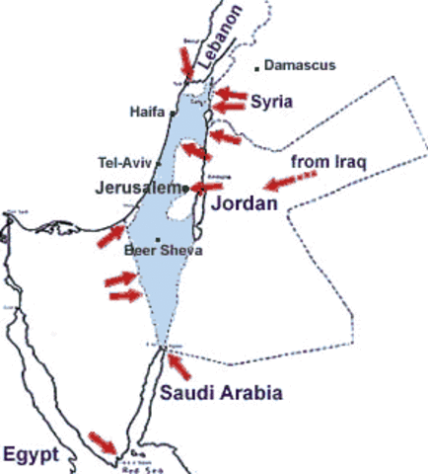
Six Arab armies arrayed against Israel
Egypt ordered the withdrawal of the United Nations Emergency Force from Sinai and the UN Secretary-General hastily complied
Egypt denied Israel access to its port at Eilat by closing the straits of Tiran at entrance of the Gulf of Aqaba

Slide 5
Immediate Outcomes
Israel was in possession of significant new land
The Sinai peninsula and Gaza strip
The West Bank including all of Jerusalem
The Golan Heights
The intended Arab objective of annihilating Israel was prevented

Slide 6
As the Scriptures foretold
For, lo, thine [God’s] enemies make a tumult: and they that hate thee have lifted up the head.
They have taken crafty counsel against thy people, and consulted against thy hidden ones.
They have said, “Come, and let us cut them off from being a nation; that the name of Israel may be no more in remembrance.”
For they have consulted together with one consent: they are confederate against thee:
Psalm 83:2-5

Slide 7

The identity of the confederates
Arab League Member States 1967
Algeria
Egypt
Iraq
Jordan
Kuwait
Lebanon
Libya
Morocco
Saudi Arabia
Sudan
Syria
Tunisia
Yemen
The tabernacles of Edom, and the Ishmaelites; of Moab, and the Hagarenes; Gebal, and Ammon, and Amalek; the Philistines with the inhabitants of Tyre; Assur also is joined with them: they have holpen the children of Lot.

Slide 8
The origin of the Arab peoples
Terah
Nahor (12 sons) | Abraham |  | Haran
Bethuel |  |  | Lot
Laban |  |  | Moab, Ammon
Ishmael, son of Hagar the Egyptian (12 sons) | Isaac |  | Midian & five other sons of Keturah
Esau (Edom) |  | Jacob (Israel)
Amalek |  | 12 sons

Slide 9
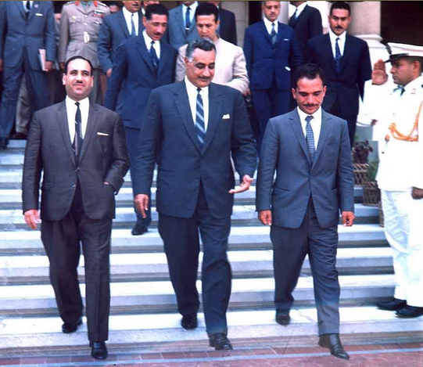
Israel’s enemies take counsel together
Unanimously defined national objectives for the liberation of Palestine from Zionist colonialism
Welcomed the establishment of the Palestine Liberation Organization to consolidate the Palestine Entity, and as a vanguard for the collective Arab struggle for the liberation of Palestine.
The 1964 Second Arab League Summit in Alexandria, Egypt

Slide 10
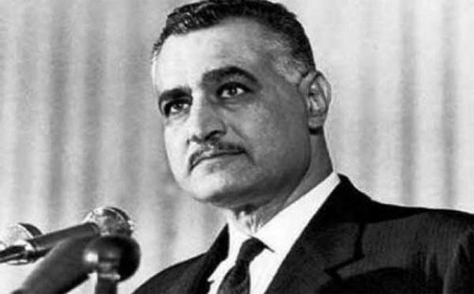
Israel’s enemies speak
Our basic objective will be the destruction of Israel. The Arab people want to fight – President Nasser of Egypt on May 27, 1967

Slide 11
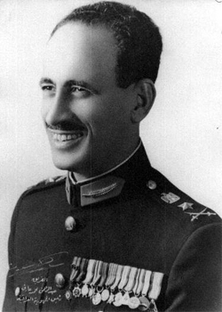
Israel’s enemies speak
The existence of Israel is an error which must be rectified. This is our opportunity to wipe out the ignominy which has been with us since 1948. Our goal is clear – to wipe Israel off the map – Abdul Rahman Aref, President of Iraq, June 1, 1967
Iraqi President Aref

Slide 12
Immediate Outcomes
Israel was in possession of significant new land
The Sinai peninsula and Gaza strip
The West Bank including all of Jerusalem
The Golan Heights
The intended Arab objective of annihilating Israel was prevented
The Russian (Soviet) military lost face in that the countries which it armed and supported were defeated
The world’s willingness to defend Israel was found wanting but its willingness to restrain Israel was forthcoming
The implacable hatred of the Arab nations towards Israel was reaffirmed

Slide 13
As best we can discern it, how did this war advance God’s purpose?
PART II

Slide 14
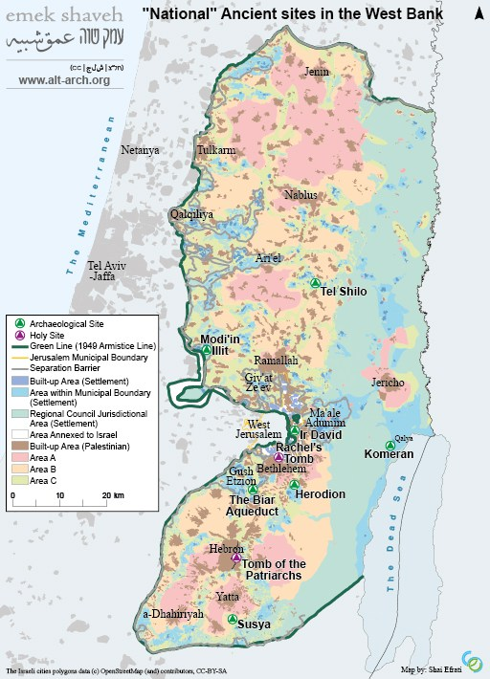
1967 – “the moment that created modern Israel”
The state between 1948 and 1967 did not have a single significant Jewish holy place. Think about that and what it says about the place of religion in Israeli identify in those years. The state the Ashkenazi socialist founders created had little place for religion as an animating force of identity.

Slide 15
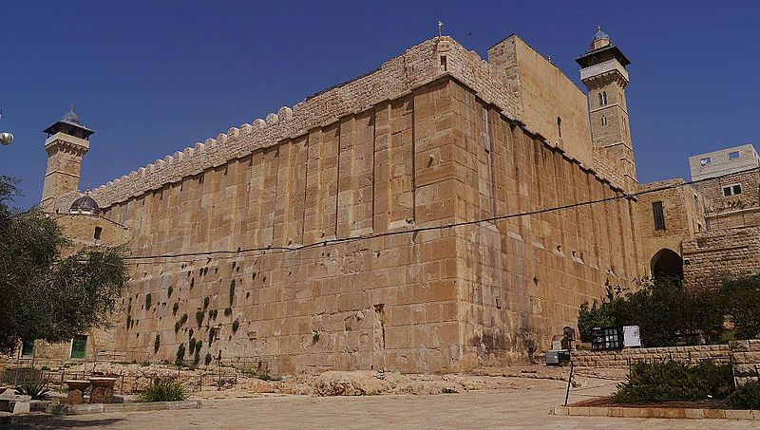
1967 – “the moment that created modern Israel”
The state between 1948 and 1967 did not have a single significant Jewish holy place. Think about that and what it says about the place of religion in Israeli identify in those years. The state the Ashkenazi socialist founders created had little place for religion as an animating force of identity.

Slide 16
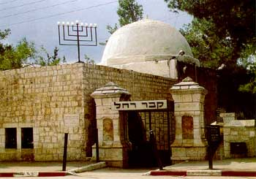
1967 – “the moment that created modern Israel”
The state between 1948 and 1967 did not have a single significant Jewish holy place. Think about that and what it says about the place of religion in Israeli identify in those years. The state the Ashkenazi socialist founders created had little place for religion as an animating force of identity.

Slide 17
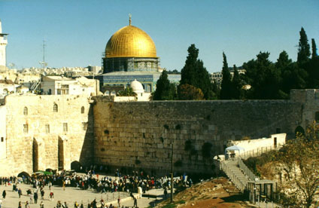
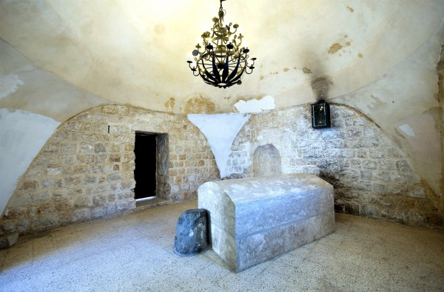
1967 – “the moment that created modern Israel”
The state between 1948 and 1967 did not have a single significant Jewish holy place. Think about that and what it says about the place of religion in Israeli identify in those years. The state the Ashkenazi socialist founders created had little place for religion as an animating force of identity.

Slide 18
1967 – “the moment that created modern Israel”
The state between 1948 and 1967 did not have a single significant Jewish holy place. Think about that and what it says about the place of religion in Israeli identify in those years. The state the Ashkenazi socialist founders created had little place for religion as an animating force of identity.

Slide 19
UNESCO’s World Heritage Committee will rule on Hebron this week
The members are: Angola, Azerbaijan, Burkina Faso, Croatia, Cuba, Finland, Indonesia, Jamaica, Kazakhstan, Kuwait, Lebanon, Peru, Philippines, Poland, Portugal, Republic of Korea, Tunisia, Turkey, Tanzania, Vietnam and Zimbabwe.
UNESCO Is the United Nations Educational, Scientific and Cultural Organization
Tzipi Hotolevy is Deputy Foreign Minister of Israel

Slide 20
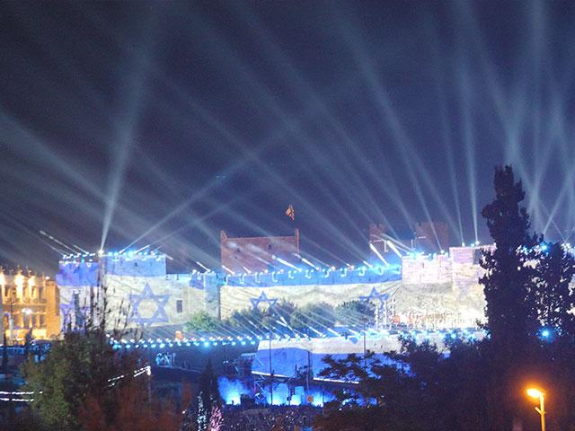
“1967 changes the place of religion in Israeli identity”
Pre-1967 Israel pretended it was inhabiting a secular landscape, and the absence of the religious sites encouraged that illusion. 1967 ends the notion that you can bring the Jews back to Zion and bypass Judaism.

Slide 21
Another major transformation
Another major transformation we experience here every day is the rescue and reclamation of the lost Jews of the Soviet Union, and that begins during the Six Day war when a generation of almost completely assimilated Soviet Jews, the products of decades of forced amnesia by the Communist regime, rediscover their Jewish identity and inexplicably develop this longing for a country they didn’t know…Now we have 1.5 million former Soviet Jews in this country who have changed the culture and the economy of this society, and it is a direct gift of the 1967 war.
Yossi Klein Halevi, Israeli author
May 1, 2017 interview with the Jerusalem Post

Slide 22
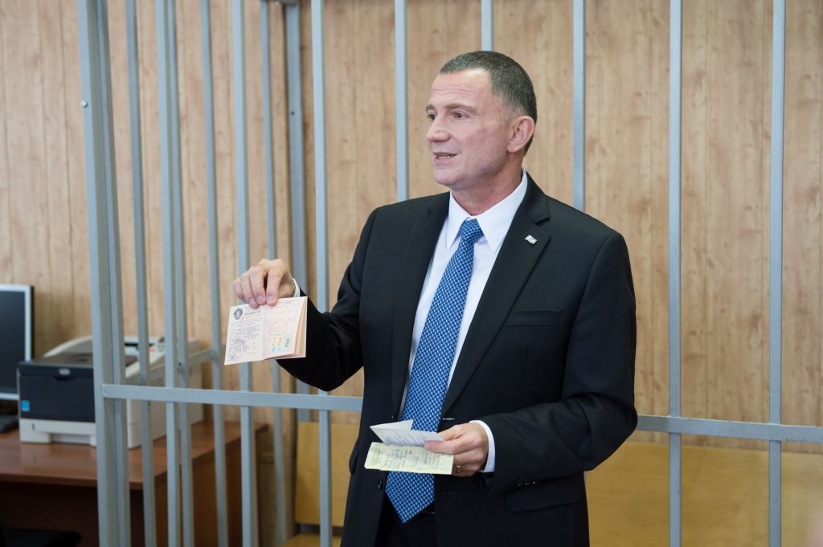
Yuli Edelstein, speaker of the Knesset

Slide 23
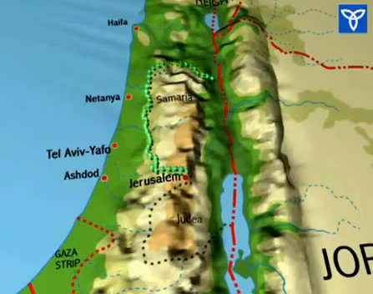
From a prophetic standpoint
The Six Day returned “the mountains of Israel” to Israel for the first time – significant settlement began in 1977
This possession is directly foretold in Ezekiel 36:8-12
But ye, O mountains of Israel, ye shall shoot forth your branches, and yield your fruit to my people of Israel; for they are at hand to come… And I will multiply men upon you, all the house of Israel, even all of it: and the cities shall be inhabited, and the wastes shall be builded:

Slide 24
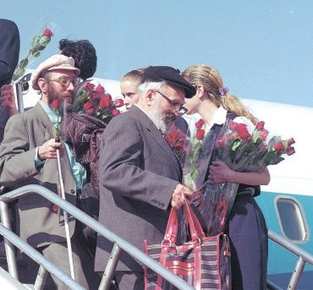
From a prophetic standpoint
2014
The Six Day War enabled the return of one million Soviet Jews after 1987
This return is directly foretold in Isaiah 43:5-6 and Jeremiah 23:7-8
Therefore, behold, the days come, saith the Lord, that they shall no more say, The Lord liveth, which brought up the children of Israel out of the land of Egypt; But, The Lord liveth, which brought up and which led the seed of the house of Israel out of the north country, and from all countries whither I had driven them; and they shall dwell in their own land.

Slide 25
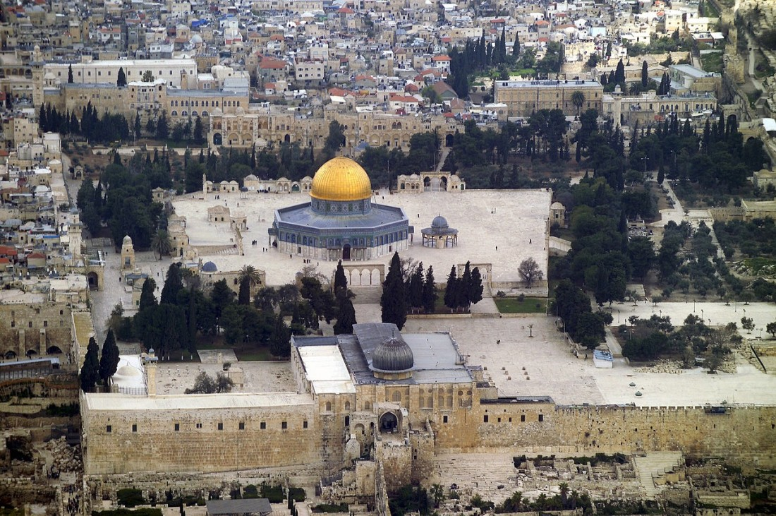
From a prophetic standpoint
The Six Day War gave Israel sovereign control over the entire city of Jerusalem including Temple Mount
The end of the treading down of Jerusalem by Gentiles is foretold is by the Lord Jesus – Luke 21:24
And they shall fall by the edge of the sword, and shall be led away captive into all nations: and Jerusalem shall be trodden down of the Gentiles, until the times of the Gentiles be fulfilled.

Slide 26
From a prophetic standpoint
The Septuagint translation of Zechariah 12:3 reads, “And it shall come to pass that in that day that I will make Jerusalem a trodden stone to all the nations: everyone that tramples on it shall utterly mock at it and all the nations of the earth shall be gathered together” against it.”
And they shall fall by the edge of the sword, and shall be led away captive into all nations: and Jerusalem shall be trodden down of the Gentiles, until the times of the Gentiles be fulfilled.

Slide 27
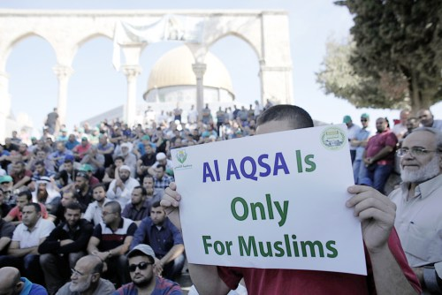
The question of “how long?”
Then I heard a holy one speaking, and another holy one said to the one who spoke, “For how long is the vision concerning the regular burnt offering, the transgression that makes desolate, and the giving over of the sanctuary and host to be trampled underfoot?” And he said to me, “For 2,300 evenings and mornings. Then the sanctuary shall be restored to its rightful state [KJV ‘cleansed.’]” Daniel 8:13-14 ESV

Slide 28
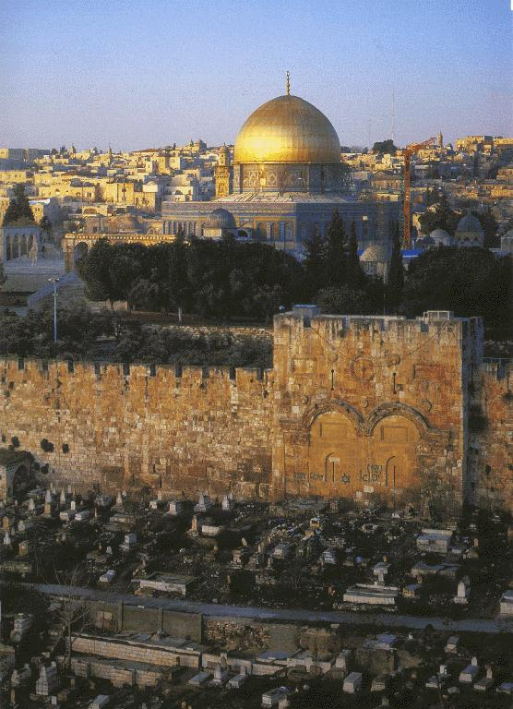
The restoration of the sanctuary to its rightful state
Event | Date
Restoration of the Temple Mount to Jewish sovereignty | 1967
Full access of Jews to pray without interference from the Muslim Waqf
Removal of the Dome of the Rock and al Aqsa Mosque and the opening of the gate
Construction of the temple to serve as an house of prayer for all people

Slide 29
The restoration of the sanctuary to its rightful state
And on the temple shall be the abomination of desolations; and at the end of the time an end shall be put to the desolation. Daniel 9:27, Septuagint

Slide 30
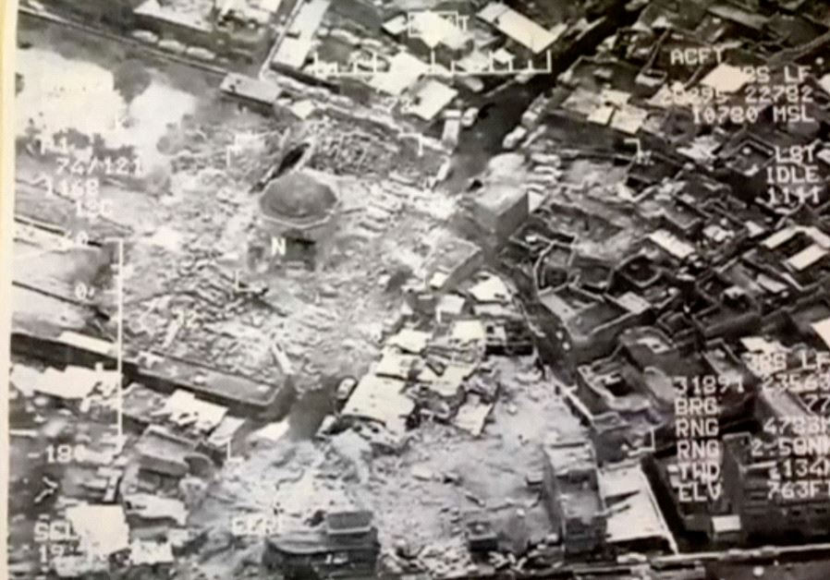
The destruction of Grand al-Nuri Mosque in Mosul June 21 2017
ISIS blew up an historic mosque in Mosul that dates to the 12th century and which was distinguished by a leaning minaret.
Mosul is on the western bank from where Nineveh stood on the opposite side of the Tigris River.

Slide 31
Though the vision tarry, wait for it
Then the angel of the Lord answered and said, O Lord of hosts, how long wilt thou not have mercy on Jerusalem and on the cities of Judah, against which thou hast had indignation these threescore and ten years? And the Lord answered the angel that talked with me with good words and comfortable words. So the angel that communed with me said unto me, Cry thou, saying, Thus saith the Lord of hosts; I am jealous for Jerusalem and for Zion with a great jealousy. And I am very sore displeased with the heathen that are at ease: for I was but a little displeased, and they helped forward the affliction. Therefore thus saith the Lord; I am returned to Jerusalem with mercies: my house shall be built in it, saith the Lord of hosts, and a line shall be stretched forth upon Jerusalem. Zechariah 1:12-16

Slide 32
Ye that make mention of the Lord,
Keep not silence, And give him no rest, till he establish, and till he make Jerusalem a praise in the earth.
Isaiah 62:6-7

