Slide 1
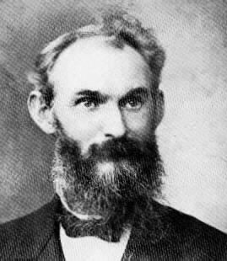
Ministers by whom we believed
Kentucky christadelphian bible school
July 1 – 7 2017
Thomas Williams 1847 - 1913

Slide 2
Note to PDF slide copy
The PDF software picks up background icons from the Microsoft Powerpoint template that show up on certain slides as circles.
In the original presentation, these circles did not display.
It has not been possible to suppress them in making the PDF copy.

Slide 3
Five day lesson plan
We also believe and therefore speak
The work of an evangelist
The care of all the ecclesias
Let your moderation be known unto all men
Prove all things; hold fast that which is good

Slide 4
Do you understand what you are reading?
And there was an Ethiopian, a eunuch, a court official of Candace, queen of the Ethiopians, who was in charge of all her treasure. He had come to Jerusalem to worship and was returning, seated in his chariot, and he was reading the prophet Isaiah. And the Spirit said to Philip, “Go over and join this chariot.” So Philip ran to him and heard him reading Isaiah the prophet and asked, “Do you understand what you are reading?” And he said, “How can I, unless someone guides me?” And he invited Philip to come up and sit with him. Now the passage of the Scripture that he was reading was this:

Slide 5
“How can I unless someone guides me?”
“ Like a sheep he was led to the slaughter and like a lamb before its shearer is silent, so he opens not his mouth. In his humiliation justice was denied him. Who can describe his generation? For his life is taken away from the earth.”
And the eunuch said to Philip, “About whom, I ask you, does the prophet say this, about himself or about someone else?” Then Philip opened his mouth, and beginning with this Scripture he told him the good news about Jesus.
Acts 8:27-35 ESV

Slide 6
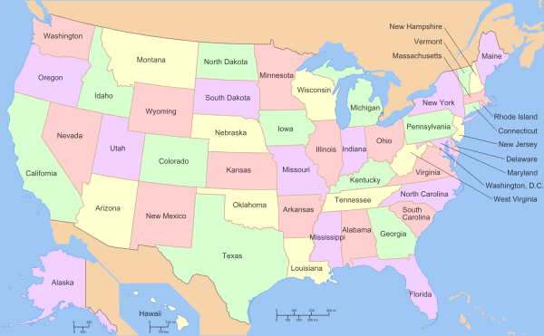
Why was this subject chosen?
For Unification
To review the work of a man who was used by God as an instrument to establish and nurture many of the ecclesias and families from which brothers, sisters and children at this Bible come – he was an influence for the truth and peace

Slide 7
The uselessness of pedigree according to the flesh
For ye see your calling, brethren, how that not many wise men after the flesh, not many mighty, not many noble, are called: But God hath chosen the foolish things of the world to confound the wise; and God hath chosen the weak things of the world to confound the things which are mighty; And base things of the world, and things which are despised, hath God chosen, yea, and things which are not, to bring to nought things that are: That no flesh should glory in his presence. But of him are ye in Christ Jesus, who of God is made unto us wisdom, and righteousness, and sanctification, and redemption: That, according as it is written, He that glorieth, let him glory in the Lord. 1 Corinthians 1:26-31 citing Jeremiah 9:24

Slide 8
Why was this subject chosen?
The thing that hath been, it is that which shall be; and that which is done is that which shall be done: and there is no new thing under the sun.
Is there any thing whereof it may be said, See, this is new? it hath been already of old time, which was before us.
Ecclesiastes 1:9-10 ESV
2. To learn from our history

Slide 9
Why was this subject chosen?
If any man speak, let him speak as the oracles of God; if any man minister, let him do it as of the ability which God giveth: that God in all things may be glorified through Jesus Christ, to whom be praise and dominion for ever and ever. Amen.
1 Peter 4:11
3. As a means for studying the message of the Bible

Slide 10
Why was this subject chosen?
When I call to remembrance the unfeigned faith that is in thee, which dwelt first in thy grandmother Lois, and thy mother Eunice; and I am persuaded that in thee also.
But continue thou in the things which thou hast learned and hast been assured of, knowing of whom thou hast learned them;
2 Timothy 1:5, 3:14
4. On account of the principle, “knowing of whom thou has learned them”

Slide 11


Why was this subject chosen?
5. For benchmarking our understanding and practice in the 21st century with that of the ecclesias in the 19th century

Slide 12
Why was this subject chosen?
And we beseech you, brethren, to know them which labour among you, and are over you in the Lord, and admonish you;
And to esteem them very highly in love for their work's sake. And be at peace among yourselves.
1 Thessalonians 5:12-13
Respect
The apostle Paul commands us to esteem brethren who undertake work for the Lord.

Slide 13
What our purpose is not
For while one saith, I am of Paul; and another, I am of Apollos; are ye not carnal? Who then is Paul, and who is Apollos, but ministers by whom ye believed, even as the Lord gave to every man? I have planted, Apollos watered; but God gave the increase.
1 Corinthians 3:4-6
To glory in men according to the flesh

Slide 14
The same spirit of faith
We having the same spirit of faith, according as it is written, I believed, and therefore have I spoken; we also believe, and therefore speak; Knowing that he which raised up the Lord Jesus shall raise up us also by Jesus, and shall present us with you.
2 Corinthians 4:13-14
The resurrection which is through Jesus [Young’s Literal Translation of the Greek preposition dia, by the means of]

Slide 15
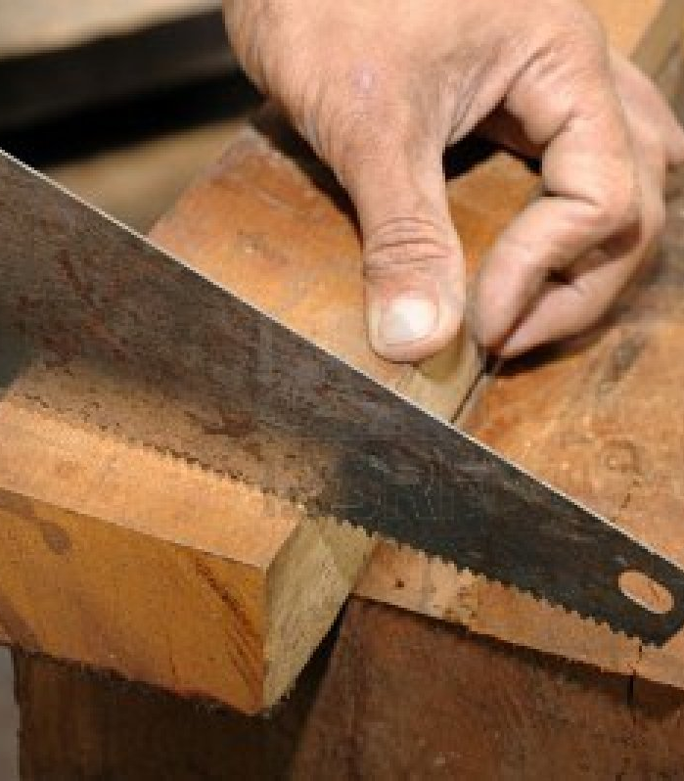
Skilled as a carpenter
Thomas Williams apprenticed as a carpenter
He taught carpentry to others as a young man in Wales
Carpentry was his connection to Christadelphians

Slide 16
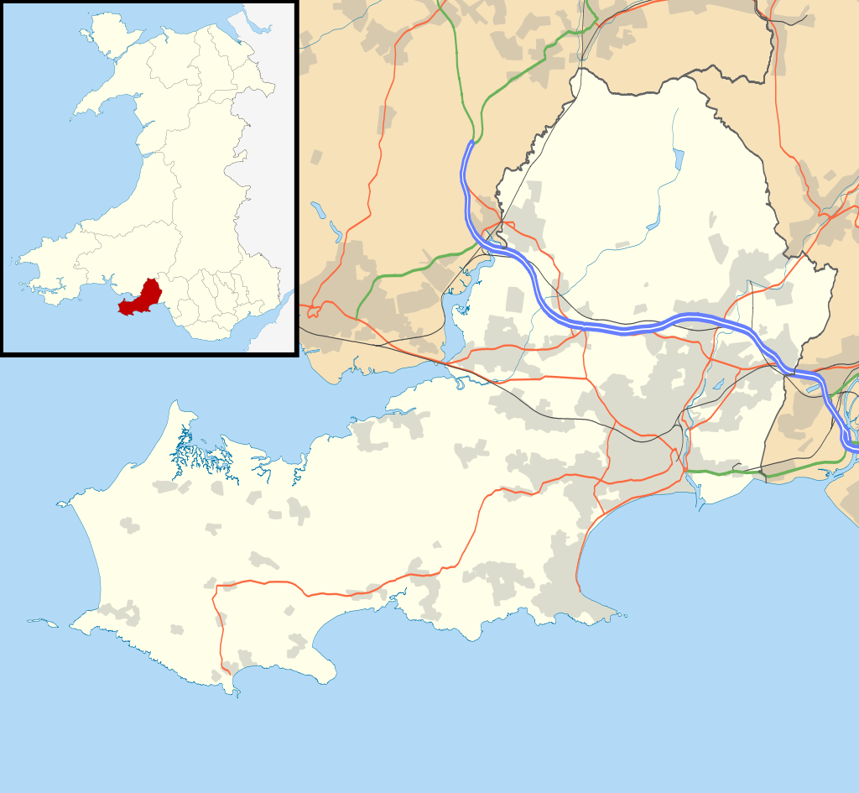
Early life in south Wales
Born in Parkmill
Lost his mother at age 2
Raised by his grandmother
Moved to Mumbles in his teens
Met William Clement, a Christadelphian and also a carpenter
Gower Peninsula
X
X
Parkmill
Mumbles

Slide 17
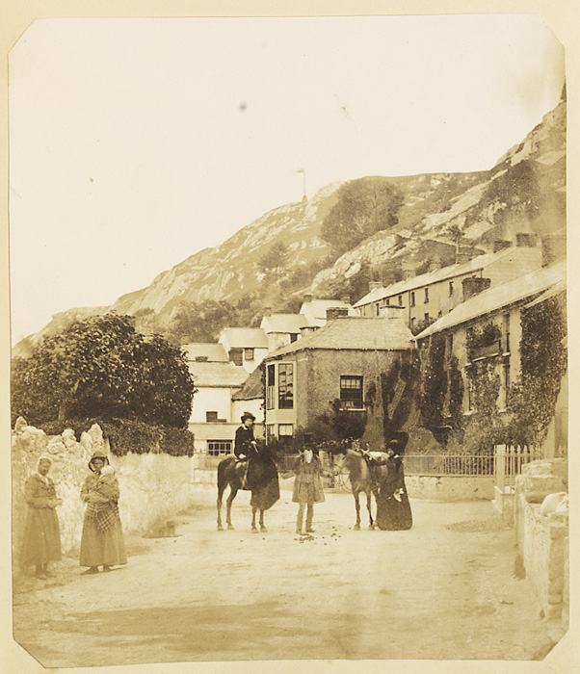
Early life in south Wales
Baptized at 17
Married to Elizabeth Clement “for the better without the worse”
Emigrated to Chicago in 1872 at age 25 with three children (five more were born in the US)

Slide 18
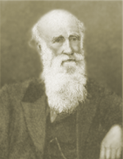
Did Thomas Williams ever meet and/or hear Dr. Thomas in person?
Yes.
Brother John Thomas probably with his daughter, Sister Eusebia Lasius, visited Mumbles in the summer of 1869 on his third trip to England.

Slide 19
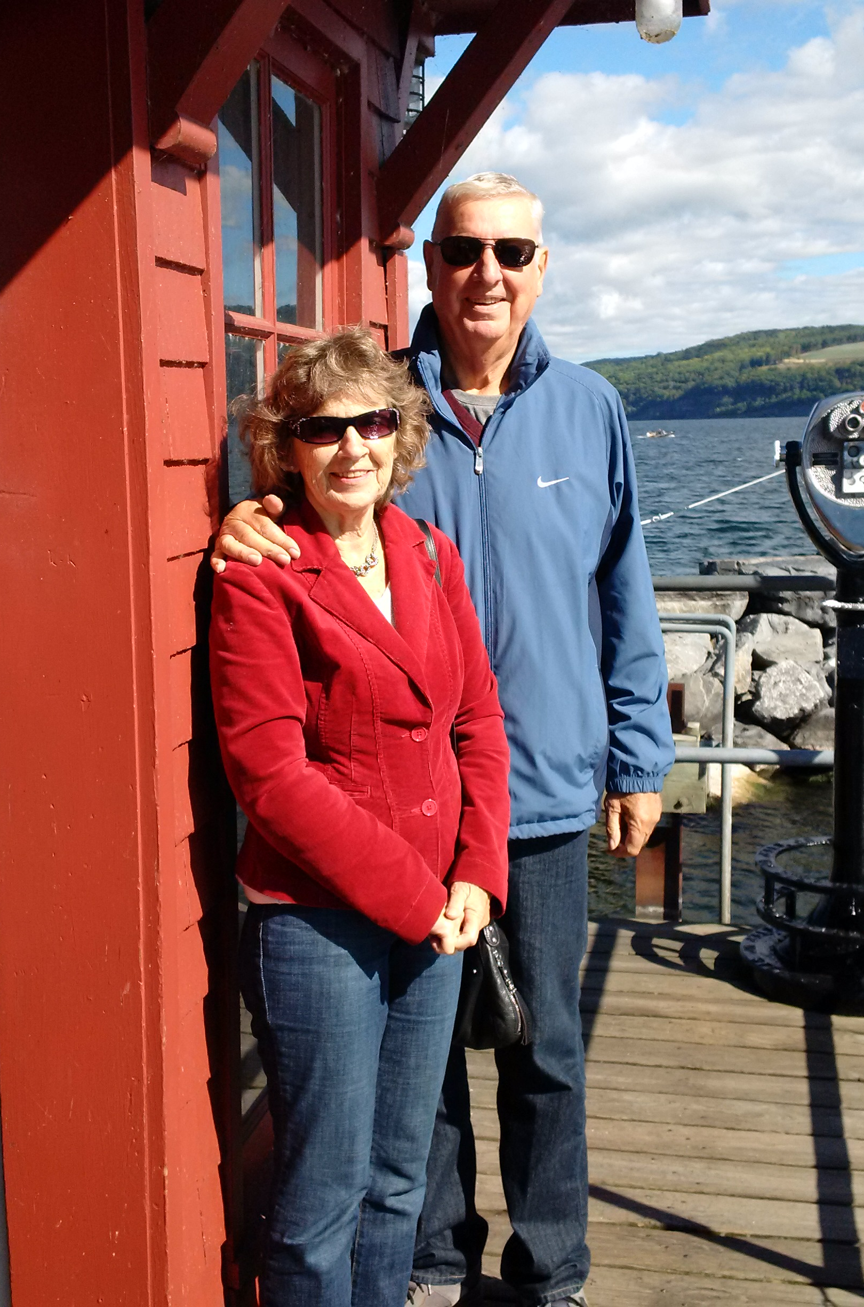
These lessons are dedicated to the memory of our late Brother Jim Millay and his work in the Lord
Picture taken at Watkin’s Glen in September 2016 on the shore of Seneca Lake
Wherefore comfort yourselves together, and edify one another, even as also ye do.

Slide 20
Question to think about
Could a “Thomas Williams” ever arise among the christadelphians of north America today?

Slide 21
The work of an evangelist
2 timothy 4:5
TUESDAY JULY 4

Slide 22
Today’s content
the Sola Scriptura movement
The establishment of The Advocate (1885)
The 1893 Chicago World’s Fair Project
Managing the thorn in the flesh

Slide 23
The rise of Sola Scriptura Protestant sects in 19th century America
The Adventist Movement in America led by William Miller
The Restorationist Movement in America led by Campbell-Stone
The Seventh Day Adventists
James and Ellen White
The Zion Watchtower Tract Society
Charles Taze Russell
Disciples of Christ and the Christian Church
Christadelphians
Church of God of the Abraham Faith
Worldwide Church of God led by Herbert W. Armstrong

Slide 24
A Christadelphian statement of sola scriptura
…the reader must, in justice to himself and the truth, study it with the Bible at his right hand, for he will find but few pages in which frequent reference is not made to its authority, and without which nothing can or ought to be determined.
Author’s Preface to the first edition
Elpis Israel, p. xx
“It is written” occurs 80 times in Scriptures, 63 times in the New Testament.

Slide 25
Thirteen Lectures on the Apocalypse p. 12

Slide 26
Other claimed sources of authority
Tradition
Extra-biblical revelation
Experience
Church government vested
in human authority
The extent and role of ecclesiastical organization
Veneration of men
Worship of relics
Substituting that which is carnal for that which is spiritual

Slide 27
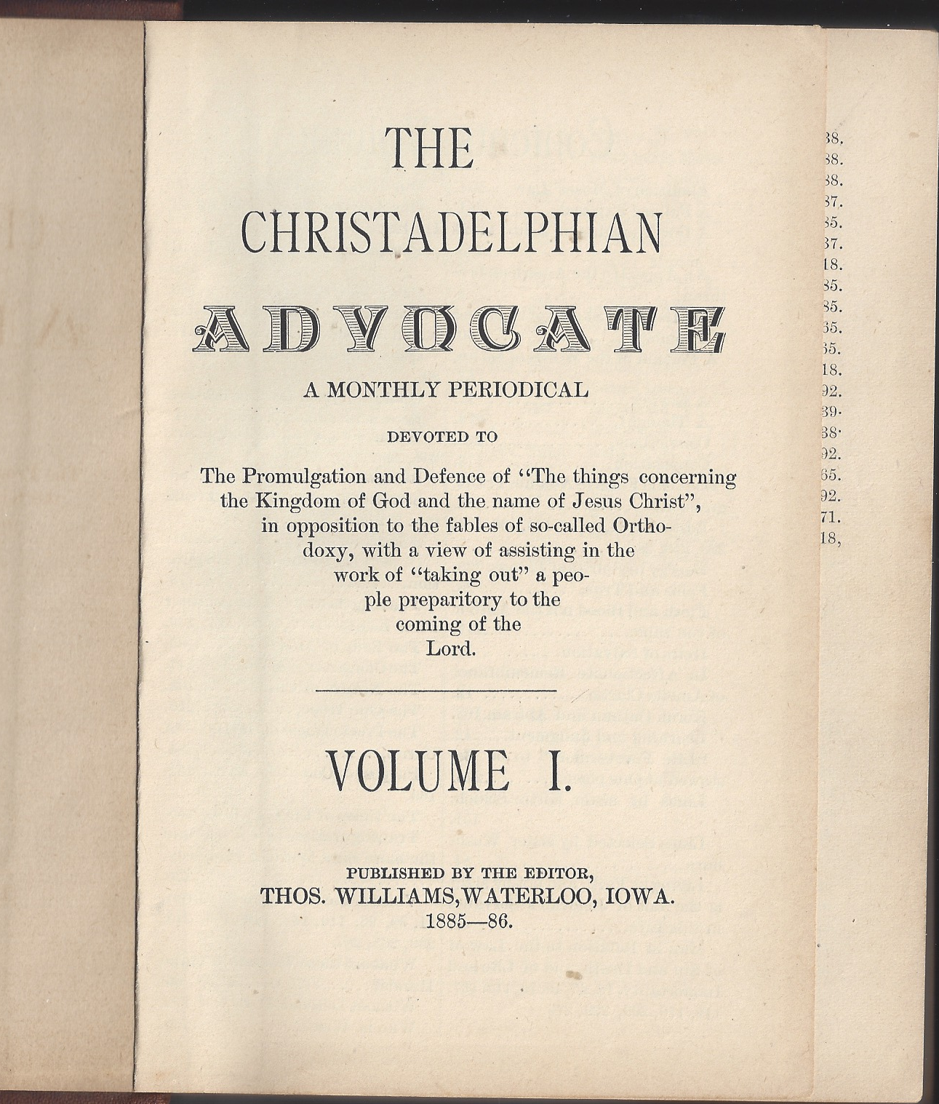
The Christadelphian Advocate project 1885-1913

Slide 28
How The Advocate started – moving from Riverside to Waterloo
Many of our readers will not be aware that the start of THE CHRISTADELPHIAN ADVOCATE was largely due to our deceased brother, Dr. G. G. Bickley. Until 1883 from the year after our arrival in America --1873 – we were engaged in business in the town of Riverside, Iowa. Bro. Bickley was the first to invite us to Waterloo to give a course of lectures, and our visits continued frequently, during which time he continued to urgently request us to remove there in the interests of the truth. No business opening appearing to us, we hesitated till, at last, Brother Bickley found us an opening in which to make a beginning; and therefore he was the cause, humanly speaking, of our removal to Waterloo.

Slide 29
How The Advocate started – a lecture tour to take counsel with the brethren
Soon it developed that our brother had solicited the assistance of Brother G. T. Washburne, then of Jersey City, N. J., to arrange for us a lengthy lecturing tour, during which we were to decide whether we thought it feasible to start an American periodical. Our tour lasted four months, and during the time Brother Bickley was writing here and there on the project of a periodical. Thus he started the idea, and he was also prepared to help financially carry the idea into effect. So far as the editor of the Advocate can see, there never would have been a Christadelphian ADVOCATE had it not been for our beloved brother, Dr. G. G. Bickley, who has now been laid to rest to await his reward.

Slide 30
“We are not very far from the brink of the grave”
Though our dear brother was seven years older than we, his death makes us feel that we are not very far from the brink of the grave. If we are permitted to live to his age – 72 – how quickly the seven years will pass away! Brother Bickley loved life, as a precious gift of God; but he had to die, and we must face the same end. It is useless for tears to flow, and for the heart to ache, we must keep face to the sun, else the shadows will overwhelm.
The Christadelphian Advocate, November, 1912, p. 285-286
Brother Williams fell asleep in Christ 13 months later in December 1913 at age 66

Slide 31
“What we are most concerned about”
That we may so write so as to be understood by the “partially educated” and the poor of this world; and with the approval of Him whose “eyes behold, his eyelids try, the children of men.” (Psalm 11:4), is what we are most concerned about. We know from experience and observation, that it is among the impossibilities for anyone to conduct a periodical in such a manner as to please every one.
The Christadelphian Advocate, Volume 1, Number 1, March, 1885, p. 2

Slide 32
“Counsel is what we shall at all times crave”
…inasmuch as someone must hold the rein, we must ask to be allowed to do so in the guiding of THE CHRISTADELPHIAN ADVOCATE – in deciding what shall go into its columns, and what shall go into the waste basket…In laying down this rule by which we intend to be governed, it must not be understood that we by any means, ignore the fact that “where no counsel is the people fall, but in the multitude of counsellors there is safety.” Counsel is what we shall at times crave, from those who have proven themselves, and who shall prove themselves “workmen that needeth not to be ashamed, rightly dividing the word of truth.”
Our Name and Object, p. 3

Slide 33
The 1884 lecture tour – Canadian portion
Leave Waterloo (Iowa) for Chicago June 23; transfer to the train to Guelph after a short visit with brethren in Chicago
Ten days at Guelph, six lectures given
Four days at Doon -- four lectures given (Doon and Blair)
Four lectures at Galt
Two lectures at Preston
One lecture at Waterloo (Ontario), return to Galt to take a sister’s funeral, back to Waterloo (Ontario) for the lecture
Three lectures on one Sunday in Hamilton, acceded to the request to take the funeral of young brother John Dixon, short steamship excursion to Toronto to get acquainted with the Toronto brethren, then back to Hamilton

Slide 34
The great responsibility that rests on us
Several years have elapsed since any intelligence has appeared in the advocate from here. Bro. and Sister Renshaw and myself have been connected with the Doon Ecclesia, but becoming alive to the great responsibility that rests upon us in proclaiming that everlasting gospel to the dying sons of Adam, and which is our only balm in this day of universal darkness, we have formed an ecclesia to be known as the Berlin and Waterloo ecclesia, meeting every Sunday morning at 10:30 A. M. on the corner of King and Queen Streets, Berlin.
E. H. E. CHART, Secretary-Treasurer

Slide 35
The problem with attention to ourselves
The older ones, who had hold of the helm when I used to visit Hamilton, seem now to stand back, possessed of a feeling that it is no use trying to get the people to listen, and seeming to be saying to themselves, “We will give our attention to ourselves.” This is a mistake. We have always found it so.
Long after some have concluded that “it is no use”, many have come out of darkness into light. It is ours to go on with the work, regardless of present visible results; and generally speaking, attention to ourselves at the expense of the alien breeds crotchets, discontent and, at last, serious trouble.
The Christadelphian Advocate, July 1898, p. 203

Slide 36
Question to think about
WHY DID OUR ECCLESIAS LOSE THEIR COLLECTIVE ZEAL TO PREACH THE GOSPEL AND HOW CAN IT BE REGAINED?

Slide 37
The 1884 lecture tour – New York State & Pennsylvania
Three lectures in Buffalo on one Sunday with two hour stop on the journey from Hamilton to Buffalo at Niagara Falls to view the falls
Three lectures in Elmira on one Sunday
Called on new brother in Corning
Two lectures given in Rochester
Mahanoy City, Pennsylvania – chartered train to Sunday School picnic

Slide 38
The 1884 lecture tour – New England and mid-Atlantic
At Jersey City he gave two lectures, visited the grave of John Thomas with his daughter, Sister Lasius
Took the steamer from New York to Fall River, MA and then the train to Fitchburg, MA – lectures given
Worcester, MA – two lectures given
Visited the believers in Lowell, MA for two days
Two lectures given in Boston
Returned to Jersey City where two lectures were given in a different part of the city
Two lectures given in Baltimore, MD
Six lectures given in Washington, DC

Slide 39
The 1884 lecture tour – Virginia, Pittsburgh, Michigan and Chicago
Lanesville, VA to attend gathering of the brethren and then a stopover in Richmond to visit brethren there
Returned to Washington, thence to Pittsburgh to visit brethren there
Stopped in Grand Rapids, MI for one week to visit the believers there and lecture
Two lectures given in Chicago
Arrived home in Waterloo on October 19th

Slide 40
The 1884 lecture tour extension
Left on November 15th on request to take the funeral of sister Thompson in Mahanoy City, PA
Returned through Spottsville, KY where five lectures were given in the public school house and then to the Barrans where five more lectures were given, one to an audience of 400, his second visit there
Seven days spent in southern Illinois at Ward’s Mills
Arrived back in Waterloo on December 17th, 1884

Slide 41
Who did the physical work of publishing The Advocate?
…but the one on whom the principal part of the work depended (our eldest daughter) was compelled, from impaired health, to give up, and a compositor whom we had hired left, to engage in business on his own account, and this almost completely stopped the machinery of the office until our return home. [1891, p. 235]
Mary Melvina, the editor’s daughter, had worked in the office for a number of years, and was well in line with the run of things as well as being an index to every detail, having an excellent memory. The first of January, 1896 ended her help in the office and took her to a farm in Iowa as help-meet to one who has promised to love and keep her in sickness and in health as long as they both shall live [1896, p. 147]

Slide 42
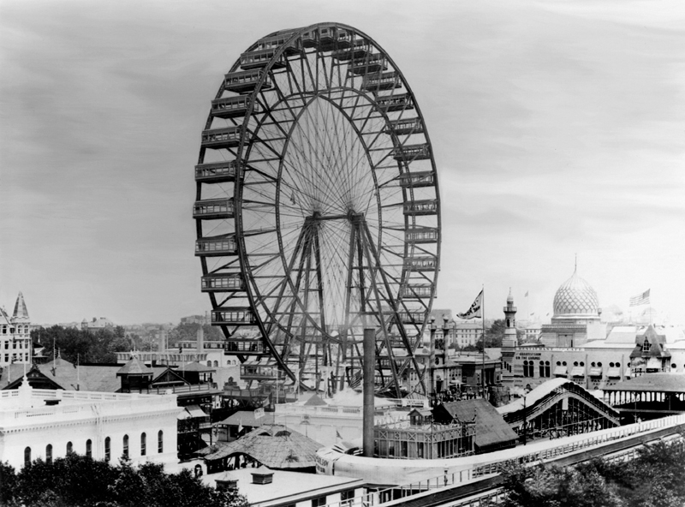
The Chicago World’s Fair 1893
The Great Salvation was produced as a response to an opportunity identified by brethren to witness to the truth at the 1893 Chicago World’s Fair.
14,000 copies were printed for that purpose and more were needed.

Slide 43
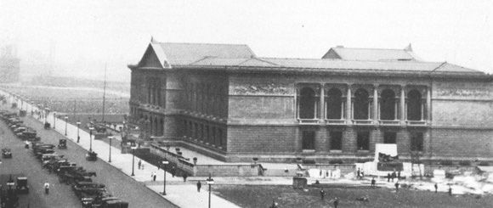
The Chicago World’s Fair 1893
The Great Salvation was produced as a response to an opportunity identified by brethren to witness to the truth at the 1893 Chicago World’s Fair.
14,000 copies were printed for that purpose and more were needed.

Slide 44
The original initiative
Through the suggestion and instrumentality of our esteemed Brother Tichenor, a stand was secured in “The American Institute Fair” (held each year in N. Y. City for two months) and supplied with Christadelphian literature, Sister Tichenor attending it, assisted by one or more brethren and sisters each day, as it was convenient to them. It was made especially attractive by having for a background an enlarged coloured “God Manifestation Chart” (12 feet square) property of Bro. Coddington.
…a greater work of like nature presents itself…having a similar stand in “The World’s Fair” in Chicago.
The Christadelphian Advocate, December 1891, p. 303
Letter to the Brotherhood from Brother Walter Andrew, Brooklyn, NY

Slide 45
The second page of the cover
To World’s Fair Visitors: This edition of “The Great Salvation” is issued specially for you.
You may feel that you have not time to read it while you are visiting the Fair.
If so, please do us the kindness and yourselves the justice of taking care of it till you return to your homes; and then lay aside prejudice and read the little book carefully.

Slide 46
We answer:
Do you ask, Whence its source? We answer:
The Christadelphians of the American continent, believing that the way outlined herein is the only way of salvation, and moved by a sense of their duty to God and their fellow-men, extend this little work to you as an olive branch of love, in the hope that it may help you to obtain the blessings of the great salvation.
Do you ask, Who are the Christadelphians? We answer;
They are a people who believe the things set forth herein and try to faithfully practice the precepts of Christ, in the hope of realizing the great salvation.

Slide 47
The labourers are few
The work of printing, folding, making up and binding these has taxed out little office to its full capacity. Such an amount of work would have been impossible a few years ago, before we were so freely helped to add new machinery and type. Nearly a ton and a half of paper has been used in this edition…
This stand (at the Art Institute where the Congress of Religions was meeting adjacent to the Fair) was placed in charge of the editor, who was to be there himself or keep someone else there during the day time, and for night meetings other brethren took turns. We gave as much personal attention as we could, and sent Brother Nungasser when we could not be there, Sister Williams also taking charge a good share of the time. [1893, p. 243-245]

Slide 48
My condition was a trial
Brothers, I entreat you, become as I am, for I also have become as you are. You did me no wrong. You know it was because of a bodily ailment that I preached the gospel to you at first, and though my condition was a trial to you, you did not scorn or despise me, but received me as an angel of God, as Christ Jesus. What then has become of your blessedness? For I testify to you that, if possible, you would have gouged out your eyes and given them to me.
Galatians 4:12-15

Slide 49
“Our hearing had become so impaired”
Having had to work hard before leaving home in order to be able to leave, and then to continue to fill platform appointments…we were worked down until our stock of vitality was at quite a low ebb…Our hearing had become so impaired that we felt somewhat alarmed…the thought of cancelling these (planned appointments in the lecture field) would be a source of mental harassing that would be harder to bear than the work itself – “the cure would be worse than the disease.” So, after reflection, we concluded to lay aside all literary work, and confine our labour to that which seemed the more pressing. We commenced to improve, and continued, until, when we reached home we were like a new creature.
The Christadelphian Advocate, June-July 1888, p. 150

Slide 50
“It is better to wear out than to rust out”
We feel that we have, during our work in the Truth for the last ten years, overtaxed our strength, and that to it is to be attributed the inconvenience we now experience from impaired hearing. However the work comes; we cannot stand still, and it is better to wear out than to rust out. We are not without hope, either, of regaining what we have lost in the life that now is as well as in that which is to come.
The Christadelphian Advocate, July 1893, p. 151

Slide 51
“Our thorn in the flesh”
“The old doctor” came close up by our side and whispered in our ear something we felt sure was confidential and esteemed important; but a whisper was of no use to us; for of late years our “thorn in the flesh” has been an impaired hearing, a fact which the doctor for the moment forgot.
“The old doctor” is a reference to aged Brother Dr. L. Edwards. Brother Edwards presided at all four lectures Brother Williams gave in the Lanesville Christadelphian meeting house, one Wednesday night, one Thursday night, and two on Friday when an ‘all day meeting’ was held.
The Christadelphian Advocate, October 1897, p. 295

Slide 52
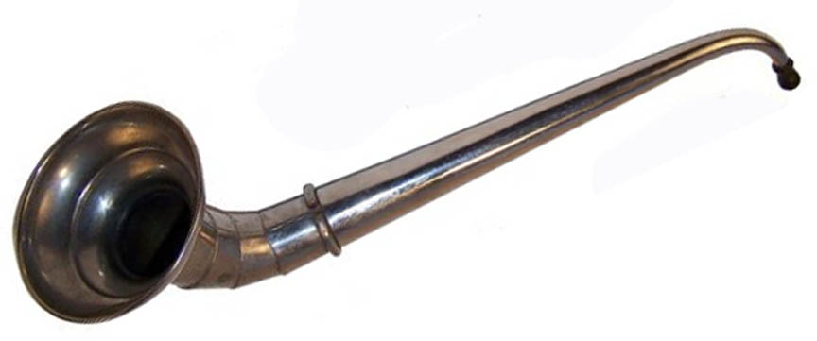
“Our thorn in the flesh”

Slide 53

“Our thorn in the flesh”

Slide 54
The care of all the ecclesias
2 CORINTHIANS 11:28
WEDNESDAY JULY 5

Slide 55
Today’s content
Learning to get along as a family
The Inspiration controversy
The debate as a preaching tool
The problem of mortality firsthand
The growth of the community - “Come over and help us”

Slide 56
The second amendment analogy
The Second Amendment of the United States Constitution reads: “A well regulated Militia, being necessary to the security of a free State, the right of the people to keep and bear Arms, shall not be infringed.”
How can a people that has no ecclesiastical hierarchical body to make policy decisions for it retain its sola scriptura commitment and preserve its understanding of the Bible?

Slide 57
Besides those things that are without
In weariness and painfulness, in watchings often, in hunger and thirst, in fastings often, in cold and nakedness. Beside those things that are without, that which cometh upon me daily, the care of all the ecclesias.
2 Corinthians 11:27-28

Slide 58
So please pardon us
[In looking back over the last two pages of our manuscript, we observe that we have been saying a good deal about our humble self – seems too personal – have a notion to draw the pen through it. But then, we are all one family, and humblest child likes to tell its little troubles to the rest of the family, especially when reminded of that wonderful sympathy that finds expression in rejoicing with those that rejoice and weeping with those that weep. So please pardon us, and we will pass on.]
Parenthetical insertion, The Christadelphian Advocate, June-July 1888, p. 150

Slide 59
God arranged the members as He chose
For the body does not consist of one member but of many. If the foot should say, “Because I am not a hand, I do not belong to the body,” that would not make it any less a part of the body. And if the ear should say, “Because I am not an eye, I do not belong to the body,” that would not make it any less a part of the body. If the whole body were an eye, where would be the sense of hearing? If the whole body were an ear, where would be the sense of smell? But as it is, God arranged the members in the body, each one of them, as he chose. If all were a single member, where would the body be? As it is, there are many parts, yet one body.

Slide 60
God has so composed the body
The eye cannot say to the hand, “I have no need of you,” nor again the head to the feet, “I have no need of you.” On the contrary, the parts of the body that seem to be weaker are indispensable, and on those parts of the body that we think less honorable we bestow the greater honor, and our unpresentable parts are treated with greater modesty, which our more presentable parts do not require. But God has so composed the body, giving greater honor to the part that lacked it, that there may be no division in the body, but that the members may have the same care for one another. If one member suffers, all suffer together; if one member is honored, all rejoice together. 1 Corinthians 12:21-26

Slide 61
“It will be hard to kill it”
Others say that if there is any danger of the advocate “dying of inanition*” in the financial sense, speak out, and many comrades will rally to the standard. The fact is, we have the work of the advocate done upon such economical principles that it will be hard to kill it. Father, mother and children do the work, and what cannot be done in day time is done at night. Brethren understanding this, and that not one of the family knew anything of the mechanical art of printing three years ago, will forbear sharp criticism, should they see any little defects.
The Christadelphian Advocate, April 1888, p. 93
*Exhaustion caused by lack of nourishment

Slide 62
We have no right to separate for dislike
The Truth brings men together possessed of various characteristics. We must try and understand the different men we are brought in contact with, and adapt ourselves to their, to us, oddities, and they to ours. We have no right to separate from the body, nor to divide an ecclesia because of some natural reasons for dislike of certain personal characteristics.
There are some men who are always on “on the off side.” If you say yes they will say no and vice versa.
…As long as the fundamental principles of the gospel are not denied nor nullified…we must adapt ourselves to the many and various forms which human nature assumes, remembering that we may appear to others as ugly as they do to us.
July 1898 p. 204 Report on Editor’s Tour

Slide 63
“The result of our own faults”
Trouble we must expect, and our fate depends upon the manner in which we conduct ourselves in encountering it. Every individual will have his trouble to bear; every Ecclesia its internal difficulties to contend with; and the whole body individually and collectively will, if faithful, have to wrestle with principalities and powers in the ecclesiastical heavenlies.
The present is a life of warfare any way we please to view it; hence the necessity of courage, fortitude and patience, so that we may not be overcome with evil but that we may overcome evil with good.
Many of our individual and Ecclesial troubles are the result of our own faults, and by a little forethought, and practical management may be obviated. Especially is this the case in many internal strifes in the disciplinary affairs of the Ecclesia.

Slide 64
The inspiration controversy 1885
For about nine months our brethren on the British Isles have been engaged in the hottest battle that has ever been fought since ‘the truth’s revival in these last days of Gentile times. In the course of the battle, measures have been resorted to, that, judging from this distance, have in some cases been extreme, and in others of such a character as to bring ‘the truth’ into public disgrace. The brethren have been almost deluged with the flood of literature that has carried far and wide matters purely of a personal and domestic nature, which has only exposed the weakness of the flesh in some instances, and, in others, the hideous deformities of the “Old Man.”
…It is in the nature of things utterly impossible to keep from forming opinions under such circumstances. Whatever such opinions may be, however, they are not subjects suitable for publication. It is not necessary to publish opinions of personal matters, and the bridling of that unruly member is specially a good exercise in such cases.

Slide 65
The inspiration controversy 1885 (2)
THE ADVOCATE has endeavored to, and we think succeeded in keeping out of its pages everything that would have the appearance of partisanship in this inspiration controversy. It has however expressed itself plainly on the subject itself at such times as it appeared necessary. It has not been, neither is it now, necessary for us to enter into an elaborate discussion of this vexing question, that has been done by those directly engaged in the conflict. The fact we have had so little to say must not be construed to mean that we underestimated the importance of the issue. We have been eagerly watching the battle, and maintaining an attitude that while compromising no principle of the precious truth, would enable us when necessary to take a stand without even the appearance of partisanship.
Editorial, September 1885, p. 161

Slide 66
Yet do it with gentleness and respect
But in your hearts honor Christ the Lord as holy, always being prepared to make a defense to anyone who asks you for a reason for the hope that is in you; yet do it with gentleness and respect
1 Peter 3:15

Slide 67
A debater for the truth’s sake
Opponent | Topic | Year | Place | ##
F. W. Grant | Orthodox doctrines heaven, hell | 1887 | Guelph | 9
C. Watts | Secularism vs. the Bible | 1888 | Hamilton | 4
C. Braden | All prophecies fulfilled already | 1893 | Chicago | 7
J. N. Hall | Heaven-going | 1898 | Zion, KY | 6
J. N. Hall | Heaven-going | 1898 | Creal Springs | 10
J. Inglis | Anglo-Israel theory | 1899 | Chicago | 4
Dr. Snowdon | Seventh day Adventism | 1899 | Martinville | 3
This is only a partial list of debates in which Brother Williams represented the Christadelphian understanding of the Bible.

Slide 68
Death firsthand – sad calamity
“I do not know if you have heard of brother and sister Blanton’s sad calamity in the loss of their son, a young man about twenty years of age. He was shot and killed in Texas last month (November). It was a severe shock…as brother Blanton says, that obedience to the truth not having been rendered, no hope can be entertained.” [Brother Boyd, 1886, p. 22]
It becomes my painful duty to report the sad news that our respected brother and sister David Cole, of Doon, have been stricken with grief by the death, on Oct. 9th, from an accident, of their second eldest son, brother James E. Cole, age 19 years. He was an exemplary young man, beloved by all who knew him: and died strong in the faith… [Blair, ON, Brother Renshaw, 1886, p. 260]

Slide 69
Death firsthand
Died at Doon, Ont. On June 28, ‘88, sister Annie Agnes Hardy, aged 18. Our young sister was afflicted with heart disease and dropsy, which she bore without complaint. Always bright and cheerful, Annie had a pleasant word for all who called to see her…She was the eldest daughter of brother and sister R. Hardy [John Renshaw, 1886, p. 286]

Slide 70
The saddest affliction of my life
Since I saw you last, I have been called upon to mourn the death of a beloved daughter who retired at night, in apparently good health, and was found dead in bed the next morning. This is the saddest affliction of my life. I am crushed and heart broken. I sorrow not, however, as those who have no hope. I rejoice to know that she was educated in the truth, had believed it, and obeyed it. She was a true Christadelphian. She now sleeps in Jesus, ready to come forth to the sound of the voice of the Lord from heaven, when she will behold his face in righteousness, and be satisfied when she awakes with his likeness. Looking for the time when all our trials will end, in the presence of the truly infallible Judge. [P. A. Blackwell, Henderson, KY, January 1887, p. 262]
Notes:
Brother Blackwell died in 1911 at age 85 and so he was 61 when his daughter died.

Slide 71
It was not so to be in the providence of God
It is with sadness and heavy hearts that we write you of the sudden and severe loss of loved ones who were near and dear to us. Some few days ago we mailed you a daily paper containing the death of our dear boy, Arthur Ernest, six years and nine months old, a fine, healthy, promising and honest little fellow who we had great hopes would have grown up and adorned the doctrine of our Lord and Saviour Jesus Christ; but, alas! It seems it was not to be so in the providence of God…our little boy died of diphtheria after seven days sickness. [Guelph, David and Eliza Tolton, p. 72 1892]
….continued

Slide 72
Sadly stricken with grief
Today we email you another daily paper containing another death, that of Bro. and Sister Benjamin Tolton’s dear boy. Bro. Ben is my twin brother in the flesh and, poor man, he is now sadly stricken with grief not only over the death of his dear boy and only child, but now also over that of his sister wife, aged 23, who was apparently in good health a week ago today, enjoying a drive with us to cheer us up over our loss, and to-day, after three days sickness we laid her in the grave…It does seem so hard that a man should be deprived of a dear, fine, promising healthy boy of sixteen months, and in three days more of his dear sister wife, losing both in one week! [David and Eliza Tolton, 1892, p. 72]

Slide 73
Oh! That enemy, would it were destroyed.
We have had, since last writing to you, both seasons of comfort and seasons of sorrow. The sorrow was caused by the death of my only child, a boy twelve years one month and one week old. He was a great help and consolation to me in my old age; but, alas! The Father saw fit to take him away and left me to grieve his irreparable loss. Oh! That enemy, would it were destroyed. My sorrow is indescribable. [Grand Glaise, AR, Brother K. H. Sanders, 1893, p. 236]

Slide 74
“Thy will be done”
It becomes my duty to inform the readers of the advocate of the death of little Jessie Eblen, of Robards. She died on the night of April 11th of some complicated nervous prostrations and pneumonia, which bid defiance to human aid. The readers of the advocate are familiar with her name on the Sunday-school page. She was a bright girl of thirteen years and a model in her daily deportment and, considering her age, she was well informed in the Truth. All we can say is, “Thy will be done.” The deceased was a daughter of Sister Eblen. [Robards, KY, James M. Cheany, 1895, p. 120]

Slide 75
Abundant baptisms
Since our last report nine persons have rendered obedience to the truth by baptism into the sin-covering name. Their names are as follows: on Aug. 15th, Mrs. Amanda Cheaney, formerly Campbellite, and Lizzie H. White, daughter of brother J. S. White, formerly neutral. On Aug. 17th, Matie Ingram, daughter of brother W. H. Ingram. Sister Matie was rocked in the cradle of the Truth, and hence never imbibed any of the fables of a Paganized Christianity. Again, on Aug. 29th, J. M. Woods, formerly Baptist, Lucy Connaway, wife of Brother W. J. Connaway, formerly Baptist, Mary Farley, wife of Brother H. J. Farley, formerly Baptist, R. T. Connaway, Susan A. Connaway, wife of Brother R. T. Connaway, formerly neutral, and Sabina Gregory, formerly Baptist. We now number fifty-seven, standing firmly upon the “impregnable rock,” a wholly inspired and infallible Bible…
[Henderson KY reported by W. J. Green, 1891, p. 262]

Slide 76
Growing ecclesias
I have more satisfaction than words can express in our work of establishing two ecclesias, one at Good Hope, Tuenburg Co*., and one at Berea, Mulelenburg Co*., with an aggregate membership of one hundred and forty. Thirty-three have put on the sin-covering name during the past four months. Thirty of this number are members of Christadelphian families, who were brought up under the teaching of Dr. John Thomas.
These ecclesias are thoroughly rooted and grounded in the one faith, and established on a sound, and uncompromising Christadelphian basis of fellowship.
MacFarland, VA reported by W. H. Love, 1891, p. 287
*Lunenburg and Mecklenburg Counties in southern Virginia

Slide 77
Today’s thought question What motivates those in Adam to come to baptism?
What drew the individuals to the gospel whose baptisms are reported?
How did those reporting the baptism express the carrying out of the ordinance?

Slide 78
A sample of baptisms reported in the month of August 1887
It affords me great pleasure to forward to you the intelligence that our ecclesia here has been strengthened in numbers, and encouraging to continue sowing the good seed by the addition to the household of faith of Edward Parrish, who was immersed into the sin covering name June 11th, after an intelligent confession of faith in the things most surely believed among us.
We have assisted one more to put on the sin-covering name, viz: William H. Metcalf, who, after a satisfactory confession of his faith in the gospel of the Kingdom of God and in those things which concern the name of our Lord Jesus Christ, was baptized July 9th.
Your brother in Israel’s hope, GEO. DANIELS, Baltimore, MD

Slide 79
Witnessing to a good confession of the faith
During the past six months we have gained one by immersion, viz: Martin Johnson (24) formerly connected with the Swedish Congregational Church. Brother Johnson first heard the truth about two years ago from Brother Nils Peterson. He was so much distressed by what he heard and read that he determined, while on a visit to Norway, to put away all the Christadelphian reading material in his possession, and study the Bible to see if these things were so…his daily reading of the Bible only served to fasten it there more securely. The result was that he gain sought the company of the brethren when he returned to America, and on June 24th, after witnessing to a good confession of the faith, he was immersed into Christ by brethren Evison and Washburne in New York bay. Our number now is fifty…
G. T. Washburne, Jersey City, NJ

Slide 80
We are happy to say
After toiling for nearly twelve months in spreading the gospel we are happy to say two more have been brought into the fold and are now rejoicing in the glorious hope of the return of the Lord Jesus from the heavens…The first was Miss Maggie Atkinson, inducted into Christ upon the occasion of brother Luxford’s visit June 19th, who by his conclusive argument on the “One Hope” induced her to renounce, the hidden things of darkness and unite herself with the “sector everywhere spoken against.” The other is my own daughter, who approached me on Thursday last as we were sitting reading the Book. She said, “Papa, I wish to be baptized.” I asked her if she understood the will of the Book and was willing to render obedience to its requirements. She told me what she understood which was quite gratifying to us…Being quite satisfied that she understood the truth sufficiently (though young), we baptized her yesterday afternoon in the presence of a goodly number of brethren, sisters and friends. She is one of the senior class in our Sunday School…Your brother, JAS. A. ROBINS, Lanesville, VA

Slide 81
Our little band
Two more have been added to our little band here. One is my brother in the flesh, M. J. Trentham, and the other, Miss Fannie Sutherlin, both of whom after an intelligent confession of the “one faith,” were immersed by bro. G. W. Crosby into the sin-covering Name…May Israel’s God bless you and the advocate and make it the humble instrument in His hands, while the Bridegroom tarries, of “taking out” of the Gentile rubbish of this age, many people for his name.
Chloe C. Foster, Little Red, White Co, ARK
Little Red is east of Heber Springs and Greers Ferry Lake

Slide 82
Glad to report
I am glad to report that Andrew J. Boies was to-day assisted by us to put on the name of Christ in baptism. Brother Boies was formerly an Adventist, but is now full of enthusiasm for the truth. This is the fruit of our public lectures begun eighteen months ago. Others are becoming interested, and we hope that they will be obedient soon…We are now having one thousand handbills printed each month to advertise our lectures. [One of the upcoming lectures, for June 26th, was Why Christadelphians make a ‘Hobby’ of the Bible.] Yours hopefully,
WARREN CLOUGH, Lowell, MA

Slide 83
My pleasant duty
It becomes my pleasant duty to report the obedience to the faith of my oldest daughter, Lucy Spencer (nearly 16), who after an intelligent confession was immersed in the lake by brother A. North on the 20th inst., and with us is now constituted a member of the Christ body. This action on her part is very gratifying to us because perfectly free and voluntary…Your brother in the one hope,
J. SPENCER, Wauconda, ILL

Slide 84
We rejoice that God has increased our numbers
The brethren meeting in Worcester have requested me to report the obedience of Elizabeth M. Tunstal (32), formerly neutral, wife of brother Tunstal, formerly of Kidderminster, England; also Frederick H. Wainwright (25), formerly Episcopal church. Brother Wainwright’s attention was first called to the truth by brother Tunstal, who labored hard to show him the way of life; and after attending a few of our lectures and evening meetings he saw his condition – that he was without hope and separate from Christ, and expressed a desire to be united with him by baptism. After a satisfactory examination he, with sister Tunstal, who had been studying the Scriptures for some time, were baptized June 19th. We rejoice that God has increased our numbers in this way, and hope that they may be found worthy to receive a crown of life in the kingdom of God.
B. BIGGAR, Worcester, MASS

Slide 85
Let your moderation* be known unto all men
PHILIPPIANS 4:5
* gentleness, fairness, patience, mild mannered-ness
THURSDAY JULY 9

Slide 86
Seven things that make for peace
Meet face to face not by letter or by tale-bearing
Genuinely seek reconciliation, seek for a solution
Consider both sides of a disputed position honestly and carefully not just one side
Do not make threats about fellowship
Do not reason that the end justifies the means
Distinguish between core doctrines and uncertain details and do not apply the same measures to both
What you practice yourself, as a matter of your own personal conscience, may not be wise to impose on your brethren

Slide 87
I warn you, as I warned you before
Now the works of the flesh are evident: sexual immorality, impurity, sensuality, idolatry, sorcery, enmity, strife, jealousy, fits of anger, rivalries, dissensions, divisions, envy, drunkenness, orgies, and things like these. I warn you, as I warned you before, that those who do such things will not inherit the kingdom of God. Galatians 5:19-21 ESV

Slide 88
Why do peace and reconciliation matter?
May the God of endurance and encouragement grant you to live in such harmony with one another, in accord with Christ Jesus, that together you may with one voice glorify the God and Father of our Lord Jesus Christ. Therefore welcome one another as Christ has welcomed you, for the glory of God.
Romans 15:5-7 ESV
It is our response to the atonement – for he himself is our peace (Ephesians 2:14)
It enables us, as a family community, to serve our God with a unified voice and give a unified message to a perishing world
In this day of small things, the aggregation of resources (sometimes called ‘critical mass’) makes certain work in the Lord possible that would otherwise not be possible

Slide 89
Why do peace and reconciliation matter?
It is our response to the atonement – for he himself is our peace (Ephesians 2:14)
It enables us, as a family community, to serve our God with a unified voice and give a unified message to a perishing world
In this day of small things, the aggregation of resources (sometimes called ‘critical mass’) makes certain work in the Lord possible that would otherwise not be possible
Let no corrupting talk come out of your mouths, but only such as is good for building up, as fits the occasion, that it may give grace to those who hear… Let all bitterness and wrath and anger and clamor and slander be put away from you, along with all malice. Be kind to one another, tenderhearted, forgiving one another, as God in Christ forgave you.
Ephesians 4:29,31-32

Slide 90
Where the truth is paramount
Where the truth is paramount, and there is the patience and forbearance it calls for, it is not a hard task to settle the little difficulties that occasionally arise, and remove all obstacles standing in the way of hearty co-operation and fellowship.
June and July 1888, p. 146
Brother Williams is writing here about estrangement between brethren in the Doon and Galt ecclesias, that caused one to stand aside for a time for conscience’s sake, that was resolved and the one restored. The issue itself was not stated in the advocate.

Slide 91
Two dangers confronting us
There are two dangers confronting us in the sifting which seems to have been taking a fresh start the last year or two. One is that we are in danger of being frightened from doing our duty by a fear lest the cause of truth will suffer in the eyes of the world and be brought into contempt, and the other is that in our zeal for what seems to us to be the purity of the truth, and pure fellowship based upon it, we may go farther than the truth permits us to go in this evil age. God is perfect and our ideal formed by what is revealed of Him might sometimes be too high, and therefore impracticable, for weak, fallible man in this evil age in which we live.
Continued

Slide 92
The only course…safely between extremes
In striving to reach an ideal, we may create a standard too high for the majority of those who are called out ones, and who are expected to find place in the Ecclesia. Evidently the only course to pursue is one that will guide us safely between extremes. We are not allowed to compromise fundamental principles of the truth, and yet toleration is absolutely necessary to some extent among those who cannot be expected to reach to the heights that others can who have had longer experience and given closer attention to certain features of the truth.
Continued

Slide 93
Be careful; beware
To those who seem to us to be going to the extreme in adding to and formulating new statements of faith, we would say, Be careful; you may strangle weak ones for whom Christ died.
To those on the other hand who are distressed with the controversies that have arisen from time to time, and are urging these as a reason for throwing the doors wide open, as it were, in the matter of the basis of fellowship we would say, Beware: for you may compromise principles of truth, and thus become contaminated as the Ecclesias were to whom the seven epistles were written.
Editorial, May 1897, p. 154-155

Slide 94
The Lord knoweth them that are his
The love
the truth
Some of us have a need for a level of certainty and definition which is not possible to attain in this age except by the arbitrary imposition of human authority
We cannot know, we do not need to know, where anyone else is – we can only know, and are required to examine, where we ourselves stand in relation to the faith and the obedience it requires

Slide 95
The need for balance in drawing lines
The little ones
A little leaven leavens the whole lump.
Galatians 5:9 ESV,
cf. Corinthians 5:6
the key of knowledge
It is more profitable to him if a weighty millstone is put round about his neck, and he hath been cast into the sea, than that he may cause one of these little ones to stumble. Luke 17:2 YLT
Woe to you lawyers! For you have taken away the key of knowledge. You did not enter yourselves, and you hindered those who were entering. Luke 11:52

Slide 96
One who might well be carefully watched
One who can pocket principle for the sake of policy might well be carefully watched.
July 1891 p. 187
Brother Williams made this observation after relating how a brother would break bread with Christadelphians in Kansas but not in Iowa, some of the former being receptive to his ideas on the unacceptability of the name Christadelphian and the latter not.

Slide 97
“To catch him in his words”
Then said these men, We shall not find any occasion against this Daniel, except we find it against him concerning the law of his God.
Daniel 6:5
…though detectives have been at work, as it were, stealing in on us in various ways, through letters in disguise, from different quarters and at different times, trying in every conceivable way to get us committed to something that might be used against us, yet, after all this, the only thing that could be found was…the result of our telling a man not to frighten his sister into the obedience of the Truth.
1891 p. 155

Slide 98
(1) Meet face to face to personally question
In letters we had seen and in words heard certain brethren were charged with believing in partial inspiration, immortal emergence, etc. we made it our business to personally question the persons charged, and we were courteously and frankly informed to the contrary…Ah! My dear brethren, you are going beyond your jurisdiction and encroaching upon the rights of him whose prerogative alone it is and whose omniscience only can search the reins and hearts. When zeal outruns discretion it becomes a cruel tyrant, and one possessed of such zeal will be the greatest sufferer.

Slide 99
(1) Witnesses of a tale-bearing spirit
In spite of the discouragements, the brethren seemed determined to press onward in the work of the truth. They naturally feel keenly the injustice done them in the circulation of unfounded reports about their standing in the truth. Smite them not. Allow not others to smite them. Letter writing as a means of sending out charges are witnesses of a tale-bearing spirit; and to receive such letters or in any way to countenance them is to partake of the “evil deeds” of the talebearer (2 John 11).
March 1892 p. 57

Slide 100
(1) Limit the use of letters and when they must be sent, let them be “love” letters
Please pardon the apparent presumption, but another bit of good advice to every ecclesial scribe is: Do not write many letters. An ancient scripture might be paraphrased pointedly so as to read, “O that mine adversary had written a letter.” It is really surprising to note how many errors are to be found in letters when written in times of trouble. Holy Scripture enjoins moral courage, prompts “face-to-face” interviews when misunderstandings arise; pusillanimity has recourse to another line under cover of an envelope and postage stamp…Pour out your heart’s affection when and where and as you will, but always keep in close reserve all that might offend or grieve.
Practical Points, July 1894, p. 305

Slide 101
(2) Trying first to remove the evil
It is a mistake for brethren, as soon as they think an individual member, or an ecclesia is blamable in any particular, to hold them off at arms length; and shun them without trying first to remove the evil, if evil there be, and if not to find it out. Even a heretic is entitled to a “first and second admonition” before we “turn away.” Wherever there appears to be anything wrong – individually or collectively – with those of “like, precious faith,” there is the place to go to work in a spirit of love, coupled of course with firmness, ever bearing in mind that “he which converteth a sinner from the error of his ways shall save a soul from death and hide a multitude of sins. Those who are strong should bear the infirmities of the weak” and not hold up the weakness to public gaze.
1885, p. 31

Slide 102
(3) Consider both sides
Under few conditions is it wise to involve a brother at a distance or another ecclesia in local troubles. Ordinarily it is in exceedingly poor taste to inform an outside party of inside infelicities…If you reflect a moment before you write to a person away from the scene of the action you will see how utterly impossible it is for him to render a safe decision one way or another. Very often an error is made by those who are most intimately acquainted with every person and circumstance; how much more prone to mistaken judgment then must he be who has only your side of the matter as a basis for opinion. Do not ask for such an expression any more than you would give one under the same conditions.
Practical Points, July 1894, p. 305
–

Slide 103
(3) Consider both sides
One side of the question having had a hearing it is only right that the other should. We do not believe that everything pertaining to the Truth should be set forth with one-sidedness. It is to be feared that many have forgotten that it was by “looking at the other side” we escaped from “orthodox” darkness into the light of the truth.
January 1897, p. 9
Written specifically in relation to different approaches for handling cases of marriage with the alien.

Slide 104
(3) Consider both sides
How can we expected to publish in full such a mass of writing, all on one side of a matter?
For it is never safe to decide a difficulty upon the hearing of one side.
Editorial, October 1897, p. 309

Slide 105
(4) Do not make threats about fellowship
Let the brethren do what seems to truth-enlightened minds best in each individual case, in advising, exhorting, instructing and reproving, but stop, do stop, this habit of threatening and inviting divisions over almost every question, small or big, real or imaginary. And to you who seem to be trying to make believe that the advocate is championing a great apostasy, please stop your house-top talebearing, and give the advocate a chance to go on in peace…
We pray God will grant us the mercy our weaknesses need, and the blessings his goodness in the gospel has promised to bestow.
Marriage with the Alien, the advocate in self defence
November 1897, p. 332

Slide 106
(5) Do not reason that the end justifies the means
There is no use beating about the bush, brethren, there is as much inconsistency in some Christadelphians as can be found anywhere in the world; and when a brother who takes a public stand, or a paper that fears no man stands in the way of what some imagine to be their rights, you will have to go a long way to find stranger methods to remove them than are adopted (perhaps, with sincerity, upon the dangerous principle that the end (supposed to be a good one), justifies the means), by some who ought to know better.
Marriage with the Alien, the advocate in self defence
November 1897, p. 328

Slide 107
(6) Differences that do not affect salvation
Toleration, therefore, must find a place among brethren. They must have patience enough to discuss differences without passion; and if they cannot agree on differences that do not affect their salvation they must learn toleration and in patience dwell together in peace. In matters of this kind it is often the case that the “weak” is compelled to bear the infirmities of the “strong” instead of the reverse.
Editorial, July 1894, p. 314

Slide 108
(6) Can A and B leave Christ to judge?
A. and B. agree that there will be a resurrection, both of the just and the unjust, and that both classes will be judged, one reward and the other punished. Very well. They agree, too, that all judgment has been committed to Christ. He know who are the just and the unjust. Very well. Be thankful that you can agree so far; and if you should try to decide from the Scriptures where the Judge will draw the line as to the unjust and should not agree, why don’t quarrel about it. Let the judge draw the line – He will do it anyway – and have enough patience to allow a difference on a matter than can in no way affect you.
Editorial, July 1894, p. 314

Slide 109
(7) What you practice yourself may not be wise to impose on your brethren
Is it not a fact that we have been asked in several cases to officiate at marriages of believers with aliens, where too, the alien was friendly to the Truth, as we had at marriages with believers, and that we refused?
Is it not a fact that we have been invited to attend such weddings in a private capacity and that we have refused to go?
Marriage with the Alien, the advocate in self defence
November 1897, p. 328

Slide 110
The uncertainty of fellowship
On the matter of fellowship many are dissatisfied with the uncertainty of things…
So far as the late controversy is concerned, it is desirable that an understanding be had as to whether certain local withdrawals are to be considered universal, or is it to be understood that co-operation and fellowship be had on the same basis as obtained previous to the controversy. It is well known that the advocate claims and always has claimed whether or not a few Gentiles out of Christ are to be raised for judgment should not be made a test of fellowship.

Slide 111
A removal of the obstacles locally
Actions and words elsewhere, however, indicate differently, and this is one thing many would like a clear understanding upon, with the hope that what has been done is considered only to apply locally. While to make the test of fellowship different in one locality from that of another is quite inconsistent, it would not be so sweeping in its effects; and, possibly, if a clear understanding to this effect were reached first, it might lead to a removal of the obstacles locally. O that it might!
Editorial, February 1896, p. 42

Slide 112
The prerogative of the righteous Judge alone to do
Here is one faction demanding that before an applicant shall be received into fellowship he shall be expert in the Book of Daniel sufficiently to identify the man of sin and declare whether he is now historical or prophetic. Others, we are sorry to learn, are inclined to make the marriage question a test of fellowship and cause division because all cannot go to such a severe extent. It is time to stop and think, or we shall rend the body into pieces reaching out our hands to do what is prerogative of the righteous Judge alone to do.
October 1896, p. 257

Slide 113
The desired end, that of a united body
The desired end, that of a united body, has not been obtained, after all the earnest work in that direction; but a tacit agreement to differ has allowed both sides to go their way in an endeavor to do what they both believe to be right. This is not the best one could wish for, but it is the best that circumstances seem to favor us with, and since it might have been worse, we must be thankful, and do the best we can as we see the path of duty before us.
Editorial, December 1911, p. 319

Slide 114
Prove all things, hold fast that which is good
Day 5
1 Thessalonians 5:21

Slide 115
Today’s content
An experiment to try
The nature of evidence
The three pillars

Slide 116
Try the experiment
In many cases it is the result of dabbling too much with the machinery to the neglect of the work it is intended to perform. Dr. Thomas’ advice at one time in a case of this kind, was in substance, ‘Drop the subject for twelve months, and proceed with all your might to teach the truth to your perishing neighbors. We will venture to say that where there is plenty of work of that kind to be done, if it is attended to, internal squabbles will be reduced to a minimum, if they do not cease entirely.
…Let those then to whom our remarks may apply try the experiment herein suggested, and we doubt not, experience will teach them its wisdom, and the fruit of the spirit will find better soil in which to thrive to the honor and glory of Jehovah’s name, and the salvation of those concerned.
Editorial, February 1886, p. 284

Slide 117
Three sources of evidence by which we inform our lives
The Bible
The only divine and reliable source
The World
Media, books, libraries: ‘public domain’
Personal
Social media, personal emails, letters & reports
Witnesses
Historical Records
Science
The Natural World
Reports and Data

Slide 118

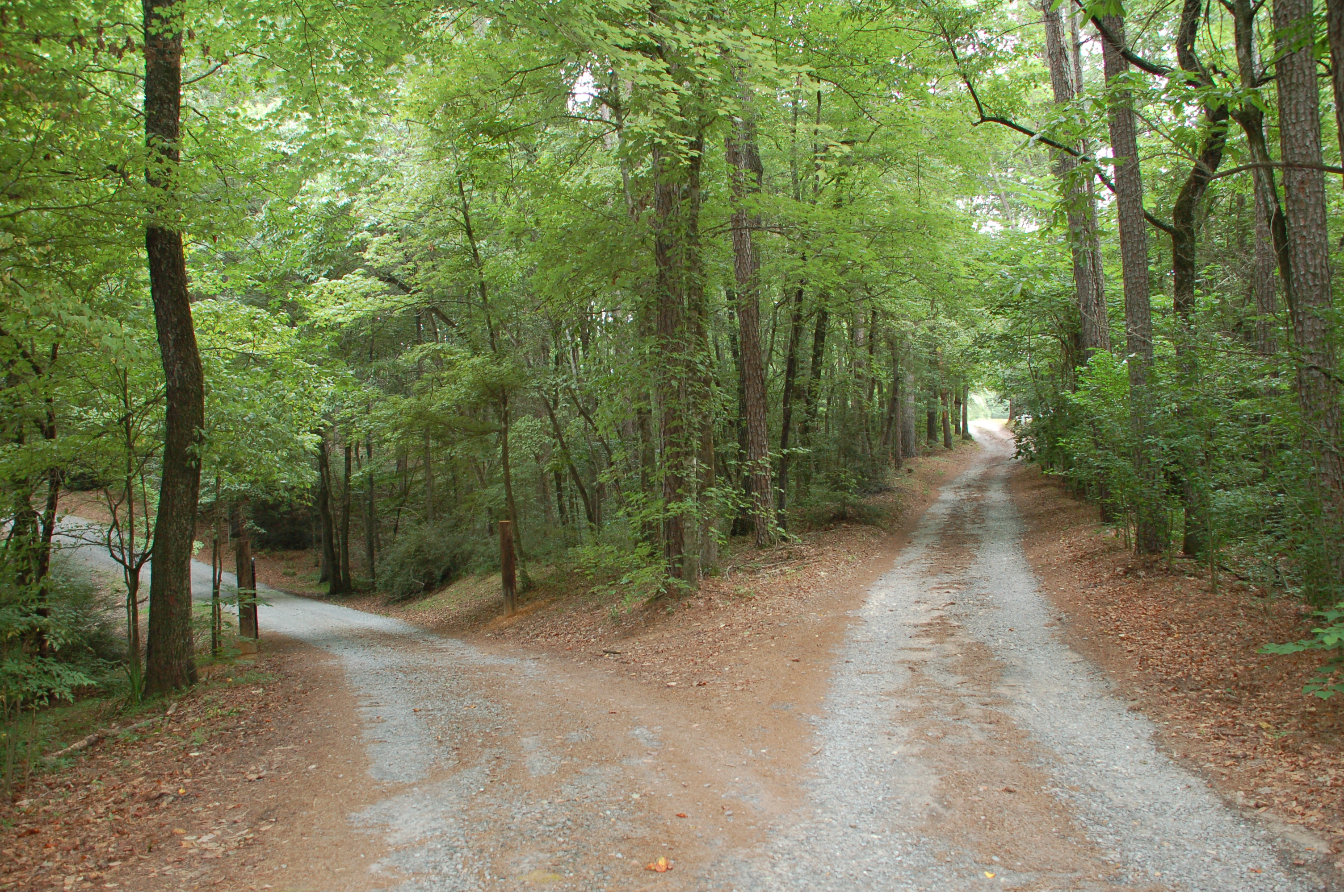

The process of faith formation
Good and honest heart
“Whose I am and whom I serve”
Faith
shown by works
Reason with the mind and engage with the heart
Draw conclusions and make decisions
Examine and weigh the evidence

Slide 119
The whole counsel of God
And Jehoshaphat the king of Judah returned to his house in peace to Jerusalem. And Jehu the son of Hanani the seer went out to meet him, and said to king Jehoshaphat, Shouldest thou help the ungodly, and love them that hate the Lord? therefore is wrath upon thee from before the Lord.
2 Chronicles 19:1-2

Slide 120
The whole counsel of God
And Jehoshaphat the king of Judah returned to his house in peace to Jerusalem. And Jehu the son of Hanani the seer went out to meet him, and said to king Jehoshaphat, Shouldest thou help the ungodly, and love them that hate the Lord? therefore is wrath upon thee from before the Lord.
2 Chronicles 19:1-2
Nevertheless there are good things found in thee, in that thou hast taken away the groves out of the land, and hast prepared thine heart to seek God.
2 Chronicles 19:3

Slide 121
The reliability of evidence
Differences in the sources of evidence between Thomas Williams’ day and our day
Differences in the principal sources of evidence used by Millennials versus Baby Boomers

Slide 122
The generational divide in how the Six Day War is viewed by Jews
The younger generations of Jews born in the US who didn’t experience the dramas of 1948, 1967 and 1973 firsthand, view them so differently from the way their parents do.
For young people, Israel’s existence is an indisputable fact. They aren’t concerned about Israel’s safety or independence. Instead, they worry about the fact that “their” Israel has been occupying another people for 50 years. They can’t accept this and wonder why a solution to the conflict has not been found yet.
Nachman Shai, Fifty Years Later

Slide 123
The reliability of evidence
Differences in the sources of evidence between Thomas Williams’ day and our day
Differences in the principal sources of evidence used by Millennials versus Baby Boomers
The concept of “fake news” and information that is biased or disseminated to advance an agenda
Things which concern Israel and the Jews
Things which concern human gender and sexuality
Things which concern the origin of the world

Slide 124
A framework to interpret the evidence
Once an agreement on the essential facts has been reached, the next step is to agree on organizing the facts into a meaningful framework to understand and relate to them
This organizing framework, as it relates to the big picture questions of life, is sometimes called a ‘worldview’ because it informs how one understands and relates to the world

Slide 125
Debate on the subject of Israel’s restoration
During the month of January, our brother Jones held a two nights’ debate with an Advent, in their own hall, on the subject of Israel’s restoration. The debate came about in this way: Mr. Higgens, who teaches a Bible class, had under consideration the ninth, tenth and eleventh chapters of Romans, and as there was none of his class who believed in Israel’s restoration, they voted to send the Christadelphians an invitation to send two or three of their members to meet in the class the following Sunday to ask and answer questions; but as we could not accomplish much in one hour, one of our brethren suggested we meet some other time during the week and continue the subject. They consented, and Mr. Higgens thought it would be better to have the meeting take the form of a debate, one on each side.

Slide 126
The result of the debate
Mr. Higgens made a very weak attempt to show that God would never restore His people Israel back to their own land; but brother Jones came down on him with such crushing effect that after the last night’s debate Mr. Higgens would neither speak to nor shake hands with Brother Jones, and I think he will never again invite us to another debate.
C. C. MANN, Sec.
WORCESTER, MASS
March 1890 p. 72

Slide 127
Difficulties which the world saw in 1892
The difficulties that the world sees in the way of carrying out God’s plan are:
Turkey has possession of the land. That is met by the “drying up of the (political) great River Euphrates.” (Revelation 16:12)
The desolation of the land. That is met by “the LORD comforting Zion, and making her waste places like Eden, and her desert like the garden of the Lord (Isaiah 51:3).
The jealousy and opposition of the great nations. That is met by “the Lord fighting against those nations as when he fought in the day of battle” (Zechariah 14:3) and rebuking them till they beat their swords into plowshares and their spears into pruning hooks, so that they shall not be able to practice war any more (Isaiah 2:4).

Slide 128
It is enough to say it is God’s plan
Too many Jews for such a small country. That is met by “purging out the rebels from among them” (Ezekiel 20:38).
The stubbornness of Israel in hardening their hearts as stone. That is met by giving them a “heart of flesh” that they may walk in God’s statutes and keep his ordinances and do them (Ezekiel 11:20).
But why detail the plan to show its practicality? Is it not enough to say it is God’s plan? That is enough, and it will prosper, while all others fail, to the utter confusion of a religious but benighted world.
The Christadelphian Advocate, August 1892, p. 188, written by Brother Thomas Williams

Slide 129
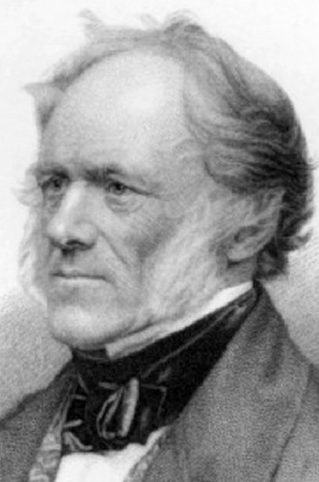
Principles of Geology
Written in 1833 by Sir Charles Lyell
The work's subtitle was "An attempt to explain the former changes of the Earth's surface by reference to causes now in operation", aka uniformitarianism

Slide 130
Three pillars of true teaching
Adam
Abraham
David
The mortality of man
The promises to Abraham
The Kingdom of God restored to Israel
Jesus Christ himself the chief corner stone

Slide 131
Condemnation to death in Adam and the meaning of that death
There are two orthodox doctrines that require the logical impossibility that an immortal being die
The doctrine of the Trinity requires that the Lord Jesus, a third part of a pre-existent Godhead, died on the stake
The doctrine of a personal Devil named Satan requires that a rebellious angel will be destroyed
The immortality of the soul
Hell torments

Slide 132
Three pillars of true teaching
Adam
Abraham
David
The mortality of man
The promises to Abraham
The Kingdom of God restored to Israel
Jesus Christ himself the chief corner stone

Slide 133
In the hope
…in the hope that it may rescue a few, whom God grant, he may be worthy to meet in the kingdom of God, and with whom he may be blessed with the power of endless life free from the pangs of sickness, sorrow, pain and death.
Original Preface to The World’s Redemption

