Slide 1
Prophecies of Christ’s Return
Class 1
Fundamental Prophecies and Signs
Notes:
Title

Slide 2
Fundamental Prophecies of Christ’s Return.
Christ will return when least expected – Rev. 16:15; Luke 12:40,45; 17:26-37; Matt. 24:50
Exhortation to clearly discern the future – Heb. 12:1-2; 2 Cor. 4:18.

Slide 3
Luke 19:11-27 – The Parable of the Nobleman – A summary of the subject
Verse 11
'Jerusalem' - He had proclaimed that as his future capital - Matt 5:35. The disciples thought they were walking to glory, not to suffering. See also Acts 1:6.
Outline of the parable:
1. The Nobleman has gone to the far country to receive his authority.
2. His servants must meanwhile “occupy till he come” (v13).
3. He returns to first reward them (v15).
4. He afterwards deals with his enemies (v27).
Notes:
Slide 5

Slide 4
CHRISTS SECOND ADVENT
To return personally and visibly - Acts 1:11
With a reward – Rev. 22:12; Isa. 40:10
To raise the dead and reward his saints – Dan. 12:2
To judge and rule the world - Acts 17:31
To establish righteousness and praise – Isa. 61:11
To set up God's kingdom, under the heaven - Dan 2:44, 7:27
Notes:
Slide 3

Slide 5
SIGNS OF HIS IMMINENT APPEARANCE
Exhortation on the subject - Luke 21:34-36
Decline of Turkey - Rev 16:12
Decline of Morals - 2 Tim 3:1-5
False teaching - 2 Peter 3:3-5; 2.1-2
Return of the Jews - Ps 102:13,16,18, Rom 11:11-15; Ezek 37:21-22
Growth of Russian power - Ezek 38
Preparations for war; Distress and antagonism among the nations; the intrigues of the “spirits like frogs” – Joel 3:9-10; Rev. 11.18; 16.13-14
The nations divided into two armed blocs - Dan 11:40-45
Notes:
Slide 4

Slide 6
Prophecies of Christ’s Return
Class 2
Judgment Seat - Sinai
Notes:
Title

Slide 7
THE JUDGMENT SEAT OF CHRIST
Exhortation on the subject – Rom. 14:10.
“… we shall all stand before the judgment seat of Christ.”
The Resurrection and Judgment of Believers precedes that of the Nations - 1 Pet.
4:17; Mal. 2.17; 3:1; Psalm 149:4-9; Zech. 14:5; 1 Thess. 4:16-17.
The Judgment Seat of Christ to be set up in a specific place - Rom. 14:10; 2
Thess. 2:1.
Not all will be raised and judged - Isa. 26:14; Dan. 12:2; Jer. 51:57; Psalm 49:19-
20.

Slide 8
Malachi 3:1
This has an application to both advents of Christ. Vv.3-4 obviously relate to the
future.
Psalm 149:4-9
Notice the sequential development:
Immortality granted - v.4;
Rejoicing of the accepted - v.5;
Preparations for war - v.6;
Executors of vengeance - v.7;
Conquest of nations - v.8;
Vindication of Yahweh - v.9.
As it is the honor of the saints to execute the judgments written, they obviously
must be judged and glorified before this.
Zechariah 14:5
The saints are described as pouring out judgments on the nations implying that
their resurrection and judgment has already taken place.

Slide 9
Locale of the Judgment Seat – Sinai
Deut. 33.1-2
“… Yahweh came from Sinai, and rose up from Seir before them…” Fulfillment awaits the future – see vs. 28 and 29
“There is none like the Ail of Jeshurun (the strength of the upright one) riding heavens in thy help, and in majesty of clouds. Mighty ones of the east is the refuge, even beneath the powers of olahm; and he shall drive out the enemy from before thy faces, and shall say, destroy. Israel shall then dwell safely: The fountain of Jacob (shall be) alone upon a land of corn and wine; his heavens shall distill dew.” Bro. Thomas translation vs. 26-28
Vs. 29 “Happy are thou O Israel. who is like unto thee, O people saved by the LORD, the shield of thy help, and who is the sword of thy excellency! and thine enemies shall be found liars unto to thee (shall be subdued – mg.) and thou shalt tread upon their high places.”

Slide 10
Locale of the Judgment Seat – Sinai – cont. 2
Psa. 68.18
“Thou hast ascended on high, thou hast led captive captivity; thou hast received gifts for “the man”; yea, for Yah Elohim to inhabit rebellious ones” Bro. Thomas translation
Psa. 68.17 – The chariots of Mighty Ones!
“The chariots of mighty ones (are) two ten thousands, thousands of glorified ones. The Adonai among them, Sinai into the Holy (Zionwards)” Bro. Thomas translation
The Psalm is Messianic (cp. v.18 with Eph. 4:8). In the statement of v.17 the
Psalmist epitomizes the work of Christ as the manifestation of Yahweh ascending
from Sinai to Zion, when the Temple of the future Age will be set up.

Slide 11
Locale of the Judgment Seat - Sinai – cont. - 3
Song 3.6-8
“… Who is this that cometh out of the wilderness…”
“The saints in the approaching “hour of judgment”, are also typified by the 60 pillars of brass, pertaining to the court of the tabernacle (Exod. 27) this dwelling in Song 3.7 is styled “his litter which is for Solomon”. It is seen ascending out of the wilderness as pillars of smoke”. The bride asks “who is this”? Her attendants reply that it is “his litter which is for Solomon himself. Sixty valiant men surround it, the stoutest heroes of Israel, every one of them grasping a sword, being expert in war; the commander his sword upon his thigh without fear in nights”. The scene is introduced in Rev. 19.14. Here the commander and his sixty heroes or brazen pillars, are in battle array, and prepared to smite the nations, and to tread the winepress, without fear or apprehension of defeat” Eureka Vol 1. Pg. 393

Slide 12
Locale of the Judgment Seat - Sinai – cont. 4
Hab. 3.3
“… Eloah shall come in from the south …”
Or – “The Mighty One shall come in from Teman, and the Holy One from Paran, consider!”
Phrase is in the future tense. Sinai is in the deep south as far as Jerusalem is concerned. Yahweh in manifestation here depicted. Eloah a divine title used for the setter up of the kingdom in Dan 2.44.
Note: Judgment at is associated with the “feet” of the mighty one – verse 5 and “he stood” verse 6.

Slide 13
Prophecies of Christ’s Return
Class 3
Gogue – Russian Invasion
Notes:
Title

Slide 14
Daniel 8.20-22 – The Ram and the Rough Goat

Slide 15
Daniel 8.23
²³ And in the latter time of their kingdom, when the transgressors are come to the full, a king of fierce countenance, and understanding dark sentences, shall stand up.
“latter time of their kingdom” – cp. Vs 19 to understand time referred to – “the last end of the indignation” – thus the time of the end.
“transgressors” – Roth. = transgressions – the transgressions of Israel
“king of fierce countenance” – warlike in aspect – application to Rome and Russia
“understanding dark sentences” – Roth. – skillful in dissimulation, hypocrisy – cp. Deut. 28.49

Slide 16
Daniel 8.24-25
²⁴ He shall destroy wonderfully, and shall prosper, and shall practice, and shall destroy the mighty and the holy people
“practice” – sig. “to establish” RV has “he shall succeed in what he does” – Was true of Rome and will be true of Russia.
²⁵ …Through his policy shall he cause craft to prosper in his hand; and he shall magnify himself in his heart, and by peace shall destroy many: he shall also stand up against the Prince of princes, but he shall be broken without hand”
“Causing craft to prosper” - i.e. deceit as in RV – Constantinople caused “priestcraft to prosper”! Cp. Jer. 9.6 – term refers to religious hypocrisy
“stands up against the Prince of princes” – power to be broken by divine agency, i.e. the Lord Jesus Christ – by peace – link to 1 Thess. 5.3

Slide 17
Daniel 11.36-38 – Development of the Roman Power in Constantinople
³⁶ And the king shall do according to his will; and he shall exalt himself, and magnify himself above every god, and shall speak marvellous things against the God of gods, and shall prosper till the indignation be accomplished: for that that is determined shall be done.
The King of vs. 36 – the power ruling from Constantinople.
³⁷ Neither shall he regard the God of his fathers, nor the desire of women, nor regard any god: for he shall magnify himself above all.
It was Constantine who spoke “marvelous things against the God of Gods” – he also did not “regard the Gods of his fathers” – He also supported the apostasy developing in the Roman Catholic Church. From Constantine onwards, the emperor ruling in Constantinople supported the Bishop of Rome.

Slide 18
Daniel 11.40
⁴⁰ And at the time of the end shall the king of the south push at him: and the king of the north shall come against him like a whirlwind, with chariots, and with horsemen, and with many ships; and he shall enter into the countries, and shall overflow and pass over.
Time of the end = the epoch of Christ’s return – see 11.35
It is the time when “Michael shall stand up” – i.e. Christ – 12.1
It is the time of trouble – 12.1
It is the time of the resurrection – 12.2
Daniel will stand in his lot – 12.13
The time of the end is defined in the prophecy of Daniel as the time when the final indignation shall be poured upon the nations, the time of the resurrection, the time of the Lord Jesus Christ’s manifestation in the earth, the time of the judgment seat, the time when Daniel will stand in his lot.
It is an epoch of time that has a beginning and an ending.

Slide 19
Daniel 11.40 – cont.
⁴⁰ And at the time of the end shall the king of the south push at him: and the king of the north shall come against him like a whirlwind, with chariots, and with horsemen, and with many ships; and he shall enter into the countries, and shall overflow and pass over.
Verse outlines the beginning of the epoch of the time of the end.
The king of the south = a foreign power in occupation of Egypt – throughout the 11th chapter – last mention is in verse 40!
Who does the king of the south push at? NOT at the king of the north – note this.
Subject of this section vs. 36-40 is “the king” of verse 36
Originally this was Rome in occupation of Constantinople – in 1453 the Turks occupied and now they enter into the prophecy.

Slide 20
Prophecies of Christ’s Return
Class 4
Tidings – Elijah- Arabs
Notes:
Title

Slide 21
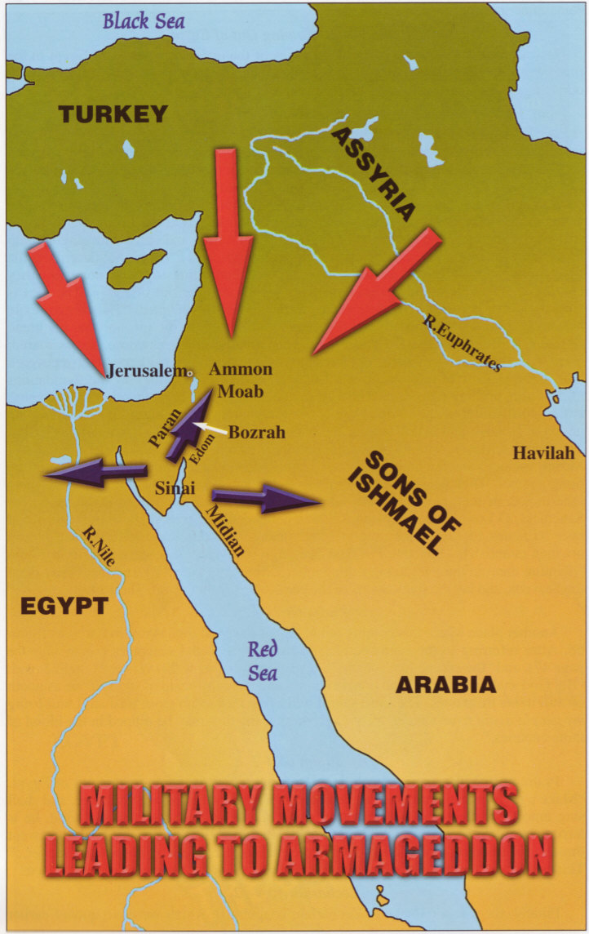

Slide 22
Tidings out Of The East And North
The former comprise the remarkable events taking place in Sinai (east of Egypt), while the latter probably relates to the efforts of the Western Powers to consolidate their power in Jerusalem to resist the attack of Gogue.
He understands the nature of the latter threat, and ignoring the first (which he does not quite comprehend), sets siege to Jerusalem. He is here ultimately destroyed by Christ and the saints (See Dan. 11:45; Dan. 8:25).
This Middle East attack by Russia will inaugurate the "time of Jacob’s trouble" for the Jewish nation (Jer. 30:6-7; Ezek. 7.7).

Slide 23
The events in sequence from Christ's return are as follows:
1. Christ's personal coming to Sinai.
2. The resurrection of the dead and. the gathering of them with the living to Sinai to
Judgment.
3. The Judgment Seat of Christ — Life Eternal to the righteous, rejection and
death to the rejected.
4. The Marriage of the Lamb to his perfected Bride — fraternization at Sinai apart
from the world.
5. Meanwhile the world is left to its own resources. Complete and utter spiritual
darkness falls upon it (Isa. 60:1-2).
6. Russia, having occupied Turkey, consolidates its power therein, forging the Gogian
confederation, and setting up the Image of Daniel 2. This results in the "peace and
safety cry" being proclaimed (1 Thess. 5:1-2).
7. The Gogian confederacy then sweeps south in a lightning attack on Egypt, which
will fall to Russia, and will be occupied by Gog.
8. Tidings "out of the east and north" will cause Gog to leave an occupation force in
Egypt, and withdraw his main forces to Jerusalem (Dan. 11:45).

Slide 24
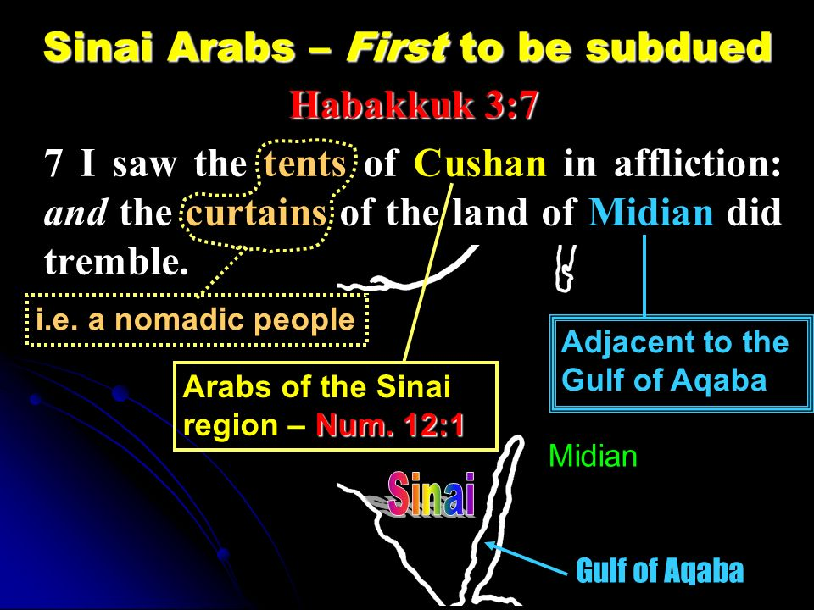

Slide 25
“Now it must be evident to everyone, that before the wild, untamed marauders, who inhabit Arabia Deserta, Arabia Petraea, and Paran, Horeb, Sinai, and the tents and villages of the Kedarite Arabs, can glorify Yahweh, and rejoice with joy and singing, and become the intelligent, happy, and contented population of this newly created Paradise, they must have been subjected to the severe discipline of the sword; to subsequent instruction, as to the true character of the New Power so recently developed in Teman (the power referred to in Hab. 3 – the power of the Lord Jesus Christ); and made witnesses of the wonderful transformation of their section of Asia from an arid, sandy and rocky wilderness, into a well- watered park of choice, odiferous, trees and shrubs! And such is the testimony of the prophets.”
Brother Thomas – Eureka Vol. 5, pg. 251

Slide 26
ISAIAH'S ARABIAN PROPHECY - CH. 21:13-15
Verse 15
"In the forest" — The Arabian Peninsula is noted for its aridness, its desert, not for its
prolific growth and forests. But the future will see forests instead of desert. Why?
Because of vast changes in the land that will be brought about (it seems) by the
tremendous earthquake that will alter the land when Christ appears at Armageddon
(Zech. 14:5). See Isa.43:20, and note Bro. Thomas’ comments in "Eureka" vol. 5, p.251.
See Isa. 42:11 - "Kedar" is an Arab tribe.
The "inhabitants of the Rock" relate to Petra. The prophecy speaks of vast changes in
the character of the land and people.
"In Arabia" — The R.V. renders this as "at evening" (cp.v.12), and in Jewish reckoning, the
"evening" is the beginning of a new day (Gen. 1:5). If the RV is to be accepted, therefore,
the term could relate to the Millennium (2 Pet. 5:8).
Though Christ will subjugate the Arabs shortly after he emerges from Sinai, the
completion of the work of restoration will not be finalized, and the desert will not have
produced its forests, until the Millennium commences, some 40 years later.
"Shall ye lodge" — Here is a difference in the character of the people. Instead of being
travelling Bedouin, or nomads, as today, the Arabs will be induced to occupy settled
abodes in the Arabian peninsula which shall then flourish with growth. They will no longer
occupy the Promised Land, which is to be given exclusively to Israel (Gen.15:18). The fact
that they will "lodge" in that place suggests a settled condition which is a great contrast
to the present nomadic existence of the Arabs.

Slide 27
ISAIAH'S ARABIAN PROPHECY - CH. 21:13-15 – cont.
Verse 14
"The inhabitants of the land of Tema" — This is the Teman of Hab.3:3,7, and relates to
the "south", the present land of the Arabs.
"Brought water and bread" — The RV renders: "shall bring" — pointing forward to the
future. This is an act of kindness (Deut. 23:4), contrasting with the present hostile attitude
of Arabs (cp. Gen. 16:12). This change of attitude on the part of the Arabs doubtless
caused by the disciplinary action of Christ (Isa. 42:11; 43:19-20; Hab. 3:7) in subduing
them. Doubtless, the terms of capitulation will be the demand on his part of a change of
heart by the Arabs towards the Jewish people. Thus, to the amazement of the Jews
fleeing from the attack of Gog, they will be met with kindness by the once-hostile Arabs.
Verse 15: "They fled" — This is Israel, fleeing from the attack of Gogue, in which two-thirds
are going to be cut off and. die (Zech.13:8).
Following upon this disciplinary action, the Arabs will submit to Christ, will be ultimately
educated, in the Truth, transferred to their fertilized Arabian peninsula and ultimately
ascend to Jerusalem to worship before the King (Zech. 14:16; Isa. 60:6-7).
Thus, the Arabs will be subdued and converted to Christ.

Slide 28
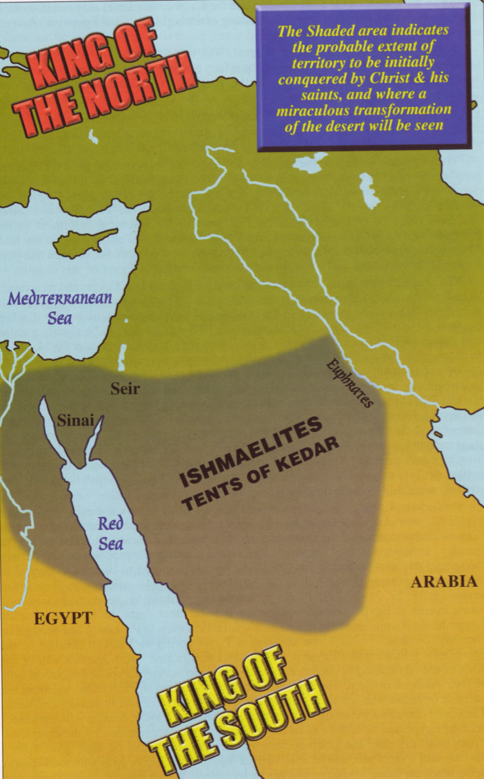

Slide 29
Prophecies of Christ’s Return
Class 5
Armageddon – The Perfect Man
Notes:
Title

Slide 30
ARMAGEDDON … Rev. 16:16
The Hebrew must be searched to ascertain the significance of this word (see Rev. 16:16).
Brother Thomas suggests it is a compound word of three Hebrew words: "arema" – a heap of sheaves; "gai" - a valley; "don" – judgment.
It therefore signifies: "A heap of sheaves in a Valley for Judgment."
This is identified with Jerusalem. See Joel 3:1-2 The Valley of Jehoshaphat is on the
northeast of Jerusalem, The word "Jehoshaphat" means: "Yah’s Judgment" - Thus The Valley of Yahweh’s Judgment.
Here the nations will be gathered to be threshed. See Joel 3:14, margin. Compare with Micah 4:12-13. Thus, Jerusalem is the site of Armageddon (Zech; 14:1-2).

Slide 31
Yahweh – The Family Name
1 Cor. 12.12 “For as the body is one, and hath many members, and all the members of that one body, being many are one body; so also is Christ.”
Family life requires us to develop certain qualities!
Character Traits Whereby Yahweh’s Family May Be Known – Exod. 34.6-7
⁶ And the LORD passed by before him, and proclaimed, The LORD, The LORD God, merciful and gracious, longsuffering, and abundant in goodness and truth, ⁷ Keeping mercy for thousands, forgiving iniquity and transgression and sin, and that will by no means clear the guilty; visiting the iniquity of the fathers upon the children, and upon the children’s children, unto the third and to the fourth generation.

Slide 32
Development of the Divine Family
Ephesians 3:14-18
¹⁴ For this cause I bow my knees unto the Father of our Lord Jesus Christ, ¹⁵ Of whom the whole family in heaven and earth is named, ¹⁶ That he would grant you, according to the riches of his glory, to be strengthened with might by his Spirit in the inner man; ¹⁷ That Christ may dwell in your hearts by faith; that ye, being rooted and grounded in love, ¹⁸ May be able to comprehend with all saints what is the breadth, and length, and depth, and height;
Ephesians 4:3-4
³ Endeavouring to keep the unity of the Spirit in the bond of peace. ⁴ There is one body, and one Spirit, even as ye are called in one hope of your calling;

Slide 33
Development of the Divine Family – cont.
Ephesians 4:13
¹³ Till we all come in the unity of the faith, and of the knowledge of the Son of God, unto a perfect man, unto the measure of the stature of the fulness of Christ:
Ephesians 4:15-16
¹⁵ But speaking the truth in love, may grow up into him in all things, which is the head, even Christ: ¹⁶ From whom the whole body fitly joined together and compacted by that which every joint supplieth, according to the effectual working in the measure of every part, maketh increase of the body unto the edifying of itself in love.

Slide 34
The Basis of the Divine family
Speaking the truth in love – love is not toleration of error – neither doctrinal or moral, there is such a thing as truth – love “rejoiceth not in iniquity” – 1 Cor. 13.6; 1 John 5.3, 2.5
We must contend for the truth using true family principles! – see Eph. 4.2 “with all lowliness, meekness, with longsuffering, forbearing one another in love”
Every joint (heir) supplieth – all must work to develop these principles.
Making increase (growth) - growth is required – unto the edifying of itself in love – edifying sig. “building, architecture” – cp. 1 Cor. 3.9 – “ye are God’s building” – all based upon agape - a capsule of 1 Cor. 13 – “rooted and grounded in love” – the basis of the Perfect Man.

Slide 35
Brother Thomas wrote concerning this in Phanerosis:
“Here, then, was a symbolic man blazing in glory and power; and representative of the Eternal Spirit hereafter to be manifested in a NEW ORDER OF ELOHIM – aggregately ONE MAN – the One Man of the One Spirit, whom the true believers shall all come unto … A PERFECT MAN – into the measure of the full age of the fullness of the Christ: who is THE HEAD, from whom the whole body fitly joined together and compacted by that which every joint (heir) supplieth, according to the effectual working in the measure of every part, maketh increase of the Body unto the edifying of itself in love.
Daniel saw the “perfect man” – the Eternal manifested in the glorified flesh of a multitude – symbolically represented in the full measure of his age.”
Phanerosis, Pg. 105 – Brother John Thomas

