Slide 1
Shrimp & Grits
KCBS 2018

Slide 2
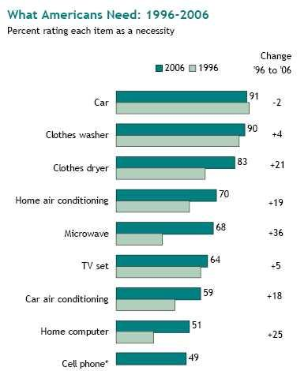
What would you choose?

Slide 3
What would you choose?
Electricity
Car
Running Water
Grocery Store
Mattress

Slide 4
Genesis 18:25
"Shall not the Judge of all the earth do right?"

Slide 5
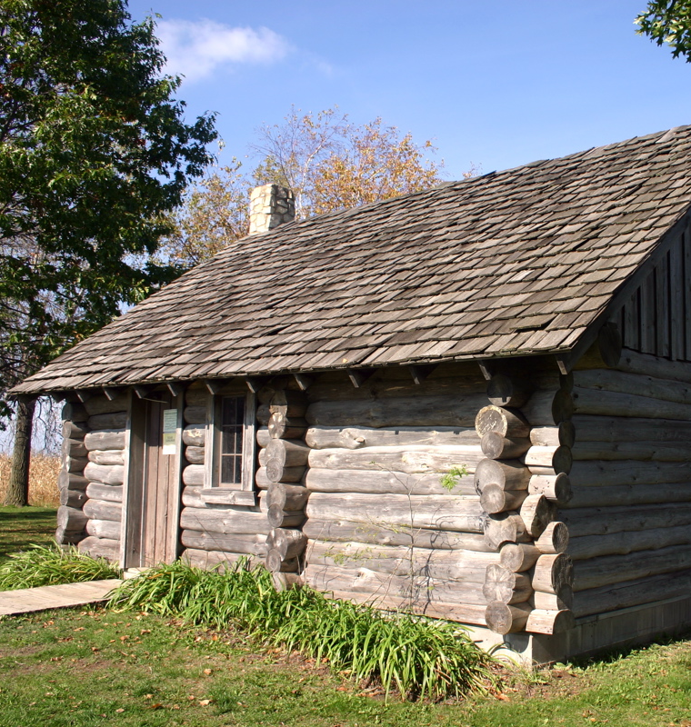
Laura Ingalls Wilder
"Then Pa and Ma and Laura and Mary stood and looked at the bed. It was a very nice bed. The zigzag rope was softer than the floor to sleep on. The straw-tick was plump with the sweet-smelling grass, the quilt lay smooth, and the pretty pillow shams stood up crisply.... That night when Ma went to bed, she settled into the crackling straw-tick and said to Pa, 'I declare, I'm so comfortable it's almost sinful.'"

Slide 6
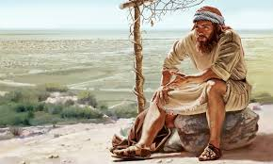
Jonah 4:4
Doest thou well to be angry?

Slide 7
Thomas Williams – 1884 lecture tour
Leave Waterloo (Iowa) for Chicago June 23; transfer to the train to Guelph after a short visit with brethren in Chicago
Ten days at Guelph, six lectures given
Four days at Doon -- four lectures given (Doon and Blair)
Four lectures at Galt
Two lectures at Preston
One lecture at Waterloo (Ontario), return to Galt to take a sister’s funeral, back to Waterloo (Ontario) for the lecture
Three lectures on one Sunday in Hamilton, acceded to the request to take the funeral of young brother John Dixon, short steamship excursion to Toronto to get acquainted with the Toronto brethren, then back to Hamilton
Three lectures in Buffalo on one Sunday with two hour stop on the journey from Hamilton to Buffalo at Niagara Falls to view the falls
Three lectures in Elmira on one Sunday
Called on new brother in Corning
Two lectures given in Rochester
Mahanoy City, Pennsylvania – chartered train to Sunday School picnic
At Jersey City he gave two lectures, visited the grave of John Thomas with his daughter, Sister Lasius
Took the steamer from New York to Fall River, MA and then the train to Fitchburg, MA – lectures given
Worcester, MA – two lectures given
Visited the believers in Lowell, MA for two days
Two lectures given in Boston
Returned to Jersey City where two lectures were given in a different part of the city
Two lectures given in Baltimore, MD
Six lectures given in Washington, DC
Lanesville, VA to attend gathering of the brethren and then a stopover in Richmond to visit brethren there
Returned to Washington, thence to Pittsburgh to visit brethren there
Stopped in Grand Rapids, MI for one week to visit the believers there and lecture
Two lectures given in Chicago
Arrived home in Waterloo on October 19th

Slide 8
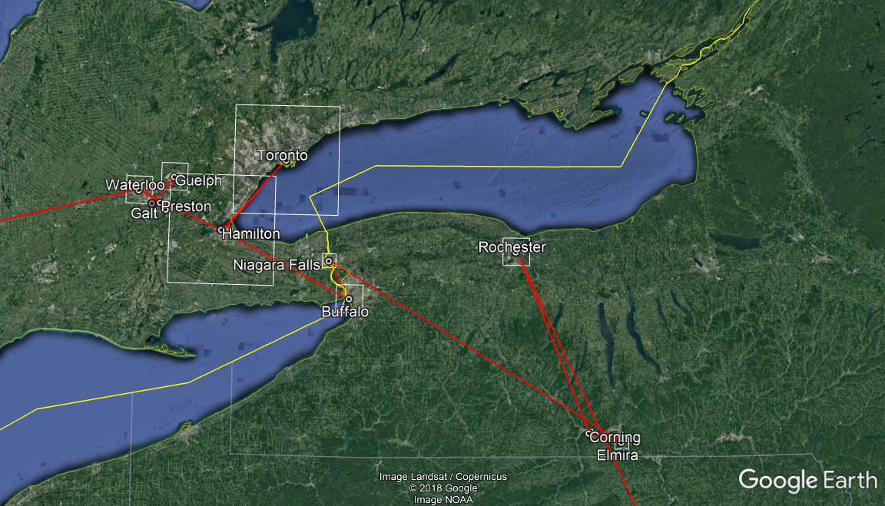

Slide 9
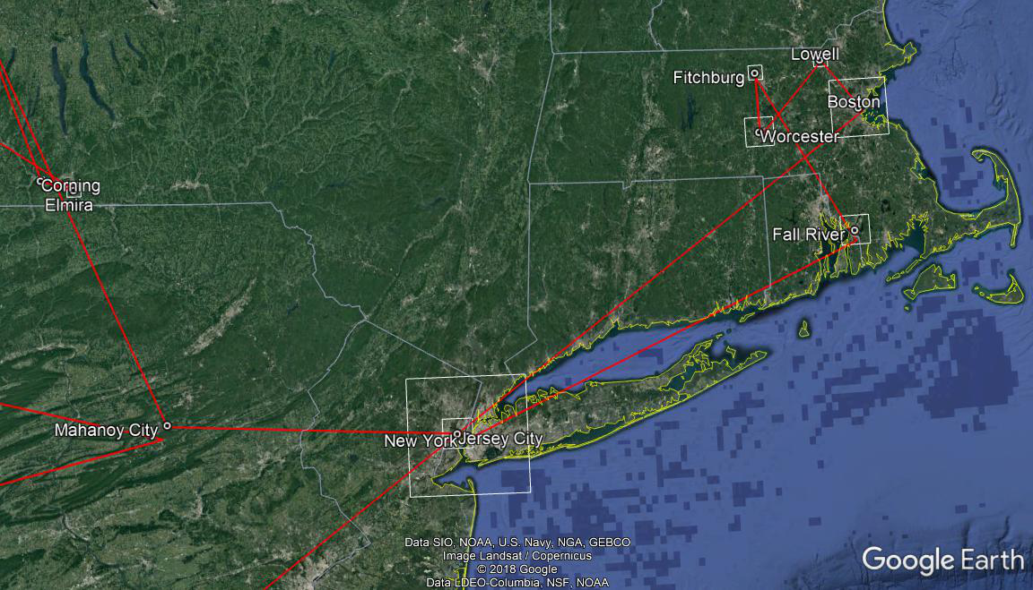

Slide 10
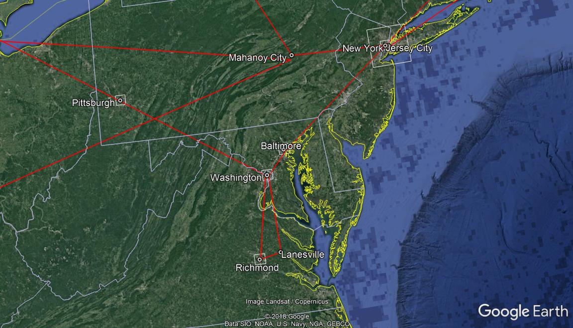

Slide 11
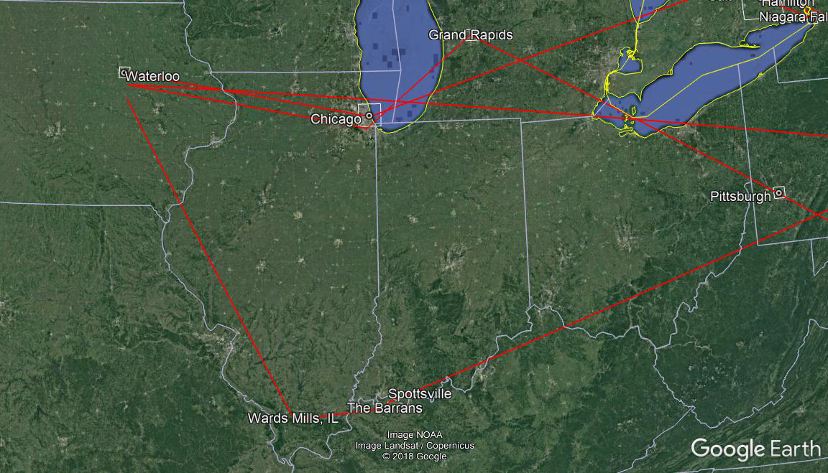

Slide 12
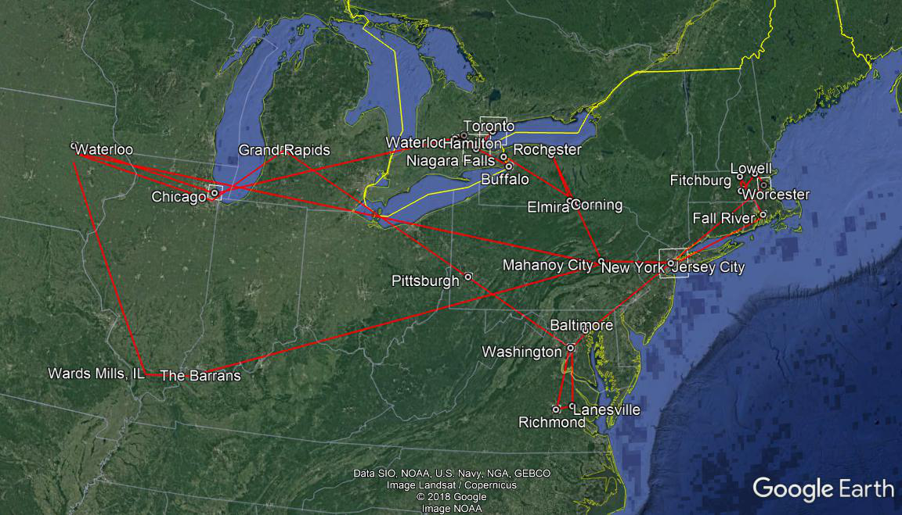
5,112 miles (8,227 km)

Slide 13
- The Christadelphian Advocate, July 1893, p. 151
“…it is better to wear out than to rust out.”

Slide 14
Deuteronomy 11:7
For your eyes have seen all the great work of the LORD that he did.

Slide 15
Matthew 9:36
When he saw the crowds, he had compassion for them

Slide 16


Slide 17

“Not that I speak in respect of want: for I have learned, in whatsoever state I am, therewith to be content.”
2 Corinthians 11:28
Philippians 4:11
1 Timothy 6:6

Slide 18
1 Corinthians 13:4-7 ESV
Love is
Love is/does not
patient
kind
rejoices with the truth
bears
believes
hopes
endures
envy
boast
arrogant
rude
insist on its own way irritable
resentful
rejoice at wrongdoing

